Slide 1
On the Moistening Role of Shallow Convection during the MJO over Manus
David Zermeno and Chidong Zhang
RSMAS University of Miami
collaborations from
Pavlos Kollias and Heike Kalesse
University of McGill
Contact: dzermeno@rsmas.miami.edu

Slide 2
1. Introduction
Is moistening from shallow convection particularly important during the MJO?
Approach: compare MJO and other types of large-scale convective perturbations (hereafter non-MJOs, Ling et al 2013)
What are the characteristics of shallow clouds during the moistening period of MJO and non-MJO episodes?
-abundance of precipitating and not-precipitating clouds
-rain rates
-height

Slide 3
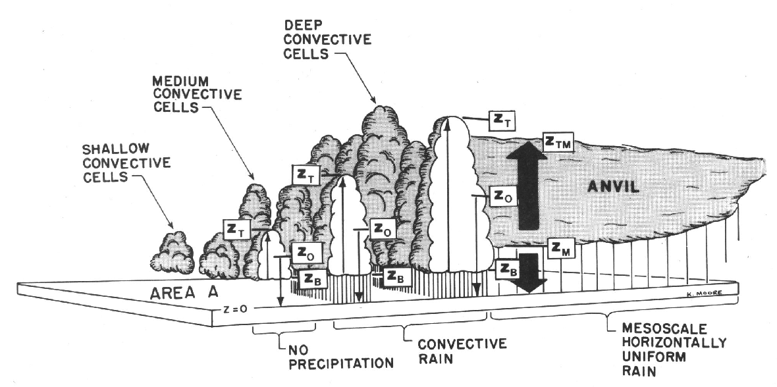
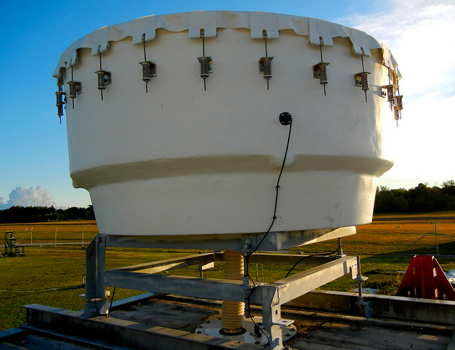
CloudSat
Observations from a super site over Manus
-Millimeter Radar (MMCR and KAZR) observations, soundings, etc
*
KAZR

Slide 4
Data
Millimeter Cloud radar (MMCR) data was binned to a 100 m vertical resolution and a 1 min temporal resolution
Soundings (available at 11 and 23 UTC). Results from soundings at 11 UTC are shown*. Soundings were binned to a 100 m vertical resolution
Radiometer and rain gauge (optical) data is available in a 1 min resolution
Daily TRMM 3B42 rainfall and RMM index
All data is available in the period 2001 to 2013**
* The RMSE of 11 UTC soundings is lower than that of 23 UTC soundings relative to the mean of 8 time per day soundings
**MMCR was replaced by KAZR in March 2011. KAZR data was not used.

Slide 5
Outline of what follows
Methods
MJO and non-MJO Identification
Shallow Cloud Identification
Results
Summary

Slide 6
MJO and non-MJO Identification Method
For each episode, an identification method needs to provide:
1) The global and
2) the local (over Manus) perspective
3) + Precipitation has to be directly involved
-RMM (Wheeler and Hendon 2004) provides 1
-TRMM was used for 2 and 3

Slide 7
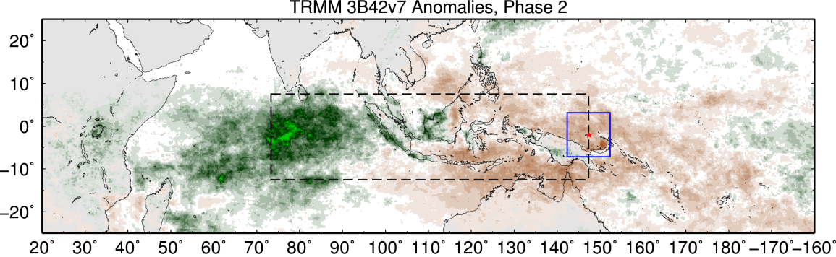
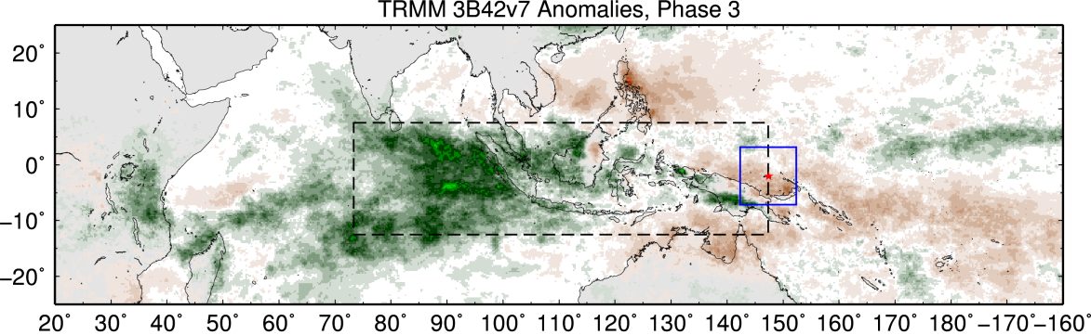
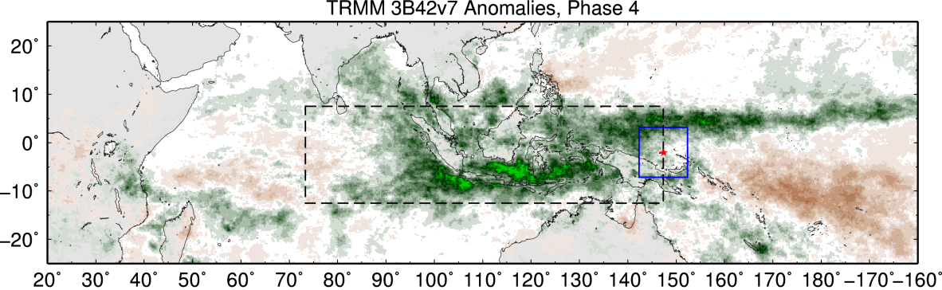
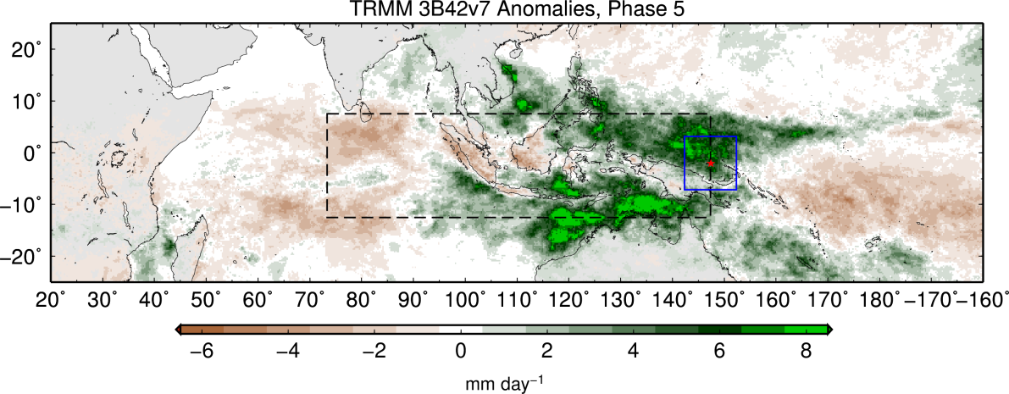
Domains
Manus location
Local or Manus Domain: 5 by 5 around Manus
MJO domain
(73 to 147 in longitude, and 8 to -12 in latitude)
MJO and non-MJO episodes are required to produce a comparable rainfall anomaly over the local domain
Figure 1. TRMM3B42v7 daily precipitation anomalies during the RMM phases in boreal winter.

Slide 8
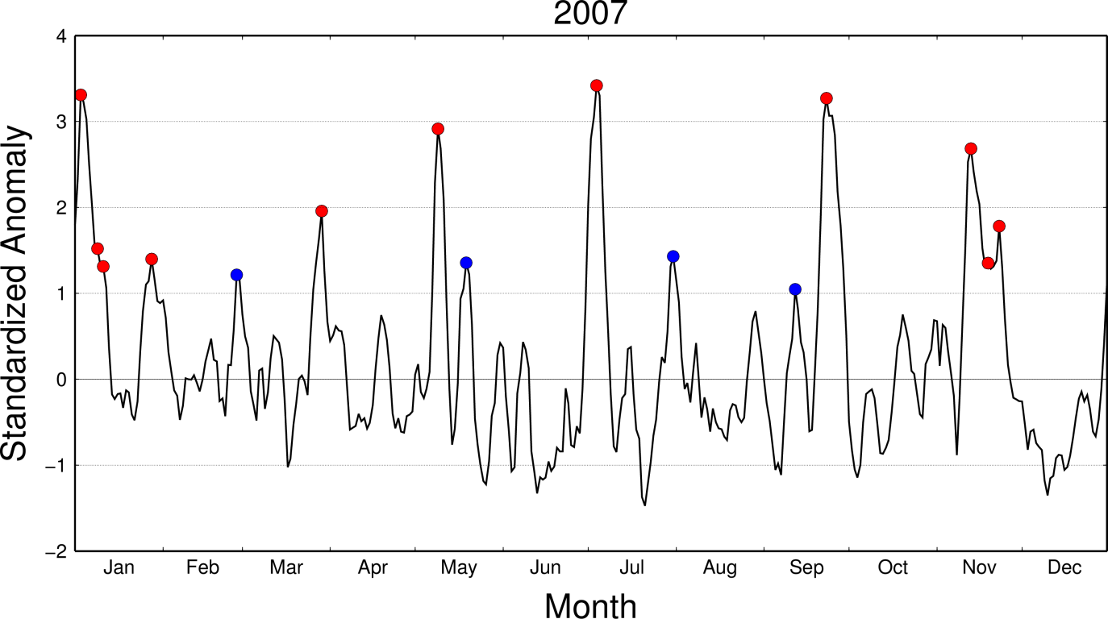
Episode Identification
Episodes were the daily anomaly* of rainfall was greater than one standard deviation for 3 consecutive days were used
-38 episodes during extended boreal winter (Oct-Apr)
Only the first peak was considered
3-day anomalies > 1
1 or 2-day anomalies > 1
*5-day running mean was applied

Slide 9
Possible MJO Trajectories associated to each episode
Onset over Manus
A set of trajectories (3 to 8 m/s) were fitted in Hovmuller diagrams
The trajectory with the largest anomalous precipitation is chosen as the possible MJO trajectory
Onset over Gan

Slide 10
Episode Evaluation
1) MJO trajectory: Mean anomalous rainfall in the trajectory is larger than the mean of the all trajectories (3.5 mm/hr)
2) RMM: RMM during the trajectory period is continuous and its strength > 1. The RMM* phase was either 4 to 7 during the onset over Manus, and 8, 1, 2 or 3 during the onset over Manus
The episode is an MJO if both are true
Is Non-MJO if neither condition is satisfied
-9 MJOs
-15 Non-MJOs
*RMM was smoothed by a 5-day running mean
All times the RMM condition was satisfied, the trajectory condition was satisfied, but not the other way around

Slide 11
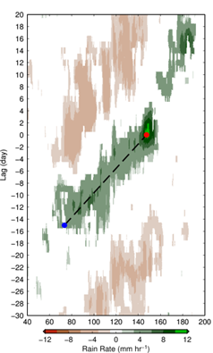
RMM and Rainfall Anomalies Longitude Time Anomalous Composites
MJOs
Non-MJO
Only regions with significance > 95% are shown

Slide 12
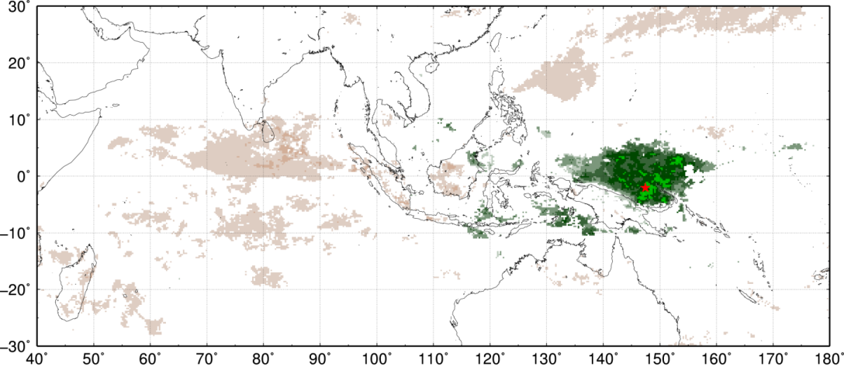
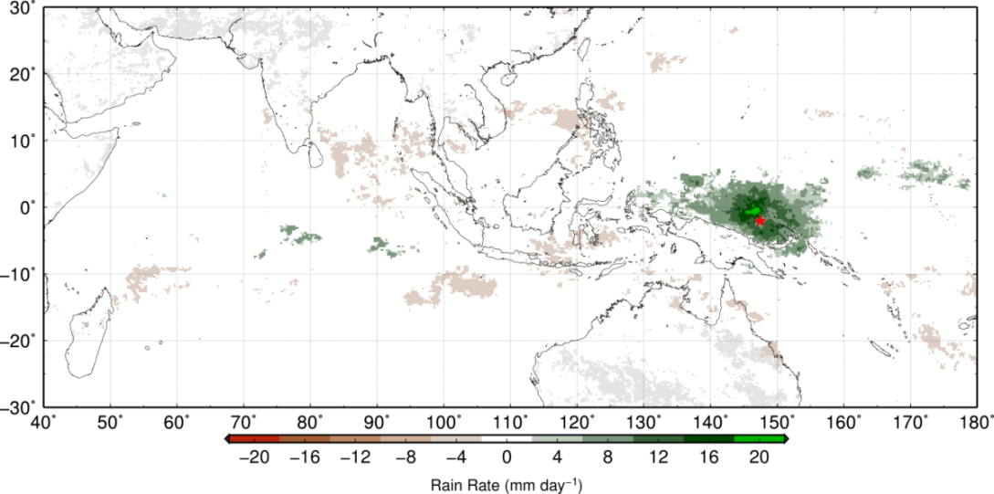
Rainfall Anomaly Composites
MJOs
Only regions with significance > 95% are shown
Non-MJOs
Rain rate

Slide 13
Shallow Cloud Identification
Cloud Classification Table
 | Category | Top height | Precipitating Sub-classification
Convective | Shallow | < 0C height | Precipitating
 |  |  | Not precip.
 |  |  | Transitional`
 | Congestus | >= 0C height < 8 km
 | Cumulonimbus | >= 8 km
Stratiform
Not precipitating: No precip detected with rain gauge
Precipitating: Precip detected with rain gauge
Convective: no bright band* and the cloud base is close to the LCL (100 m margin)
Stratiform: There is a bright band*
*Bright band: either an absolute maximum in reflectivity
close to the freezing level or DVG lower than -2 (Geerts et al 2004)

Slide 14
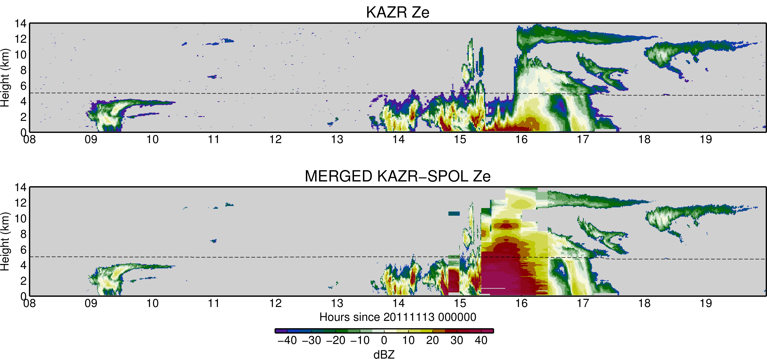
Attenuation is an Issue in Cloud Radars
Approach: A rain rate attenuation threshold was estimated
Data from SPOL and KAZR (Feng et al 2013) during DYNAMO was used to estimate this threshold

Slide 15
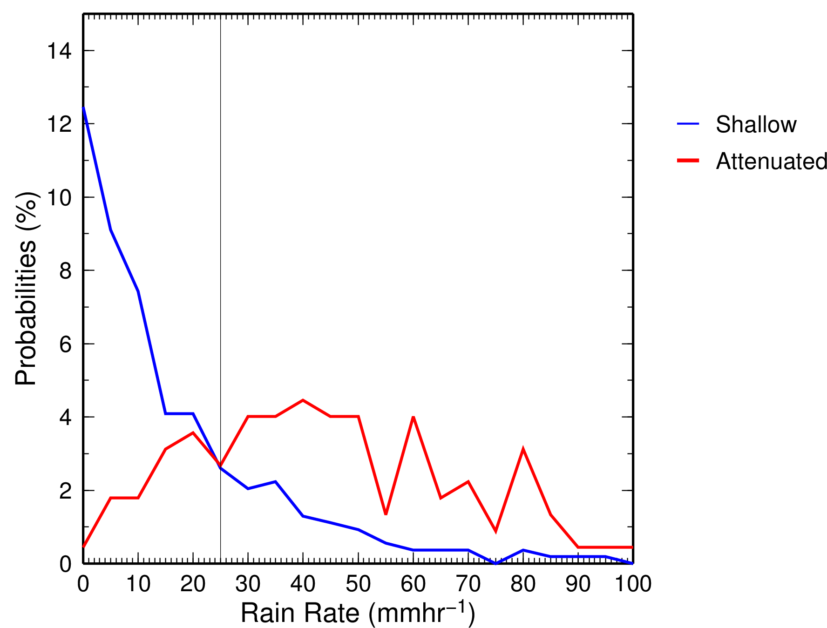
The probabilities of a cloud having a rain rate of 25 mm/hr are larger for a “shallow looking” deep cloud than those for a shallow cloud
A shallow cloud was re-categorized as deep when its rain rate or that in an adjacent shallow profile exceeds 25 mm/hr
25 mm/hr

Slide 16
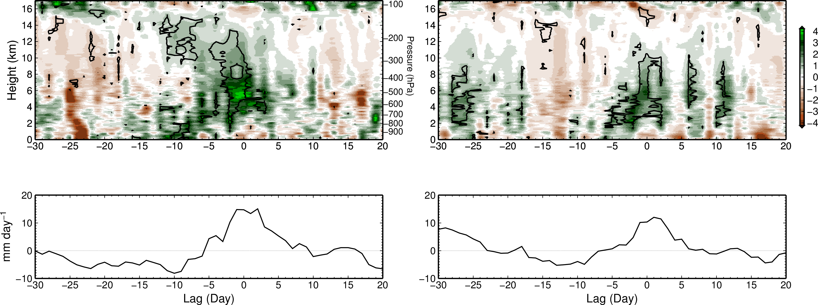
Results
MSE and Rainfall Anomalies over Manus
MJOs
Non-MJOs
Contours: 95% significance level
The 95% significance level is contoured

Slide 17
Time Lag vs Cloud Fraction Composites
MJOs
Non-MJOs
Daily fraction (%)
Lag (day)
Lag (day)

Slide 18
Normalized Anomalies in
Cloud Fraction relative to all Convective Clouds
over Manus
Shallow
Congestus
Shallow Precipitating
Cb
Shallow Not-Precipitating
Lag (day)
Shallow
Cg
Lag (day)

Slide 19
MJOs
Non-MJOs
Standardized
Standardized
Shallow
Cg
Cb
Day lag
Day lag

Slide 20
Summary
RMM index is reliable for strong MJOs but not for weak MJOs
The pre-onset of MJOs is characterized by more shallow precipitating clouds, less shallow non-precipitating clouds along with a longest and sustained moistening period
Rainfall from shallow clouds tends to increase before that of congestus and deep during MJOs but not during non-MJOs
Contact: dzermeno@rsmas.miami.edu

Slide 21
Thank you!

Slide 22
References
Geerts, Bart, Yu Dawei, 2004: Classification and Characterization of Tropical Precipitation Based on High-Resolution Airborne Vertical Incidence Radar. Part I: Classification. J. Appl. Meteor., 43, 1554–1566.
Ling, J., C. Zhang, and P. Bechtold, 2013: Large-Scale Distinctions Between MJO and non-MJO Convective Initiation over the Tropical Indian Ocean. J. Atmos. Sci., accepted.
Wheeler, Matthew C., Harry H. Hendon, 2004: An All-Season Real-Time Multivariate MJO Index: Development of an Index for Monitoring and Prediction. Mon. Wea. Rev., 132, 1917–1932.
Zhang C., Jian Ling, 2012: Potential Vorticity of the Madden–Julian Oscillation. J. Atmos. Sci., 69, 65–78.

Slide 23
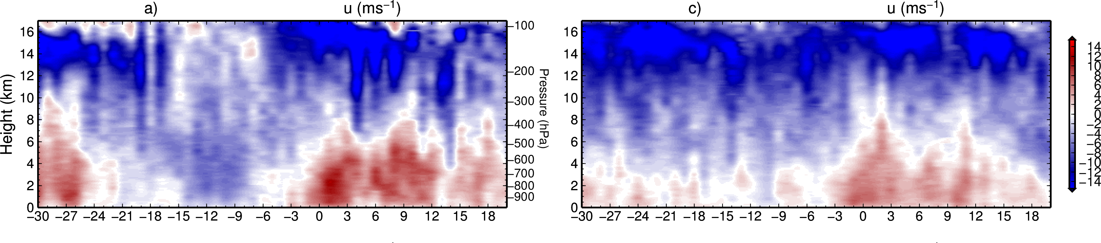
Extra Slide
Zonal Wind over Manus
Anomalies in Zonal Wind over Manus

