Slide 1
Shock-Like Structures in the Tropical Cyclone Boundary Layer and the ITCZ Boundary Layer
Wayne Schubert, Gabriel Williams, Richard Taft,
Chris Slocum and Alex Gonzalez
Workshop on Tropical Dynamics and the MJO
January 16, 2014
Dept. of Atmospheric Science

Slide 2
Aircraft Wind Data for Hurricane Hugo
Outbound: Above BL
Tangential Wind
Inbound: In BL
Radial Wind
Shock-like Structure in BL
(see Marks et al. 2008 for more details)
Vertical Velocity

Slide 3
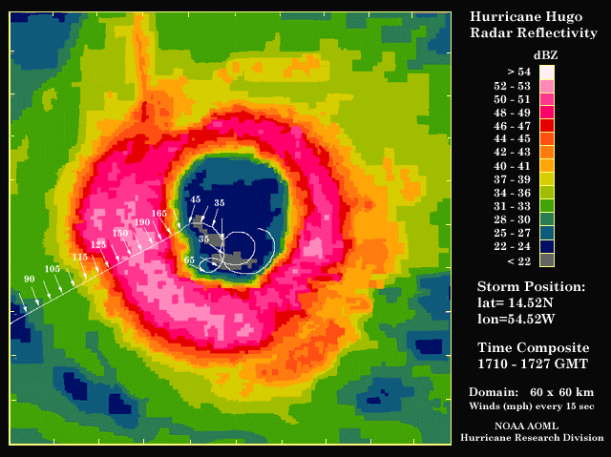
A Near Disaster Flying Into Hugo

Slide 4
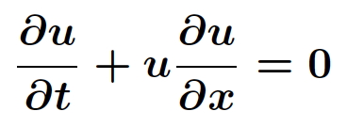

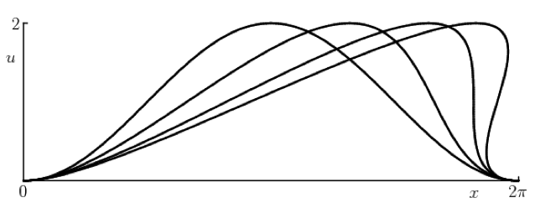
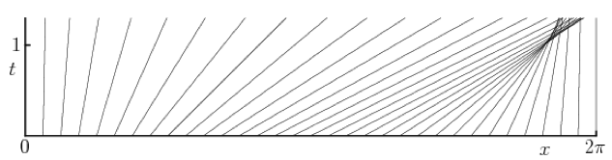
Inviscid Burgers’ Equation
Model for nonlinear wave propagation:
Example initial condition:
Results:
characteristics intersect and cross
becomes multiple-valued
not physically meaningful
(from http://www.eng.fsu.edu/~dommelen/pdes/style_a/burgers.html)

Slide 5
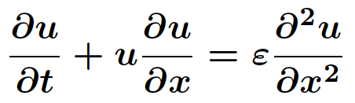
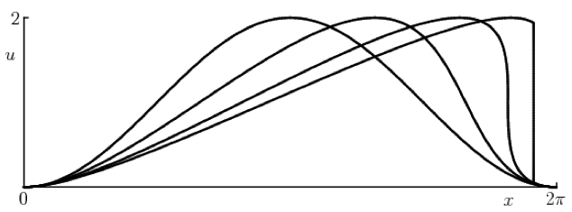
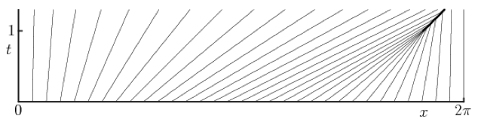
Viscous Burgers’ Equation
Now include a viscosity term:
Get more physically meaningful results:
a jump-discontinuity or “shock” develops
characteristics run into this shock and disappear
(from http://www.eng.fsu.edu/~dommelen/pdes/style_a/burgers.html)

Slide 6
Slab Boundary Layer Model for Tropical Cyclones (SBLM-TC)
Overlying Layer (provides forcing)
Specify azimuthal velocity:
Assume gradient balance
Assume constant in time
Assume radial velocity is zero
Diagnose:
Boundary Layer as an Axisymm.
-plane Slab
Solve for: and
IC’s:
Inner BC’s:
Outer BC’s:

Slide 7
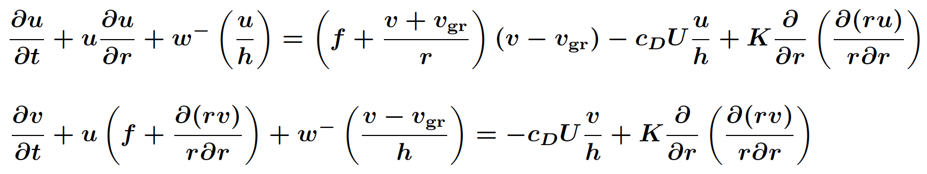
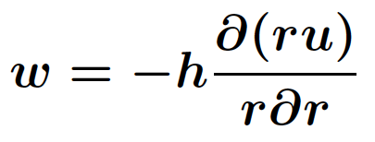


SBLM-TC Governing Equations
Two predictive equations for the horizontal winds in the slab:
Axisymmetric slab on an -plane
Note the embedded Burgers’ equation
Diagnostic equations for vertical velocity info:
rectified Ekman
suction
and
Diagnostic equation for wind speed at 10 m height:

Slide 8


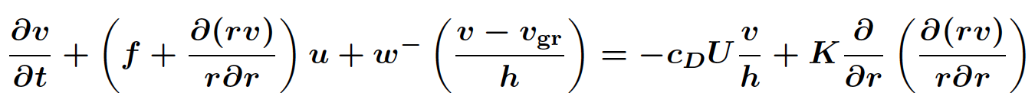
Derivation of SBLM-TC Equations
absolute angular momentum per unit mass
Define:
absolute angular momentum per unit horizontal area in the slab ( = constant)
Then:
Flux Form:
Advective Form:

Slide 9
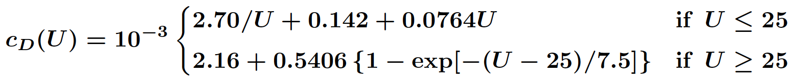
Drag Coefficient

Slide 10
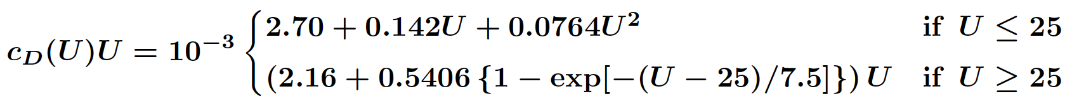
“Drag Factor”

Slide 11

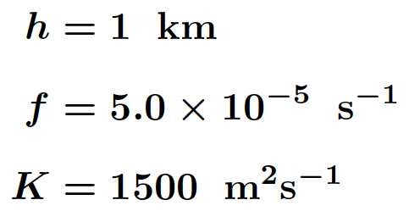
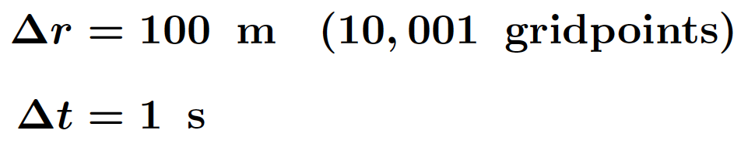
SBLM-TC Experimental Details
C5
C5
C3
C3
C1
C1
Domain:
Parameters:
Discretization:

Slide 12
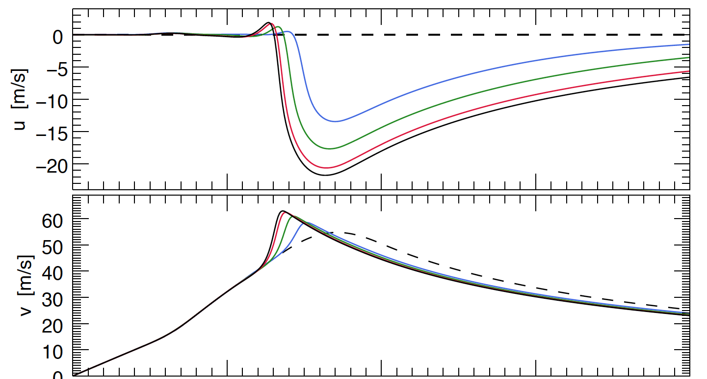
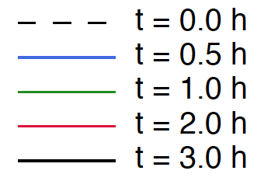

SBLM-TC Numerical Results for C3
Radial Velocity
Tangential Velocity
Shock-like steady-state quickly develops

Slide 13
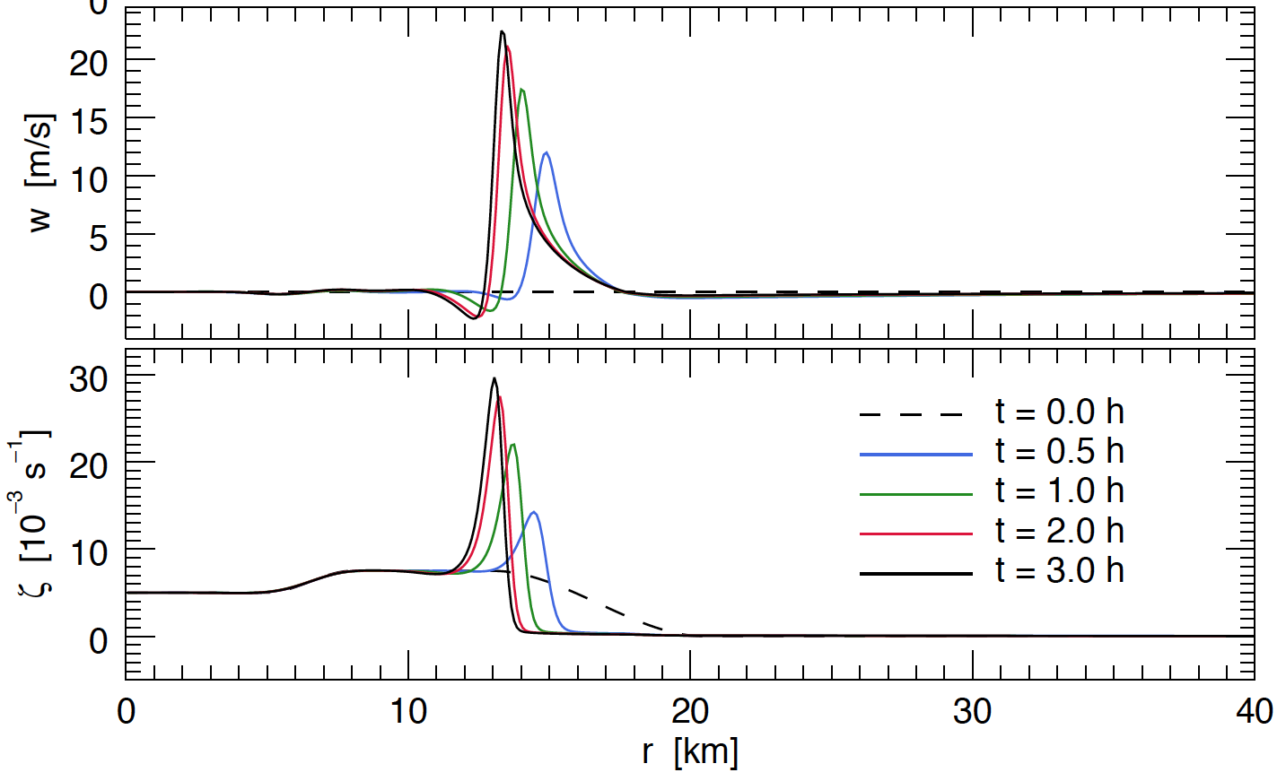
SBLM-TC Numerical Results for C3
Vertical
Velocity
Relative
Vorticity
Shock-like steady-state quickly develops

Slide 14
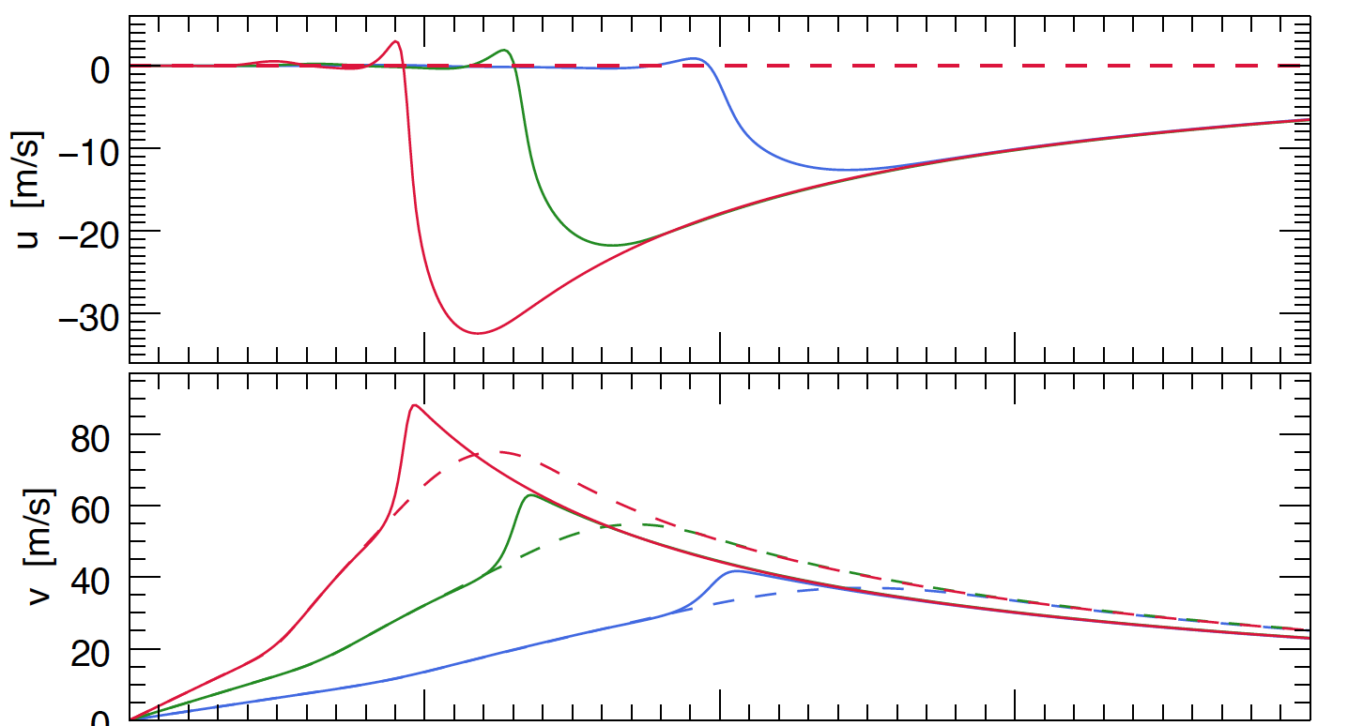
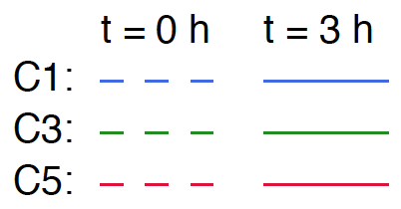

Summary of SBLM-TC Numerical Results
C1
C3
Radial
Velocity
C5
Tangential
Velocity
C5
C3
C1

Slide 15
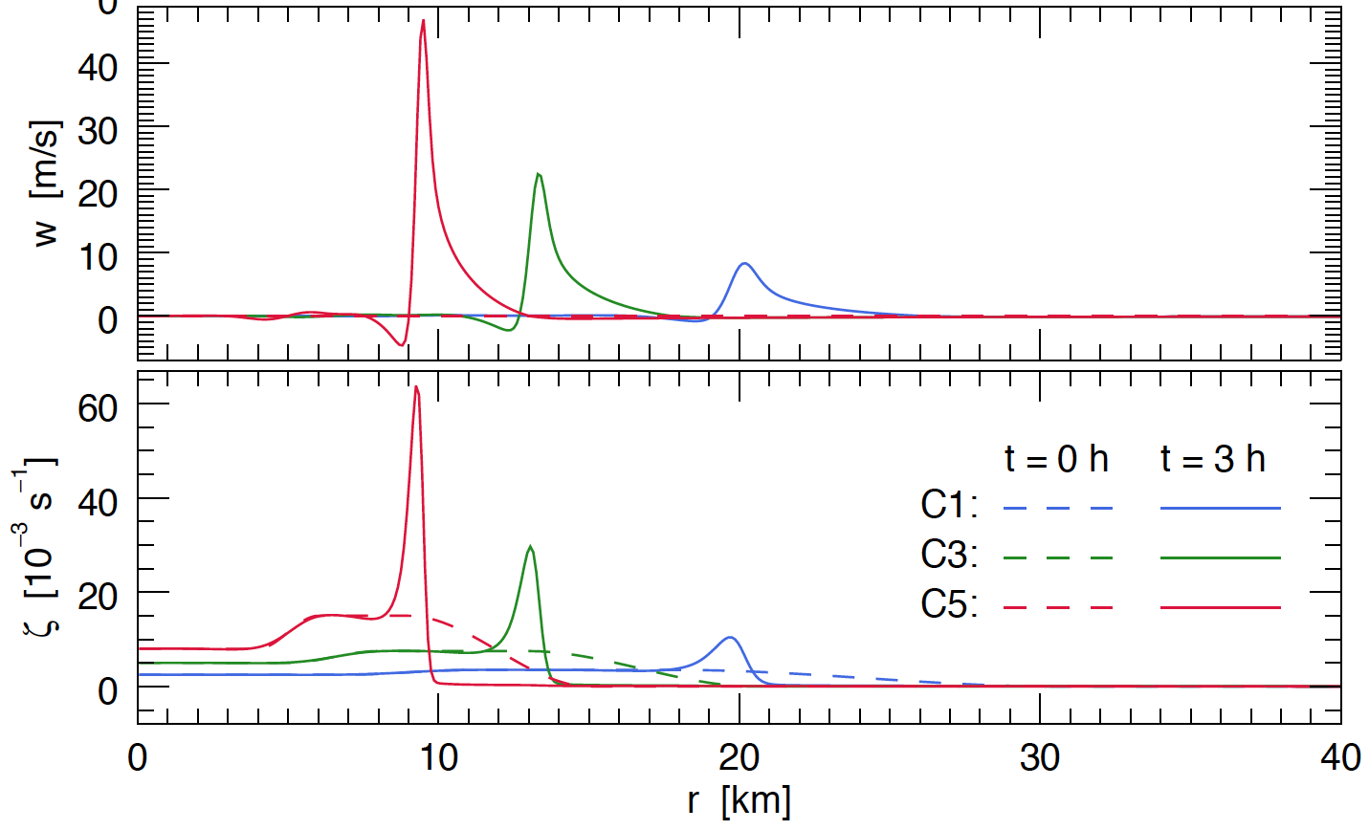
Summary of SBLM-TC Numerical Results
Vertical
Velocity
C5
C3
C1
Relative
Vorticity
C5
C3
C1

Slide 16
Simplified Analytical SBLM-TC Model
Full SBLM-TC governing equations:
Simplifications:
Ignore:
  Horizontal diffusion terms
  Ekman suction terms
  Agradient forcing term
Linearize surface drag terms

Slide 17
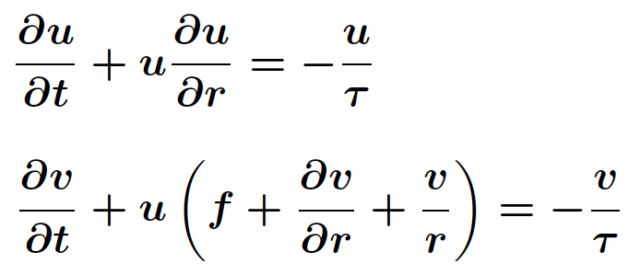
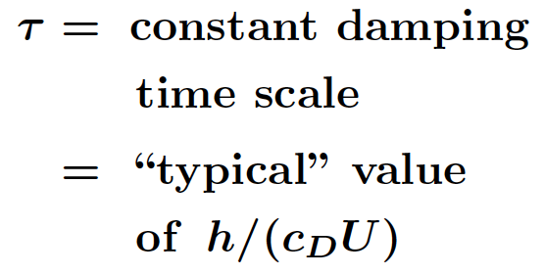
Simplified Analytical SBLM-TC Model
Full SBLM-TC governing equations:
Simplifications:
Ignore and 2) Linearize
Resulting simplified governing equations:
where

Slide 18
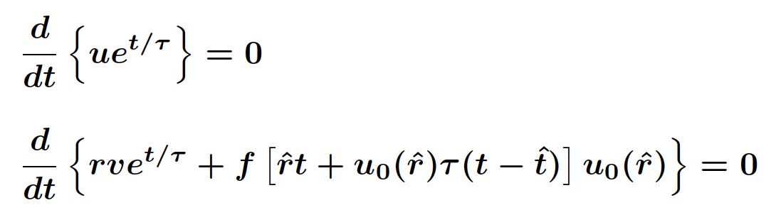
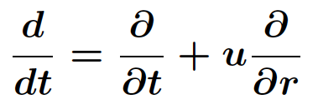

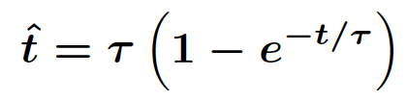
Simplified Analytical SBLM-TC Model
Alternative form using Riemann invariants:
Derivative following boundary
layer radial motion
where
Radial characteristics defined implicitly by:
where

Slide 19
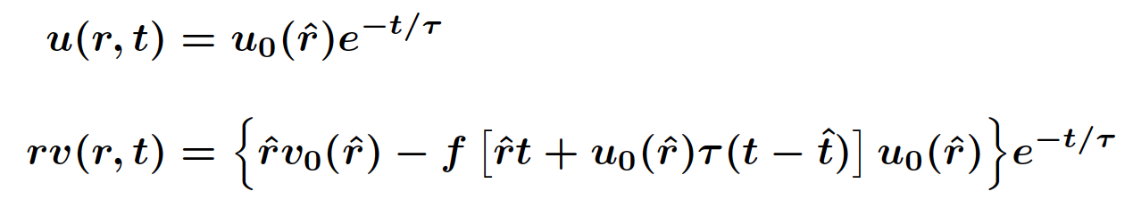
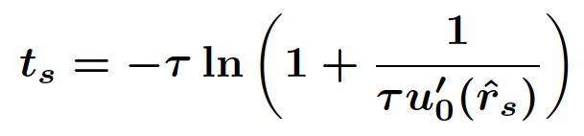
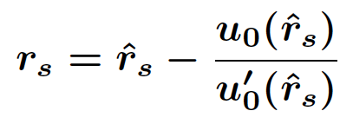
Simplified Analytical SBLM-TC Model
Analytical solutions:
where radial characteristics are implicitly defined by:
with
Useful analytical results about shock formation:
Time of Shock Formation
Radius of Shock Formation

Slide 20
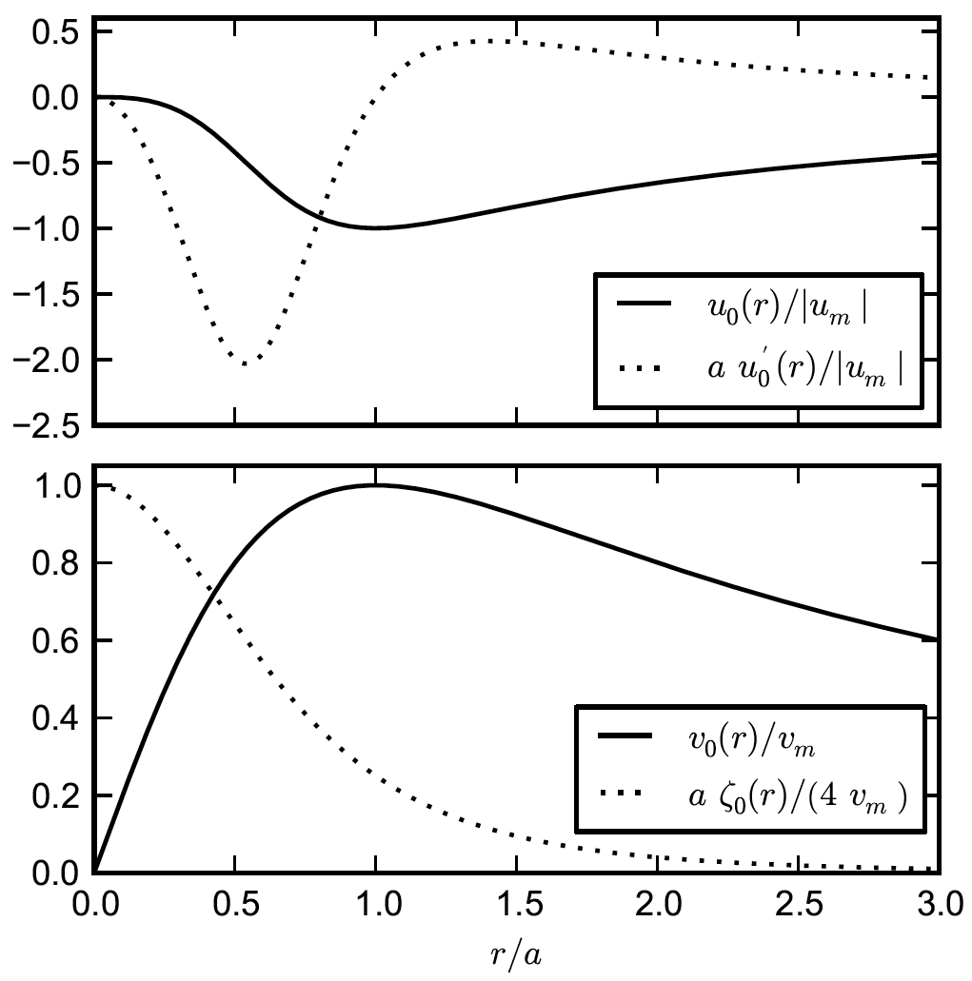
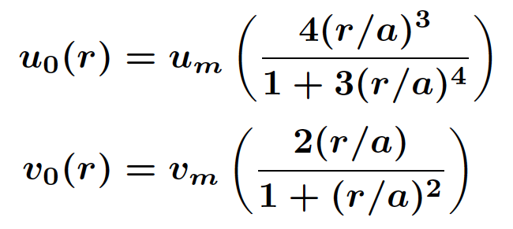
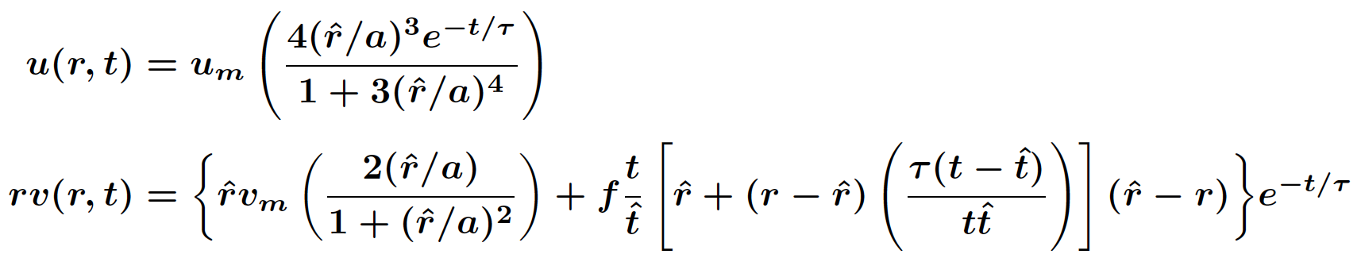
Analytical SBLM-TC Model Experiments
Initial conditions:
Analytical solutions:

Slide 21
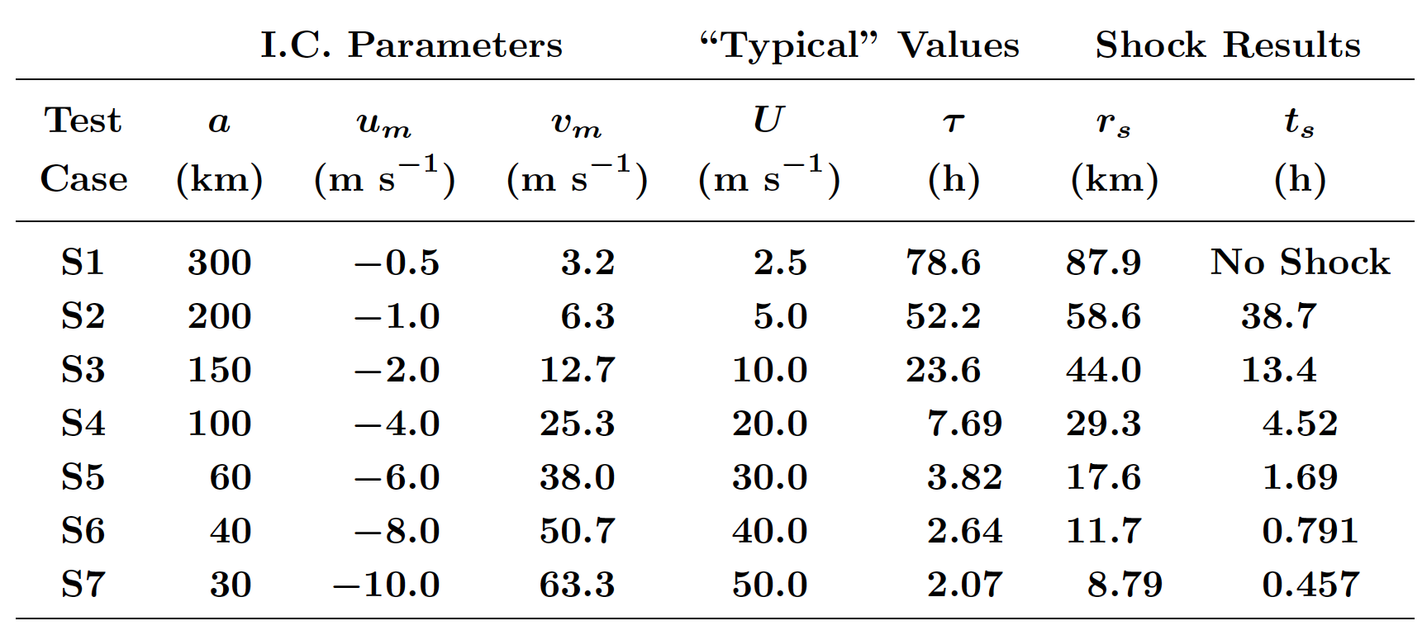
Analytical SBLM-TC Model Results
As Tropical Cyclone
Strength Increases:
Radius of Shock
Formation
Decreases
Time of Shock
Formation
Greatly Decreases

Slide 22
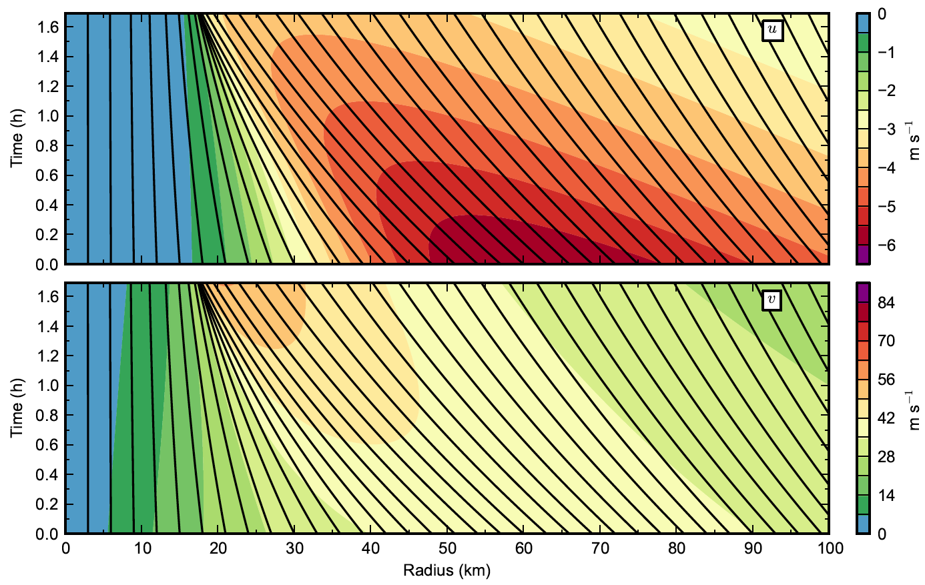
Analytical SBLM-TC Model Results for S5
Radial Velocity
Tangential Velocity
Black curves indicate
radial characteristic curves

Slide 23
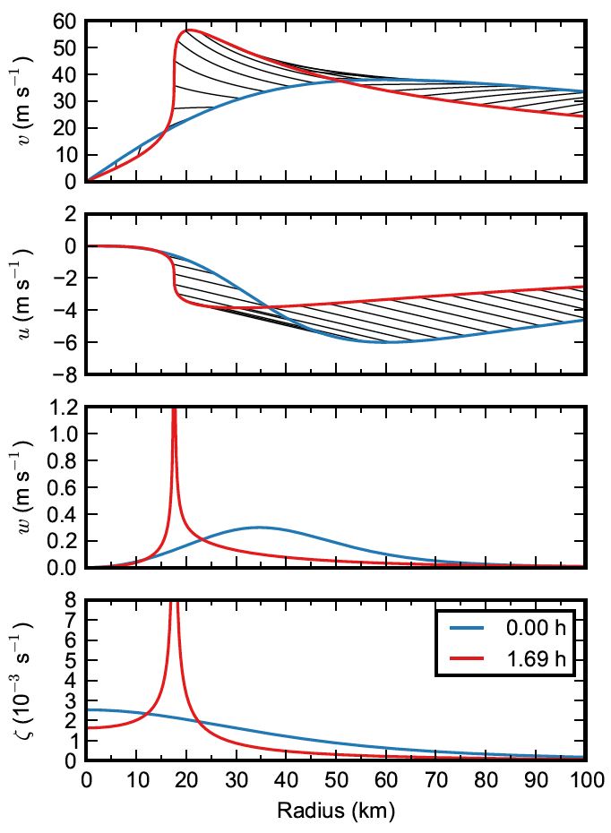
Analytical SBLM-TC Model Results for Test Case S5
Tangential Wind
Radial Wind
Blue:
Red:
Black:
Fluid particle
displacements
Vertical Velocity
At shock formation:
Radial and tangential winds become discontinuous
Vertical velocity and relative vorticity become singular
Relative Vorticity

Slide 24
Axisymmetric Numerical Model Results
From
Yamasaki
(1983)

Slide 25
NOAA WP-3D Data for Hurricane Gilbert (1988)
From Barnes and Powell (1995)

Slide 26
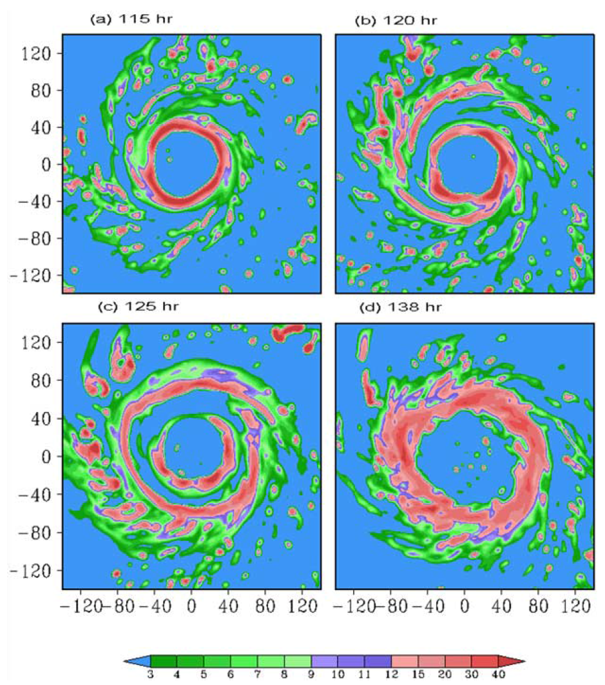
WRF Simulated Eyewall Replacement
Does a double shock
structure form?
Does the outer shock
then inhibit the inner
shock?
Simulated rainwater distribution (0.1 g/kg)
From Zhou and Wang (2009)

Slide 27
Numerical Results for a Double Eyewall
Experiment 1: Adding a secondary vorticity maximum
Relative Vorticity
In Overlying Layer
Tangential Wind
In Overlying Layer

Slide 28
Numerical Results for Double Eyewall
Experiment 1
Radial
Wind
Tangential
Wind
A second outer shock can form and significantly affect the original inner shock
Vertical
Velocity

Slide 29
Numerical Results for a Double Eyewall
Experiment 2: Like Exp. 1, but keep average vorticity the same
Relative Vorticity
In Overlying Layer
Tangential Wind
In Overlying Layer

Slide 30
Numerical Results for Double Eyewall
Experiment 2
Radial
Wind
Tangential
Wind
An outer shock can be similar to or even greater than the inner shock
Vertical
Velocity

Slide 31
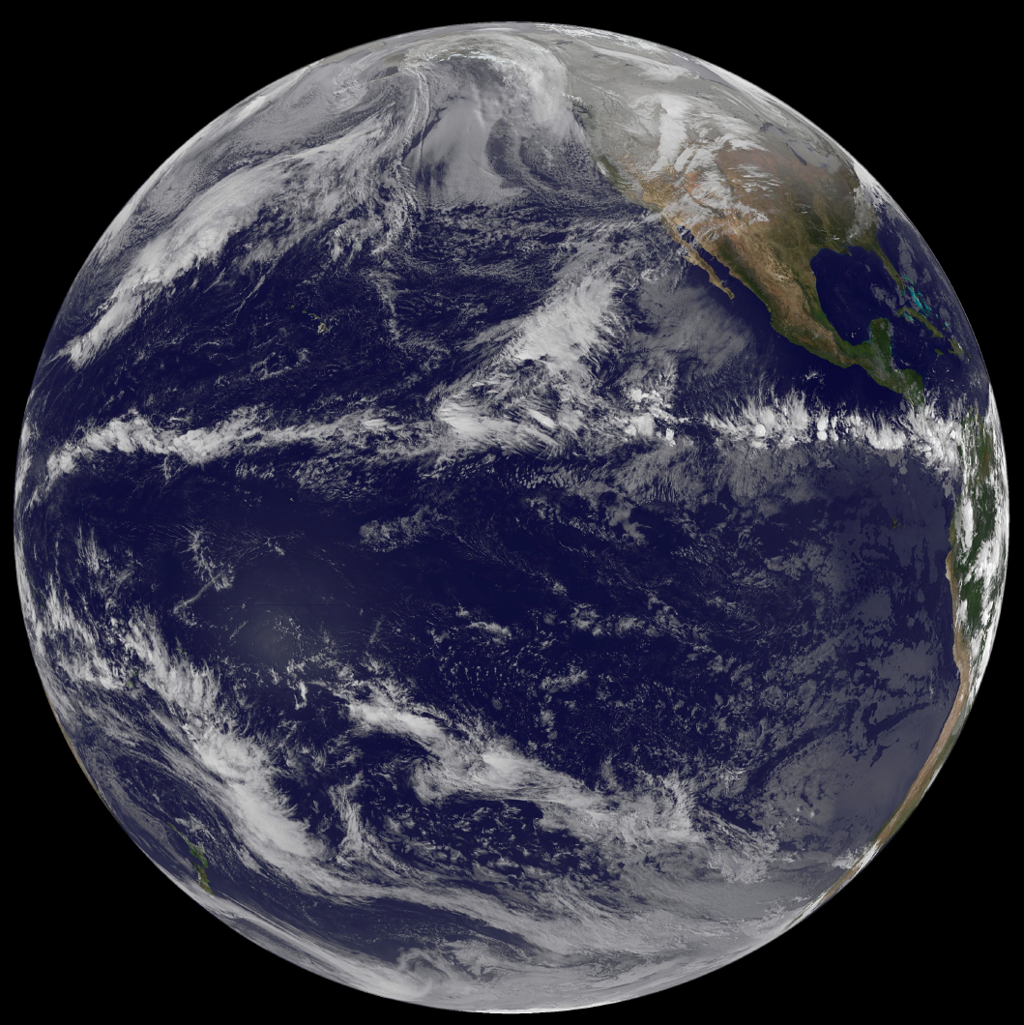
What About the ITCZ?
Visible Satellite
Imagery
Nov. 24, 2010
00:00 UTC
Do boundary layer shocks play a role in the ITCZ?
From NASA GSFC
GOES Project
website

Slide 32
Slab Boundary Layer Model for the ITCZ (SBLM-ITCZ)
Overlying Layer (provides forcing)
Specify zonal velocity:
Assume geostrophic balance
Assume constant in time
Assume meridional velocity is zero
Diagnose:
Boundary Layer as a Zonally Symm. Slab on the Sphere
Solve for: and
IC’s:
(constant)
Southern BC’s:
Northern BC’s:

Slide 33
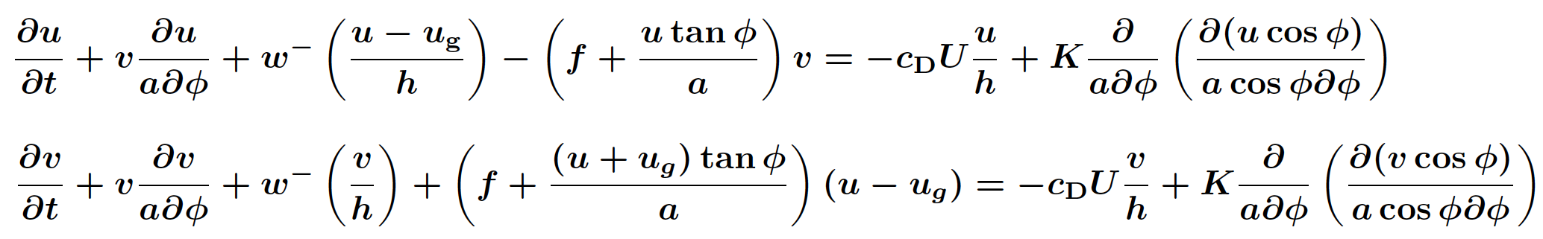
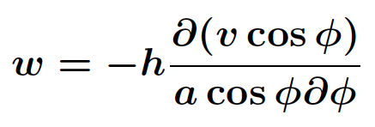
SBLM-ITCZ Governing Equations
Two predictive equations for the horizontal winds in the slab:
Zonally symmetric slab on the sphere
Note the embedded Burgers’ equation
Diagnostic equations for vertical velocity info:
rectified Ekman
suction
and
Diagnostic equation for wind speed at 10 m height:

Slide 34
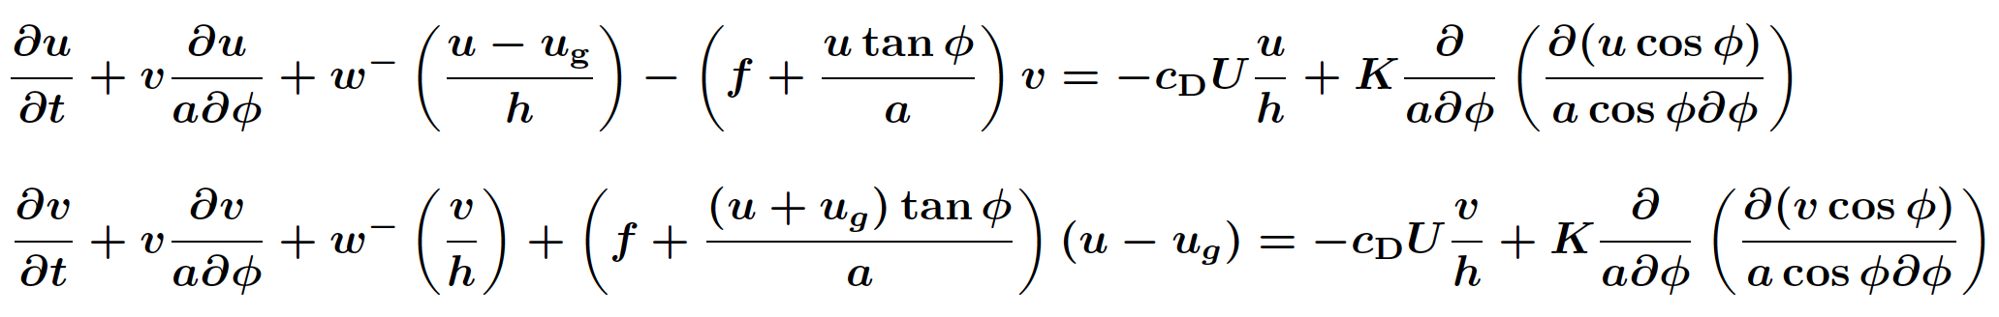
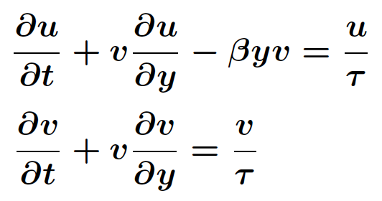
Simplified Analytical SBLM-ITCZ Model
Full SBLM-ITCZ governing equations:
Simplifications:
Ignore
Linearize
β-Plane approximation
Resulting simplified governing equations:
where

Slide 35
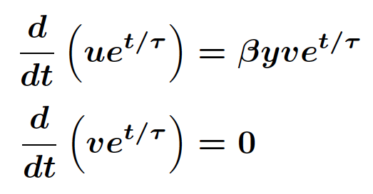
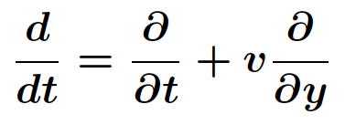


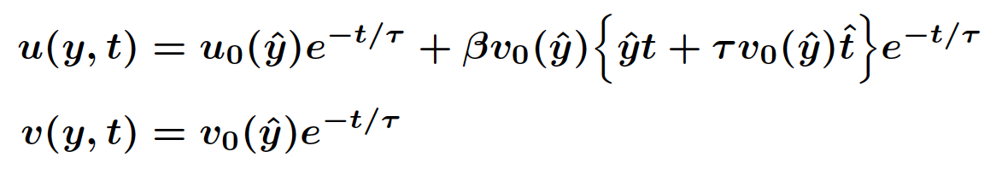
Simplified Analytical SBLM-ITCZ Model
Alternative form using Riemann invariants:
where
Derivative following boundary
layer meridional motion
Meridional characteristics defined implicitly by:
where
Analytical solutions:

Slide 36
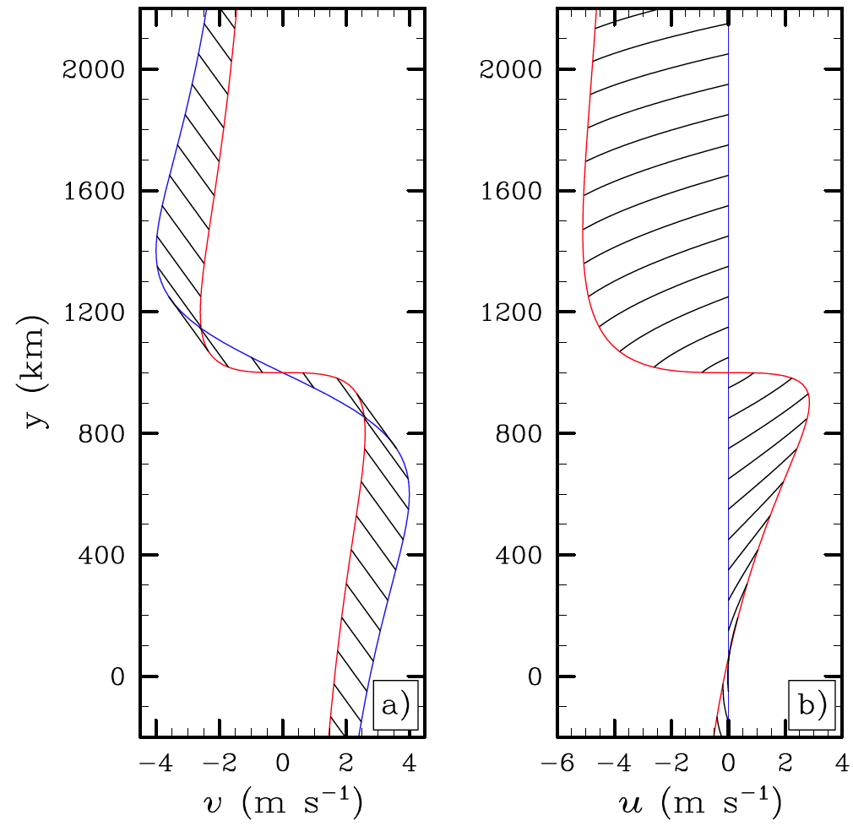
Analytical SBLM-ITCZ Model Results
ITCZ centered at
At shock formation:
Meridional and zonal winds become discontinuous
Develop different North-South symmetries
Meridional
Wind
Zonal
Wind
Fluid particle
displacements
Blue:
Red:
Black:

Slide 37
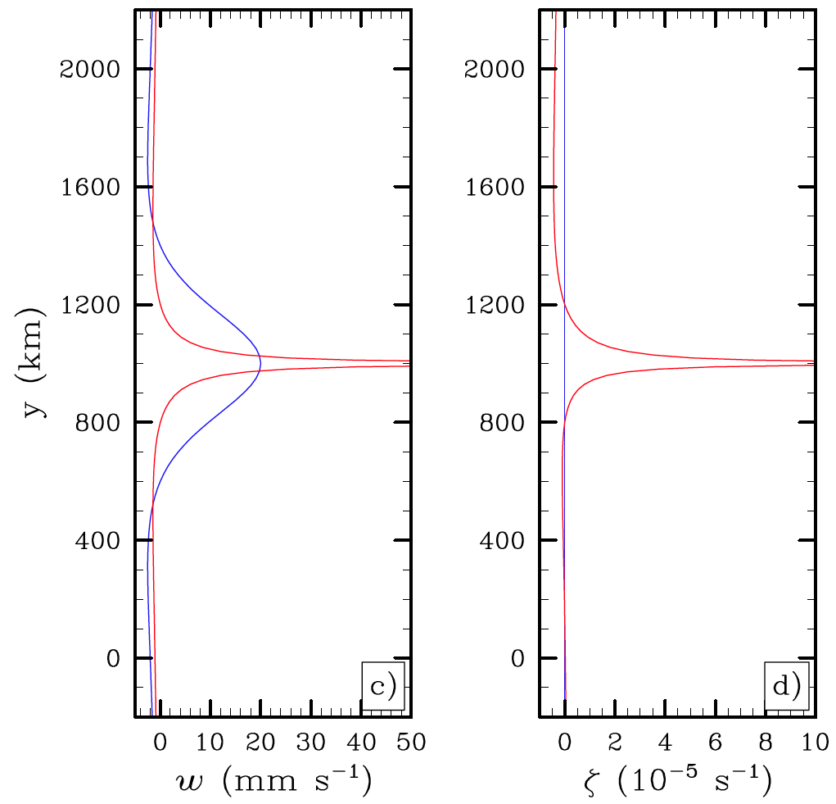
Analytical SBLM-ITCZ Model Results
Vertical
Velocity
Relative
Vorticity
ITCZ centered at
At shock formation:
Vertical velocity and relative vorticity become singular
Develop different North-South symmetries
Fluid particle
displacements
Blue:
Red:
Black:

Slide 38
Conclusions & Comments
Shock formation is associated with advection of the divergent wind by the divergent wind:
  for the hurricane boundary layer
  for the ITCZ boundary layer
Since the divergent wind is larger in the boundary layer, shocks are primarily confined to the boundary layer.
The 20 m/s vertical velocity at 500 m height in Hugo can be explained by dry dynamics, i.e., by the formation of a shock in the boundary layer radial inflow.

Slide 39
Conclusions & Comments
What determines the size of the eye? Present results indicate that eye size is partly determined by nonlinear boundary layer processes that set the radius at which the eyewall shock forms.
How are potential vorticity rings produced? Since boundary layer shock formation leads to a discontinuity in tangential wind, the boundary layer vorticity becomes singular.

Slide 40
Conclusions & Comments
How does an outer concentric eyewall form and how does it influence the inner eyewall? If, outside the eyewall, the boundary layer radial inflow does not decrease monotonically with radius, a concentric eyewall boundary layer shock can form. If it is strong enough and close enough to the inner eyewall, this outer eyewall shock can choke off the boundary layer radial inflow to the inner shock.

Slide 41
Conclusions & Comments
How can the ITCZ become so narrow? If, in the boundary layer, there is northerly flow on the north edge and southerly flow on the south edge of a wide ITCZ, then the term provides a steepening effect to the profile, which can then produce a singularity in Ekman pumping and thus a very narrow ITCZ.

Slide 42
Questions?

