Slide 1

Convective clouds, Moisture Preconditioning, and the Diurnal Cycle during DYNAMO
James H. Ruppert, Jr. and Richard H. Johnson
Colorado State University
Tropical Dynamics Workshop
Honolulu, Hawaii
Tue-Thu, 14–16 January 2014

Slide 2
We acknowledge
  CMMAP / workshop organizers (Eric, Dave, and Claire) for support to be here
  Paul Ciesielski for sounding QC and objective analysis

Slide 3
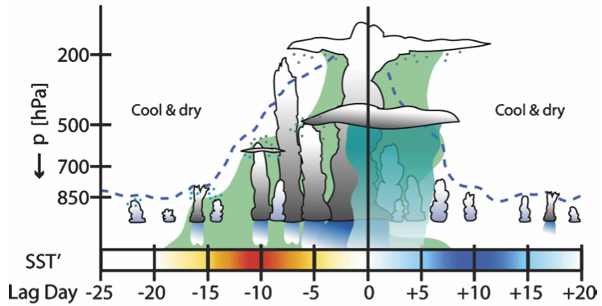
Benedict and Randall (2007)’s Composite MJO
“Transition phase”:
What processes account for the moistening during this transition?
SST warms
Trop. moistens
Convection transitions from shallow to deep
Pressure

Slide 4
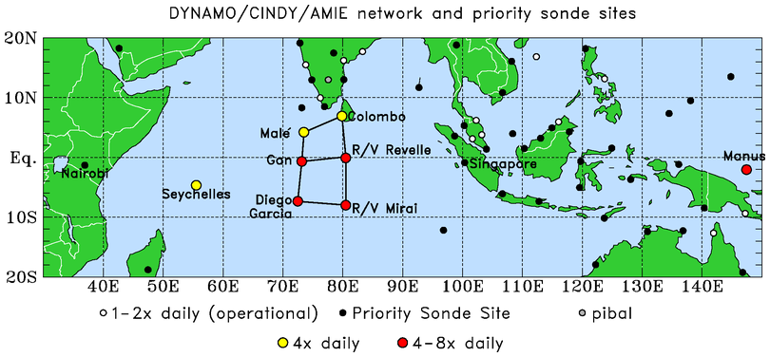
DYNAMO - Dynamics of the MJO
Oct 2011 – Jan 2012
Two MJO events captured by northern sounding array
Budgets calculated from soundings only
Notes:
Revelle port calls: 31 Oct – 6 Nov, 8-16 Dec

Slide 5
The Apparent Heat Source Q₁ and Moisture Sink Q₂ (Yanai et al. 1973)
s = c_{p}T + gz
Q_{R} = radiative heating

Slide 6
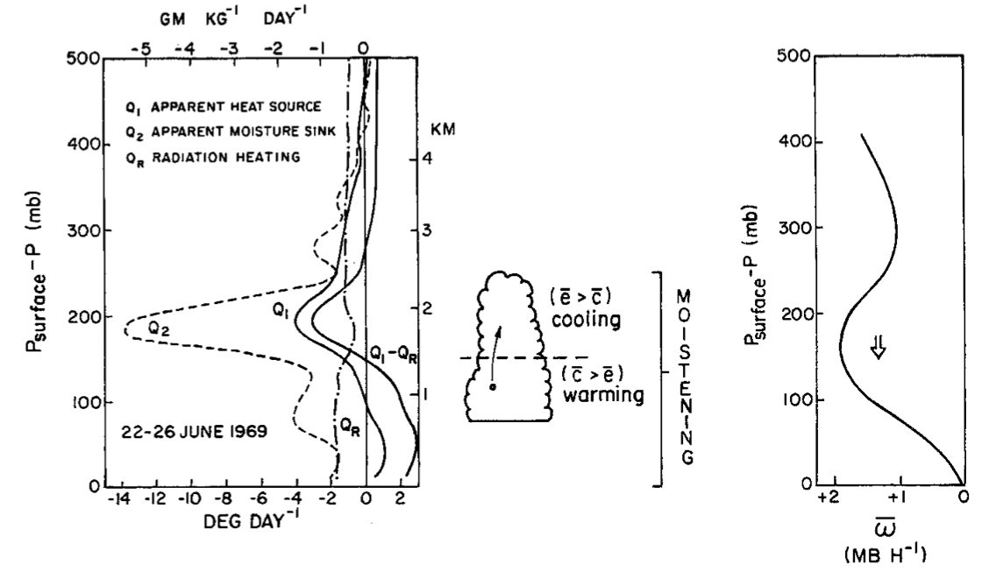
Non-precipitating Shallow Cu Regimes in BOMEX (22–26 June 1969; Nitta and Esbensen 1974; Yanai and Johnson 1993)
(Q₁)
(Q₂)
<<
600
Pressure (hPa)
800
1000
Notes:
Weak large-scale sinking motion and drying
Weakly negative Qr
Strongly negative Q2 and weakly negative Q1
Q2 and Q1 peaks Indicate strong evaporation
Strong vertical MSE flux convergence indicated by difference

Slide 7
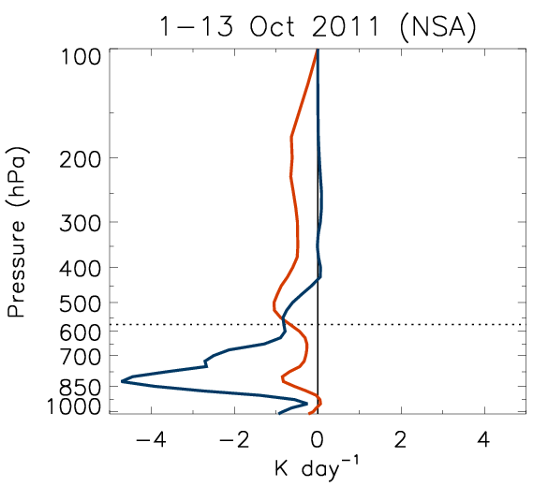
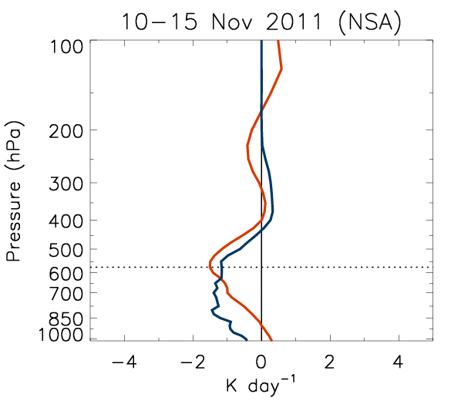
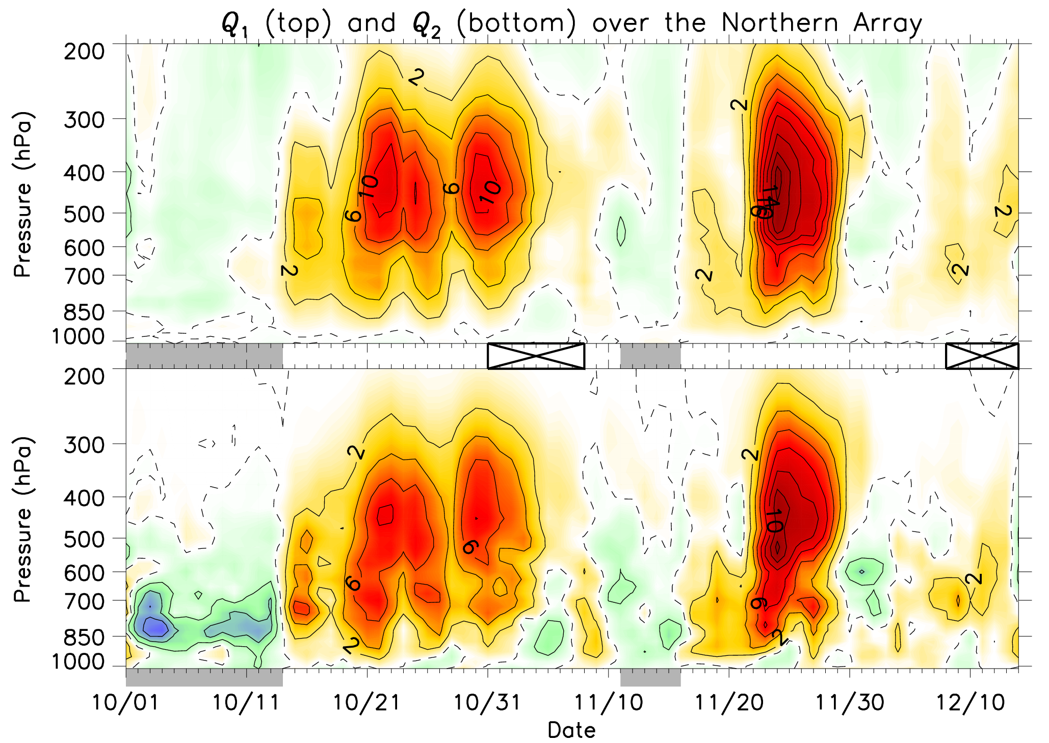
DYNAMO Budgets (three-day smoothing; K day⁻¹)
Q₁
Frz Lev
Q₂
Q₁
Q₂
Q₁
Q₂
Only three stations
Trade cu regimes before onset
(onset = when Q_{1,2} switch to > 0)
Notes:
Define terms
Two MJOs: westerly drying vs. easterly moistening
Also drying from sinking motion
Profiles resemble shallow convection
Two periods chosen for persistence and R/V Revelle

Slide 8
Moisture Budget
Directly measured
The sum
Budget validation:
(E₀ from WHOI)
< > = vertical integral

Slide 9
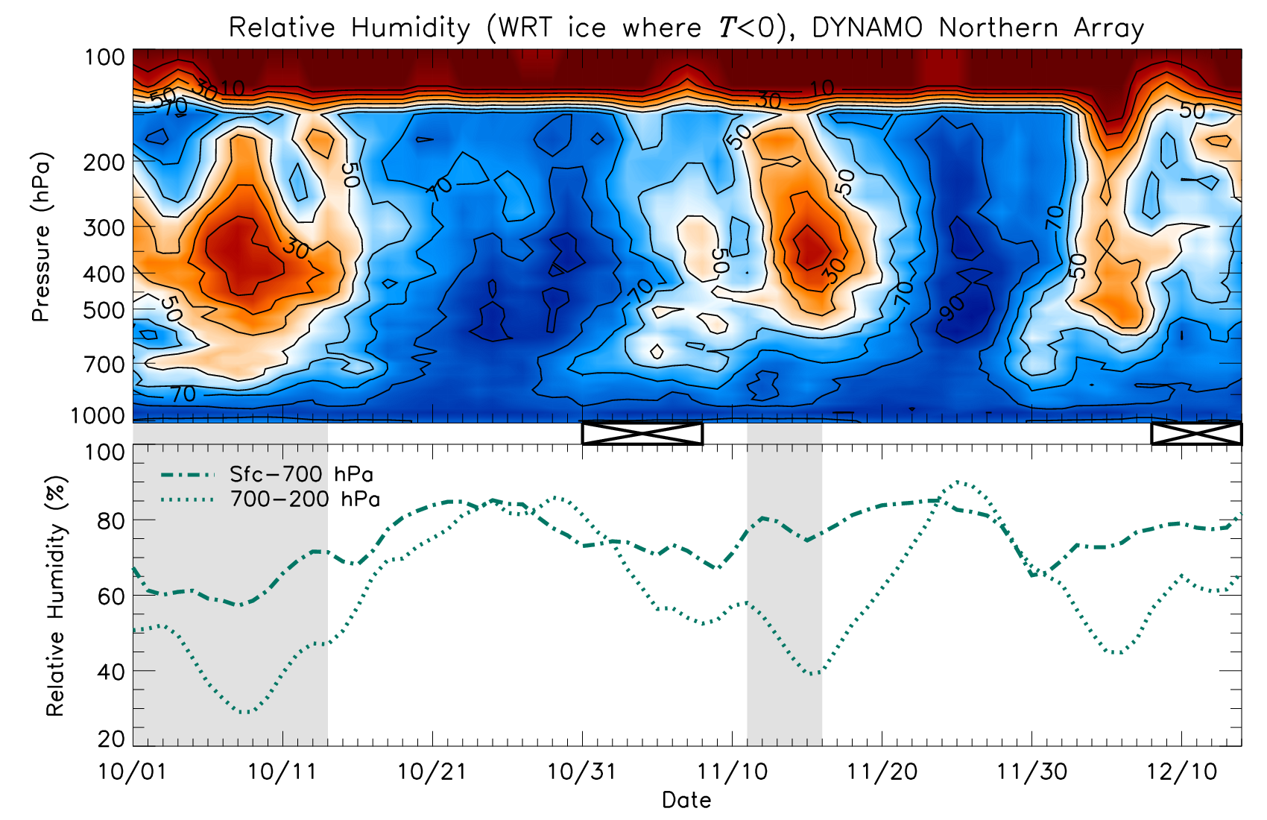
2 x Local tendency
5-day smoothed
, no means removed
Good agreement between TRMM and P₀
RH

Slide 10
Advection
3D
Vertical ( = moisture convergence)
Zonal

Slide 11
Total Source

Slide 12
All
Onset of large-scale moisture convergence is associated with more bottom-heavy Q₁ heating
Q₁
Transition periods:
Drying by large-scale flows competes with moistening by local processes
Moistening continues for another ~week in connection with moisture convergence

Slide 13
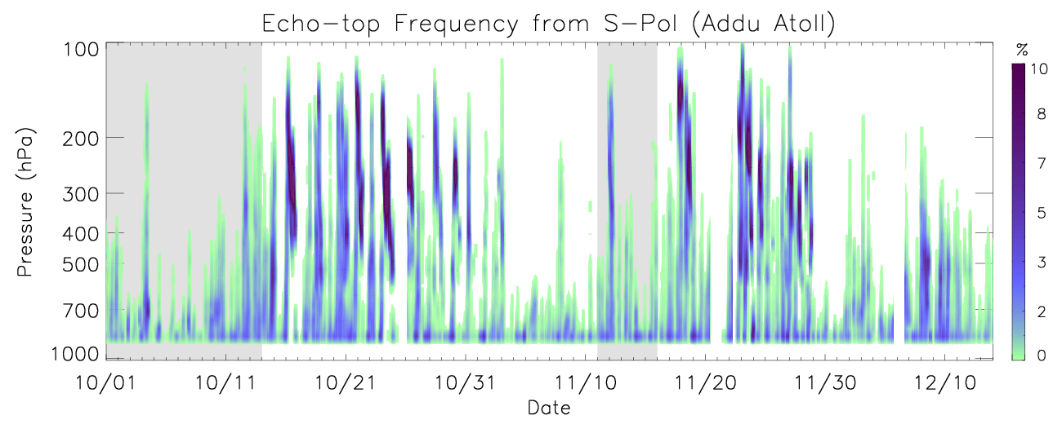
Pronounced short-timescale variability
Transition periods: deepening clouds
Echo top (minimum detectable echo) from S-Pol
Methodology:
  15-min S-Pol RHI scans over the northeast radar quadrant
  Echo features filtered for:
    Base ≤ 1 km, thickness ≥ 1.5 km, and features within 50 km range of radar
    Frequency is echo-top occurrence / # grip points

Slide 14
Analysis of the Diurnal cycle

Slide 15
Sea Surface Temperature from the R/V Revelle (Courtesy, C. Fairall)
24-h running mean

Slide 16
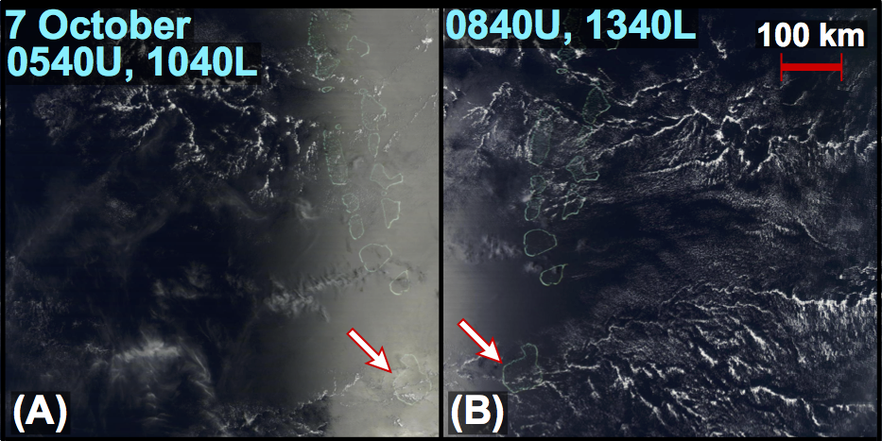
MODIS Terra/Aqua
Morning
Afternoon

Slide 17
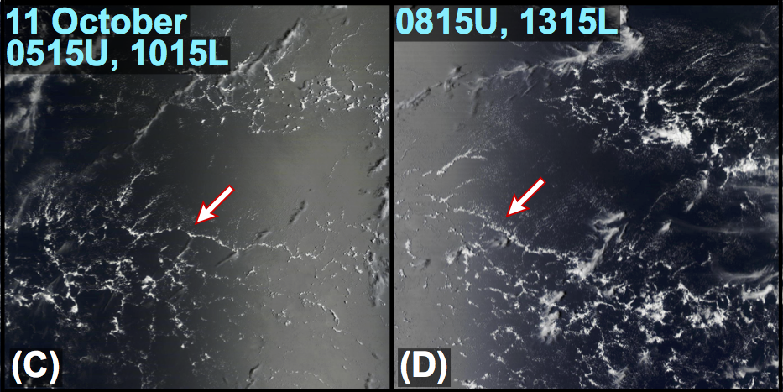
MODIS Terra/Aqua
Morning
Afternoon

Slide 18
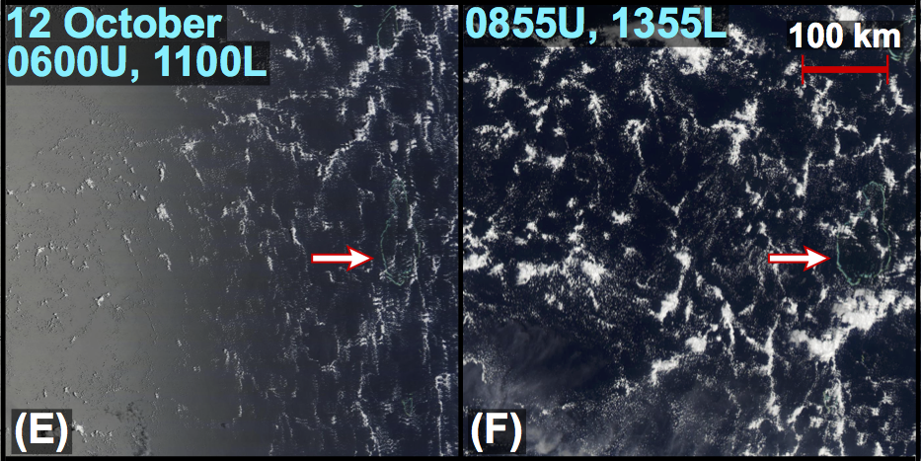
MODIS Terra/Aqua
Morning
Afternoon

Slide 19
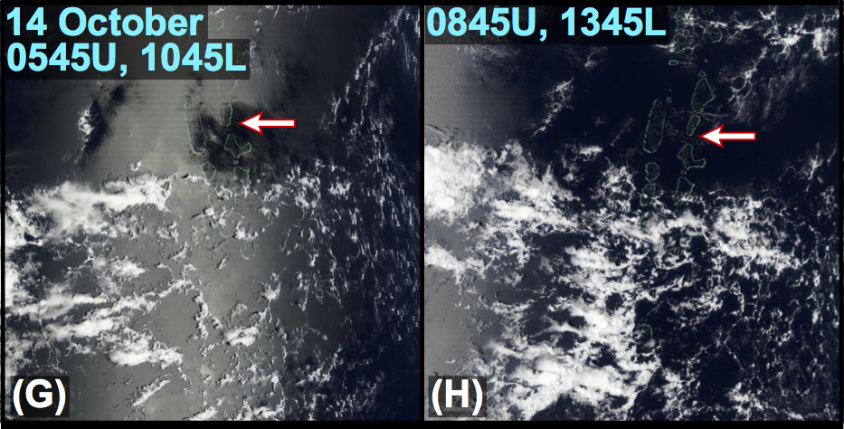
MODIS Terra/Aqua
Morning
Afternoon

Slide 20
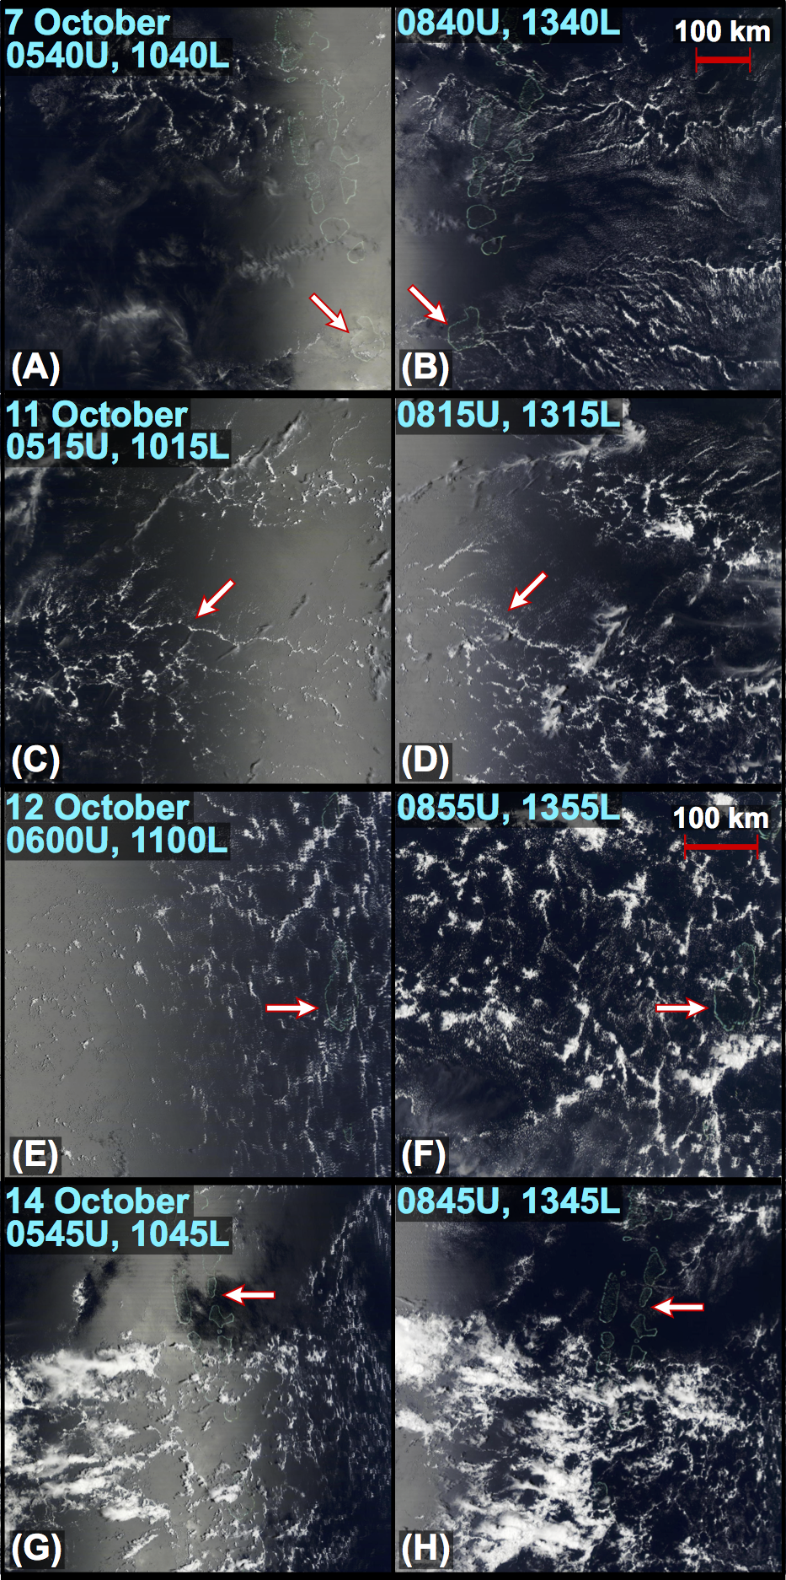
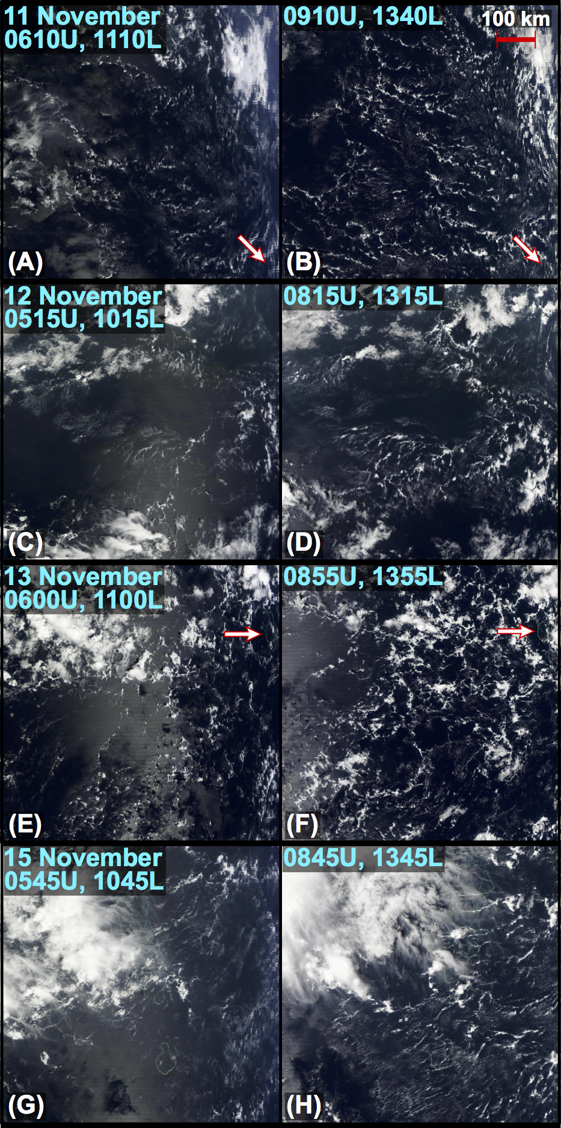
Oct
Nov
Clouds deepen
Clouds deepen
Clouds deepen
Clouds deepen

Slide 21
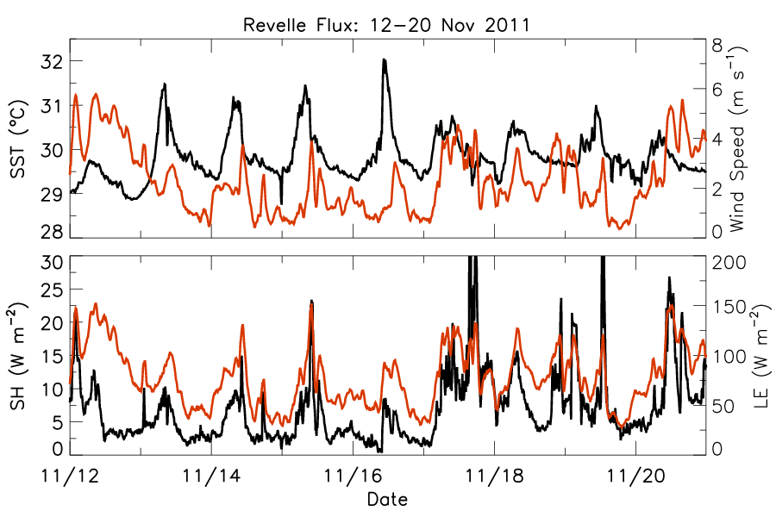
Fluxes from R/V Revelle (November)
Wind speed
SST
SH
LE

Slide 22
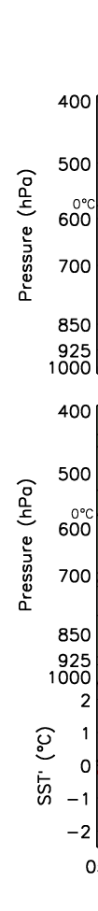
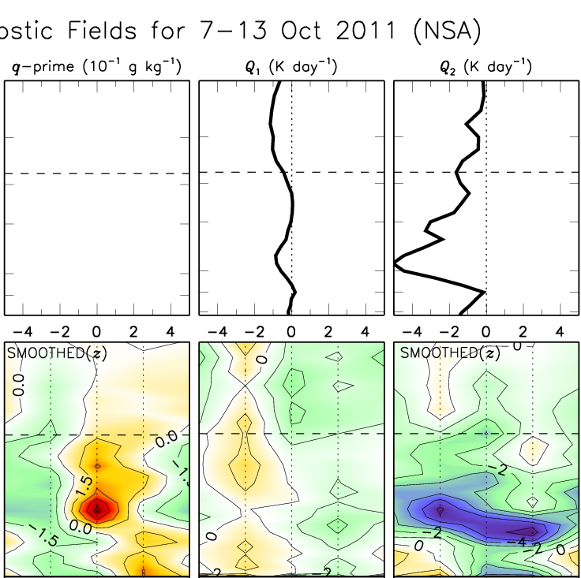
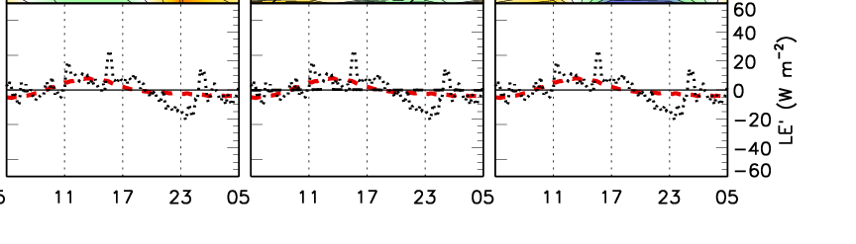
Diurnal Composites: 7–13 Oct 2011 (4/day)
Q₁
Q₂
Means
Moistening peaks around ~750 hPa in the late-morning –afternoon
q’
Similar PBL moistening was found in COARE by Sui et al. (1997) and MISMO by Yasunaga et al. (2008)
Diurnal
cycle
SST
LE
05
11
17
23
05
Local Time
Notes:
Radiation signature
Afternoon SST peak matches LE
Mean LE was O(100) W/m2
Moistening strengthens at SST and LE peak, with 5pm q’ peak
Evap peaks midday, convec. pumps moisture into trop.
Rainfall is nearly absent
Q2 dominated by local tend, hence not a large-scale feature
Others shown evening BL moistening, not sorted out
Possibly dry air entrainment with daytime mixed layer deepening

Slide 23
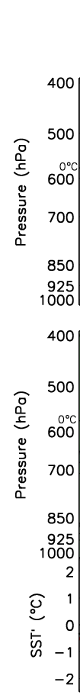
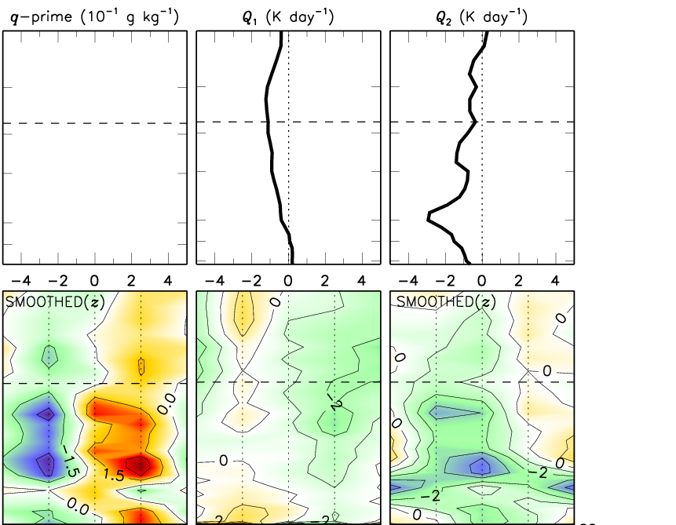
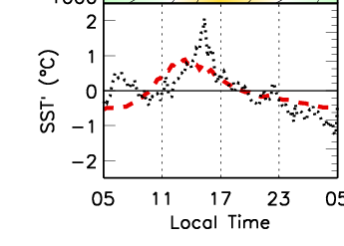
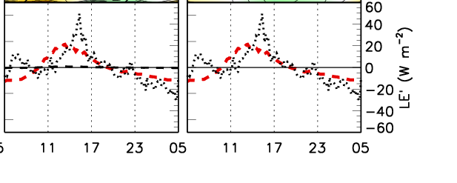
Diurnal Composites: 11–16 Nov 2011 (4/day)
Q₁
Q₂
Means
Peaks in SST and LE → peak cumulus moistening
q’
Diurnal
cycle
SST
LE
05
11
17
23
05
Local Time
Notes:
Much stronger diurnal cycle in SST (and hence LE) owing to surface weaker winds
There are both diurnal and semidiurnal peaks in rainfall, though rainfall amounts are still VERY small
Moistening occurs over a greater depth during this period, likely due to a moister trop

Slide 24
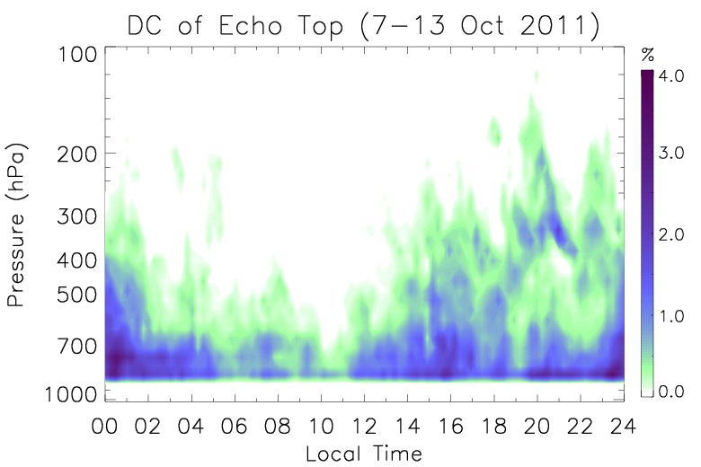
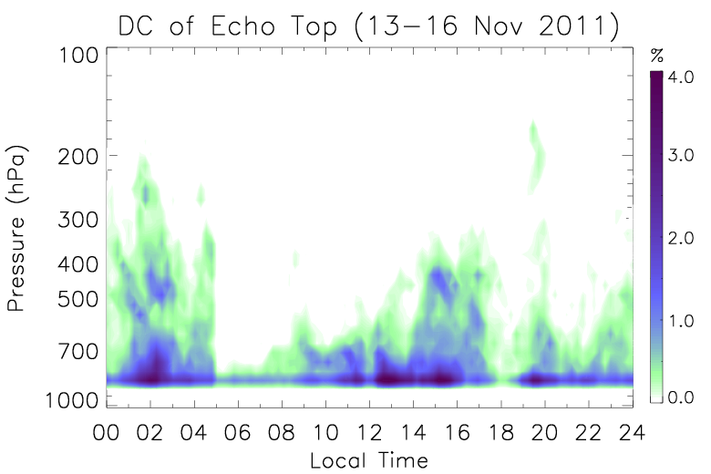
Diurnal Cycle of Clouds
October Period
November Period
Afternoon transition from shallow to congestus clouds
Nocturnal cloudiness

Slide 25
Summary:
DYNAMO Overview
Transition periods exhibit Q₁ & Q₂ < 0, indicating moistening by local processes (surface fluxes → vertical transport by clouds)
These local processes act to offset the drying by the large-scale (similar to a trade-cu regime)
Once Q₁ and Q₂ switch to positive (rainfall onset), large-scale moisture convergence becomes the key moistening process
  Bottom-heavy convection

Slide 26
Summary:
DYNAMO Overview
The transition period can be described as a “tug-of-war” between local processes (moistening) and the large-scale (drying)
In the presence of an unstable boundary layer, local processes readily moisten and force deeper convection as the large-scale drying abates

Slide 27
Summary:
The Diurnal Cycle
Pronounced diurnal variation observed during transition periods
  Convective moistening peaks in the afternoon, around the time when SST and surface fluxes maximize and clouds transition from shallow congestus
Mesoscale organization (~50 km)
  Rather than occurring in a ubiquitous/scattered cloud field, moistening is focused in narrow cell walls (recall cold pool talk: S. van den Heever)
  Organization likely owes fundamentally to Rayleigh–Bénard instability

Slide 28
Summary:
The Diurnal Cycle
From a moisture budget, we cannot readily ascertain what is driving what…
Testable hypotheses based on observations:
  The diurnal cycle (DC) in SST and clouds drives enhanced afternoon moistening, and is thereby important for the timescale of the MJO convective transition
  Similarly,
  Mesoscale organization leads to enhanced lifting in focused areas, more effectively communicating moisture from surface fluxes into the free troposphere

Slide 29
Thanks for listening!

Slide 30
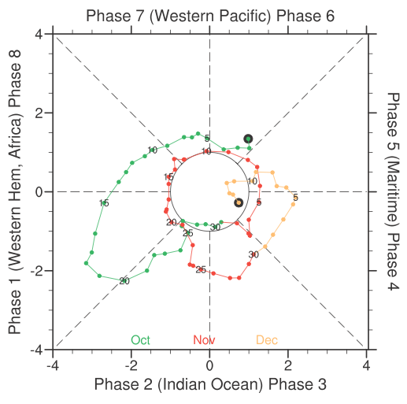
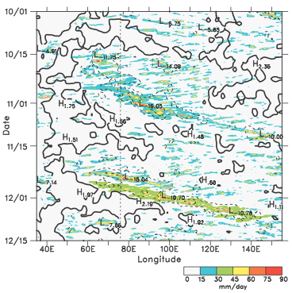
Large-scale Perspective (Johnson and Ciesielski 2013)

Slide 31
Diurnal Cycle of Clouds and Rainfall (Oct)
Rainfall exhibits minimum in late-morning
Increases into afternoon, with maximum in evening/nighttime
Afternoon transition from shallow to congestus clouds
Nocturnal cloudiness

Slide 32
Diurnal Cycle of Clouds and Rainfall (Nov)
Semidiurnal cycle in rainfall: early-morning and afternoon peaks
Similar afternoon cloud transition
More distinct nocturnal peak

Slide 33
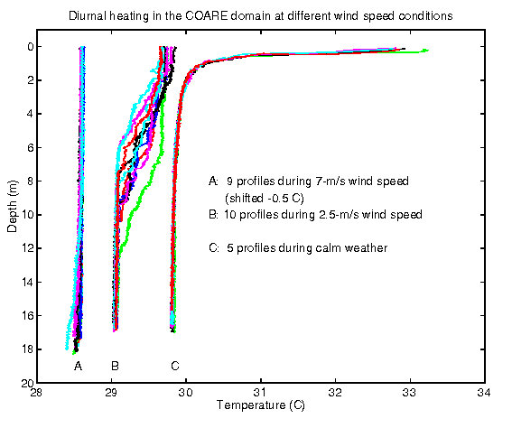
Soloviev and Lukas (1997)

