Slide 1
Extended Madden-Julian oscillation simulations by NICAM for the CINDY/DYNAMO period
Hiroaki Miura (Univ. of Tokyo)
Tomoki Miyakawa (JAMSTEC)
Masaki Satoh (Univ. of Tokyo)

Slide 2
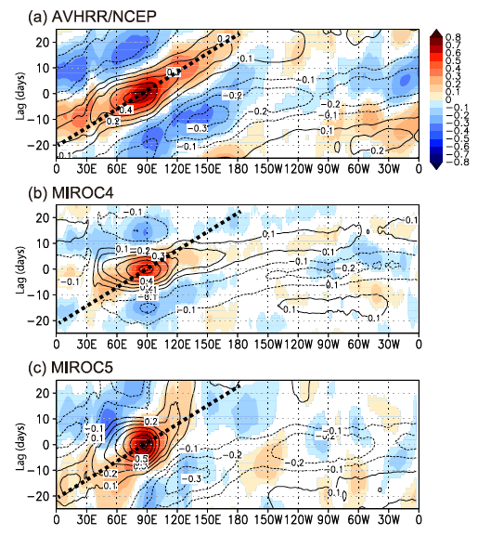
MJO in MIROC5 model
He is now working in a road company.
Miura, H., T. Maeda, and M. Kimoto, 2012: A comparison of the Madden-Julian oscillation simulated by different versions of the MIROC climatemodel. SOLA, 8, 165-169.
A letter journal of Japanese Meteorological Society
Standard MJO diagnostics (Kim et al. 2009) were used to evaluate boreal winter MJO in MIROC climate model.
MIROC5
T85 horizontal resolution
Chikira(-Sugiyama) scheme for cumulus convection

Slide 3
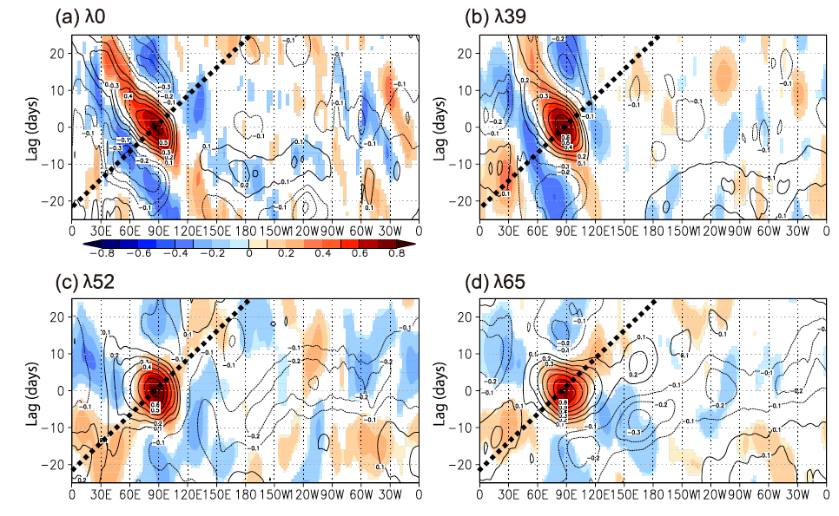
Miura, Maeda, Kimoto (2012, SOLA)
Entrainment rate ( ) in the Chikira scheme
OLR (color) and U850 (contour)

Slide 4
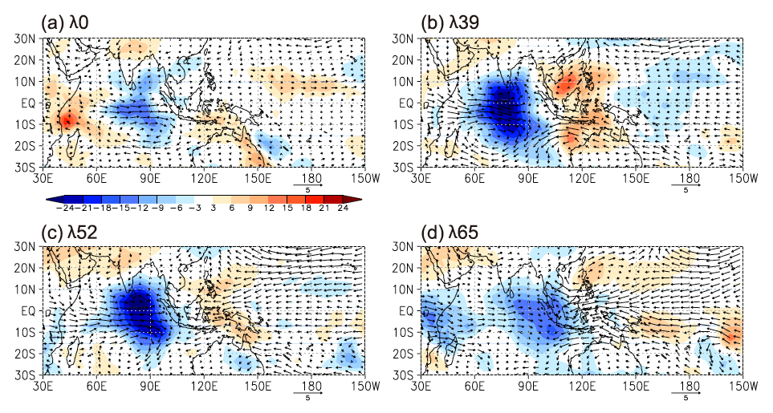
Miura, Maeda, Kimoto (2012, SOLA)
Eastward moving speed
Rossby-mode enhanced
Kelvin-mode enhanced
Composite of U850,V850, and OLR when the strong convection is in eastern Indian Ocean.

Slide 5
CINDY/DYNAMO simulations
MJO simulations by NICAM
Slow eastward movement (2006-12) (Miura et al. 2007)
Initiation (2006-11 MISMO) (Miura et al. 2009)
Current challenges
Robustness (Dr. Miyakawa’s talk)
Cycle
(CINDY web page)

Slide 6
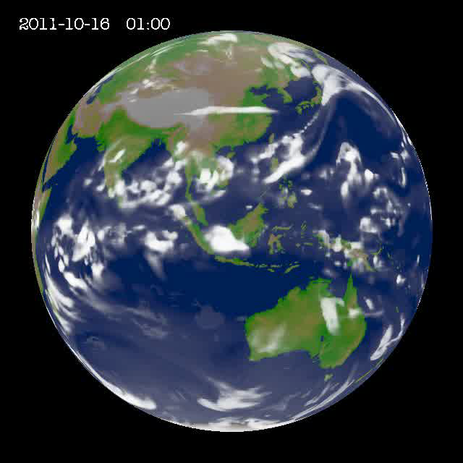
CINDY/DYNAMO simulations
7-km mesh run
2011-10-16 00z to 2011-12-15 00z (60 days)
  NCEP final analysis (ds083.2)
Realistic SST time change (Reynolds SST)
Microphysics: NSW6 (Tomita 2008)
  Results are sensitive to parameter settings.
14-km mesh ensemble runs
Five 60-day runs initialized at 2011-10-12,13,14,15,16 00z
5 SST settings
  Realistic SST
  SST fixed at 2011-10-12
  Climatological monthly mean SST added by 2011-10-12 anomaly
  3.+ ocean mixed layer (depth=15 m)
  3.+ ocean mixed layer (depth=25 m)

Slide 7
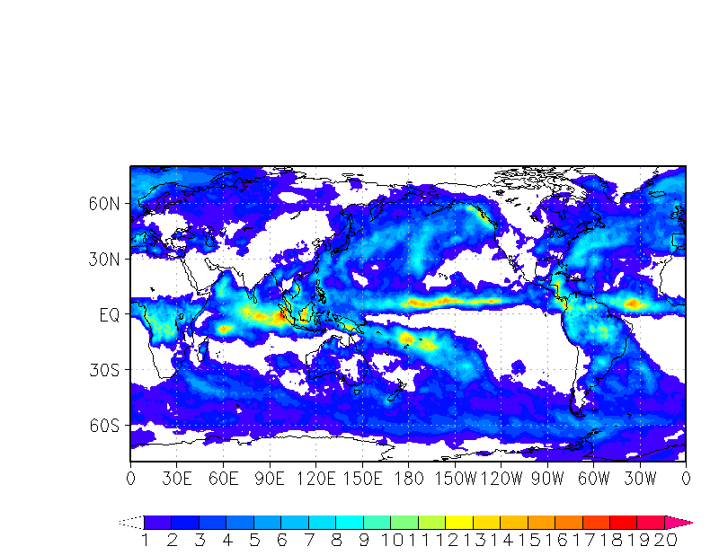
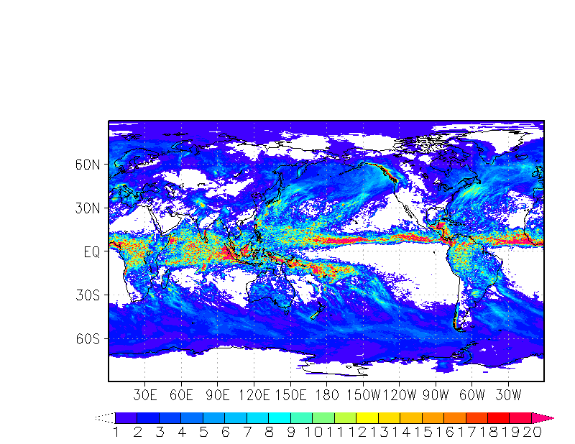
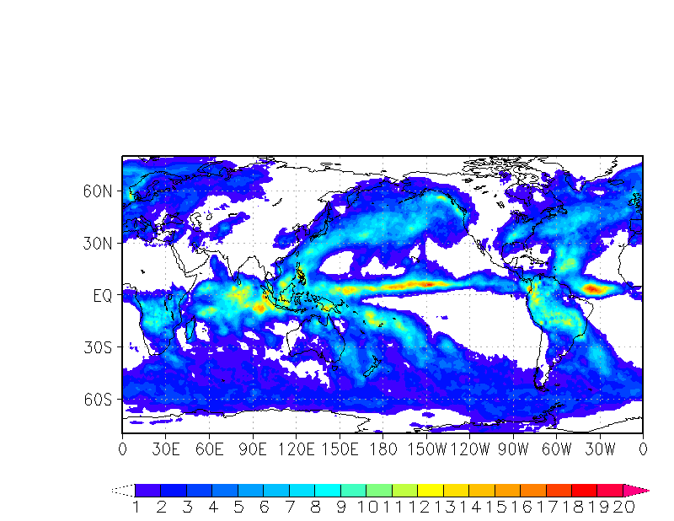
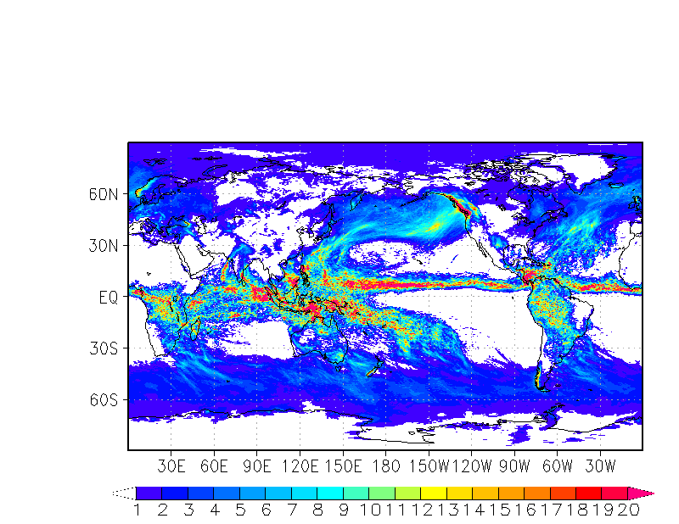
Monthly mean?
Precipitation (GPCP)
10/16-11/14
7-km run
11/15-12/14

Slide 8
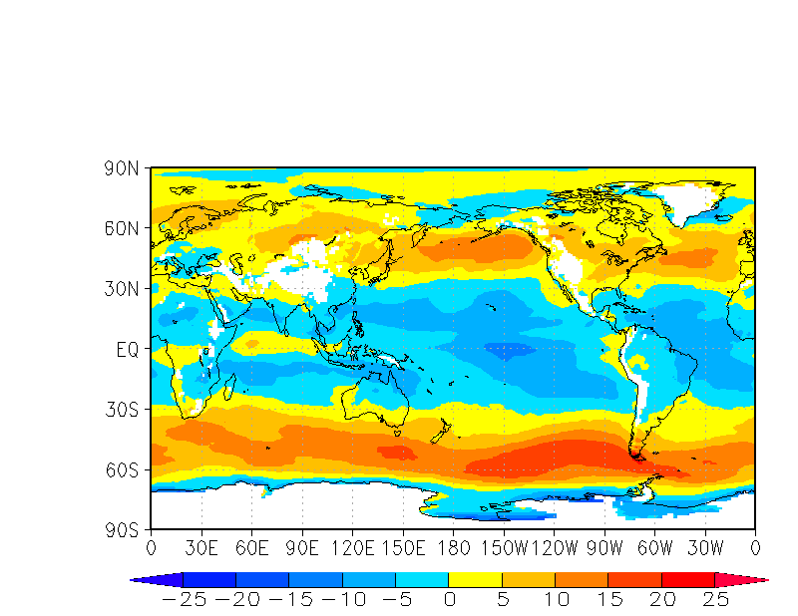
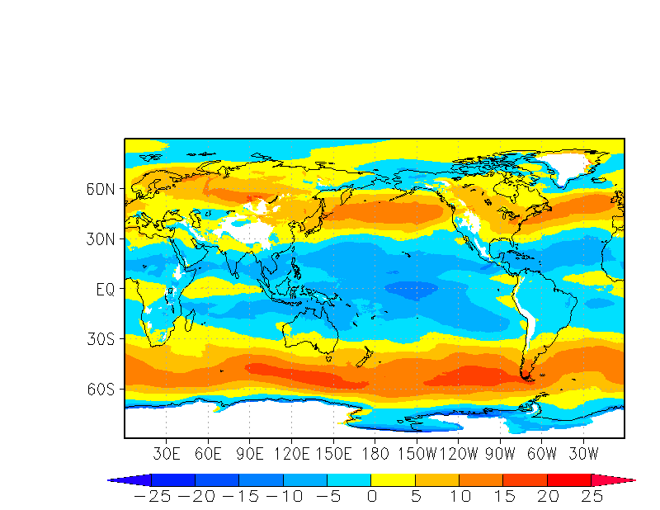
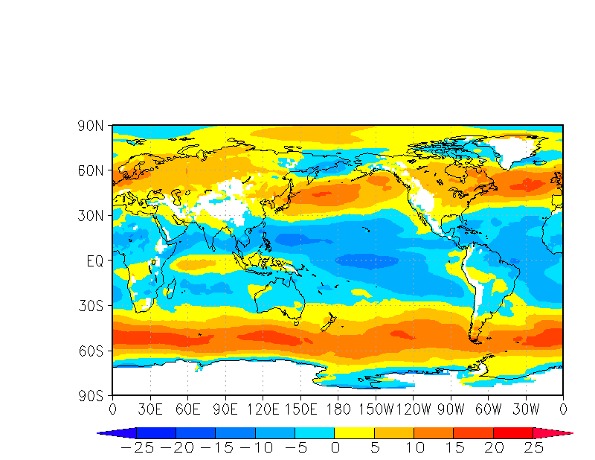
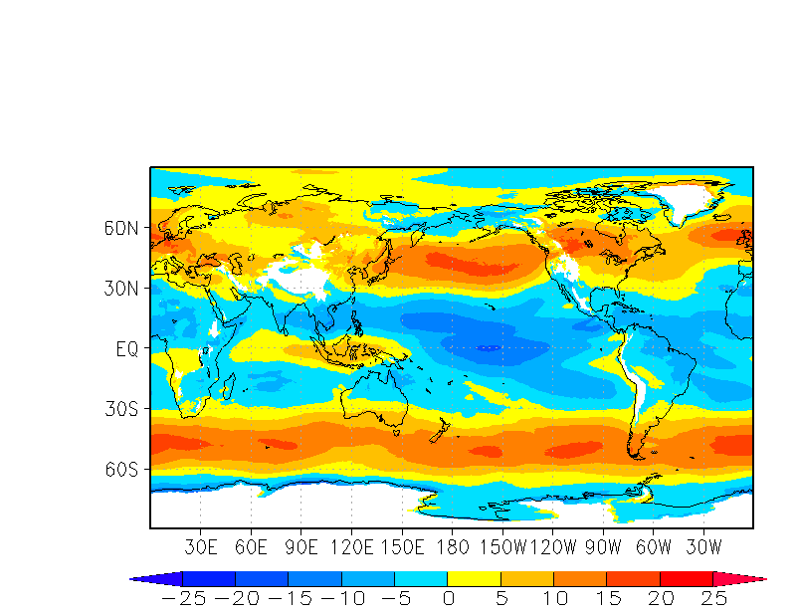
Monthly mean?
NCEP U850
10/16-11/14
7-km run
11/15-12/14

Slide 9
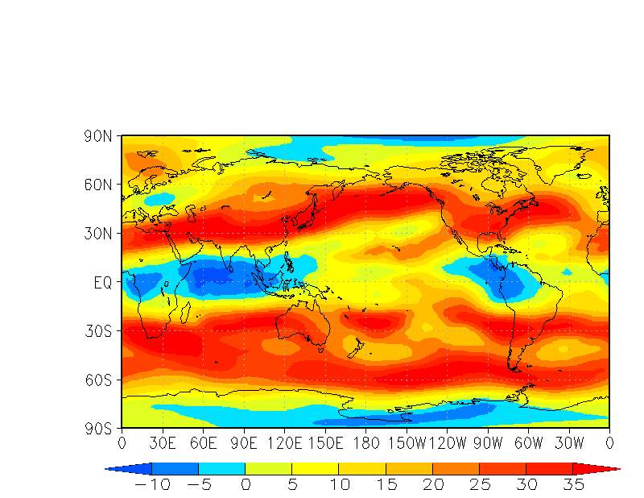
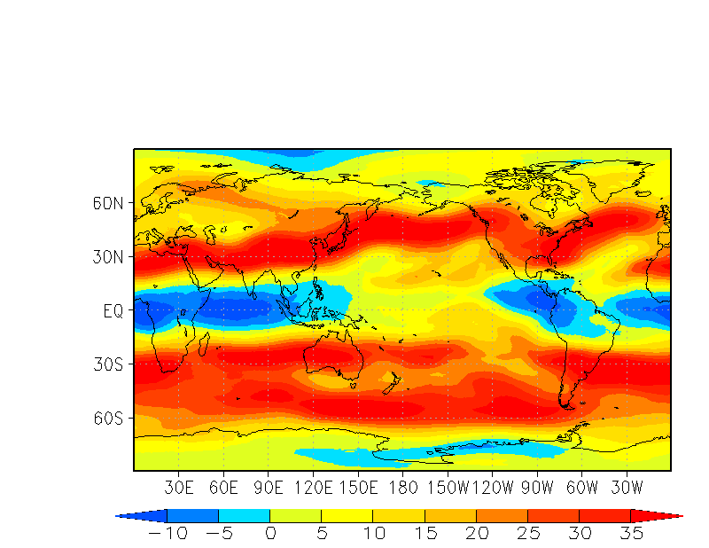
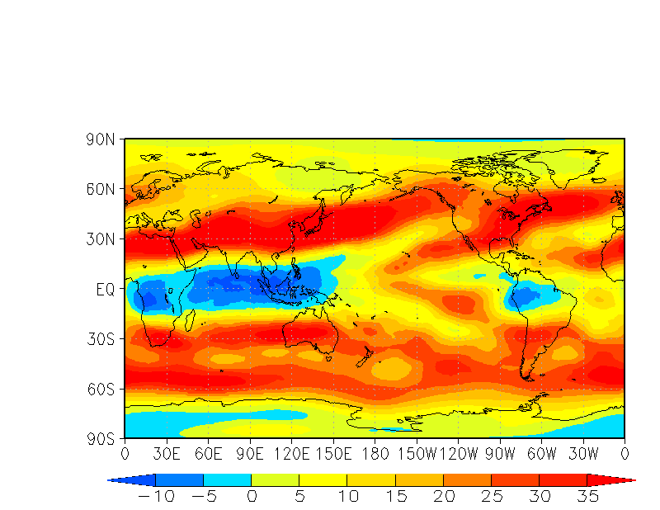
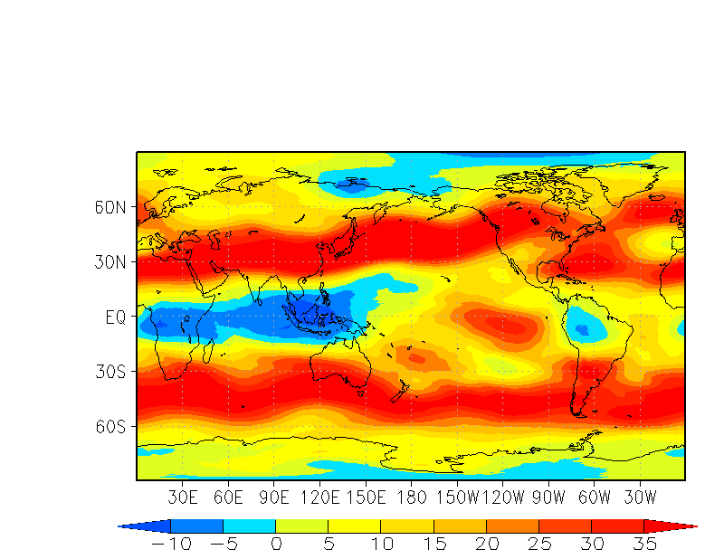
Monthly mean?
NCEP U200
10/16-11/14
7-km run
11/15-12/14

Slide 10
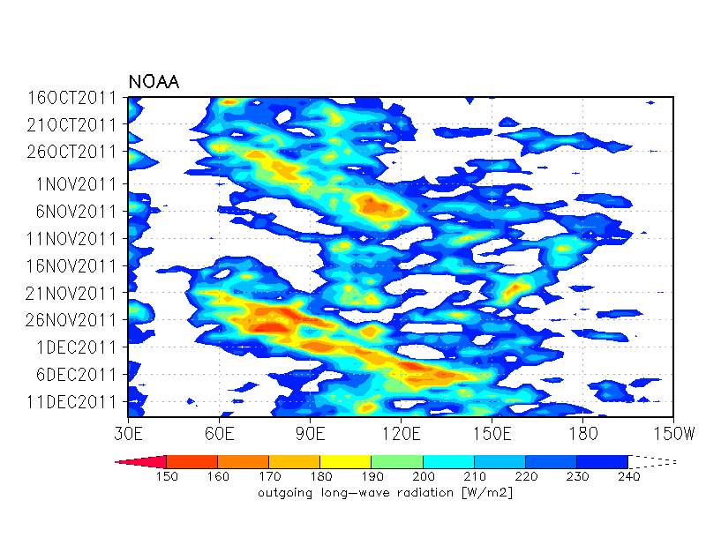
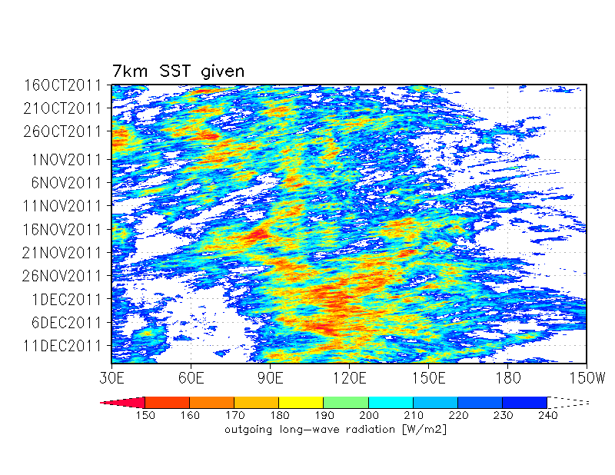
Hovmoller diagram
NOAA OLR
7-km run
MJO-1
  Simulated, but weak over the maritime continents.
MJO-2
  (Apparently) initiated over the western Indian Ocean.
  About 5 days earlier than observed.
  Much stronger convection over the maritime continents.

Slide 11
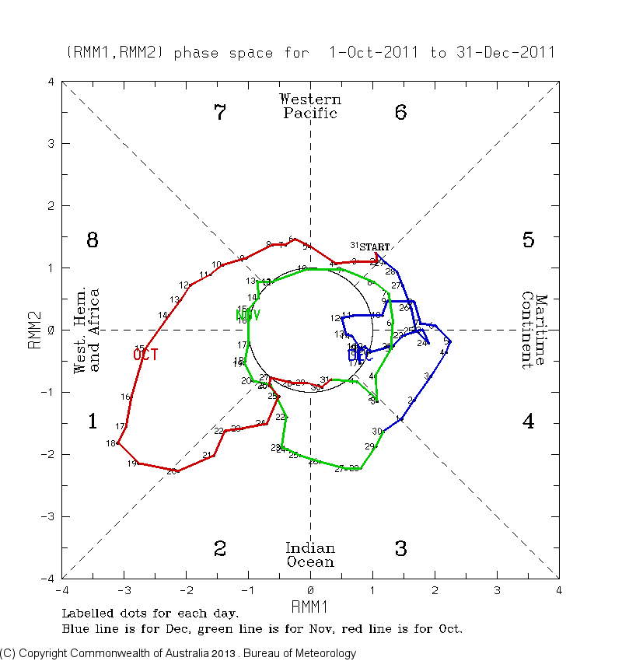
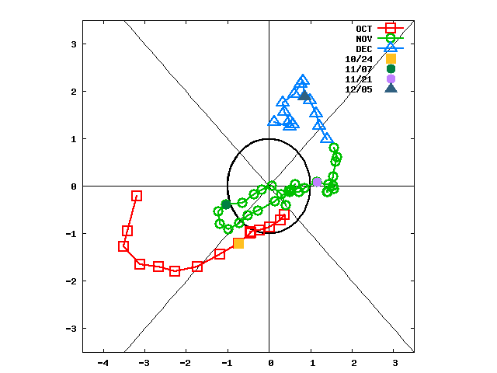
RMM plot
7-km run
NCEP climatology is subtracted.
Projected on to the eigenvectors given by BOM.
BOM
Circular motion in November is not good.
Convective activity resides in the Indian Ocean.
Re-enhancement of convection in late November.
Location is biased eastward.

Slide 12

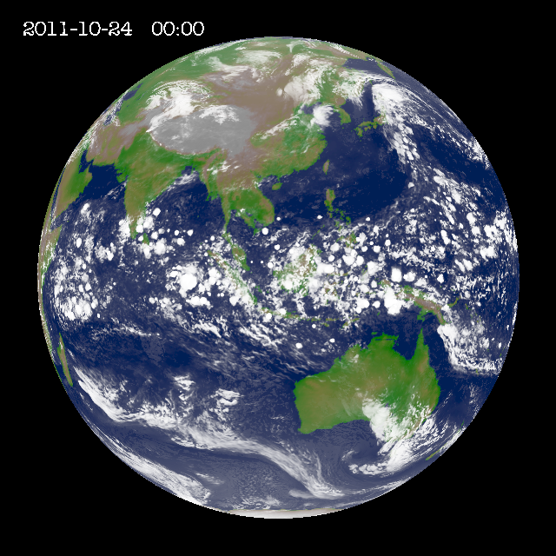
10/24/2011
Global IR
7km-run

Slide 13

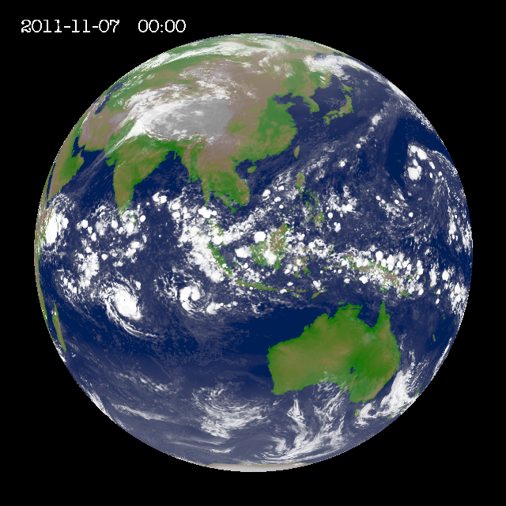
11/07/2011
Global IR
7km-run

Slide 14

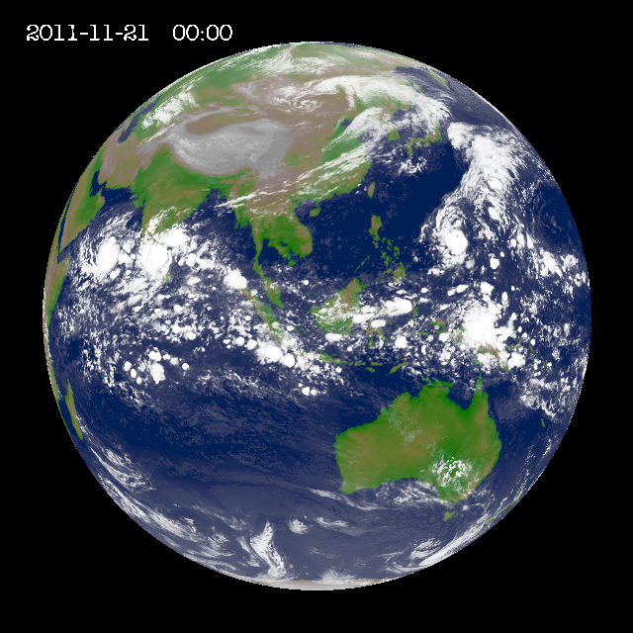
11/21/2011
Global IR
7km-run
?

Slide 15

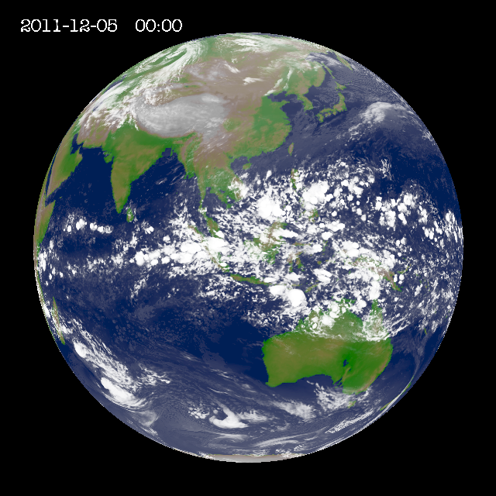
12/06/2011
Global IR
7km-run

Slide 16
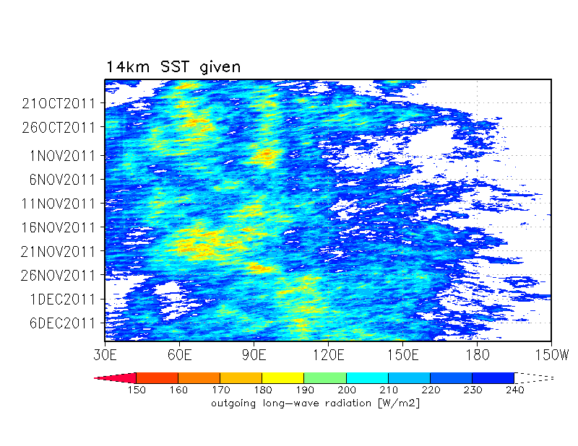
Although its timing and evolution is far from perfect, the initiation of MJO-2 appears to be simulated marginally.
Is that just an artifact in a single simulation?
Mean of 5 initial ensemble runs
(14-km mesh)
The timing is still earlier, but MJO-2 is generated again.

Slide 17
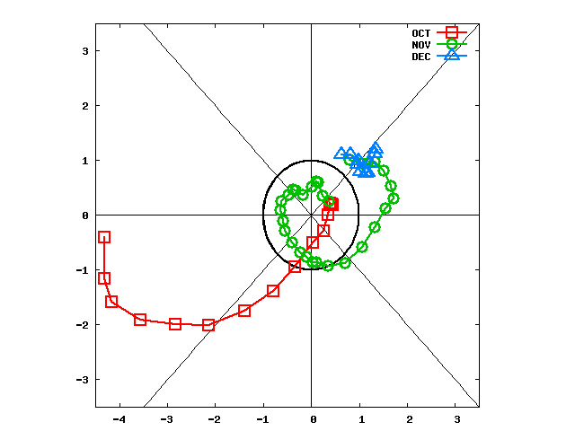
RMM plot
BOM
14-km ensemble
Circular motion is recovered, although its “amplitude” is smaller and its “speed” is faster.

Slide 18
Sufficient information to simulate MJO-2 (marginally) seems to be included somewhere.
Initial condition(s)?
SST time change?
Is it possible to simulate MJO-2 without “future” information (i.e. realistic SST)?

Slide 19
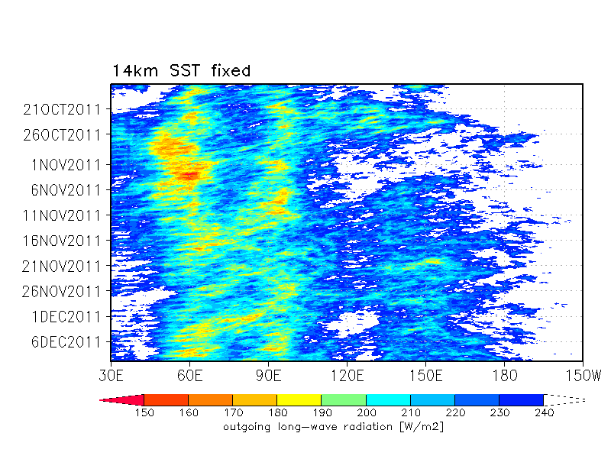
Sensitivity to SST (Fixed SST)
Realistic SST
SST fixed on 2011-10-12
Convection stays in the Indian Ocean.
No propagation to the maritime continents.
  (This result might be consistent with Fu et al. 2013.)
Temporal change in SST could be important to allow more power for the eastward moving signal.

Slide 20
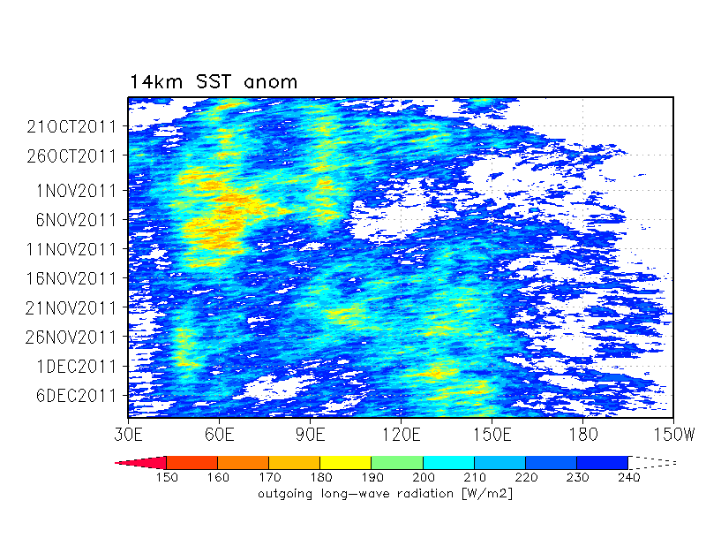
Sensitivity to SST (initial anomaly)
Climatological SST (Oct., Nov., and Dec.)
+ SST anomaly on 2011-10-12
Realistic SST
The eastward shift is recovered partly.
The shift of the convective center in late November may be partially helped by the seasonal cycle of SST.

Slide 21
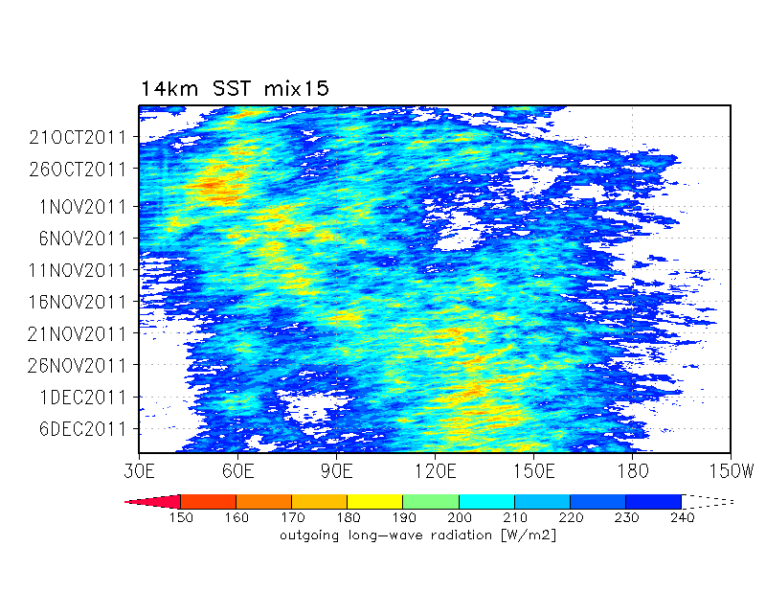
Sensitivity to SST (mixed layer)
Climatological SST (Oct., Nov., and Dec.)
+ SST anomaly on 2011-10-12
+ ocean mixed layer (15 m)
(ref. Maloney and Sobel 2004)
Realistic SST
The western Indian Ocean and the maritime continents are “connected”.
Strong and stationary convection in the western Indian Ocean is diffused.
Only one big eastward moving packet.

Slide 22
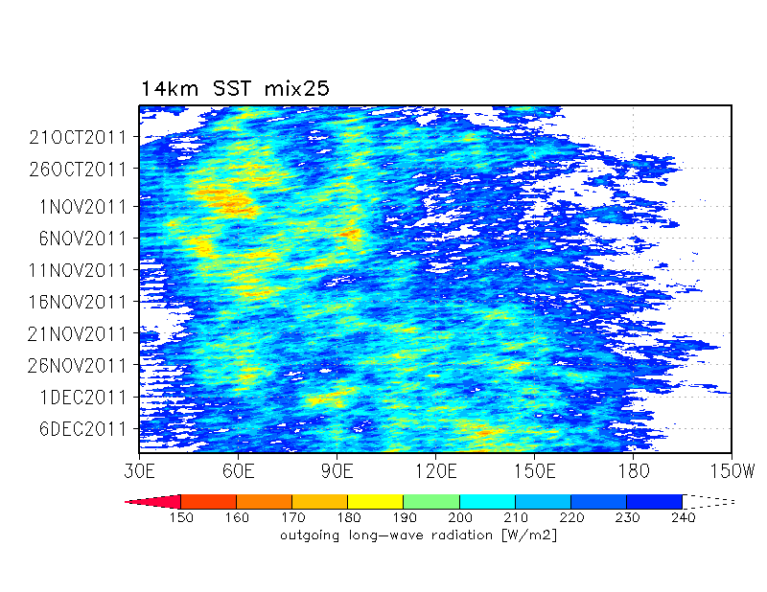
Sensitivity to SST (mixed layer)
Climatological SST (Oct., Nov., and Dec.)
+ SST anomaly on 2011-10-12
+ ocean mixed layer (25 m)
(ref. Maloney and Sobel 2004)
Realistic SST
?
Several eastward moving signals appear.
  MJO-1 is the best among the 14-km ensembles.
Does the ocean mixed layer add an inertia to disperse the eastward movement?

Slide 23
Summary
Miura, Maeda, and Kimoto (2012,SOLA)
Entrainment rate switches eastward/westward movement of MJO in MIROC5.
MJO-1 and MJO-2 in CINDY/DYNAMO were simulated marginally.
But, initiation of MJO-2 was about 5 days earlier than observed.
(So, the simulation may be useless as a “prediction”.)
RMM plot was not good due to the persistent unrealistically strong convection in the Indian Ocean or the Western Pacific.
We could not recover realistic MJO-2 with idealized SSTs.
But, it seemed that gross behavior of MJO-2 (e.g. initiation, eastward shift) could be reproduced without details in SST evolution.
The initial atmospheric and oceanic conditions (hopefully) include sufficient information to “predict” MJO-2.
A realistic atmosphere-ocean coupling (and its proper initialization) would help the seasonal prediction of MJO of global CRMs.

