Slide 1
Process-oriented model diagnostics based on the moisture and MSE budgets
Eric D. Maloney
Walter Hannah, Brandon Wolding, Jim Benedict
Colorado State University
Others contributors: Adam Sobel, Dargan Frierson, Daehyun Kim
Sponsors: NSF Climate and Large-Scale Dynamics
NOAA MAPP

Slide 2
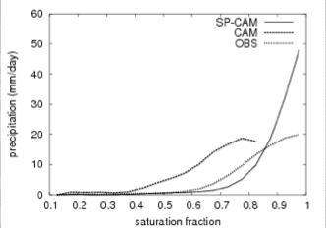
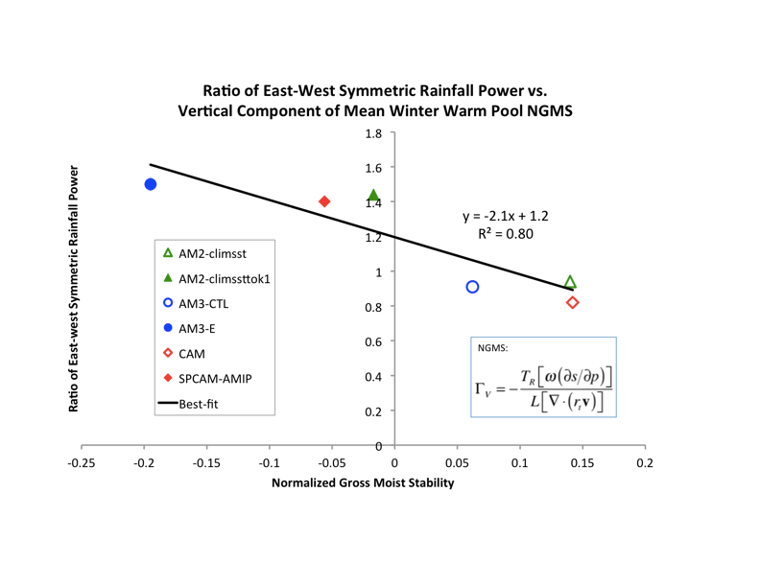
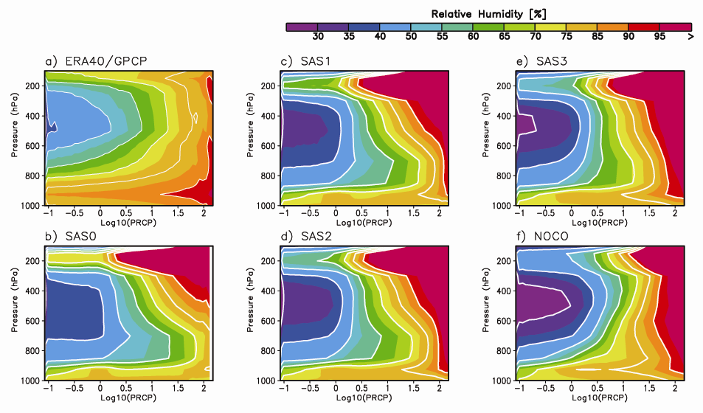
WGNE MJO Task Force Subproject: Process-Oriented Diagnostics
Zhu et al 2010
Exploring Diagnostics/Metrics that provide more insight into why a model may have a good/poor MJO
Facilitate improvements in convective and other physical parameterizations relevant to the MJO.
Hannah and Maloney 2011; Benedict et al. 2013
Thayer-Calder and Randall 2009; Kim et al 2009

Slide 3
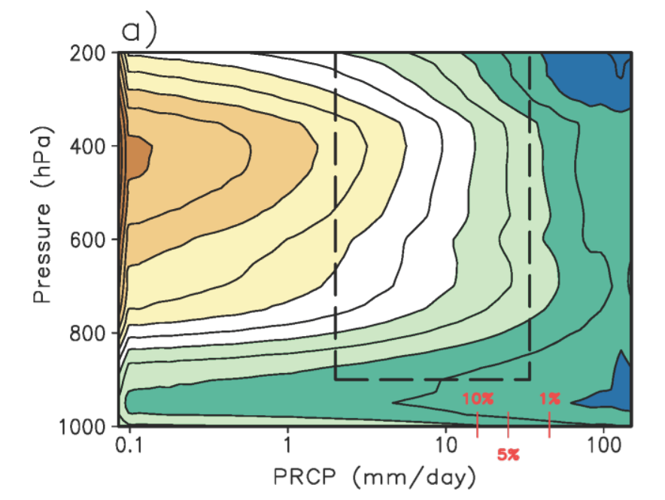
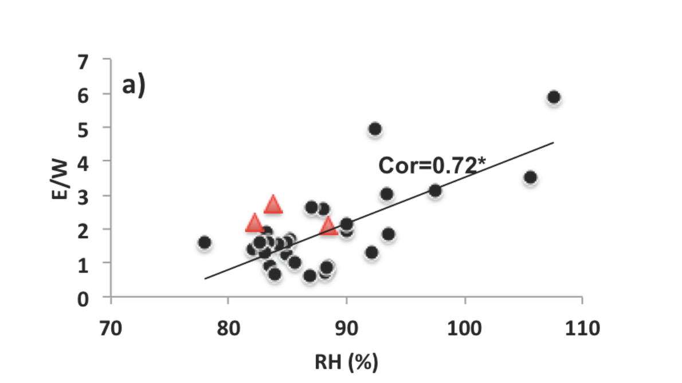

Applying a RCP (Relative humidity Composites as a function of Precipitation) diagnostic to a subset of CMIP3 and CMIP5 models
ERA-I RH Composite
A metric is derived from the RCP diagnostic by using the lower-tropospheric (850-500hPa) mean RH for upper 1% of rain events and the east-west precipitation power ratio in the MJO band.
This scatter plot shows the good relationship between this metric and model’s MJO strength.
Thayer-Calder and Randall (2009)
Kim et al. (2014)

Slide 4
Vertically-Integrated MSE Budget Becomes a Moisture Equation Under WTG Balance
For weak tropical temperature gradients (WTG):
The vertical advection term (plus radiative heating) implicitly accounts for the cancelation of vertical moisture advection and condensational drying.
Vertically-integrated MSE budget thus becomes a convenient way of diagnosing and modeling MJO dynamics, assuming MJO is regulated by WTG theory and resembles a moisture mode
s=dry static energy
m=moist static energy
LE= Latent heat flux
SH=sensible heat flux
R= radiative heating

Slide 5
We Initially Study Three Model Pairs with Both a Good and Bad MJO
GFDL AM2-CTL and AM2-Tokioka
GFDL AM3-CTL and modified AM3
NCAR CAM3 and SP-CAM
Benedict et al. (2014)

Slide 6
We Initially Study Three Model Pairs with Both a Good and Bad MJO
GFDL AM2-CTL and AM2-Tokioka
GFDL AM3-CTL and modified AM3
NCAR CAM3 and SP-CAM
Models with better MJO import energy by vertical advection
Benedict et al. (2014)
Boreal winter Indo-Pacific warm pool
30ºE
150ºE
210ºE

Slide 7
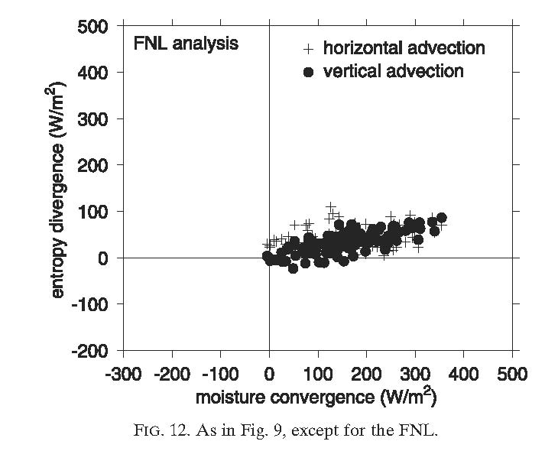
Column-Integrated MSE (or Entropy) Export Binned by Some Measure of Convective Activity
Analysis from (older) NCEP forecast model, which produced poor MJO activity
X-axis is some measure of convective activity, in this case vertically-integrated moisture convergence, for a convective region of the tropical west Pacific (could be precip or mass flux)
Export due to vertical MSE or entropy advection (y-axis) implicitly includes sum of vertical moisture advection and drying due to precipitation
In GFS, for positive column-integrated moisture convergence, MSE export due to vertical advection is positive even for periods of modest convergence
Raymond and Fuchs (2009) argue that negative gross moist stability may be needed for successful MJO simulation
Integrated MSE Export (W m⁻²)
Raymond and Fuchs (2009)

Slide 8
The Advection Terms Can Be Rewritten by Normalizing by Convective Activity
Normalize by convective activity C
C might be: vertically integrated moisture convergence or dry static energy export, mass flux, precipitation, etc..
Γ_{v} and Γ_{h} (and sometimes combined)are typically referred to as the vertical and horizontal components of “gross moist stability (GMS)”, or the efficiency of moist static energy discharge from the column (per unit convective activity).
If the moisture anomaly associated with the MJO were to survive, we would want GMS to be low or negative, making convective inefficient at discharging moisture from the column

Slide 9
Vertical Component of GMS (Γ_{v}) As a Function of Precipitation
Low Min. Entrainment
Hannah and Maloney (2011)
High Min. Entrainment
Two versions of CAM3/RAS with different strength Tokioka minimum entrainment parameters (strong and weak).
GMS significantly lower in model with higher minimum entrainment

Slide 10
Vertical Component of GMS (Γ_{v}) Versus
Model MJO Skill
Benedict et al. (2014)
Three sets of good-bad MJO model pairs, 10 yr simulations.
Models with “good” MJOs have low to negative GMS.
ERA-I has GMS of about 0.025 and E-W ratio of 2.5.

Slide 11
Vertical Component of GMS (Γ_{v}) Versus
Boreal Summer East Pacific Leading Mode Amplitude
Leading complex EOF mode
Maloney et al. (2014)
Models have significant spread of leading mode amplitudes
VGMS lower in models with stronger variability.

Slide 12

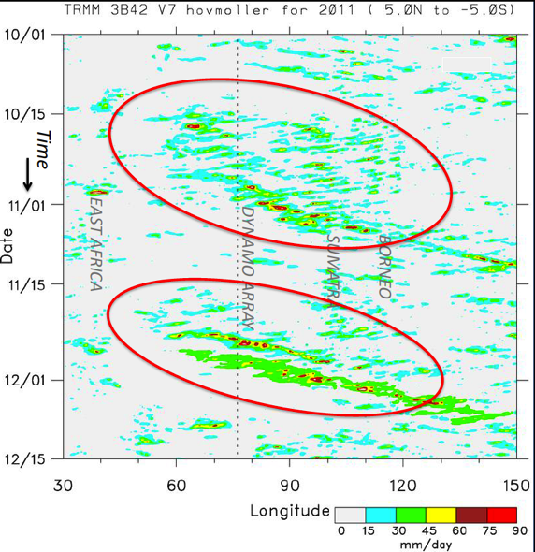
Hindcasts During DYNAMO Period

Slide 13
CAM5 Hindcast setup
CESM 1.0.4
  FV dynamical core
  0.9° x 1.25° horizontal resolution
  30 vertical levels
  MG microphysics (Morrison and Gettelman 2008)
  UW shallow convection scheme (Park and Bretherton 2009a)
  UW moist turbulence scheme (Park and Bretherton 2009b)
  ZM deep convection w/dilute CAPE (Zhang and McFarlane 1995, Neale et al. 2008)
Hindcast
  Initial conditions created from ECMWF operational analysis
  Simulations lasted 20-days starting
  every 5th day from 01 Oct – 15 Dec, 2011
  3 configurations were used with different
  values of entrainment used in the
  dilute CAPE calculation (e.g. see Klein et al. 2012)
Simulation | Entrainment [km⁻¹]
ZM_0.2 | 0.2
ZM_1.0 | 1.0
ZM_2.0 | 2.0

Slide 14
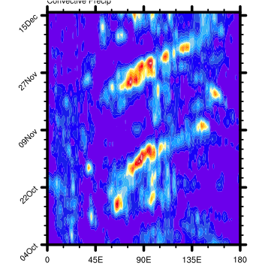
Forecasts at One-Week Lead Time
Hannah and Maloney (2014)
TRMM
Highest Entrainment
Default
Lowest Entrainment
lower entrainment leads to less coherent precipitation variability and weaker MJO amplitude at longer lead times
Stronger MSE anomalies maintained in the higher entrainment runs as well

Slide 15
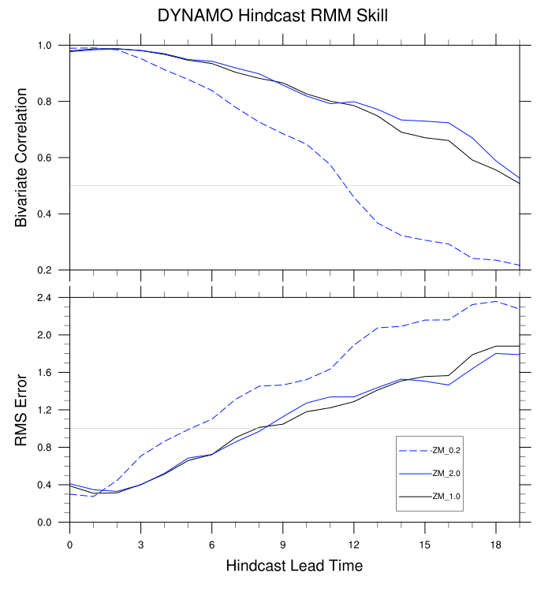
Higher Entrainment=Better Skill
Higher Entrainment
Lower Entrainment
Lowering the entrainment parameter has a dramatic effect on RMM skill scores
The models skill saturates at larger entrainment values
Hannah and Maloney (2014)

Slide 16
Mean GMS vs. Standard
Deviation of MSE
The mean VGMS over the equatorial Indian Ocean shows a systematic reduction as entrainment is enhanced, which follows the improvement of the MJO amplitude
However, the value of VGMS is unrealistic.
Effective VGMS however that includes radiative feedbacks is commensurate between models and obs.
Γ_{h}
Γ_{v}
Hannah and Maloney (2014)

Slide 17
Radiative Feedbacks in CAM5 Too Weak
Too severe a reduction in VGMS compensates for radiative feedbacks in CAM5 that are too weak in all simulations
Similar to result recently found by Daehyun Kim
Hannah and Maloney (2014)

Slide 18
Relationship Between MSE and Moistures Under WTG
Under WTG the vertical MSE advection can be rewritten:
Hence, under WTG effective VGMS provides measure of the cancellation of condensational drying and vertical moisture advection.

Slide 19
How Well Does it Work?
ERA-I: Indian Ocean (20-100 day anomalies)
r=0.7
Wolding (2014)

Slide 20
Vertical Advection Exceeds Precipitation on Intraseasonal Timescales
ERA-I: Indian Ocean
a=-0.13
Drying
Moistening
Wolding (2014)

Slide 21
Budget Terms Relative to
Maximum Humidity (ERA-I)
-180º
0º
180º
60º
120º
180º
240º
Residual

Slide 22
Conclusions
We have been developing process-oriented model diagnostics based on the moist static energy budget. Can be applied successfully in hindcast mode.
Models producing better MJO activity have lower gross moist stability, meaning convection and associated divergent circulations are less efficient at discharging moisture from the column
The vertical component of GMS is often too low for good MJO models, which might explain their mean state biases, as increased horizontal advection appears to compensate. Might compensate for too weak of diabatic feedbacks

Slide 23
Thanks

Slide 24
Initial Calculation of GMS
Hannah and
Maloney (2014)

Slide 25
Calculation of GMS
Hannah and Maloney (2014)

Slide 26
Reasons for GMS Diff.
Hannah and Maloney (2014)

Slide 27
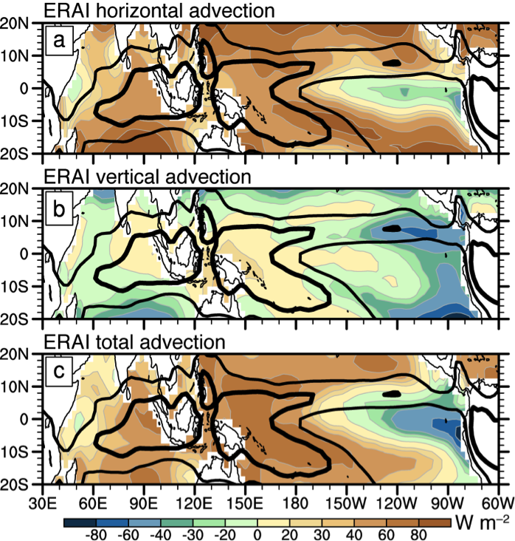
ERA-I Mean Moist Static Energy Advection
Vertical advection weakly exports energy in the Indo-Pacific warm pool in ERA-I
Horizontal advection is a stronger discharge term
Benedict et al. (2014)

Slide 28
Weak Temperature Gradient Theory
Major thermodynamic balance at sufficiently long timescales:
Under such conditions, gravity wave solutions are not admitted.
Modes are admitted in which the dynamics are strongly regulated by processes that control the growth and propagation of moisture (and convection) anomalies (e.g. Sobel et al. 2001; Raymond et al. 2009; i.e. moisture modes)
Convection only occurs where the troposphere is moist, and resulting convection regulates the vorticity and divergence fields through the mandated WTG thermodynamic balance
The diagnosis of the tropical atmosphere in such a framework is typically done with the vertically-integrated moist static energy budget
Q=diabatic heating
s= dry static energy

Slide 29
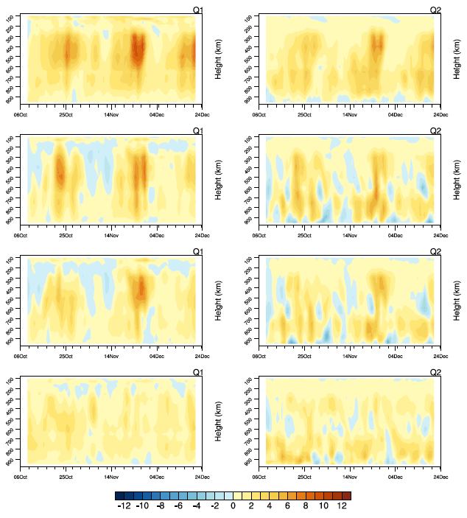
Q₁/Q₂ at One-Week Lead Time
Q₁
Q₂
ERA-I
High
entrainment
Default
Low
entrainment

Slide 30
Standard Deviation of GMS vs. Standard Deviation of MSE
The standard deviation of both HGMS and VGMS increases with increased entrainment, but is much larger than reanalysis
σΓ_{h}
σΓ_{v}
5-9 day lead only

Slide 31
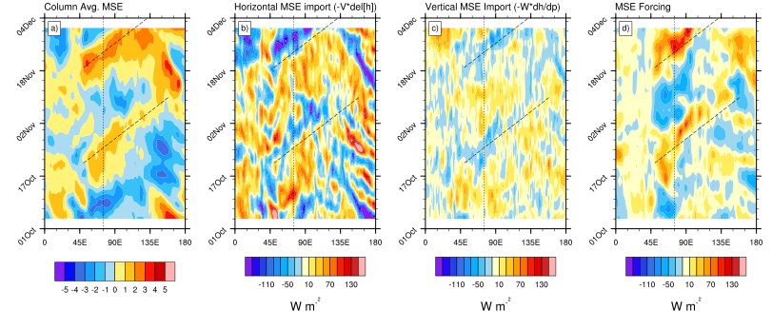
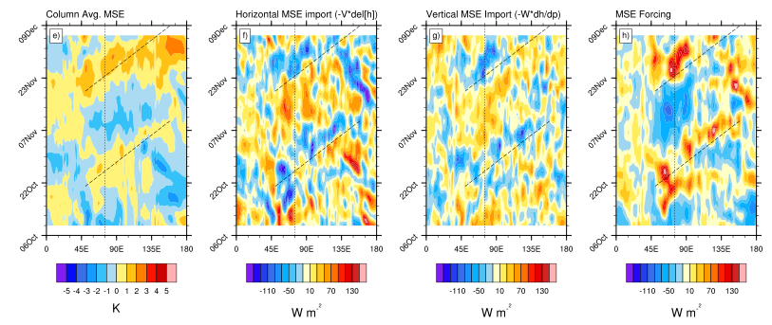
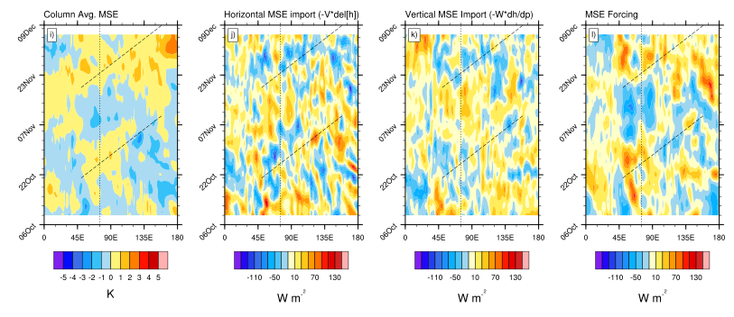
Higher Entrainment Runs are Able to Maintain Stronger MSE Anomalies
ERAi
ZM_1.0
ZM_0.2
At leads of 5-9 days,
all tendencies are weaker with lower entrainment
5-9 day Hindcast lead times

Slide 32
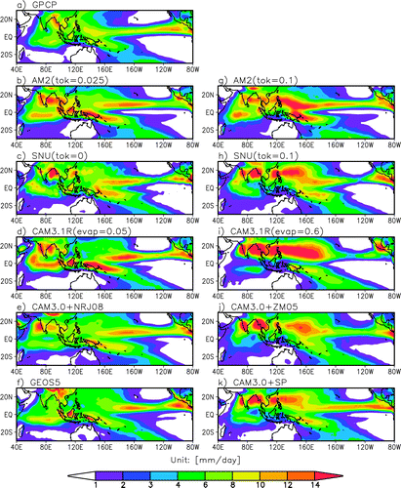
Kim et al. (2011)

Slide 33
MJO TF Subproject: Process-Oriented Diagnostics/Metrics
Zhu et al 2010
Exploring Diagnostics/Metrics that provide more insight into why a model may have a good/poor MJO
Facilitate improvements in convective and other physical parameterizations relevant to the MJO.
Hannah and Maloney 2011; Benedict et al. 2013
Thayer-Calder and Randall 2009; Kim et al 2009

Slide 34
Vertical and Horizontal Advection Versus Precipitation Rate
Benedict et al. (2013)

Slide 35
Weak Temperature Gradient Theory
Major thermodynamic balance at sufficiently long timescales:
Under such conditions, gravity wave solutions are not admitted.
Modes are admitted in which the dynamics are strongly regulated by processes that control the growth and propagation of moisture (and convection) anomalies (e.g. Raymond 2001; Sobel et al. 2001; Raymond et al. 2009; i.e. moisture modes)
Convection only occurs where the troposphere is moist, and resulting convection regulates the vorticity and divergence fields through the mandated WTG thermodynamic balance
The diagnosis of the tropical atmosphere in such a framework is typically done with the vertically-integrated moist static energy budget
Q=diabatic heating
s= dry static energy

