Slide 1
The GCMs with Implicit and Explicit cloud-rain processes for simulation of extreme precipitation frequency
In-Sik Kang and Young-Min Yang
Seoul National University

Slide 2
Content
Conventional GCM precipitation processes
Precipitation processes in a Cloud Resolving Model (CRM)
The GCM with cloud microphysics
All results with AGCM
50km horizontal resolution
Annual mean

Slide 3
Conventional GCM precipitation processes
Convective rain (sub-grid scale)
Convective parameterization based on a quasi equilibrium condition
2. Large-scale condensation (grid scale)
- Function of relative humidity with auto-conversion time scale
Convective rain
Large-scale condensation
$$l_{u}=q_{u}−q_{cv}$$
Cloud water, l_{u}
Condensation (${\overline{q}+q}^{′}>q_{s}$)
T>0
T<0
$$Precipiation rate:R(z)$$
Convective adjustment
Time scale
Cloud water
Cloud ice
Auto-
conversion
Time scale
Falling down
Without
Time scale
Precipitation
Precipitation

Slide 4
TRMM
Annual mean
(50km)
precipitation
BULK scheme without triggering
BULK scheme with triggering (w_{cb} > 0.2 m s⁻¹)
Ratio of convective to total precipitation
No convective parameterization (NOCONV)
Ratio of convective to total precipitation

Slide 5
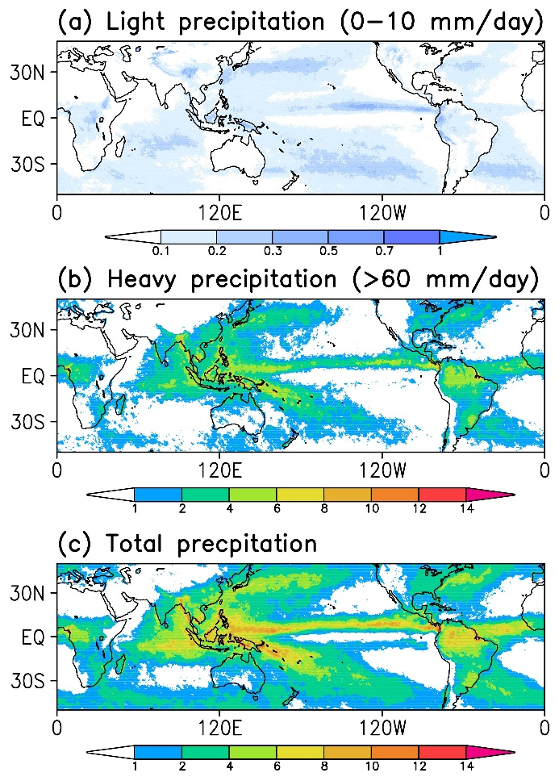
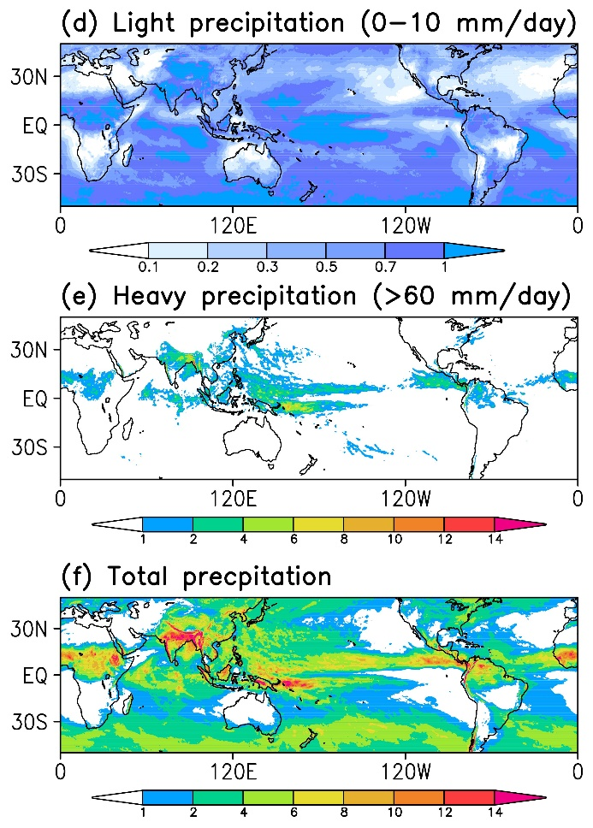
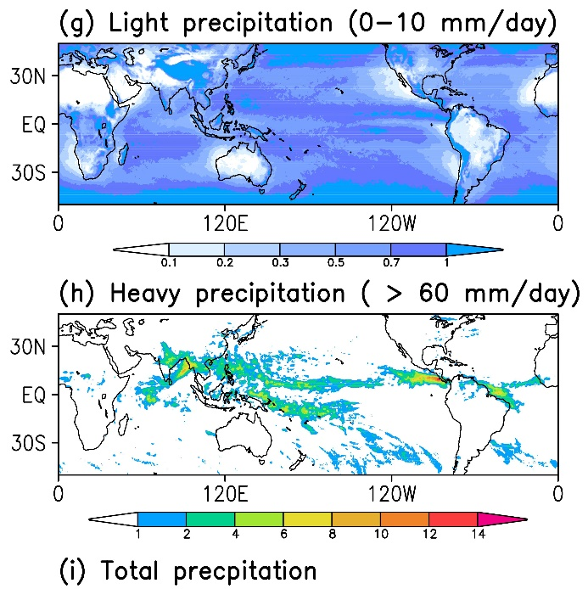
Global distribution of 3-hourly light & heavy precipitation
TRMM
BULK+LSC
NOCONV

Slide 6
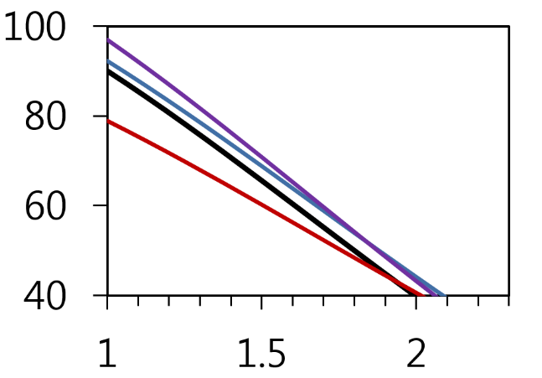
Frequency of 3-hourly precipitation
TRMM
BULK_Original
BULK_Triggering
No convection

Slide 7
Precipitation processes in a cloud resolving model (CRM)
CRM experiments
Goddard Cumulus Ensemble (Tao et al. 1993)
Two-dimensional model with cyclic boundary conditions
1km horizontal resolution with 41 vertical level and 256km domain size
TOGA-COARE forcing data

Slide 8
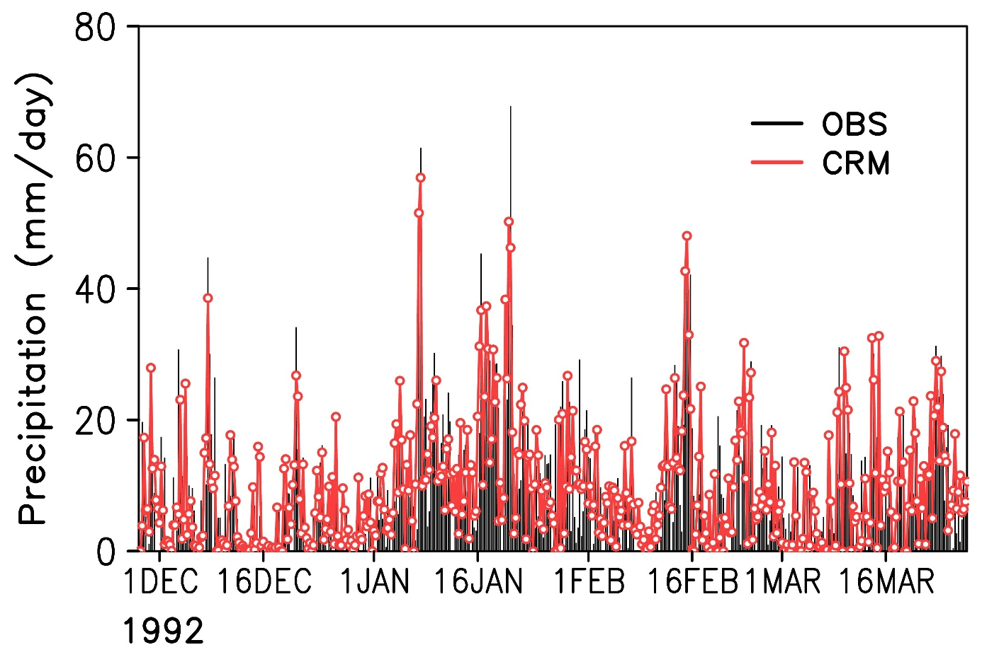
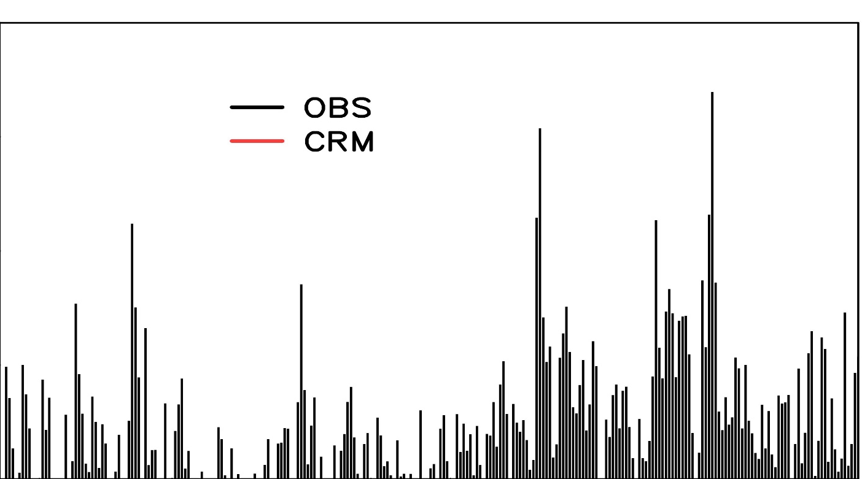
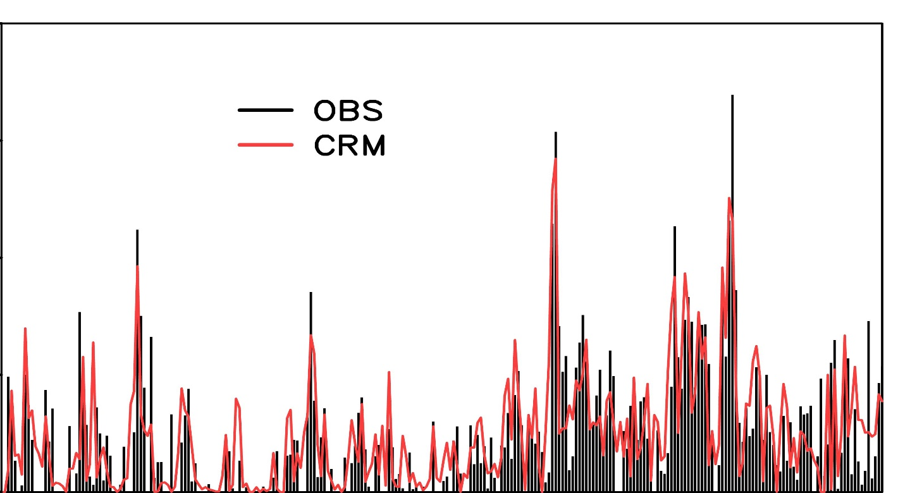
Precipitation – CRM vs. OBS
6-hour mean precipitation (mm day⁻¹)
Goddard Cumulus Ensemble model (Tao et al. 1993) simulation with TOGA-COARE forcing for boreal winter

Slide 9
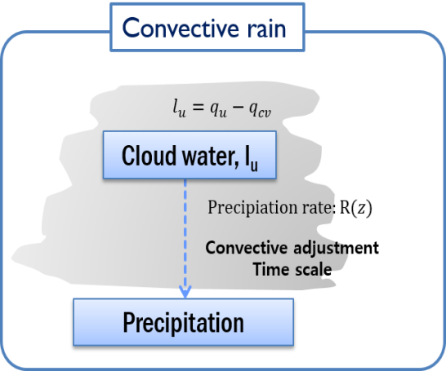
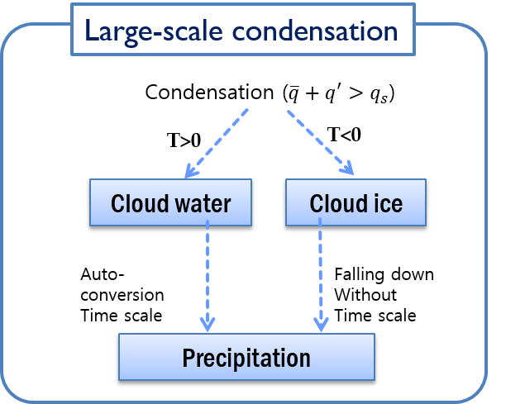
CRM Microphysics
Cloud Microphysics
AGCM parameterization
Condensation
Deposition
Freezing
Cloud water
Cloud ice
Accretion
Accretion
Accretion
Snow
Rain
Melting
Graupel
Precipitation

Slide 10
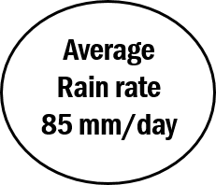
Budget of microphysical processes
(a)Light precipitation ( 0 – 10 mm day⁻¹)
<Unit>
Cloud species : g/g
Processes : g/g/s
(b) Heavy precipitation ( > 60 mm day⁻¹)

Slide 11
Relationship between precipitation and graupel
Rainfall vs. Accretion of cloud water to graupel
Rainfall vs. Graupel

Slide 12
The GCM with cloud microphysics

Slide 13
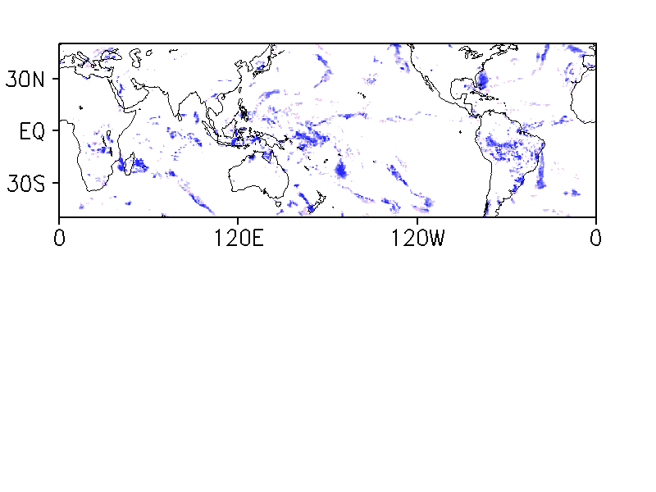
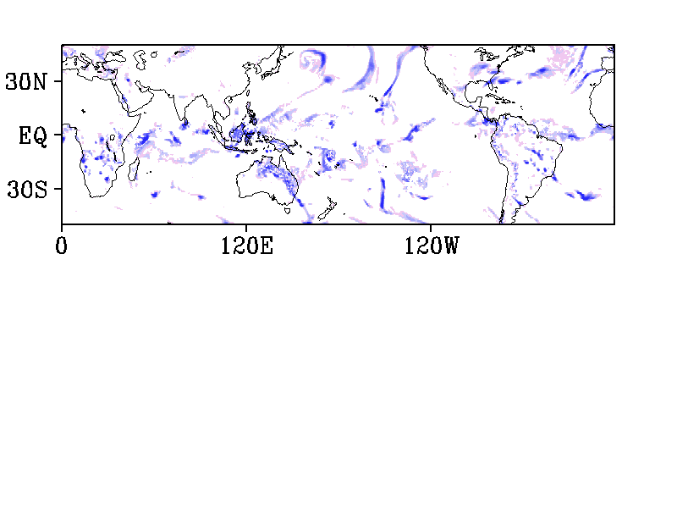
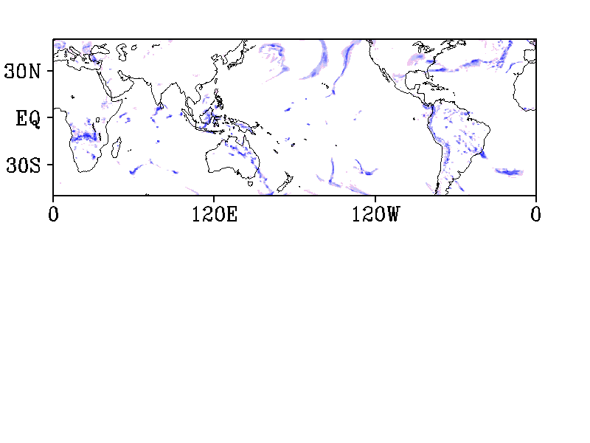
GCM simulation with cloud microphysics (50km, 수정필요)
Annual mean precipitation
Animation of 3hourly precipitation
TRMM
TRMM
GCM with parameterizations
GCM with parameterization
GCM with microphysics
GCM with microphysics

Slide 14
Modification of cloud microphysics
Less condensation due to relatively coarse horizontal resolution (50km)
=> Modification of condensation process by using the parameterization used
in the large-scale condensation scheme (Le Treut and Li 1991)
2. Insufficient accretion due to weak vertical motion
=> Decrease of the terminal velocity of cloud hydrometers (Satoh and Matsuda 2009)
GCM with microphysics
TRMM
GCM with Modified microphysics

Slide 15
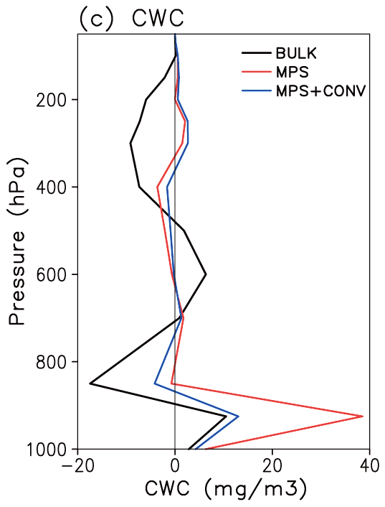
Biases of vertical structure of cloud water
Adding vertical mixing
Diffusion type of convective scheme
Too excessive
cloud water

Slide 16
Annual mean precipitation
TRMM
Modified Microphysics
Modified Microphysics + Convection

Slide 17
Frequency of 3-hourly precipitation

Slide 18
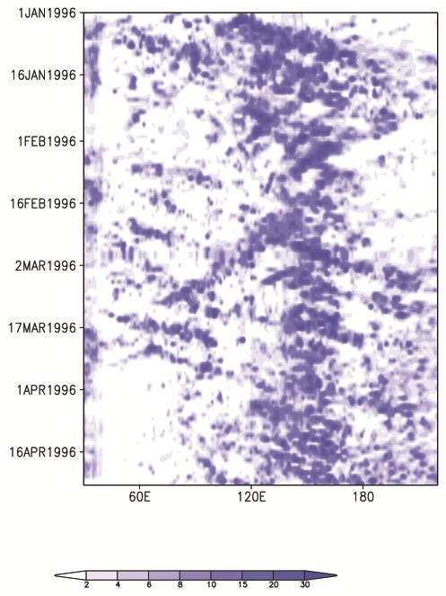
Hovmuller diagram of daily mean precipitation (10°S-10°N)
TRMM
Parameterization
Modified microphysics
and convection

Slide 19
Summary
GCM requires
Cloud Microphysics for
Simulation of heavy and extreme precipitation
Reasonably well
The GCMs with convective parameterization produce too much light rain but less heavy precipitation compared to the observed.
Graupel and Accretion are important hydro-meteor and hydor-process for heavy precipitation.

Slide 20
Thank you!

Slide 21
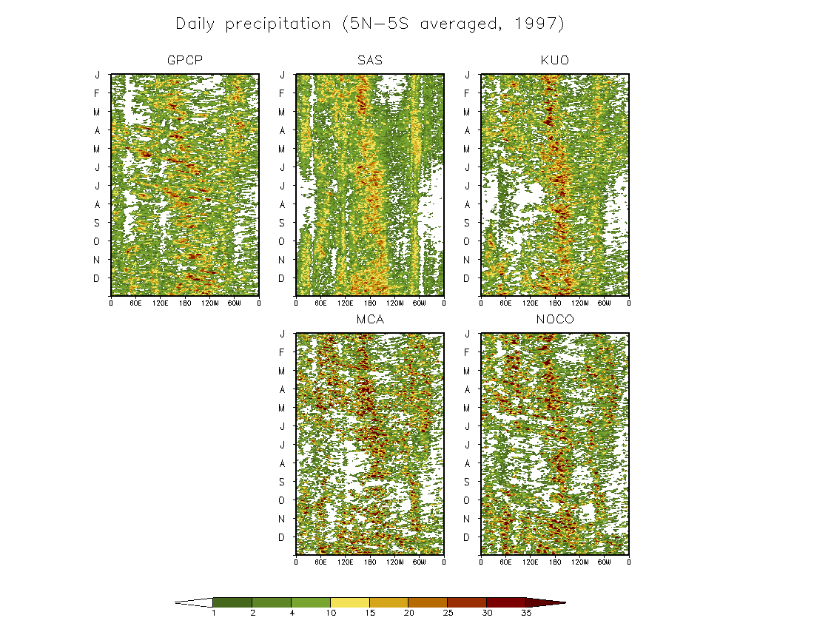
Hovmuller diagram of daily mean precipitation along the equator (5S-5N)
OBS
SAS
BULK
KUO
MCA
NOCONV
Convection scheme is
entirely turned off!!

Slide 22
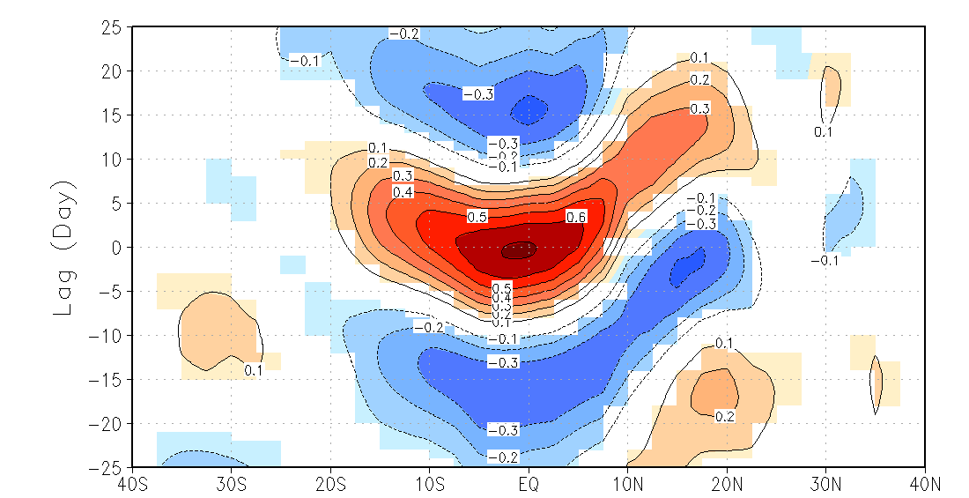
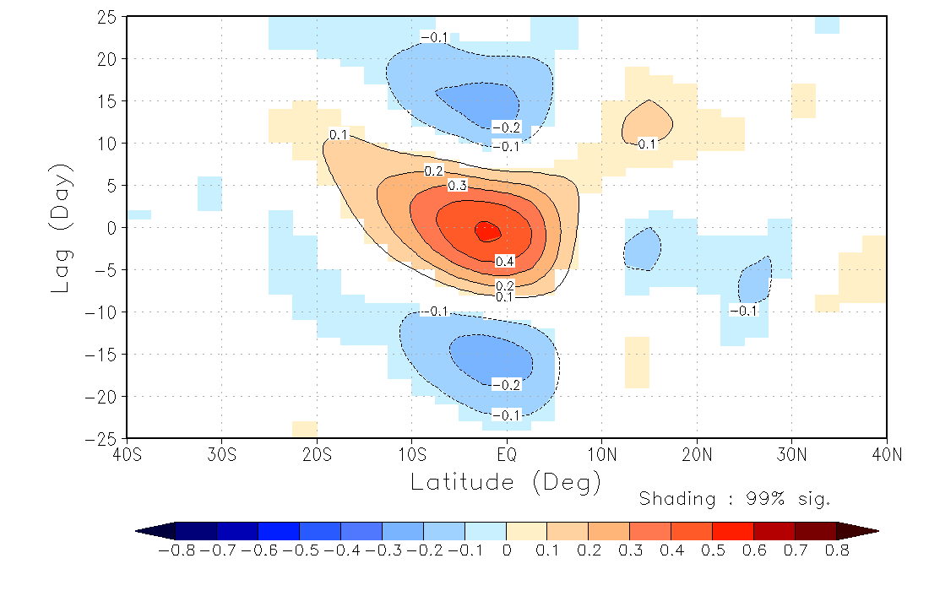
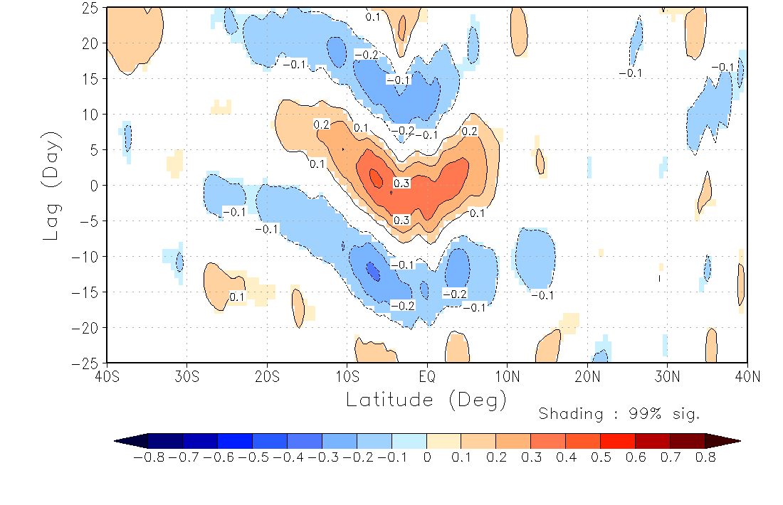
Northward propagation of daily mean precipitation
Lag correlation ( Indian ocean, May-October)
GPCP (20yrs)
Parameterization (6yrs)
Modified microphysics
and convection (6yrs)

Slide 23
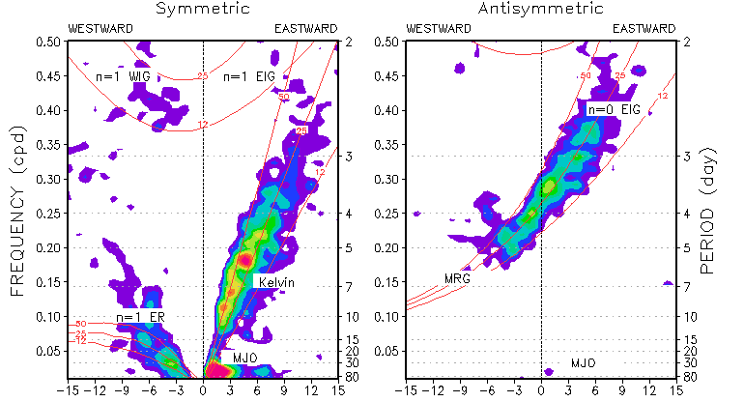
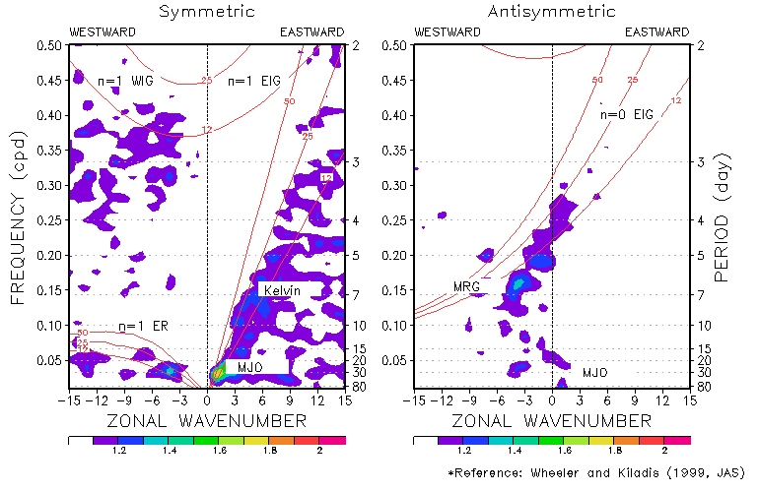
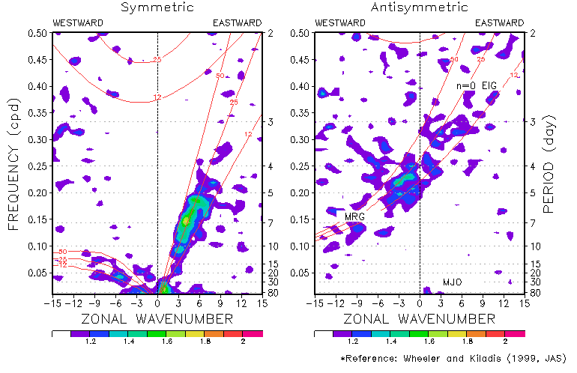
Wheeler-Kiladis diagram
GPCP (20yrs)
Modified microphysics
and convection (6yrs)
Parameterization (6yrs)

Slide 24
Wheeler-Kiladis diagram (1yr PRCP)
TRMM
parameterization
Modified microphysics
and convection

Slide 25
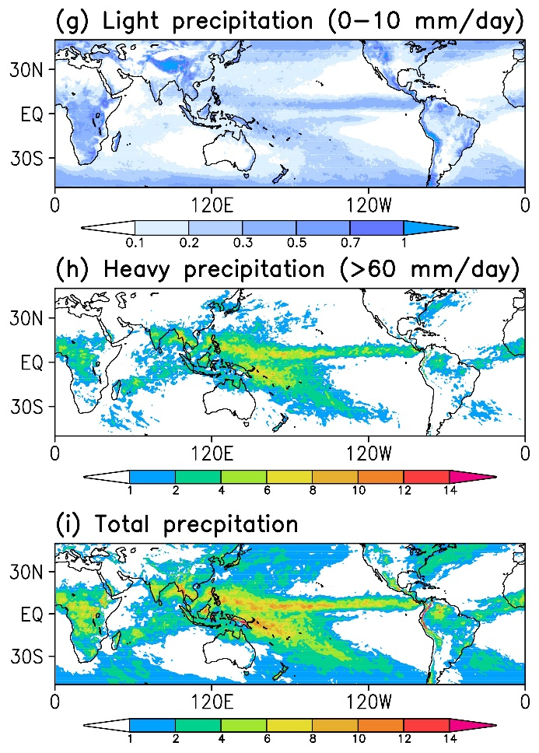
Global distribution of 3-hourly light & heavy precipitation
TRMM
BULK+LSC
Microphysics+
shallow convection

Slide 26
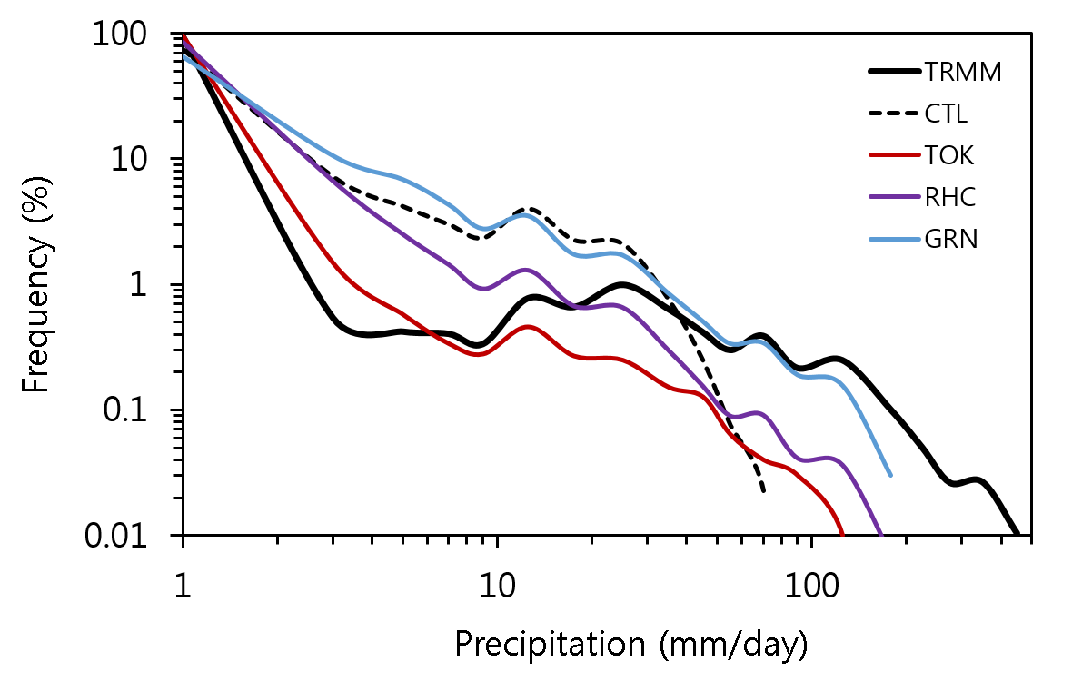
Frequency of 3-hourly precipitation
Notes:
Each modification was implemented in a climate model and integrated for 10year. This fugure show the precipitation frequency of each modified model. The black line is observation and black dashed line is original model. other color line shows the results of each climate model. All model partly improve heavy precipitate frequency but all model still do not produce extreme rainfall more than 200 mm /day

