Slide 1


The MJO Response to Warming in Two Super-Parameterized GCMs
Nathan Arnold^{1,2}
with Eli Tziperman¹, Zhiming Kuang¹,
David Randall² and Mark Branson²
¹ Harvard University, ² Colorado State University
Tropical Dynamics Workshop
January 14, 2014

Slide 2
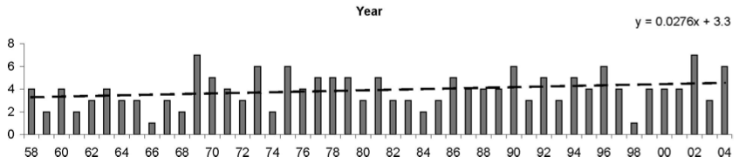
Historical MJO trends and Model Results
Weak positive long-term trends in Reanalysis products
Jones and Carvalho (2006), Oliver and Thompson (2012)
Statistical models applied to GCM projections predict MJO increase
Jones and Carvalho (2011)
Some GCMs with high SST or CO2 have shown increased MJO activity
Lee (1999), Caballero and Huber (2010), Liu et al (2012), Arnold et al. (2013), Subramanian et al. (2013)
…but little agreement among CMIP3 models on sign of change…
Takahashi et al. (2011)
…and MJO seems sensitive to spatial pattern of warming.
Maloney and Xie (2013)

Slide 3
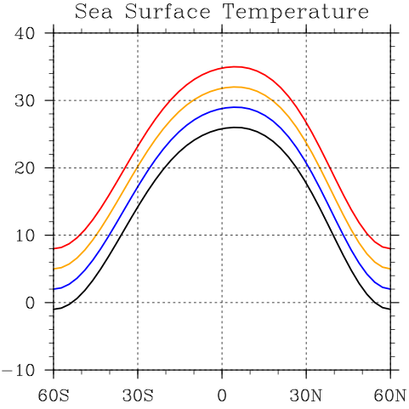
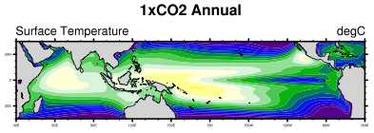
Super-Parameterized Warming Experiments
“SP-Aqua”
“SP-Terra”
Aquaplanet SP-CAM3.5, SL dycore
Prescribed zonally symmetric SST, peak offset to 5N.
SST increased in uniform 3K intervals
Horizontal resolution 2.8°,
30 vertical levels
Coupled runs with SP-CESM1.0.2,
FV dycore, CAM4 physics
Pre-industrial (1x) and quadrupled (4x) CO₂.
Horizontal resolution 1.9°x2.5°, 30 vertical levels
Spin up with CESM, then run with
SP for 10 years.
Sea Surface Temperature
35C
26C
In both cases: Embedded CRM is SAM6,
run with 32 4km columns oriented E-W.

Slide 4
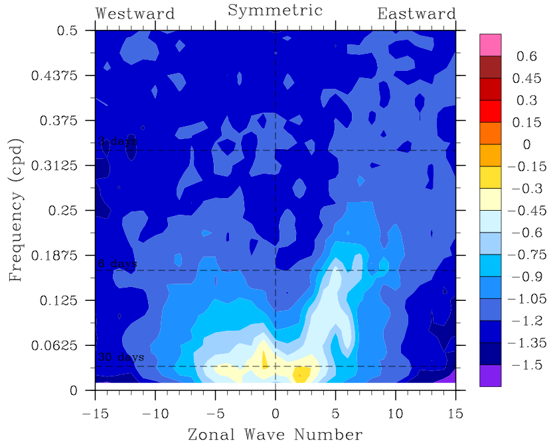
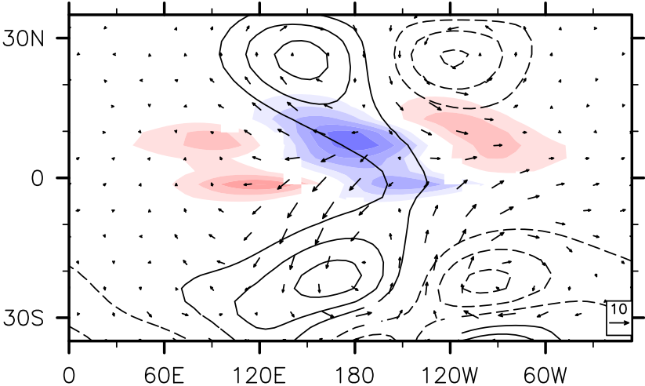
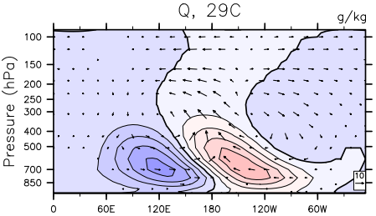

SP-Aqua: The MJO at low SST
26C
200hPa Z and Precip
Q cross section
Composites made by linear regression
against 20-100d, k=1-3 OLR.
Realistic precipitation spectrum,
horizontal and vertical structure.

Slide 5
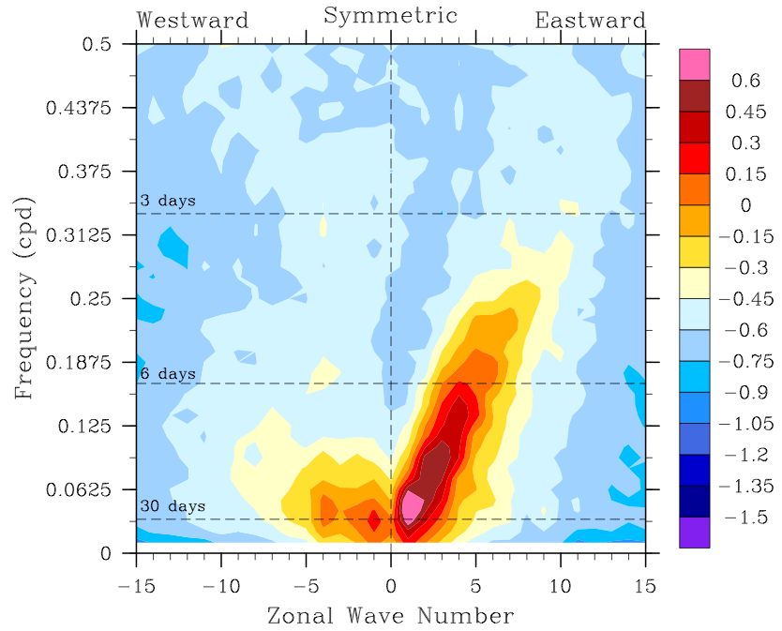
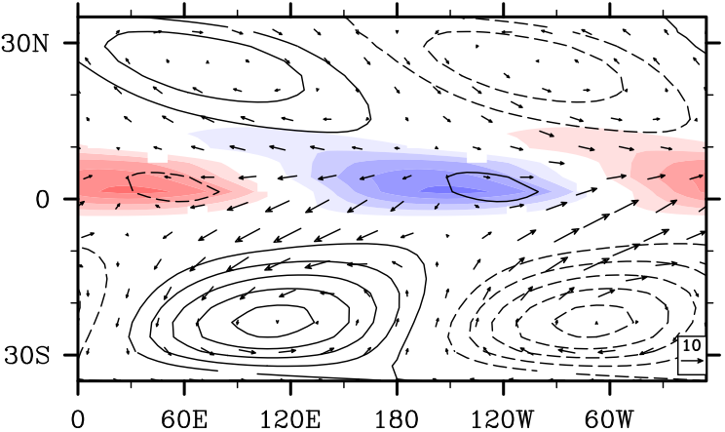
SP-Aqua: Increased MJO and KW activity at high SST
26C
35C
Precipitation
200hPa Z and Precip
Shift in peak from k=2 to k=1:
MJO has greater zonal extent

Slide 6
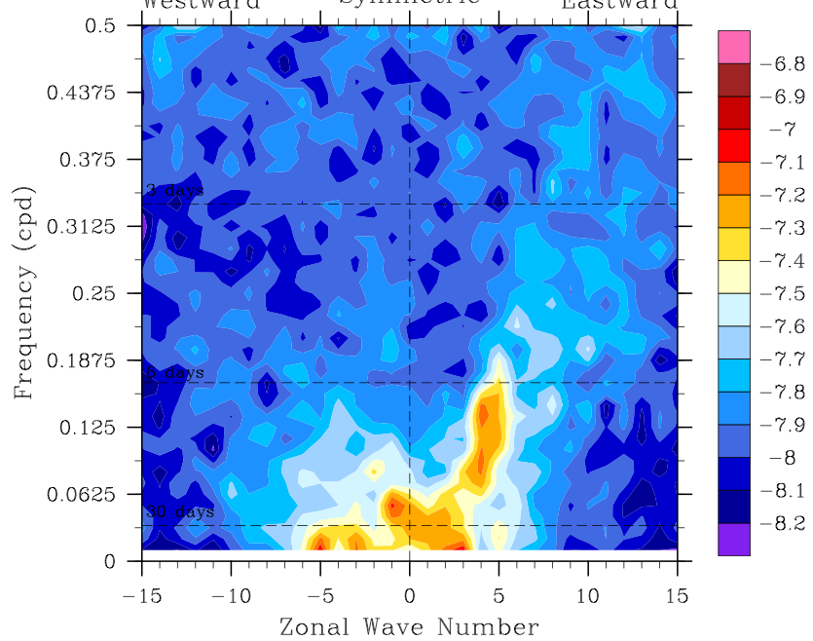
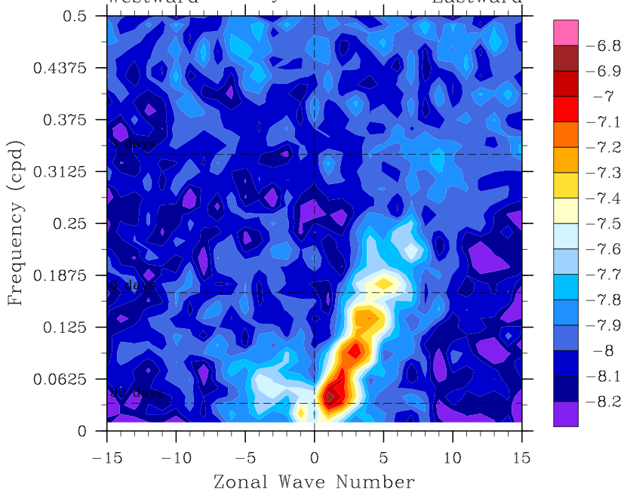
SP-Aqua: Increased MJO and KW activity at high SST
26C
35C
Precipitation
Convective mass flux
MJO increase distinct from background!

Slide 7
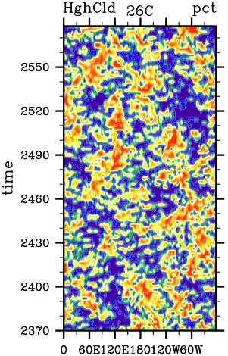
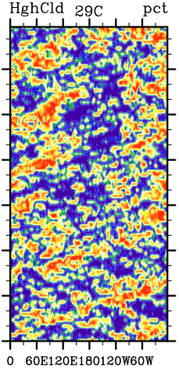
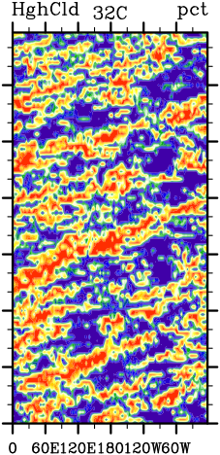
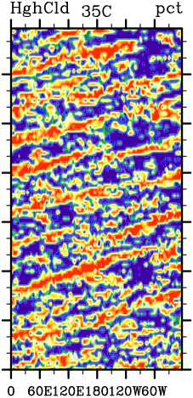
SP-Aqua: Increasingly organized high cloud fraction with higher SST
26C
29C
32C
35C
time (days)
longitude
longitude
longitude
longitude

Slide 8
SP-Aqua: Increasingly organized high cloud fraction with higher SST
26C
29C
32C
35C
time (days)
10m/s
8m/s
13m/s
longitude
longitude
longitude
longitude
Modest increases in eastward propagation speed

Slide 9
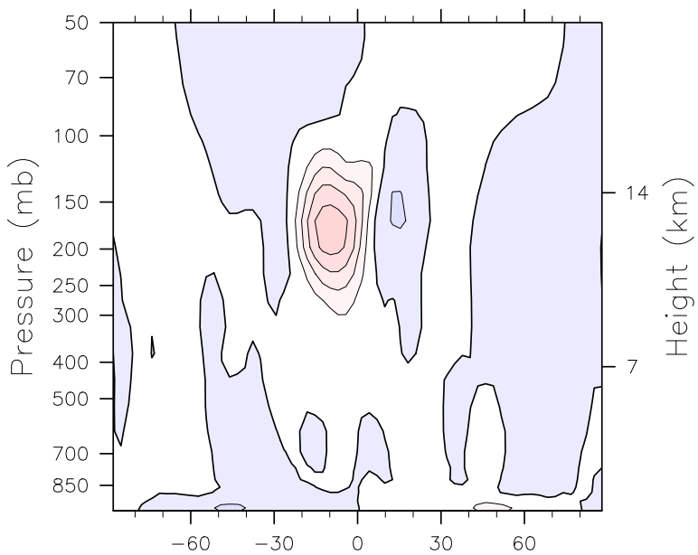
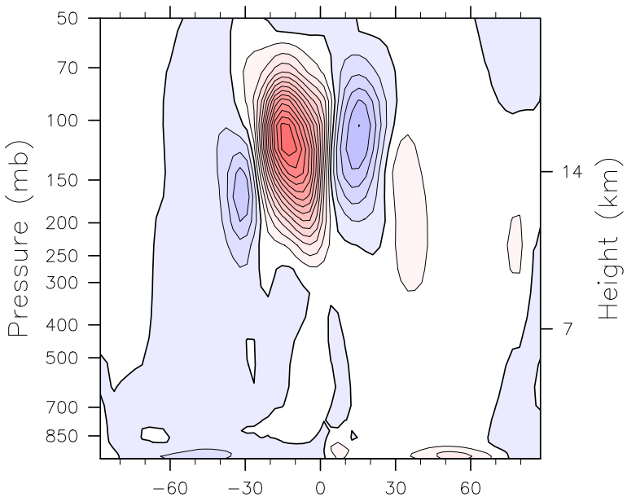

Enhanced momentum convergence leads to equatorial westerlies
Eddy momentum flux,
k=1-3, P=20-100d
26°C
Equatorial Zonal Wind
35°C

Slide 10
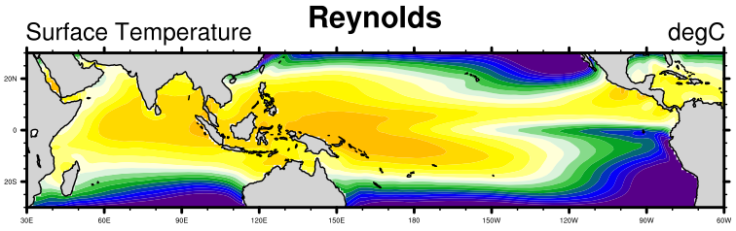
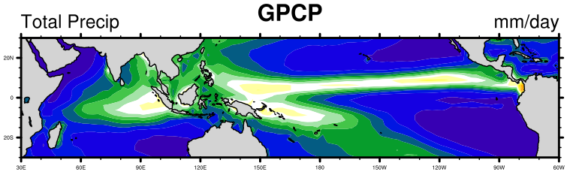
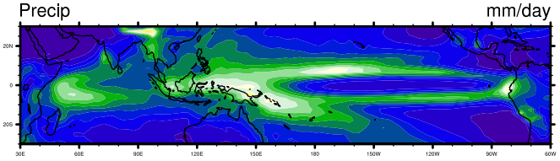
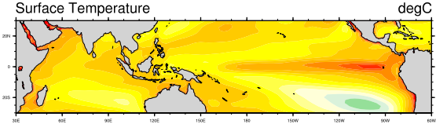
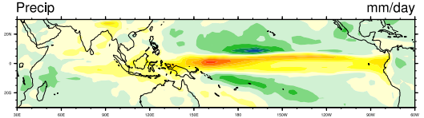
SP-Terra mean state
SST
1xCO₂
Precip
1xCO₂
1C tropical-mean cool bias.
Double ITCZ, shifted IO precip.
SST
Difference (4x – 1x)
Precip
Difference (4x – 1x)
4C average tropical warming,
enhanced around cold tongue.
Precip increase along ITCZ.

Slide 11
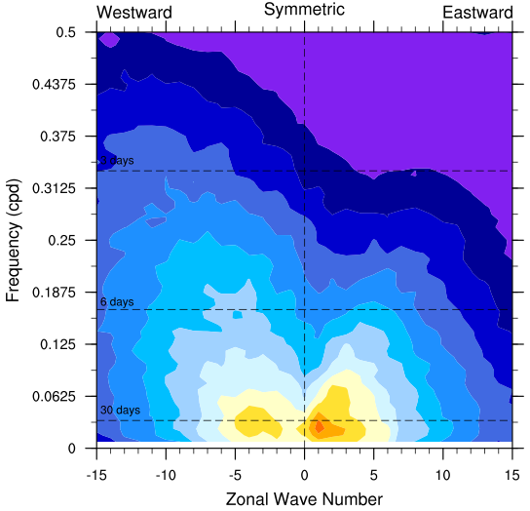
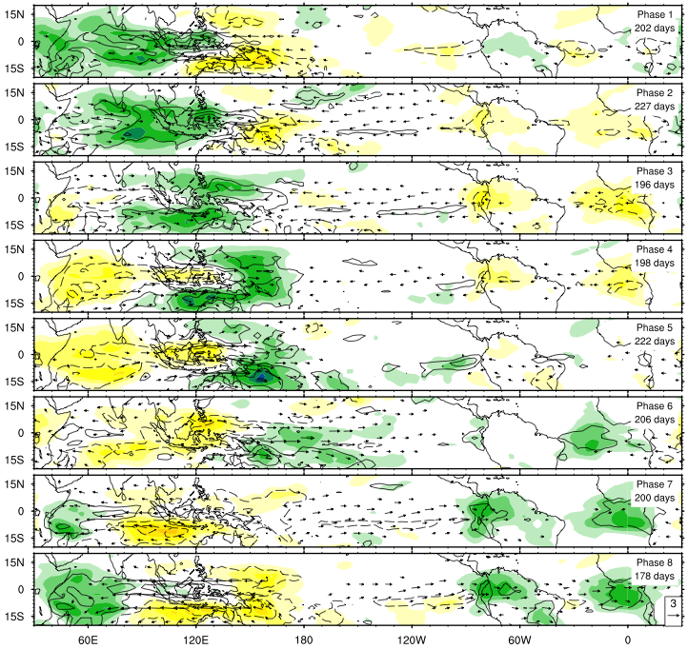
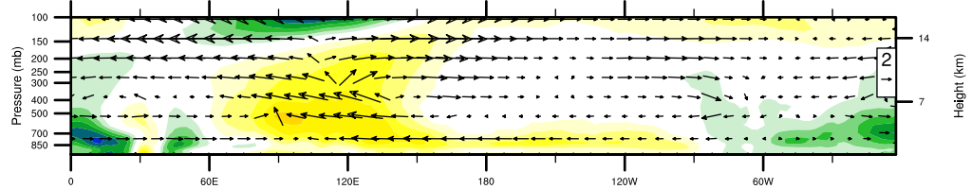
Composite OLR Anomalies
(Nov-Apr, following WH04)
SP-Terra: The MJO at 1xCO₂
OLR Eqtr Spectrum
MSE Anomaly, phase 2
Longitude
Longitude
Realistic eastward propagation, spectral peak, vertical structure.

Slide 12
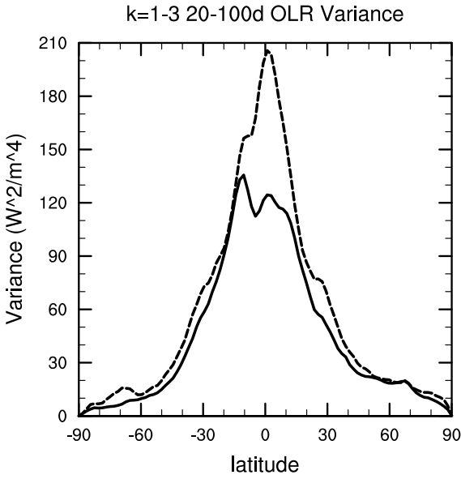
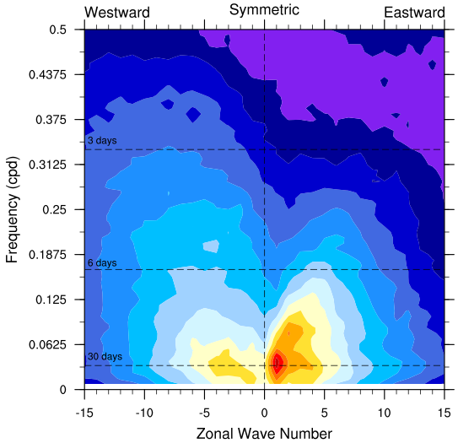

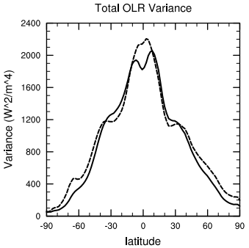
Increase in MJO variance, distinct from total
k=1-3 OLR ISV
1xCO2
4xCO2
Total OLR Variance
Wavenumber 1-3 OLR ISV increases 50%
E/W OLR ratio increases 1.3 to 1.7
E/W precip ratio increases 1.9 to 2.8
Eastward IS precip increases 15%/degC
MJO variance increases significantly
more than background.

Slide 13
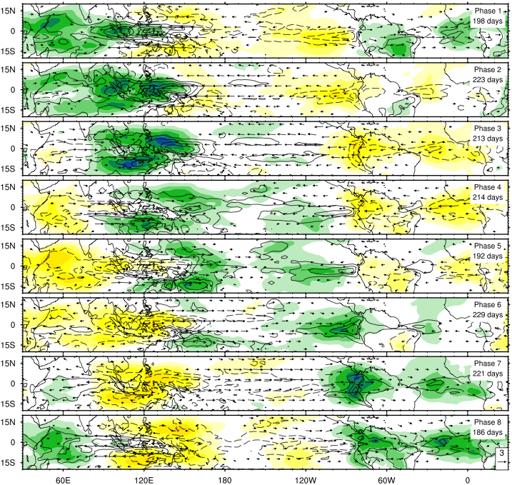
Composite OLR Anomalies (Nov-Apr, following WH04)
1xCO2
4xCO2
Larger magnitude, convection propagates further eastward.

Slide 14
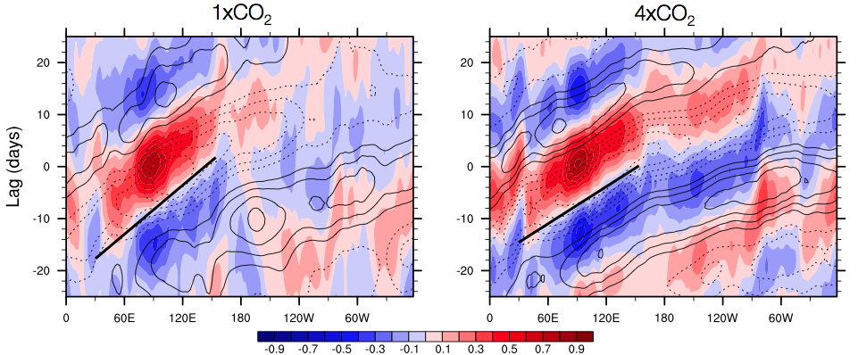
More rapid eastward propagation,
stronger signal over Pacific
Lag-longitude correlation plots of precipitation and U850:
8 m/s
11 m/s
More coherent signal over Pacific

Slide 15
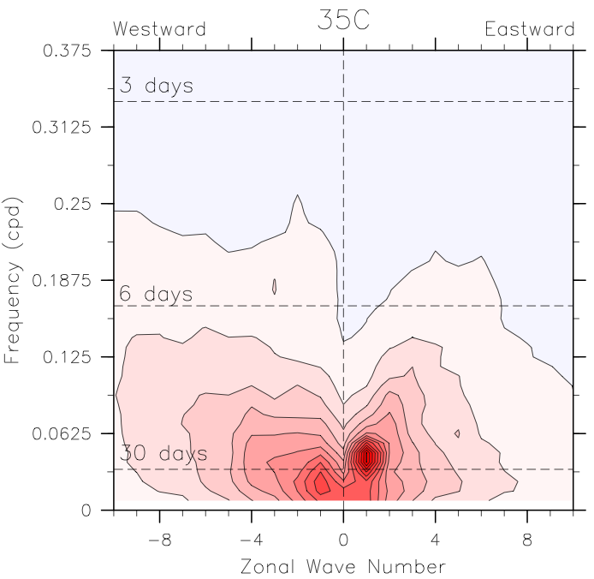
Understanding changes in the MJO with a composite MSE budget
MSE, SP-Aqua 35C
MSE variance dominated by MJO!
frequency
Calculate budget of frozen MSE:
zonal wavenumber
horizontal advection
surface latent heat
surface sensible heat
longwave heating
shortwave heating
tendency
vertical advection
Which term(s) are responsible for intensification with SST?

Slide 16
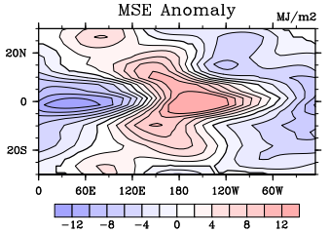
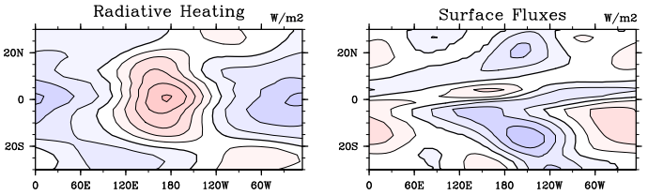
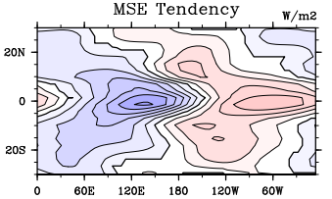
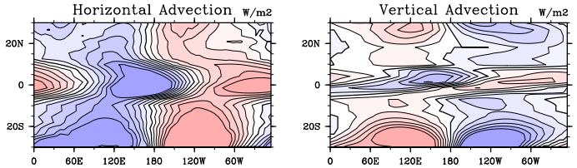
Understanding changes in the MJO with a composite MSE budget
SP-Aqua 35C:

Slide 17
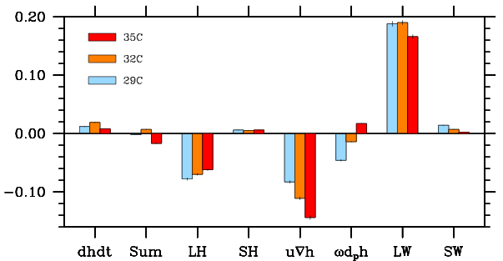

Contribution of each term to MSE maintenance
Projection of budget term x onto anomaly h:
(see Andersen and Kuang, 2012)
MSE anomaly is largely supported by longwave heating,
but vertical advection shows a positive trend with SST

Slide 18
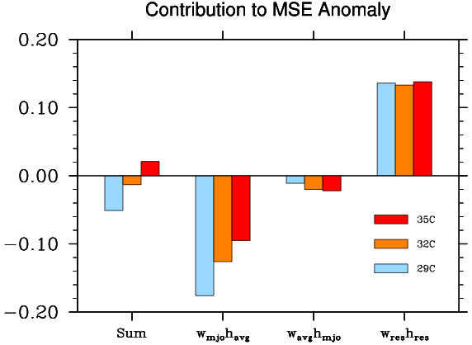
Why does vertical advection change?
Decompose the vertical advection term:
Total
The MJO vertical velocity acting on the mean MSE gradient accounts for most of the trend with SST

Slide 19
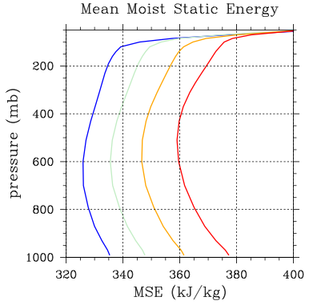
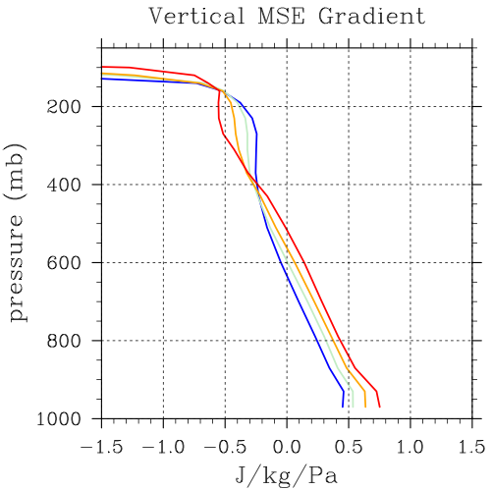
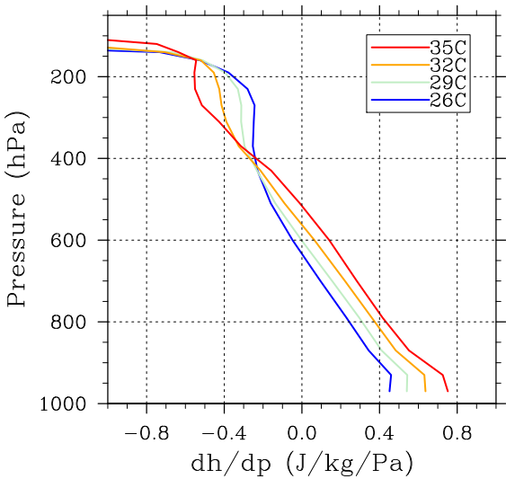

Why does vertical advection change?
The MSE gradient dh/dp is increasingly positive with SST
Ascent → slower discharge / faster buildup of MSE:
Descent → faster discharge / slower buildup of MSE:

Slide 20
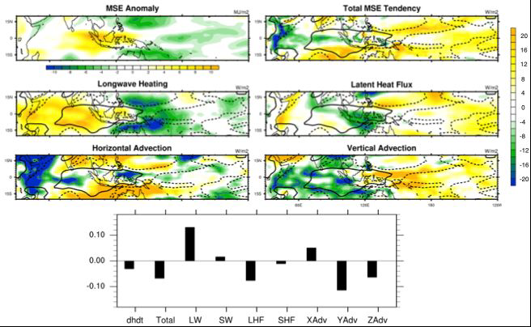
Repeat for SP-Terra: winter/summer seasons, all MJO phases

Slide 21
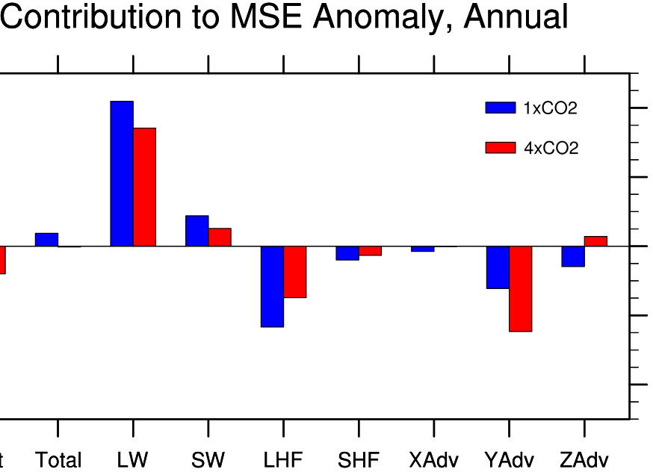
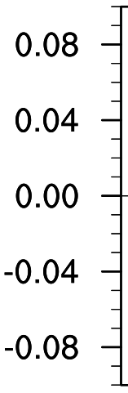

SP-Terra MSE budget,
averaged over all seasons and phases:
Projection of budget term x onto anomaly h:
(see Andersen and Kuang, 2012)
MSE anomaly is largely supported by longwave heating,
but (1) vertical advection and (2) surface fluxes
show positive trends with SST.

Slide 22
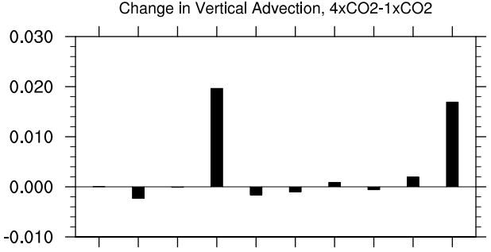
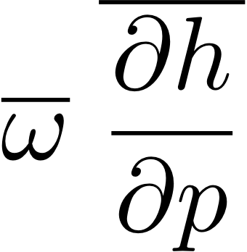
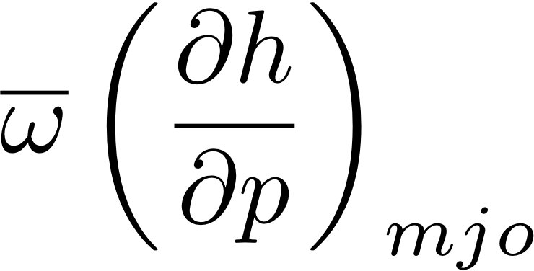
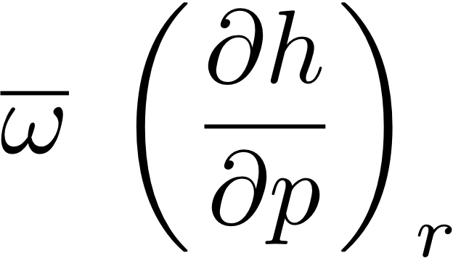
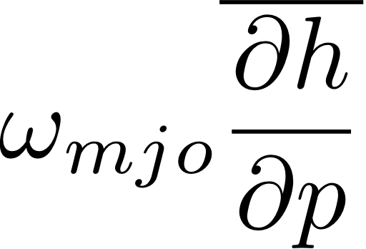
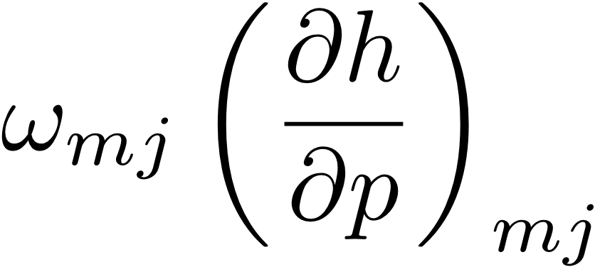
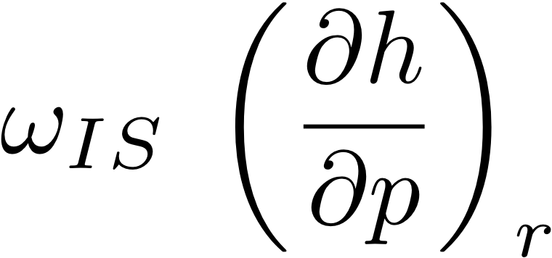
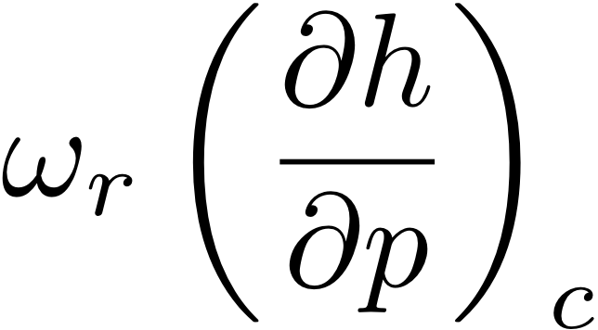




(1) Why does vertical advection change?
Change in Vertical Advection Components, 4xCO₂-1xCO₂
Total
MSE Gradient,
Consistent with SP-Aqua,
the MJO vertical velocity acting on the mean MSE gradient accounts for most of the change with SST.

Slide 23






(2) Why do surface fluxes change?
Change in , 4x – 1x
Use decomposition:
becomes much more positive. Secondary decomposition shows term scales with Clausius-Clapeyron:
Total
Term scaling with Clausius-Clapeyron can’t “keep up” with column MSE, so projection decreases in magnitude.

Slide 24
Summary and Conclusions
In aquaplanet runs with SP-CAM3.5 and coupled runs with SP-CESM, higher SST leads to enhanced MJO activity. The MJO exhibits larger magnitude and faster eastward propagation in both models.
Composite moist static energy budgets suggest MJO activity increases due to changes in vertical advection associated with the steepening mean MSE profile (effectively reducing the GMS).
Surface fluxes may provide a positive feedback. Mean state biases increase uncertainty of this effect.
The MSE profile steepening is robust, but can be offset by changes in vertical velocity profile. The real-world MJO response to global warming will depend on many poorly constrained factors.

