Slide 1
Tracking propagation of the MJO with MPAS
MJO hindcasts
Pilon Romain^{1,2}, Chidong Zhang¹, Jimy Dudhia²
1. RSMAS, University of Miami, Miami
2. NCAR

Slide 2
Outline
MPAS
Attempt to simulate an MJO event during YOTCE
And during Cindy/Dynamo

Slide 3
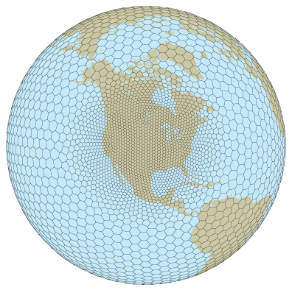
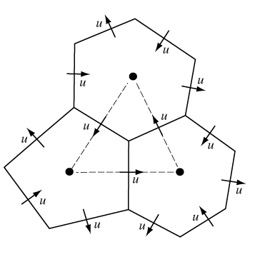
MPAS Atmosphere
MPAS: Model for Prediction Across Scale
Unstructured spherical centroidal Voronoi mesh:
uniform or variable-resolution meshes
Fully compressible non-hydrostatic equations
Integration schemes are similar to WRF.
41 vertical levels

Slide 4
Is MPAS able to simulate MCS?
Approach:
Different uniform meshes, same set of physics
Model setup
3 configurations: 3km 15km
Deep convection resolved Tiedtke or resolved
Shallow convection resolved –
PBL YSU
Microphysics WSM6
RRTMG longwave and shortwave radiation
Noah LSM
No SST forcing (no update) no ocean model, one initial state (GFS)
How is the atmospheric model is able to do by itself?

Slide 5
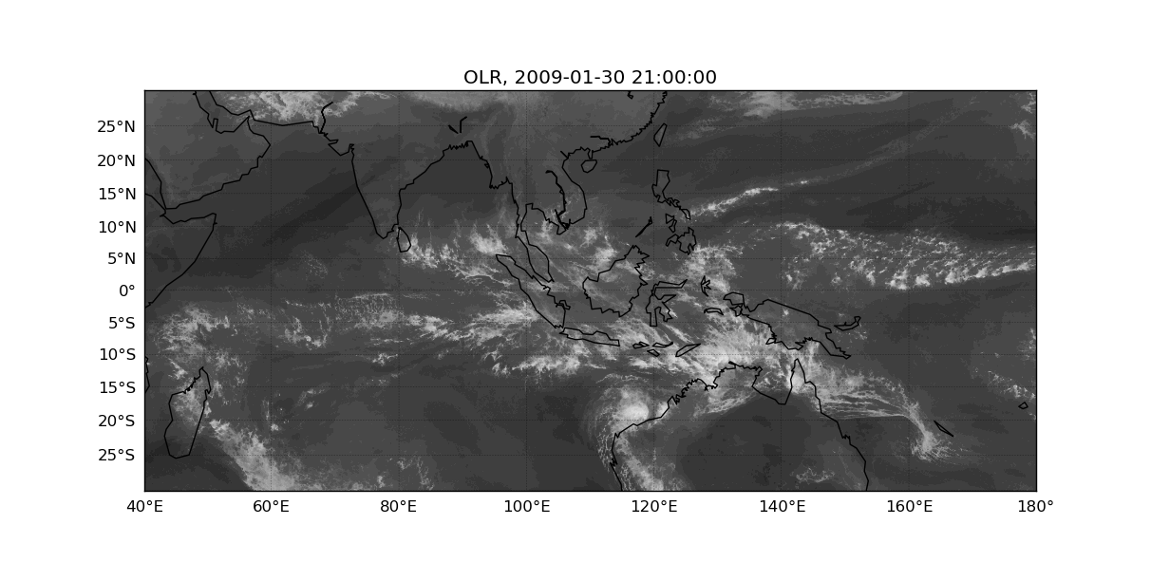
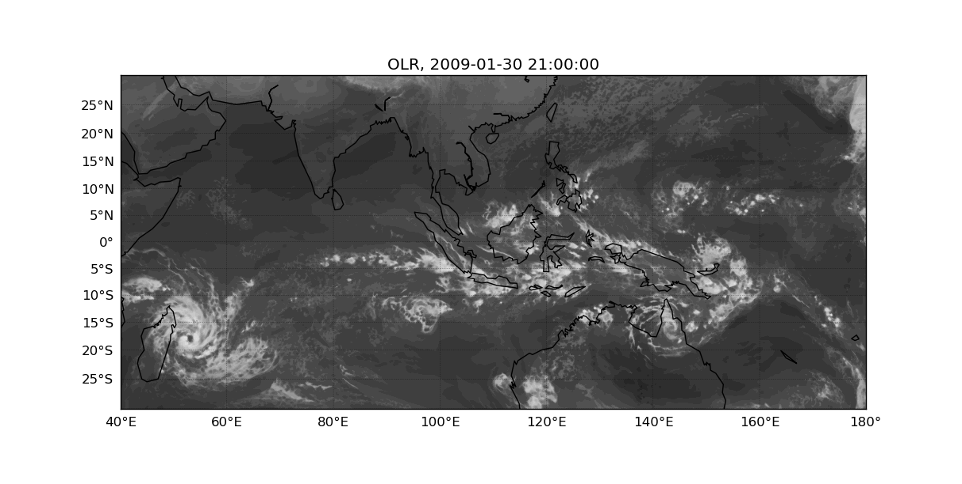
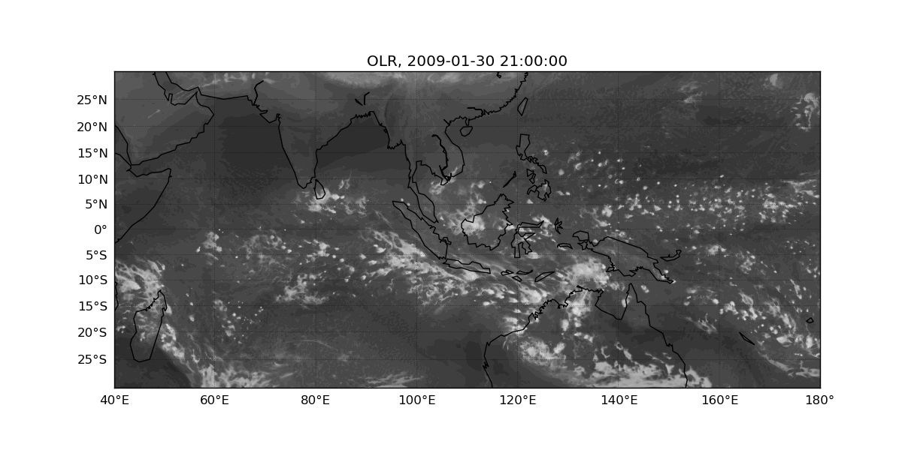
Is MPAS able to simulate MCS?
January/February 2009: OLR the 31th of January
3km
15km Tiedtke
15km no parametrisation of convection

Slide 6
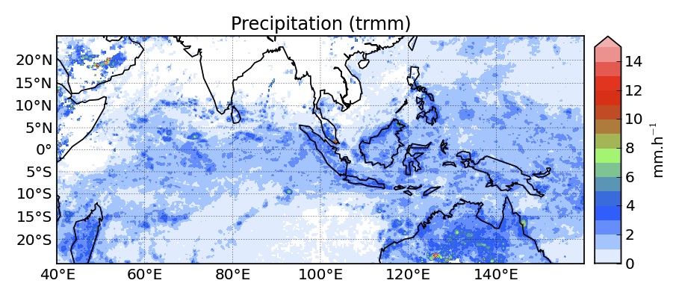
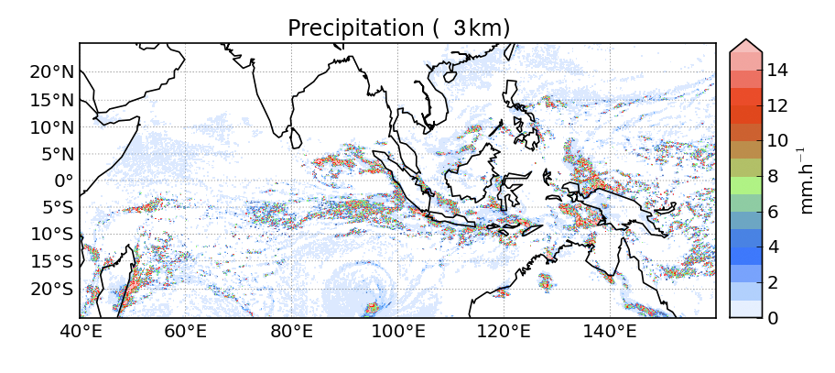
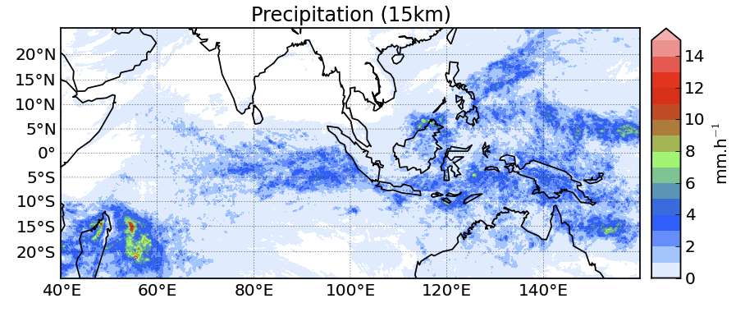
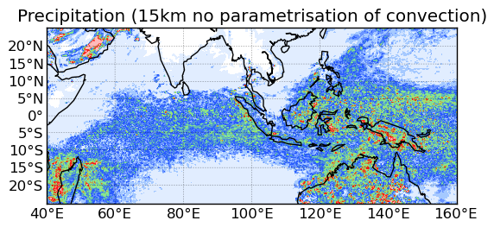

Some discrepancies
January/February 2009: averaged precipitation
In the simulation without parametrisation of convection:
Precipitation in simulations is much stronger compared to TRMM.
Problem with the microphysics? Resolution too coarse for an explicit deep convection.

Slide 7
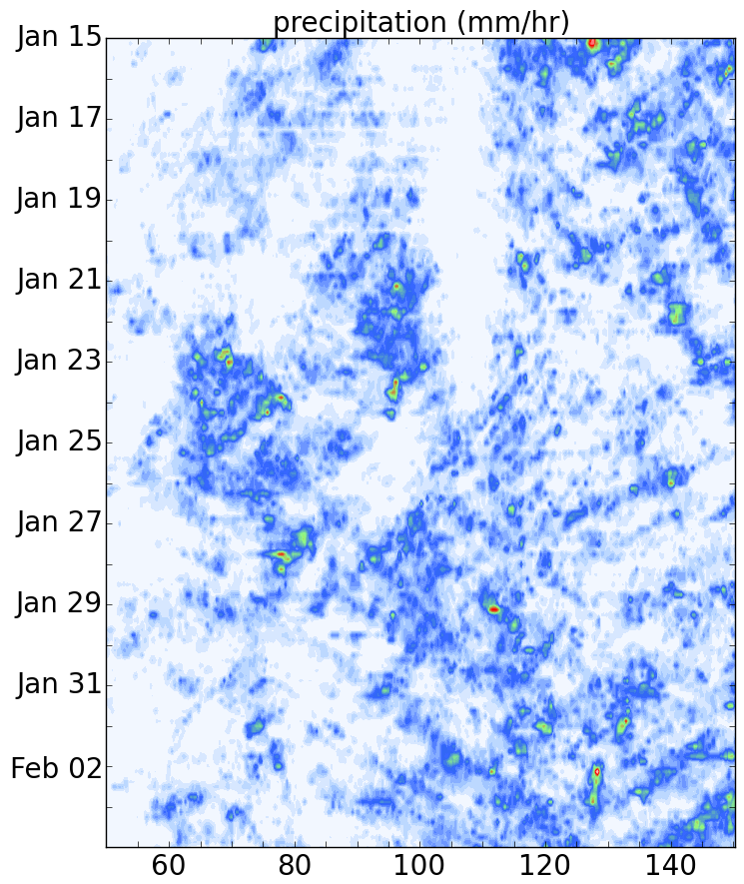
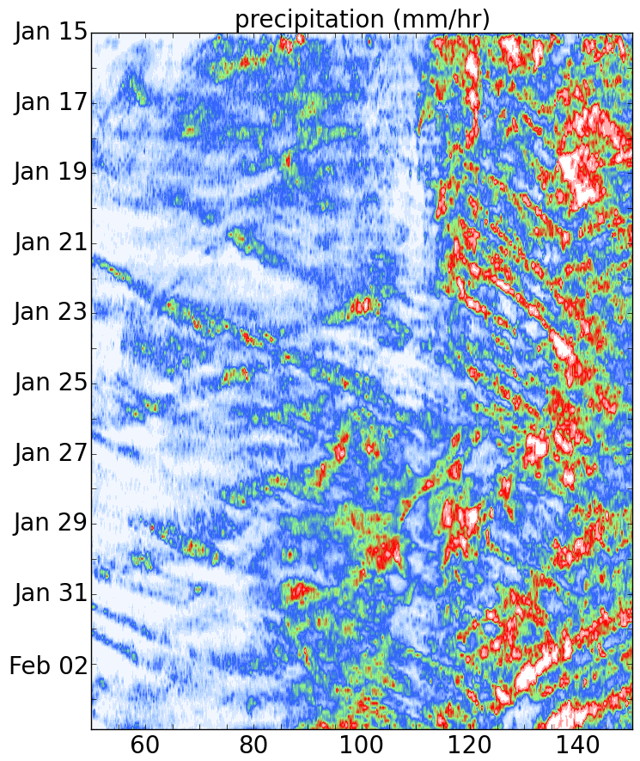
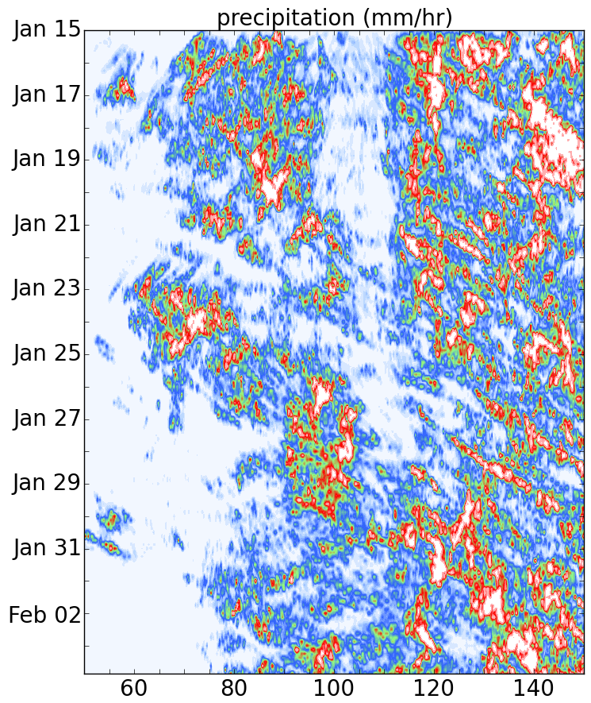
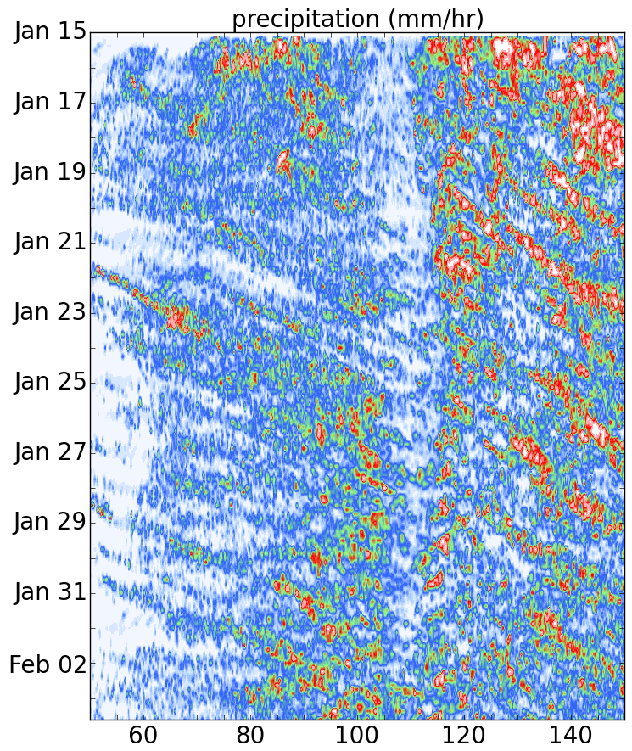
Is MPAS able to simulate the MJO?
4
3
TRMM
2
mm/h
1
0
3km
15km Tiedtke
15km no parametrisation of conv

Slide 8
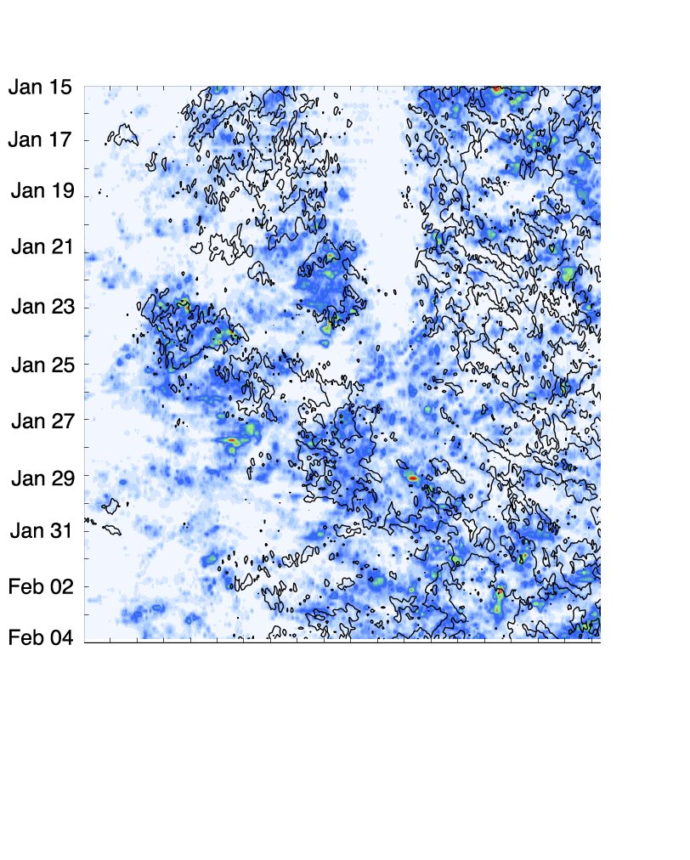
Is MPAS able to simulate the MJO?
Colors: Trmm , contour: 15km run with Tiedtke

Slide 9
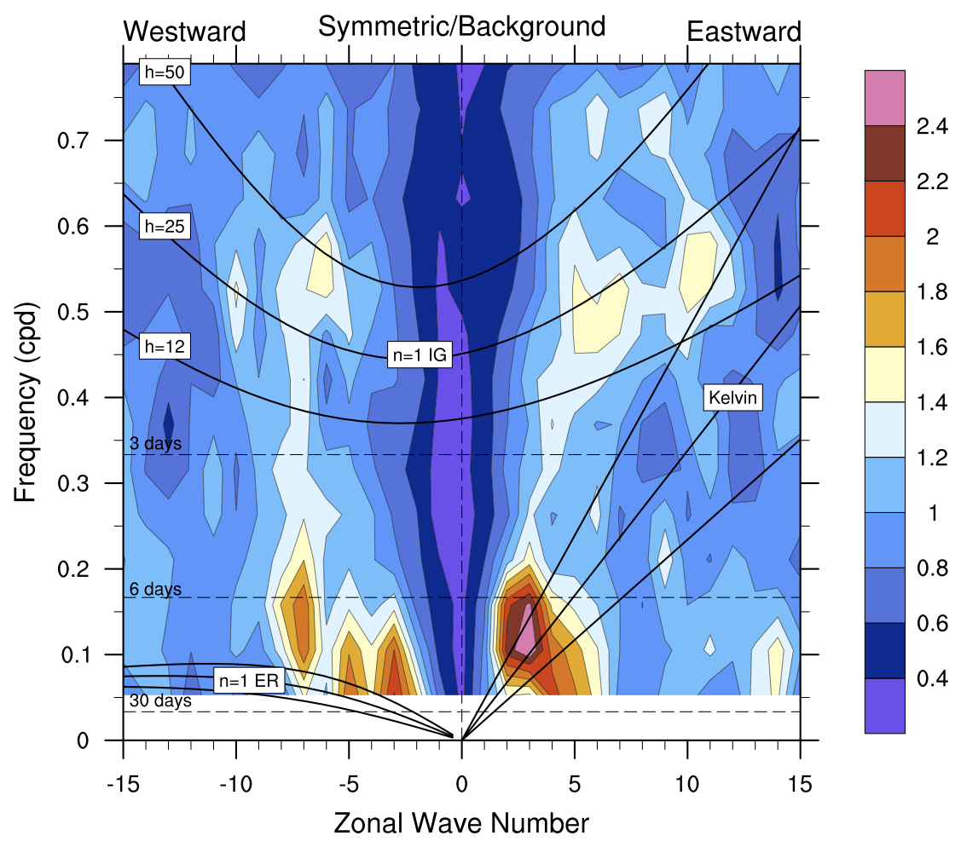
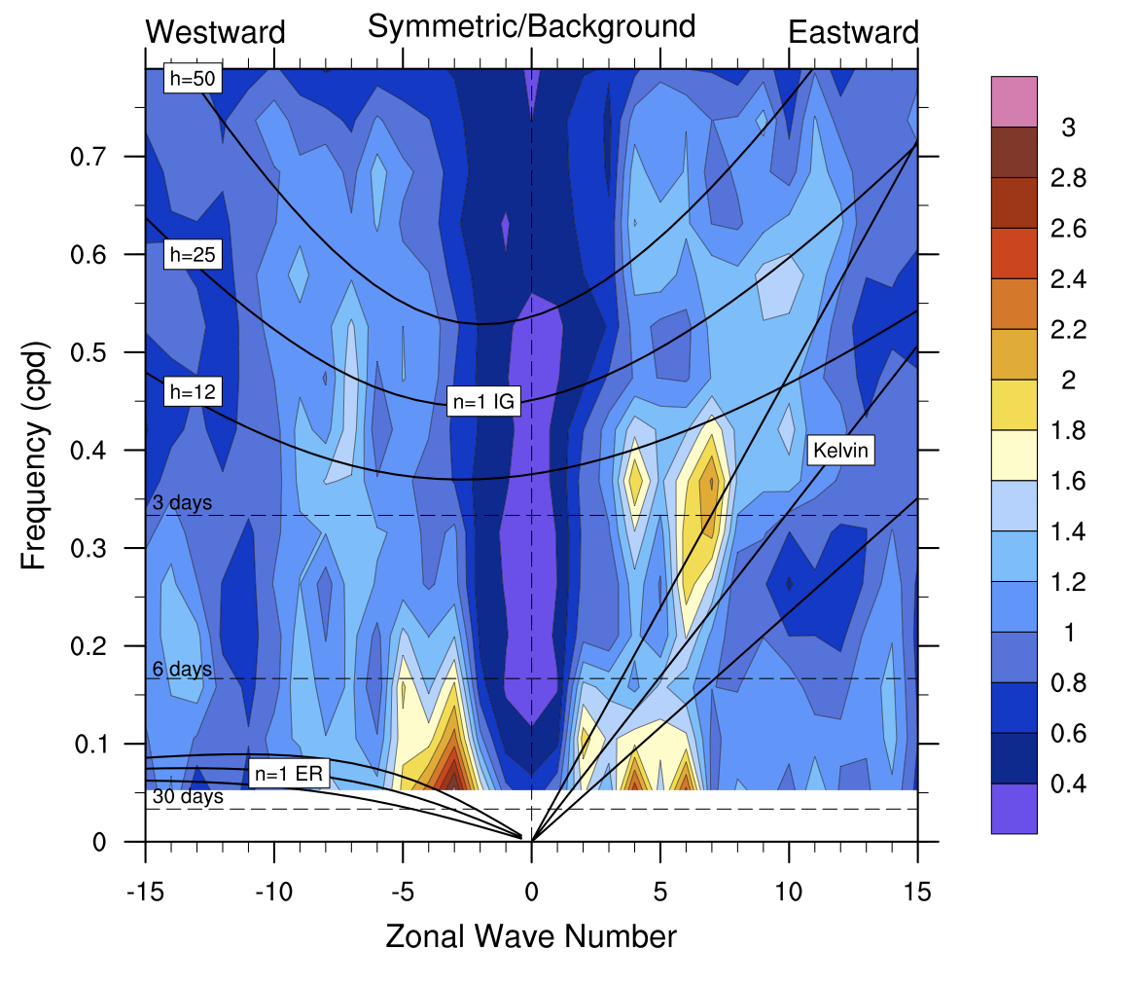
Tracking method
How to diagnose with only 20 days?
u850 15km Tiedtke
U850 3km

Slide 10
Tracking method
How to diagnose with only 20 days?
MJO tracking method (Ulate et al., 2013, JGR)
Remove the mean of 120 days (interannual variability)
Apply a 5-day running mean (high-frequency variability).
Average of the field (precipitation, u850hPa, olr) between 10°S and 10°N

Slide 11
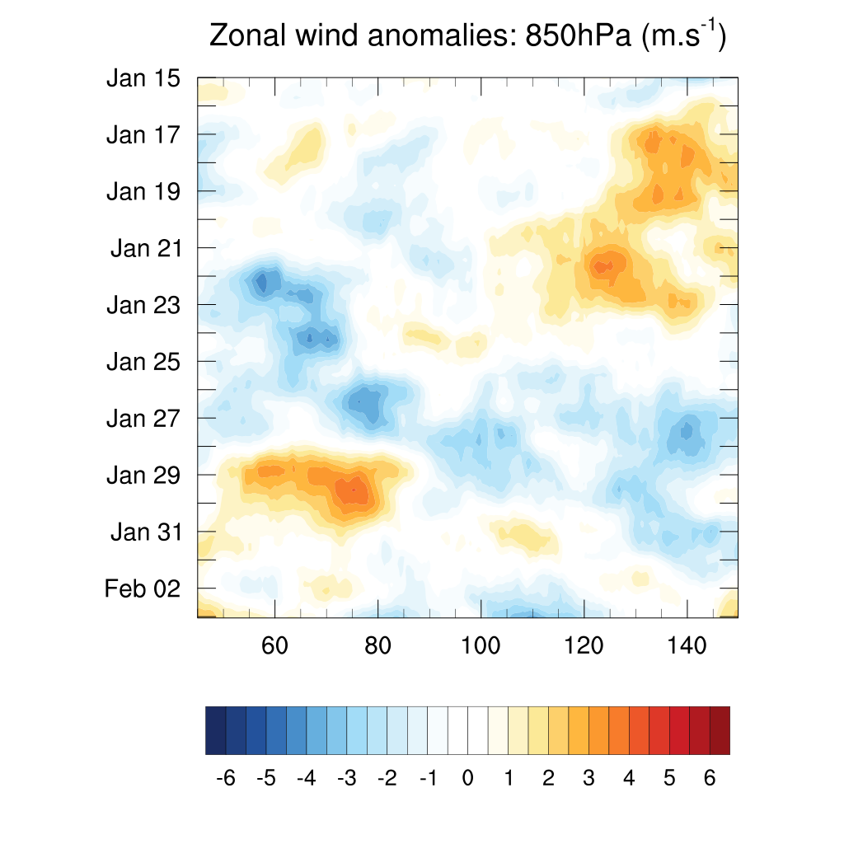
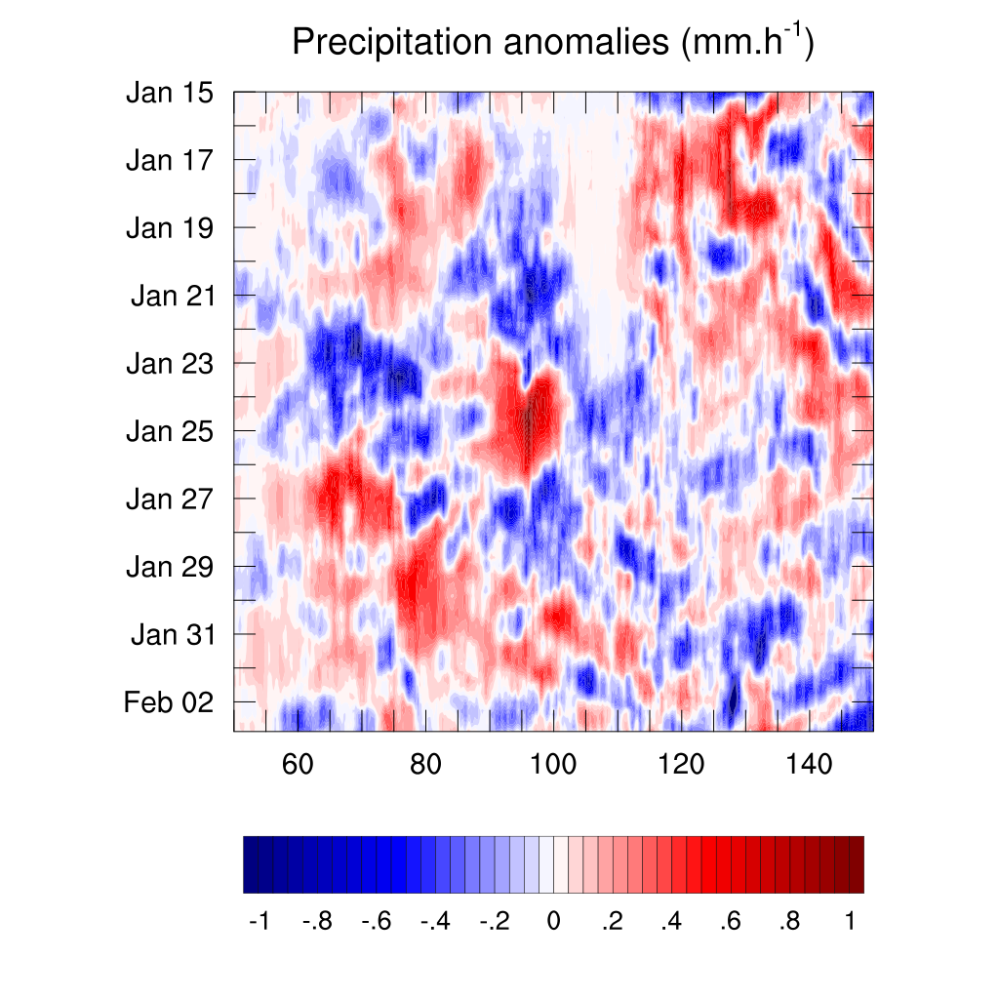
Tracking method
MJO January/February 2009
Era-Interim
TRMM
Take the trajectory which has the maximum of the quantity

Slide 12
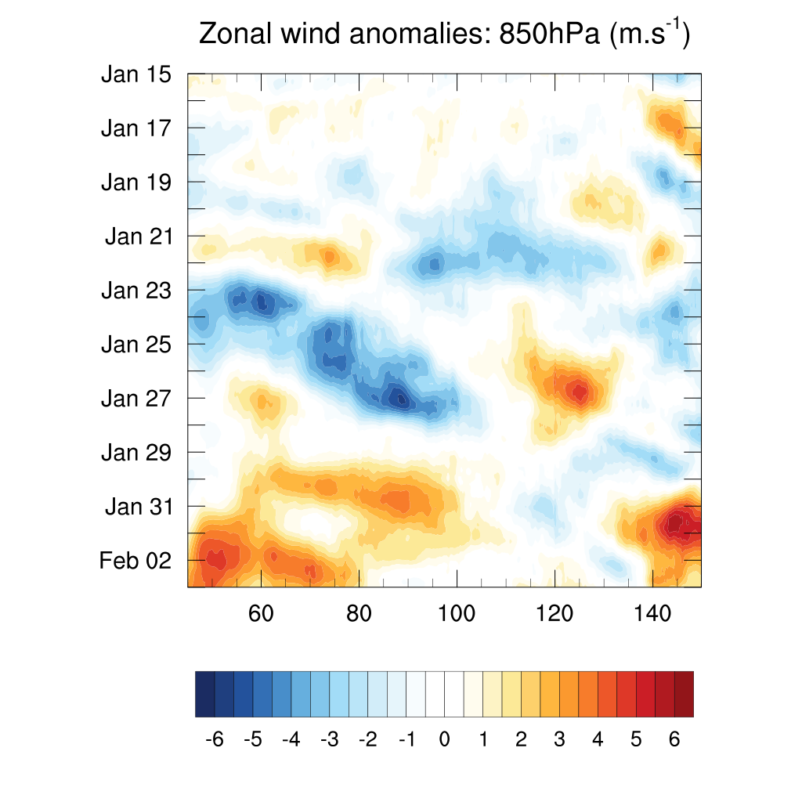
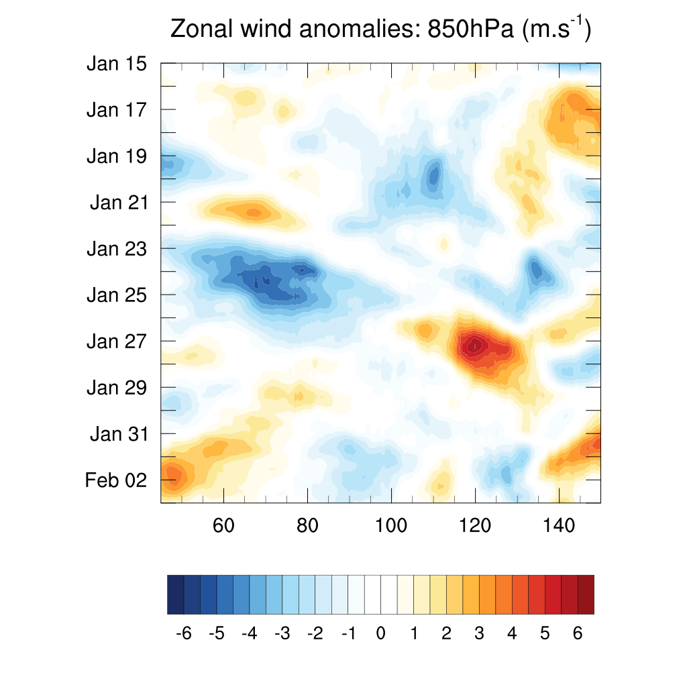
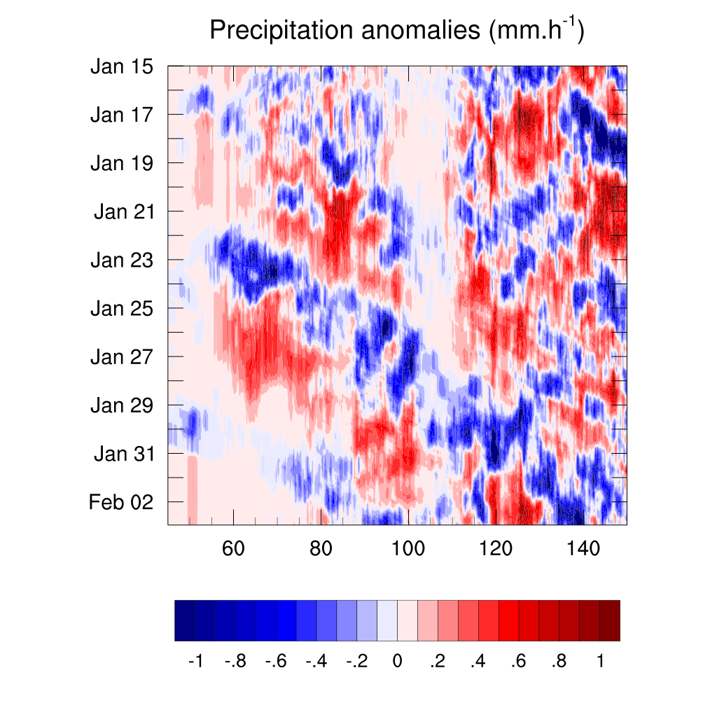
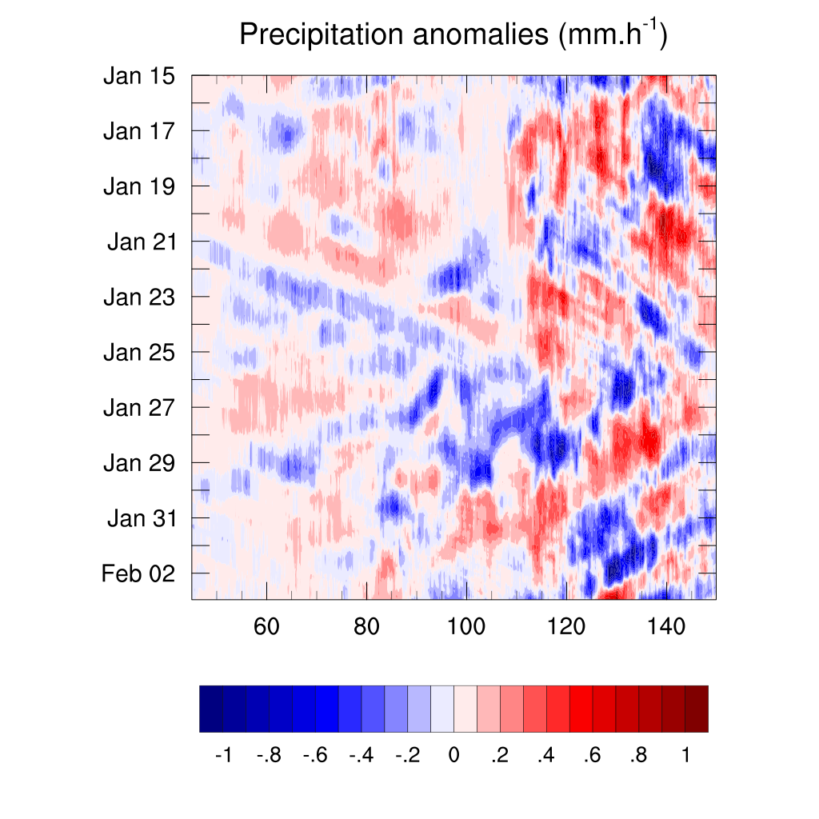
Tracking method
MJO January/February 2009
Reanalysis/obs 15km (Tiedtke) 3km
?
~9m/s
~15m/s
?
~11m/s
~11m/s

Slide 13
Diurnal cycle
TRMM
local time between 130˚ and 150˚E

Slide 14
Diurnal cycle
3km
local time between 130˚ and 150˚E

Slide 15
Diurnal cycle
15km
Tiedtke
local time between 130˚ and 150˚E

Slide 16
MPAS and Cindy/Dynamo

Slide 17
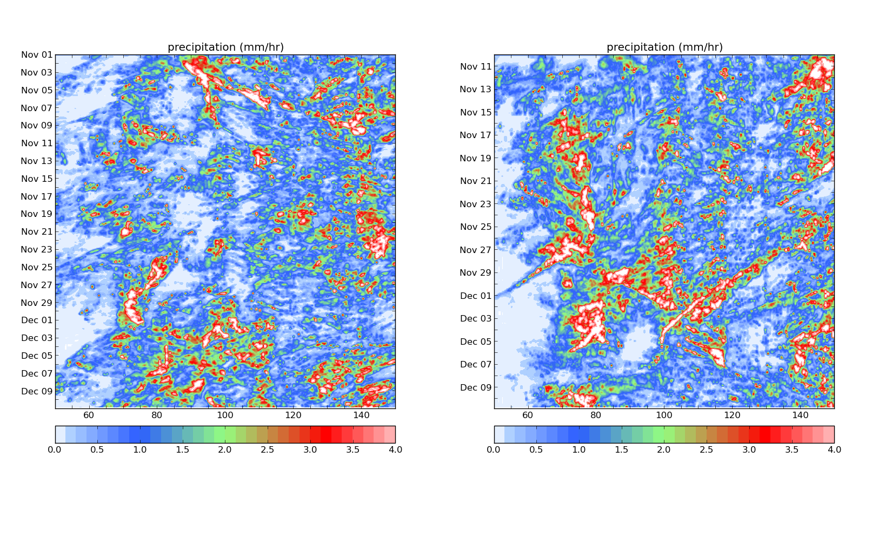
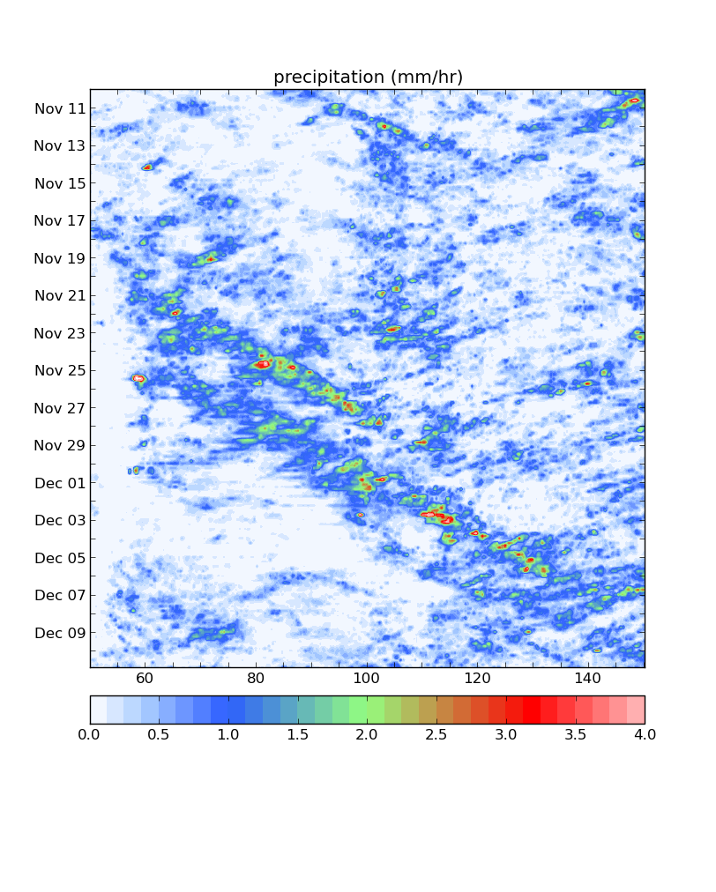
MPAS and Cindy/Dynamo
Sensitivity of the initial state
60km global
2 starts: 01 November and 10 November

Slide 18
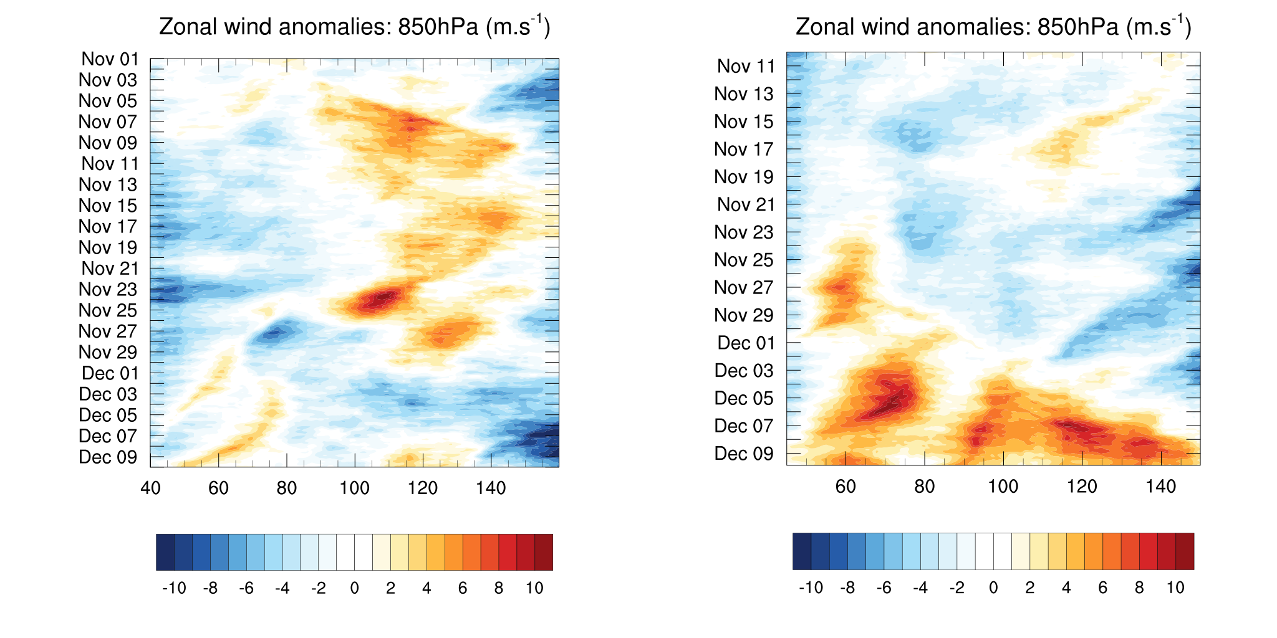
MPAS and Cindy/Dynamo
Sensitivity of the initial state
60km global
2 starts: 01 November and 10 November
This is not a deterministic simulation when using a global model, and it is not expected to be.

Slide 19
Conclusion - Next steps
Simulation with a 15km global resolution with Tiedtke scheme looks successful
Sensitive to the resolution (2 more simulations at 7.5km)
Go further in the analysis
Cindy-Dynamo:
- Use higher resolutions: 30 to 15km and 15 to 3km.
Find a way to improve the simulations:
- representation of convection in MPAS
- go cloud permitting?

Slide 20
Extra - Diurnal cycle
15km
no parametrisation
of convection

Slide 21
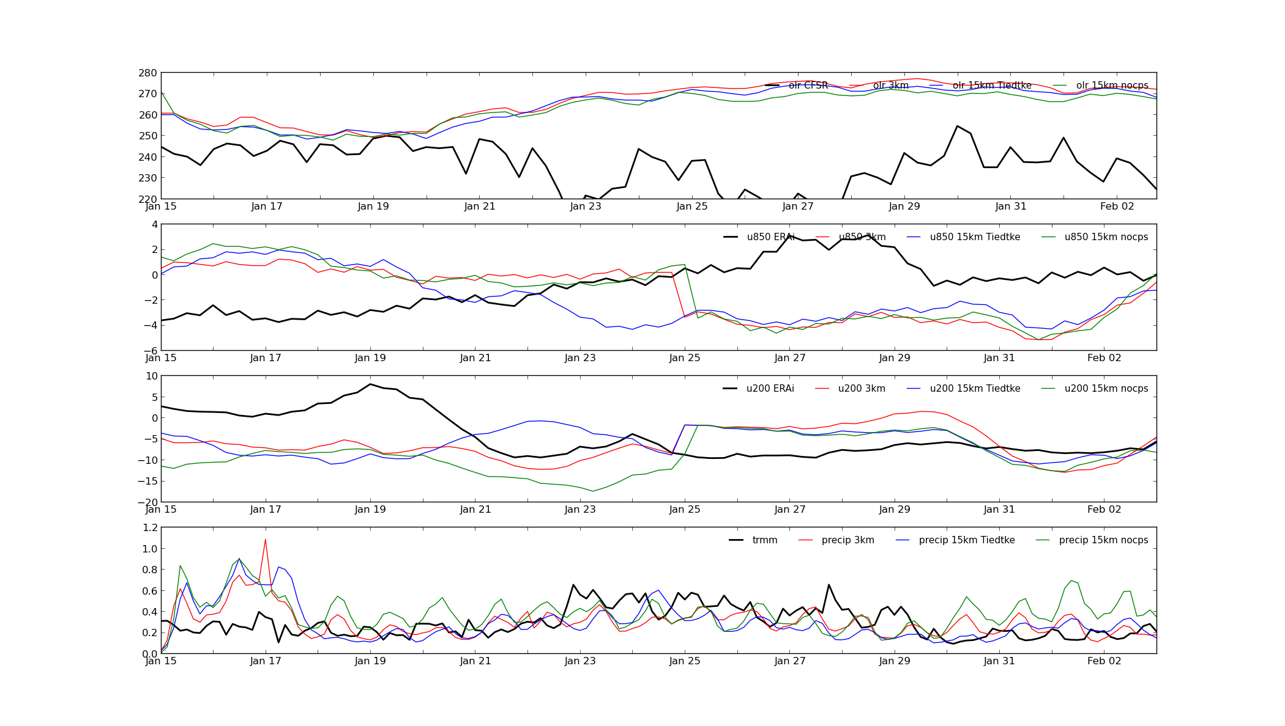
Evolution over the time (between 10˚S and 10˚N)
OLR
u850
u200
precip
‘Observation’ (CFSR, ERA-Interim or TRMM)
3km
15km with Tiedtke
15km no convection

