Slide 1
Matrix "anomaly physics" in realistic global flows
Brian Mapes, Patrick Kelly, Siwon Song
RSMAS, University of Miami

Slide 2
Motivation
Most GCM physics schemes are algorithmic rule sets, defined in mathematical frameworks based in conceptual cartoons (idealizations).
  Possibilities are countless...we could fiddle forever, neither understanding quite how our "reasonable" assumptions really play out, nor covering a bounded space of possibilities.
  Impacts on mean state (climate) & fluctuations (weather) are entangled, muddling MJO esp.

Slide 3
Our Approach:
Let's cast physics as a Matrix calculation
  A finite, well-defined space of coefficients linking tendencies to state variables in an air column.
    locally linearized -- like Calculus, and that's quite general...
  Isolate variability: make anomalous tendencies
        (deviations from a time mean)
    in realistic time-mean flow
      maintained by calibrated, time-independent forcing
        (the climatology of nudging, measured from nudged runs)

Slide 4
The background global model
A Dry PE solver with time-independent, 3D forcing (sources-sinks) of T, q, div, vort
  forcing represents the time mean of all physics
    including fluxes by missing scales of motion
        and compensations for numerics errors
  devised to give realistic climatology
    for a particular resolution and viscosity
    for a particular season – here perpetual JJA or OND
    following: Hall (2000), Lin Brunet & Derome (2007), Sardeshmukh and Sura (2009), Leroux Kiladis Hall (2011), ...

Slide 5
First model: simple and cheap
5 levels (900,700,500,300,100 mb).
  deep convection only touches the first 4
Four internal vertical modes
Low res = R15 today
Dry-run variability comes from hydrodynamic instabilities only

Slide 6
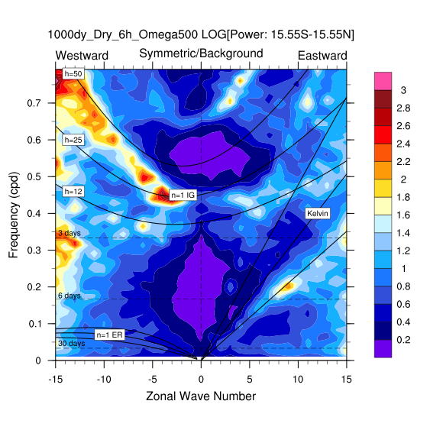
Model's discrete dry wave spectrum
(4 internal modes, as tickled by dry hydrodynamic instabilities)
wave7/1d = 66 m/s
wave7/1d = 66 m/s
33
33
10
10

Slide 7
Quiz 1: on dry general circulation
We first nudged the model to climatological averaged JJA flow (u,v,T).
  this suppresses transients, as well as enforcing closeness to the observed large-scale mean state
In second run, the time mean of this nudging is used as a time-invariant forcing.
  transients now occur due to shear instabilities
Can you guess how the mean flow differs from observed climo, due to dry transient eddy-mean flow interaction?

Slide 8
Quiz 1: on dry general circulation
Answer in Patrick's talk (Part II). Stay awake.

Slide 9
"Dry" model also has a tracer q
model includes tracer q: Dq/Dt = S_{q}(x,y,p)
  S_{q} devised to give water vapor-like climatology
  but q is unbounded
    Negative S_{q} regions can create q<0
    no Clausius equation yet to limit positives

Slide 10
Quiz 2: "Dry" model with tracer q
Dry-transient driven mean flow errors (see Quiz 1) advect q
Can you guess what happens to the JJA Asian monsoon (as seen in PW for example)?

Slide 11
Ready for Matrix physics:
∂X/∂t|_{phy} = MX
But what state vector X?
& what matrix M?
Is it "linear"? Depends what you mean.
M (x,y?,t?,U?,T?,q?,(P-E)?,?)

Slide 12
Ready for Matrix physics:
∂X/∂t = MX
But what state vector X?
& what matrix M?
Is it necessarily "linear"?
Only locally... framework quite general actually...
M (x,y?,t?,U?,T?,q?,(P-E)?, etc?)

Slide 13
Another nonlinearity
Should X or ∂X/∂t values be clipped?
    e.g. forbid implied rain<0
    e.g. forbid negative values of q being created
    e.g. saturation adjustment
    e.g. numerical limiters to avoid computational inst'y
No clipping implemented yet

Slide 14
∂X/∂t = MX
If the time-invariant forcing is devised to be correct time-mean physical tendencies, which give a realistic time-mean state, then our matrix outputs should be intended to act as anomalous physical tendencies
        that is, deviations from the time mean

Slide 15
∂X/∂t = MX
How to get anomalous physical tendencies?
If the inputs X are anomalies, and M is time independent, then outputs MX (tendencies) will likewise be anomalies
  because any linear combination of zero-mean input variables also has zero mean

Slide 16
State vector X : a possible choice
T' profile
for matrix-based
convection using
Kuang (2010)'s CRM-derived M
q' profile
←Windspeed' for WISHE,
←shear' for CRF...
...
...(Or whole u' profile for CMT)...

Slide 17

MSE sources
hum.dep. anvil CRF
WISHE
shear dep. anvil CRF
"Moist Convection": Each
matrix column in this section
adjusted to conserve MSE
WISME
CMT depends on C (thus on T',q')...
Surface
...& on
shear
friction

Slide 18
A space for estimation
(serious work)...
and postulation
(incisive play)!
WISHE
shear dep. anvil CRF
"Moist Convection": Each
matrix column in this section
conserves MSE
WISME
CMT depends on C (thus on T',q')...
Sfc.
...& on
shear
friction

Slide 19
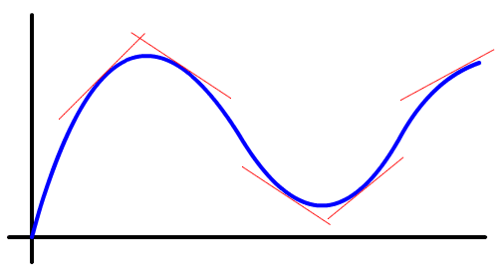
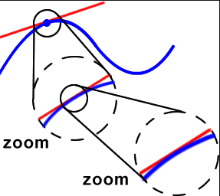
As linear (or not) as you want...
M a global constant → very linear math system
        whatever it does can be analytically deconstructed
clipping of hydrologic negatives, extremes, etc.
        physically possible; difference from above interesting (bias)
M devised very locally in space, time, regime
        you can build in any relationship you think you know...

Slide 20
So far, we only show...
Thermo. physics

Slide 21
So far, we only show...
MSE-conserving moist convection matrix M_{c}

Slide 22
Two kinds of anomaly thermophysics
Column MSE conserving
  all vertical convection, with or without condensation
Column MSE sources
  anomalous energy fluxes at top/bottom boundaries:
    surface flux of T,q
    radiative flux
        each must be assigned a profile
M = M_{conv} + M_{sflux} + M_{rad + ...}

Slide 23
Anomaly physics 2: NOT YET
MSE source I: Surface fluxes
  Linearizations of SHF and LHF
    F = C_{D} |U| (ψ_{sfc}-ψ_{air})
  Two terms from product linearization:
    ∂F/∂ψ|_{U} ψ' thermo. damping
    ∂F/dU|_{T,q} U' WISHE

Slide 24
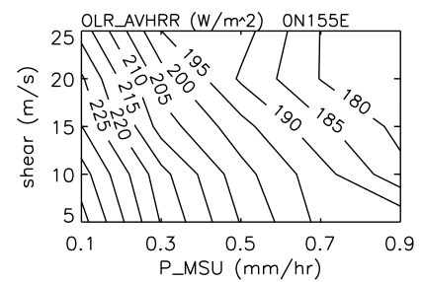
Anomaly physics 3: NOT YET
MSE source II: Radiation
  really, flux convergences Q_{rad} in the column
  Linearization of ∂Q_{rad}(T,q_{v},cloud)/∂T, etc.
  For cloud: regress Q_{rad} data on rainrate & shear
Lin and Mapes 2004

Slide 25
Anomaly physics 1: MSE conserving
Anomalous moist convection
    represents anomalous condensation + vertical eddy flux divergences
    Scaled by clim. rainrate (e.g. zero where no rain)
    Kuang (2010) devised a clever way to estimate M_{c}, from interrogation of a periodic, partly-disabled CRM (no radiation, ...), via matrix inversion
      exploiting surprising linearizability also noted in Tulich and Mapes
        (JAS, 2010, same issue as Kuang)

Slide 26
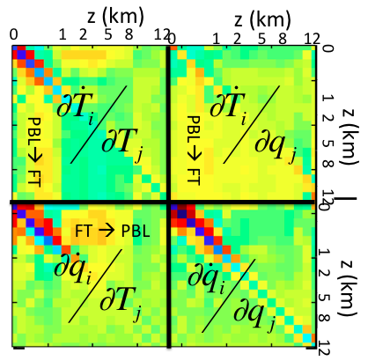

Slide 27

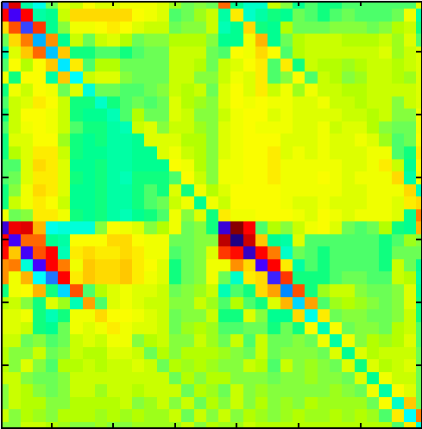
Math-ordered view of M
z (km)
z (km)
0 1 2 5 8 12
0 1 2 5 8 12
0
PBL→ FT
PBL→ FT
z (km)
z (km)
0 1 2 5 8 12
0 1 2 5 8 12
FT → PBL
square root color scale

Slide 28
Time scale of desired response: GCM timestep? (no, timescale implied by scale separations...)
M →instantaneous tendency etc.
        largely local diffusion
We want convection's responses integrated over a deep cloud system life cycle
    say 4h

Slide 29
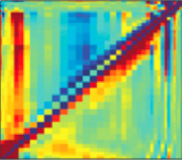
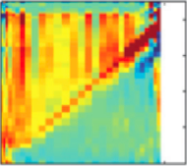
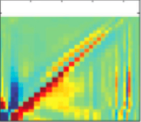
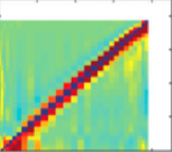
M_{c,4h}

Slide 30
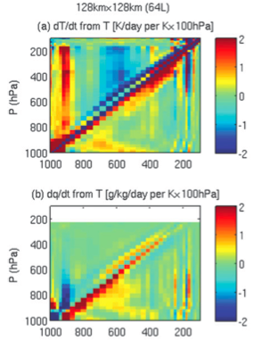
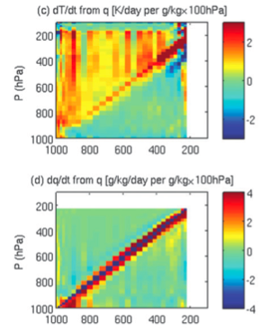
Friendlier "plot view" of the quadrants of M_{4h}
(published in Kuang 2012 JAS)
Heat source
sensitivities:
Moisture
source
sensitivities:

Slide 31
Enhancement of deep convection by q' at any level
Inhibition of deep convection by T' in 500-850mb
Heat source
sensitivities:
PBL T or q
good for deep conv
(CAPE)
Moisture
source
sensitivities:

Slide 32
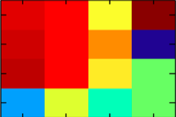
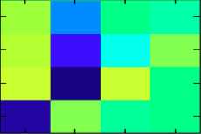
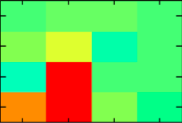
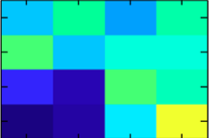
Eyeball regrid to 900,700,500,300 then MSE balancing, then eigenvalue negation for stability
Heat source
sensitivities:
Moisture
source
sensitivities:

Slide 33
Still has T700 inhibition and q700 sens.
Heat source
sensitivities:
Moisture
source
sensitivities:

Slide 34
EXPERIMENT: set this column to 0
Heat source
sensitivities:
Moisture
source
sensitivities:

Slide 35
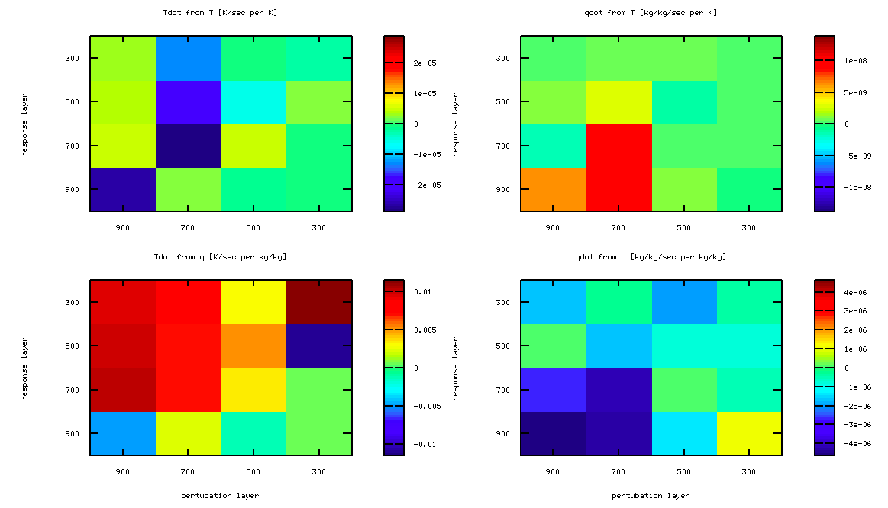
Standard (control) M
T tendency from T
q tendency from T
Response Layer
T tendency from q
q tendency from q
Response Layer
Perturbation Layer
Perturbation Layer

Slide 36
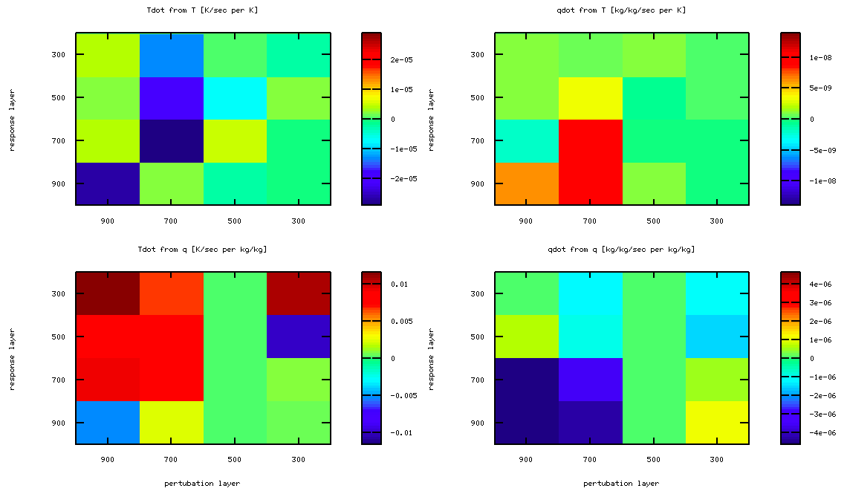
Experiment: q500 sensitivity disabled and again eigenvalues negated for stability
T tendency from T
q tendency from T
Response Layer
T tendency from q
q tendency from q
Response Layer
Perturbation Layer
Perturbation Layer

Slide 37
SUMMARY OF FORMULATION
Bias-correct a "bad" GCM (here a dry PE solver) by turning climatology of nudging-to-obs into a time-independent forcing → good mean flow
A time-independent (but clim. rain scaled) M times an anomaly state vector → anomaly tendencies
  coupled w/ global dyn. → interesting (unforeseeable)
Postulations in M space → nice clean expts
  e.g. How does tropical weather depend on convection's FT moisture sensitivity (∂convection/∂q₇₀₀)?
  ...on MSE sources (∂F_{sfc}/∂ψ ψ', ∂CRF/∂ψ ψ')?
Moist transients that result may lead to noise-induced climate drift – but that is interesting too...

Slide 38
Patrick's challenge
He will show our/his very very first results...
We will do several things differently next time! (Like next week! But not today...deadline-fresh results...)
  We nudged to climatology, not obs w/ eddies
    Quiz: what happens to our JJA monsoon in no-M case?
  Only 5 levels (4 int. modes for M to couple to)
    Unknown discrete modes! Should do Kasahara analysis.
    Or just jump to N layers. And >> R15 resolution
  Too-subtle comparison of two matrices
    imperfectly-rebinned Kuang convective M vs. the same with its (weak) sensitivities to q500 disabled
  Bugs? Eyes open please!

Slide 41
extra slides

Slide 42
Matrix physics
M = M_{conv} + M_{sflux} + M_{rad}
M can differ for different columns
  e.g. Q₁'(T',q') result is scaled by local rainrate
    no convection ←→ no conv. response to T' and q'
  e.g. LHF' = [∂LHF/∂q]_{local} q' + [∂LHF/∂U]_{local} U'
But what is local? How intimate? ➔ how nonlinear?
  Merely a terrestrial typical value (global constant; fully linear)
  Local in space? (physics linear locally, but nonlinear globally)
  In spacetime?
  Localized to a variable value? (e.g. [∂e_{sat}(T)/∂T]_{T=Tlocal}?)
        getting on toward lookup-table approach to fully nonlinear physics

Slide 43
So is it "linear", just a toy?
With such limits, and rescaling linearization slopes at different locations, and perhaps times, and perhaps values, anomaly physics calculated by matrix could get quite complicated & quite far toward realistic.
Can verge on a "lookup table" approach to complex and nonlinear relationships...if desired.
Even then, itis much more explicit and clear than specifying only rules for an iterative algorithm (like a plume computation)...
Can cleanly test things like the effects of convection's free tropospheric moisture sensitivity on variability, within a constant & realistic mean climate.

Slide 44
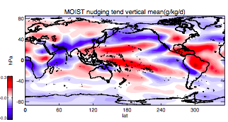
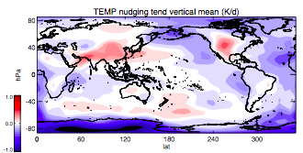
JJA mean forcing
E-P is implied by mass integral {S_{q}}
column integrated heating {S_{T}}

Slide 45
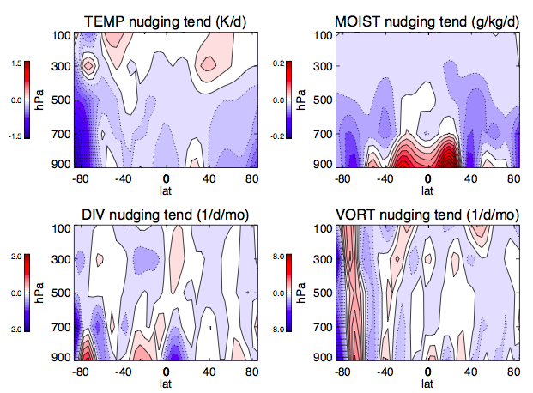
JJA mean forcing zonal means:

