Slide 1

Understanding of essential dynamics of the MJO
Bin Wang
Department of Meteorology and IPRC University of Hawaii
Workshop on the Tropical Dynamics and the MJO, Honolulu, January 14-15 2014

Slide 2
MJO –a Dynamic Definition
An equatorial planetary scale circulation system coupled with a multi-scale convective complex moving eastward slowly with a rearward tilted, mixed Kelvin-Rossby wave structure.

Slide 3
Observed MJO Characteristics
(Theoretical implications)
1. Planetary scale circulation and a large scale of convective complex. (Madden and Julian 1972) Scale selection.
2. Slow eastward propagation leading to 30-60 days Oscillation(Madden and Julian 1972, Weickman and Knutson 1986).
3. Mixed Kelvin and Rossby waves structure. (Rui and Wang 1990) Waves
4. Backward tilted baroclinic structure with PBL moisture convergence leading convective anomalies (Madden and Julian 1972, Wang 1988, Hendon and Salby 1994) PBL dynamics.
5. Amplification/decay (Madden-Julian, 1972, Wang and Rui 1990) Instability
6. Remarkable Seasonality (Yasunari 1980, Madden 1986) Mean flow effect
7. Multi-scale structure of the convective complex (Nakazawa 1988)
Upscale transport of eddy properties?
8. Coupling with ocean mixed layer Air-sea interaction

Slide 4
Outline
1. Theoretical framework
2. MJO: Frictionally coupled miost K-R wave theory
3. BSISO: Modified MJO mode by seasonal mean flows
4. Effects of Multi-Scale Interaction

Slide 5
1. Theoretical Framework for Essential Dynamics of MJO
--Wang 2005, 2012: Theory, Chapter 10 in “Intraseasonal oscillation in the atmosphere and Ocean”, Eds. W. Lau and D. Waliser, Praxis-Springer
--Hoskins and Wang 2006: Large scale dynamics, Chapter 9 in “Asian Monsoon”, Ed. B. Wang, Praxis-Springer

Slide 6

Physical Processes
Essential Large scale
MJO dynamics
Important
Feedbacks
Boreal Summer
ISO
Low-Frequency
Equatorial Waves
Cloud
Radiation
Background Circulation
(Annual & Interannual )
Convective
Latent
Heating
Boundary
Layer
Dynamics
Meso-Synoptic
Disturbances
Air-Sea
Interaction
Moisture
Distribution
Land-sea Distribution | Climatological SST | Surface Heat Flux
Lower boundary forcing

Slide 7
Governing Equations on equatorial beta-plane
Mean flow
Effects: MISO
(1)
(2)
(3)
(4)
(5)
Scale
interaction
Basic-state
MSE
SST control
Of MSE
Wang 1988

Slide 8
Two-layer free atmosphere with a PBL
PBL
PBL equations

Slide 9
Theoretical Framework for ISO
Two and half layer model for ISV (nondimensional)
Long wave
approximation
Mean flow
effects
Scale
interaction
Boundary layer Ekman Pumping: (Wang and Rui 1990)
Basic MJO model: neglects scale interaction and mean flow effects

Slide 10
2. Frictionally Coupled Moist Kelvin-Rossby Wave Theory:
MJO is a moist Kelvin-Rossby wave couplet driven by frictional moisture convergence

Slide 11
Frictional coupled moist K-R wave model
(nondimentional)
Assumption:
Frictional convergence instability
No Wave-CISK
Include Wind-Evaporation feedback
Precipitation parameterization: Moisture conservation with neglect of perturbation moisture fluctuations;
Interactive Heating:
Linear or Positive-only nonlinear (Wang and Li 1994)
Wang and Rui 1990 :Dynamics of coupled moist Kelvin-Rossby waves on an equatorial beta-plane. JAS

Slide 12
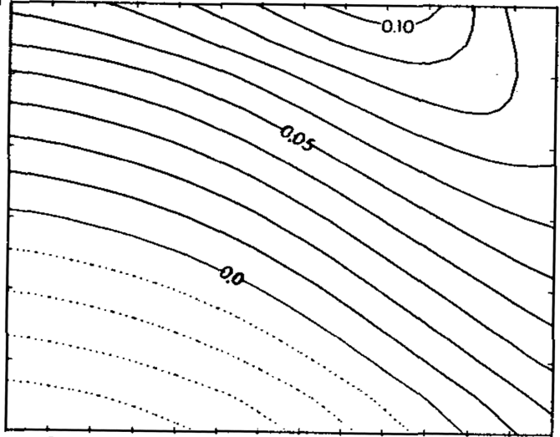
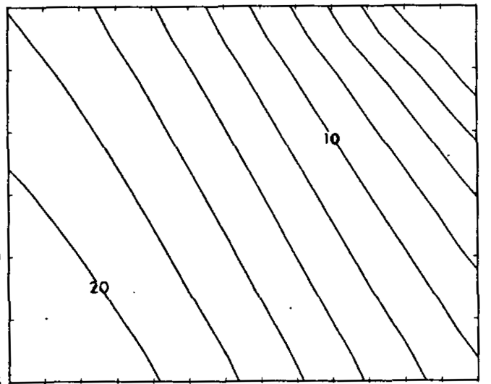
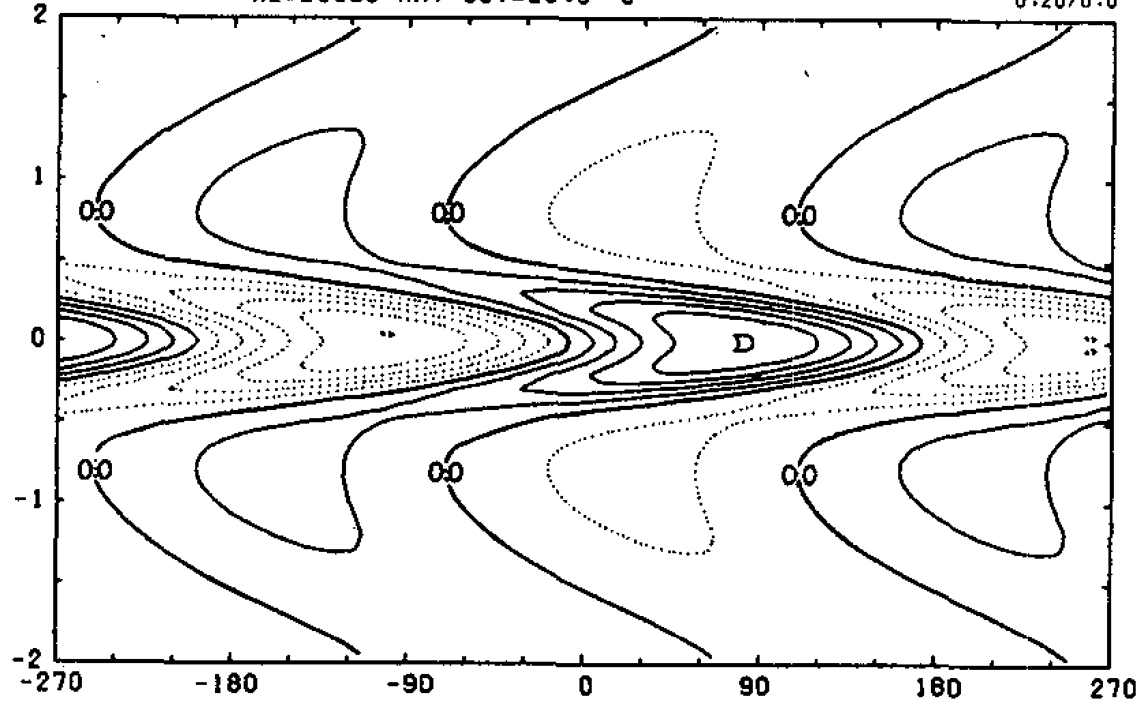
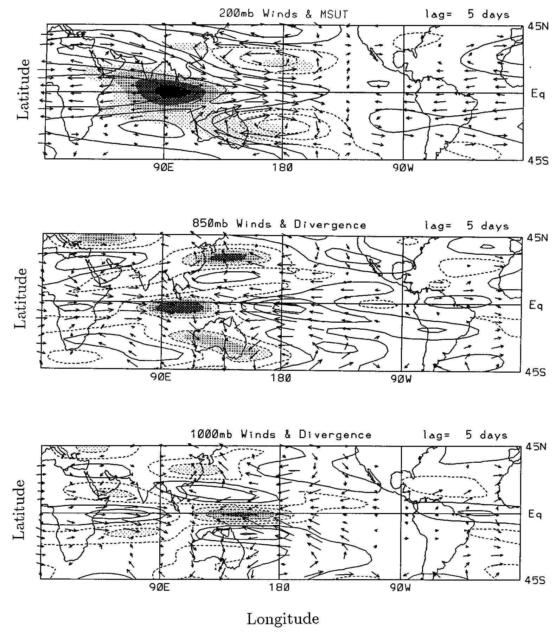
Frictional moisture convergence instability
(a) Growth Rate (1/day)
(b) Phase Speed (m/s)
Longwave grows
faster
30.0
Slow eastward
movement
SST (ºC)
29.5
29.0
28.5
2
15 20 25 30 35 40
15 20 25 30 35 40
Wavelength (1,000³ km))
Wavelength (1,000 ^{k}km)
(c) Upward motion at p_{e}
(d) Observed winds & convergence
1
Non-dimensional Y
Hendon and Salby 1994
Coupled K-R Structure
BL upward motion leads convection
0
-1
-2
0 90E 180
0 90E 180 90W

Slide 13
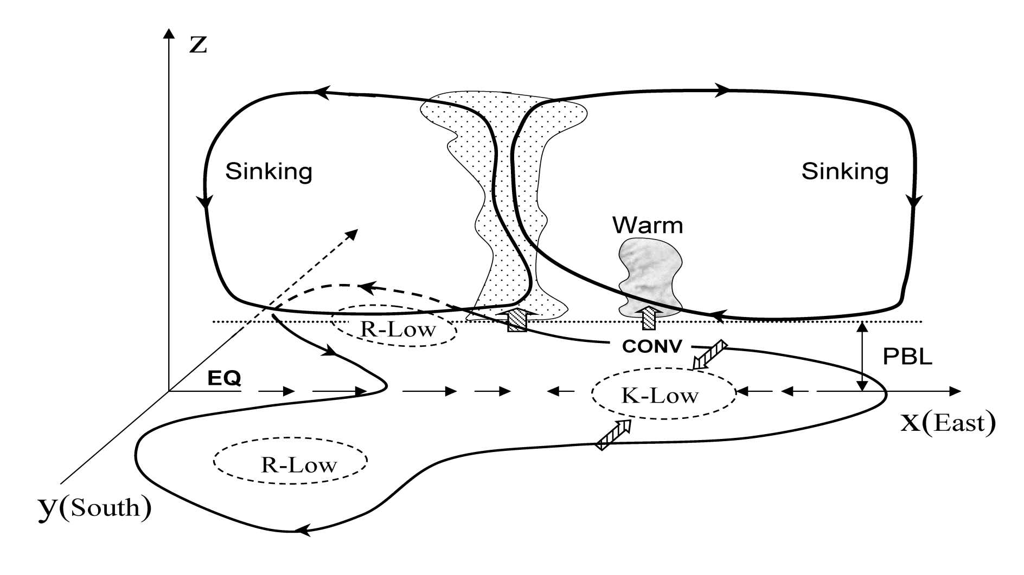
The model yields
a mixed R-K wave structure and
PBL convergence leading major convection
R-High

Slide 14
A central question for MJO theory
What mechanism couples the convective complex and Kelvin-Rossby waves and Why does it move eastward slowly?
Boundary layer moisture convergence

Slide 15
Equatorial boundary layer convergence
Barotropic boundary layer model
ub and vb: BL vertical averaged winds,
E: BL friction coefficient
Due to change of sign of the Coriolis force at the equator, equatorial boundary layer dynamics differs from the quasi-geostrophic Ekman theory
The equatorial frictional convergence is determined by the Laplacian of the pressure at the top of the boundary layer and the strengths of the eastward and poleward surface winds.
Wang and Li 1994

Slide 16
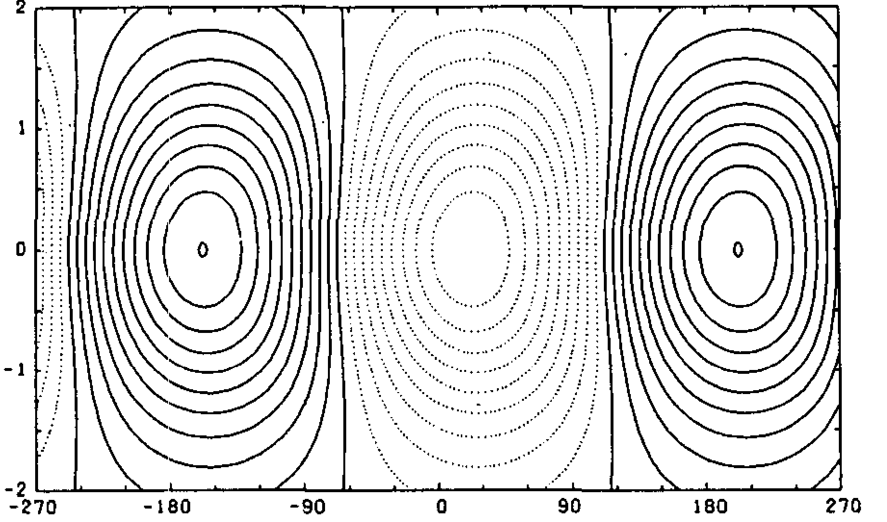
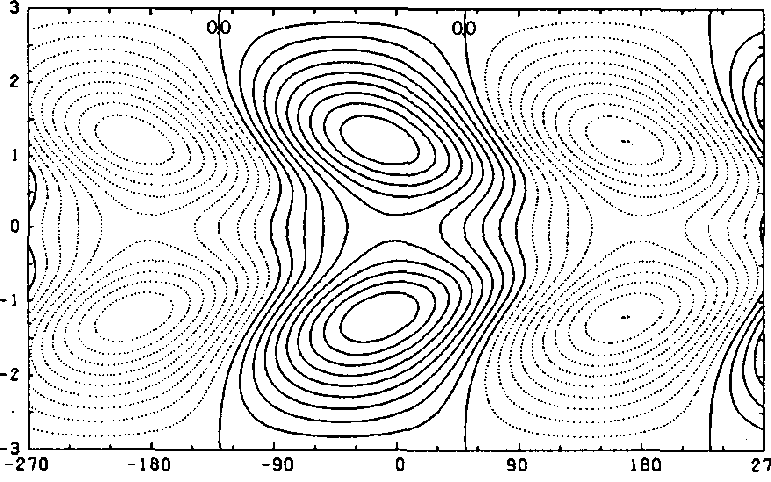
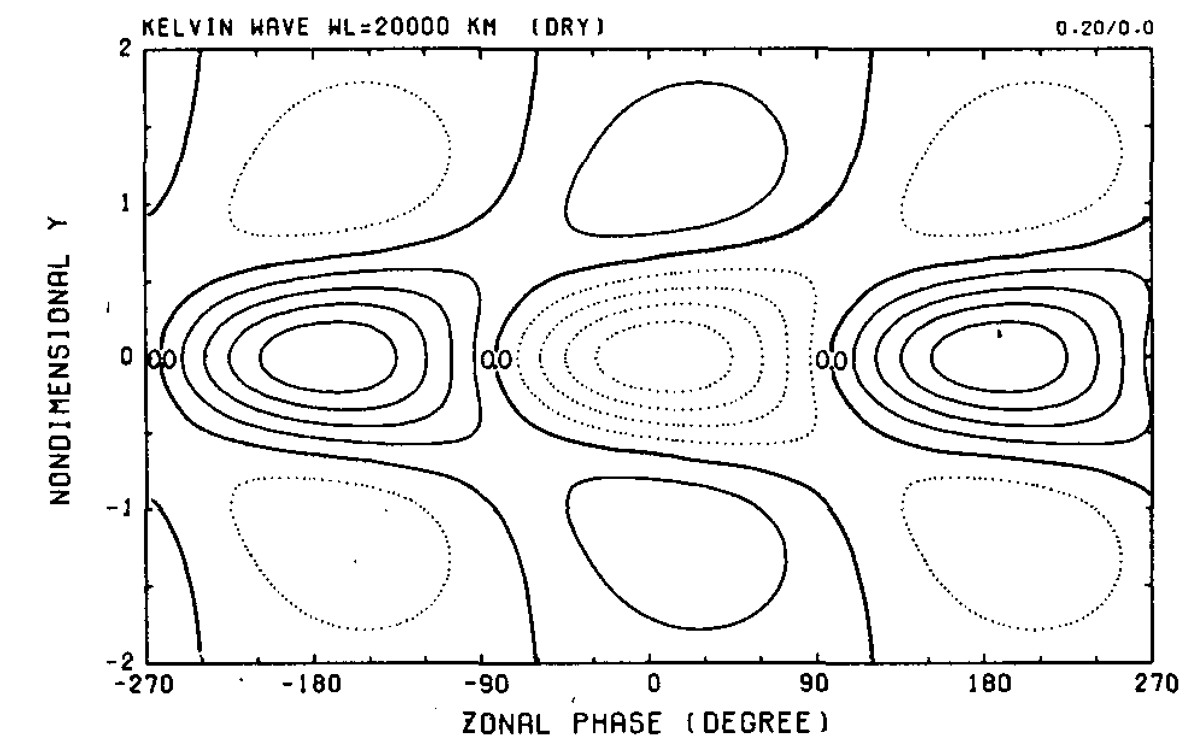
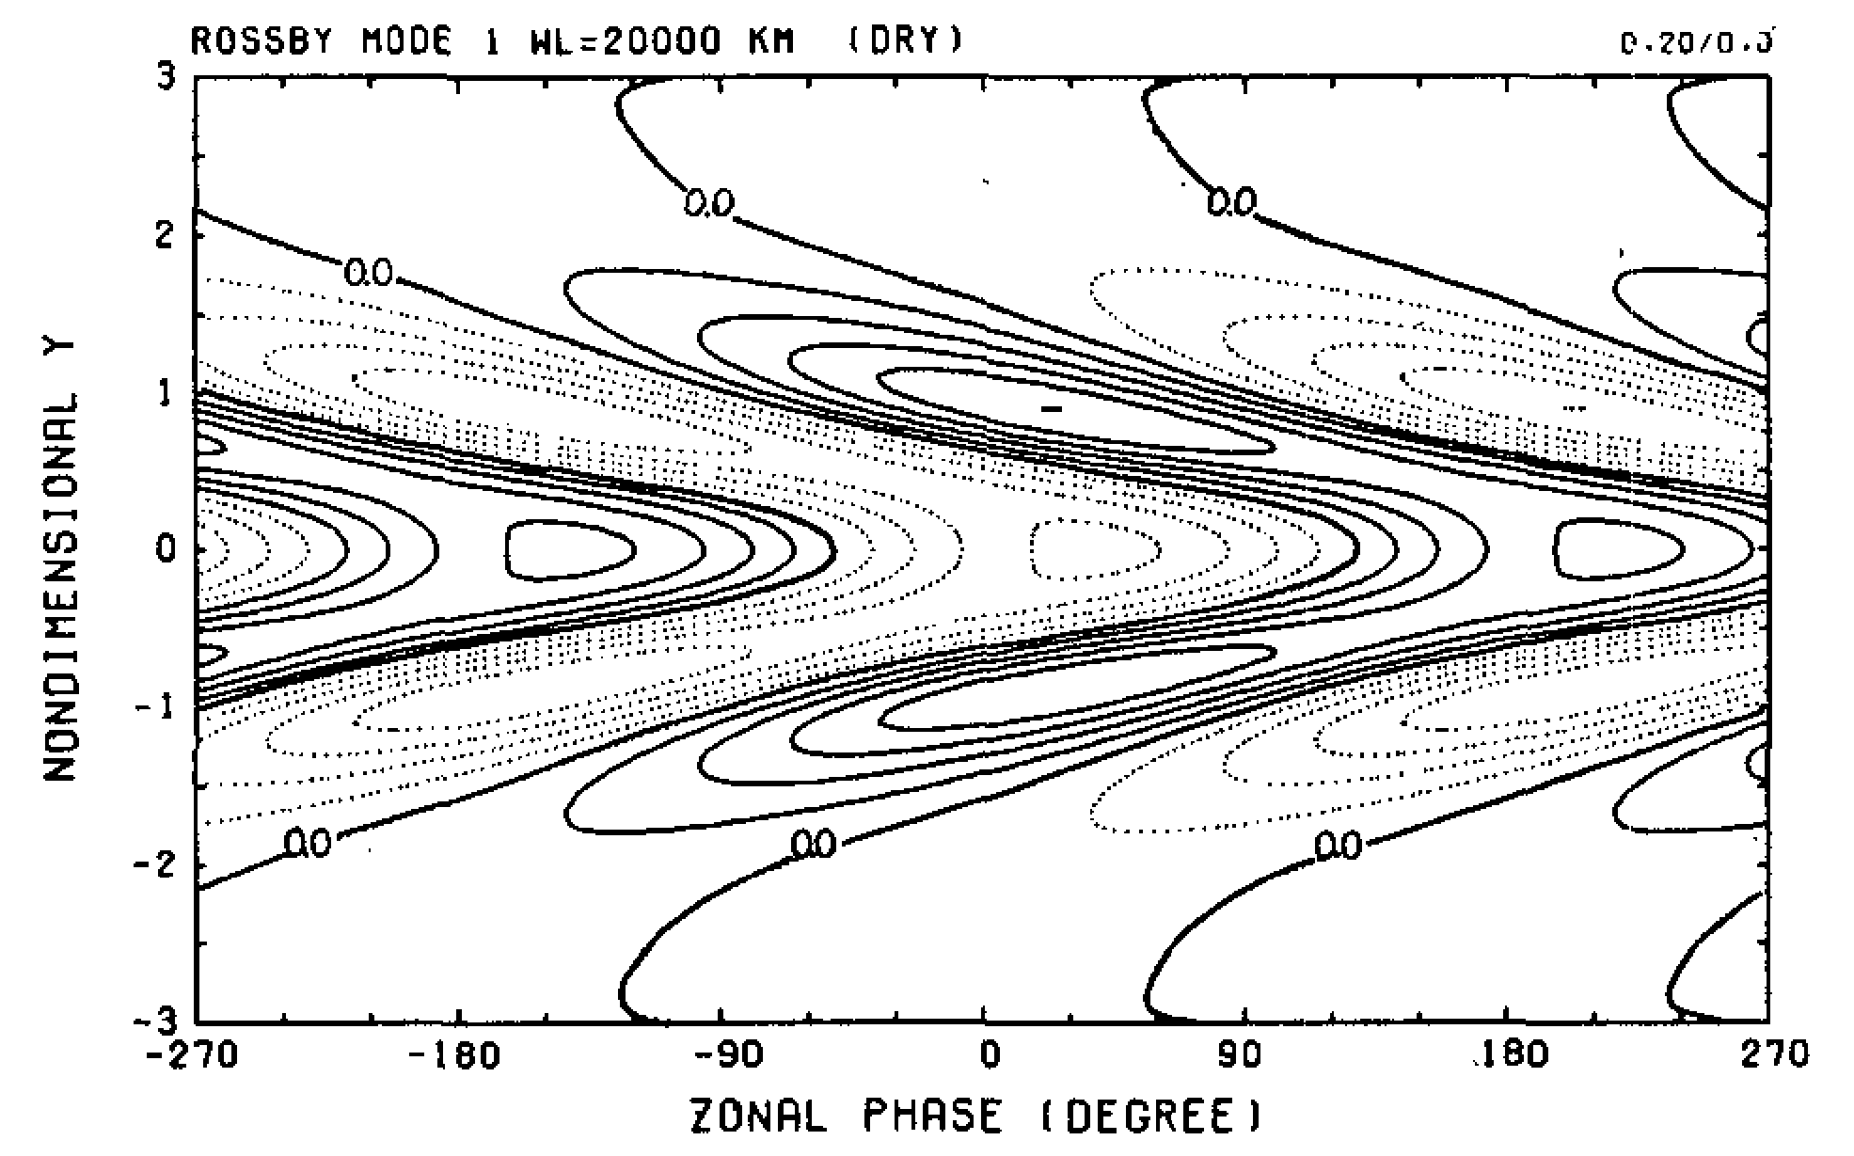
Boundary layer convergence associated with
Kelvin Wave
Rossby Wave
(a)
Non-dimensional Y
(b)
Zonal Phase (degree)
Both K and R waves create a unified boundary layer convergence field
leading the major convective heating,
creating east-west moisture asymmetry, and
Resulting in vertical backward tilted structure.
Wang and Rui 1990

Slide 17
PBL-Moistening creates convectively unstable stratification ahead of MJO convection
MJO equivalent potential temp.
Convective instability index:
unstable
stratification
Stable stratification
Hsu and Li, 2012
MJO convection

Slide 18
Vertical Structure and Diabatic Processes of
the MJO: Global Model Evaluation Project
MJO Task Force/YOTC and GASS
Lag-regression of rainfall with Indian Ocean (70-90E; 5S-5N) base point
20-100day filtered
dash line – 5 m/s
Jiang et al. 2013

Slide 19
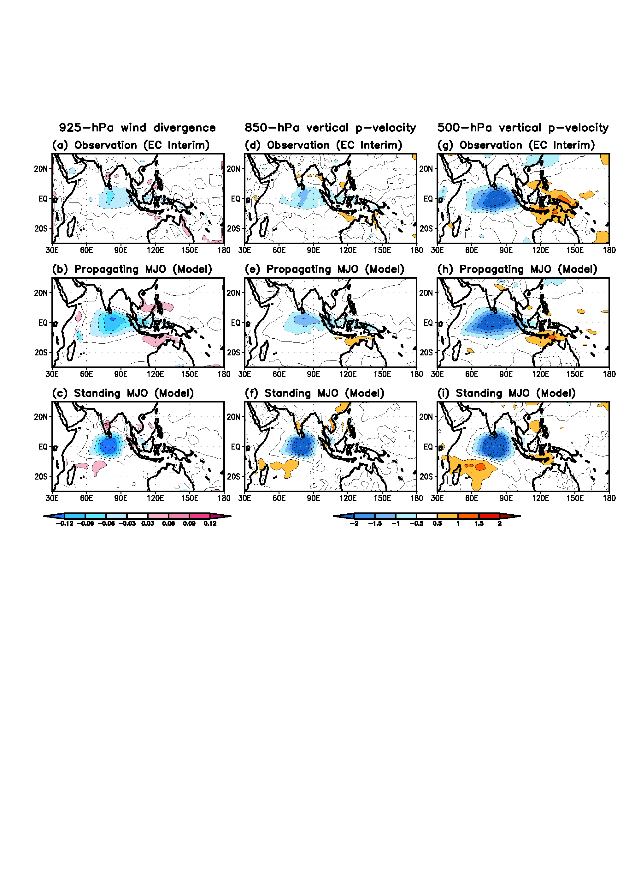
Composite vertical p-velocity with reference to the MJO wet phase centered at (5S-5N, 70-90E) reaches maximum.

Slide 20
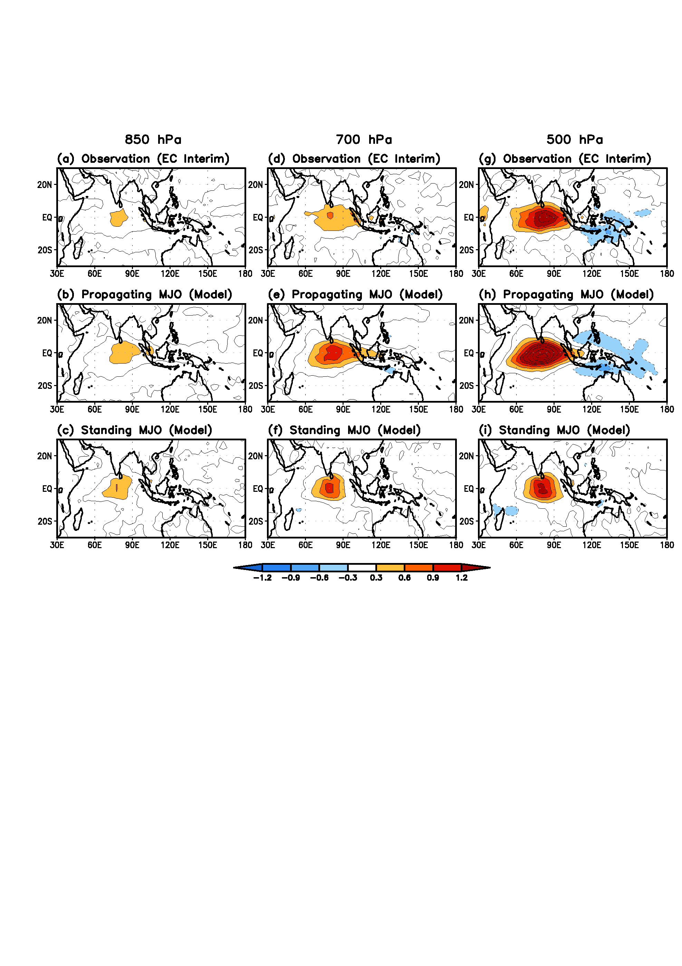
Composite diabatic heating fields (K/day) at 850 hPa (left panels), 700 hPa (middle panels), and 500 hPa (right panels) with reference to the MJO wet phase in the equatorial Indian Ocean (EIO) for (a)(d)(g) Observation (EC Interim), (b)(e)(h) Propagating MJO (model), and (c)(f)(i) Standing MJO (model). The EIO wet phase is defined by the precipitation averaged in the region (5S-5N, 70-90E) reaches maximum.

Slide 21
Roles of Frictional moisture feedback
couples K and R waves and convection heating, explaining MJO horizontal structure;
Creates upward and westward tilt of vertical motion (vertical structure)
generates E-W moisture asymmetry that establishes convective instability to the east of MJO convection, selecting eastward propagation.
generates instability in a stable regime to wave-CISK.
slowing down eastward propagation due to coupling Rossby and Kelvin waves.
Other mechanisms for slow eastward propagation: reduction of effective static stability, air-sea interaction

Slide 22
Frictionally coupled K-R wave theory
.
Links convective heating, large-scale waves and PBL thermodynamics (moist entropy) and allow instability in a stable regime to wave-CISK. Frictional moisture convergence feedback provides mechanisms for
selecting eastward propagating planetary scale waves,
upward and westward tilt of vertical motion,
horizontal structure of coupled Kelvin-Rossby wave packet, and
low-frequency amplification.

Slide 23
3. BSISO:
Modified MJO mode by seasonal mean circulation

Slide 24
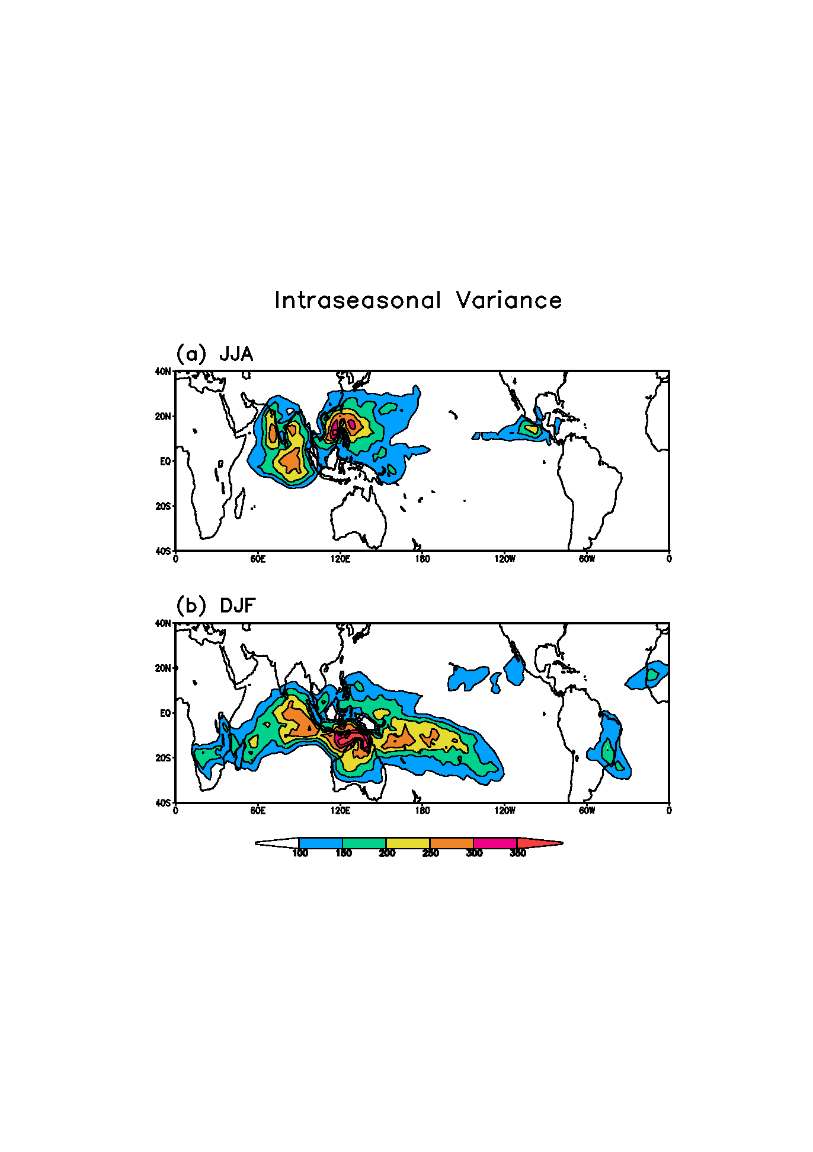
OLR
1979-2010
Why the variability center shift to monsoon region
1979~2010
How the tilted rain band form
Why move northward

Slide 25
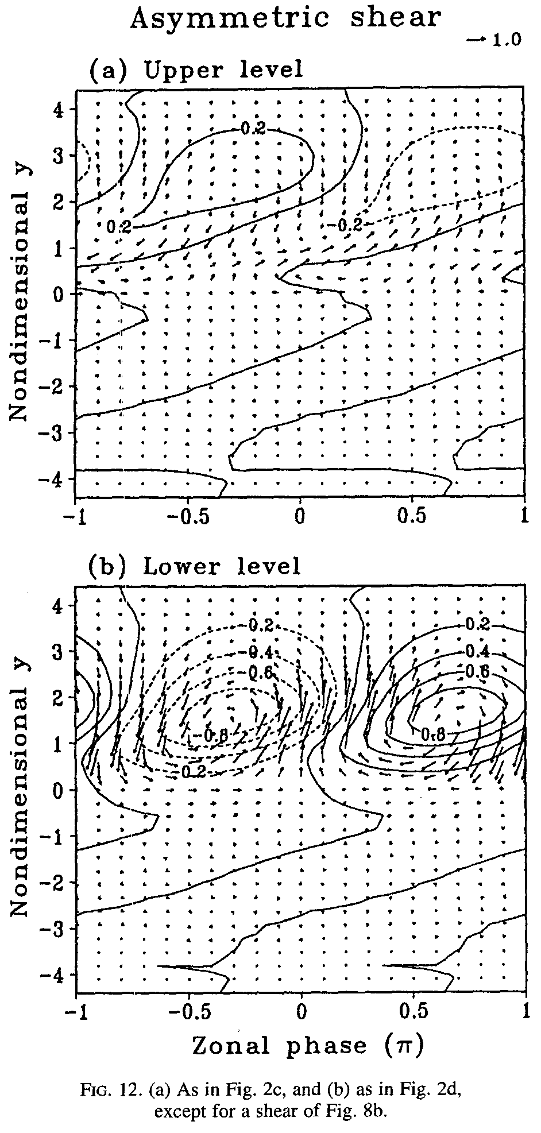
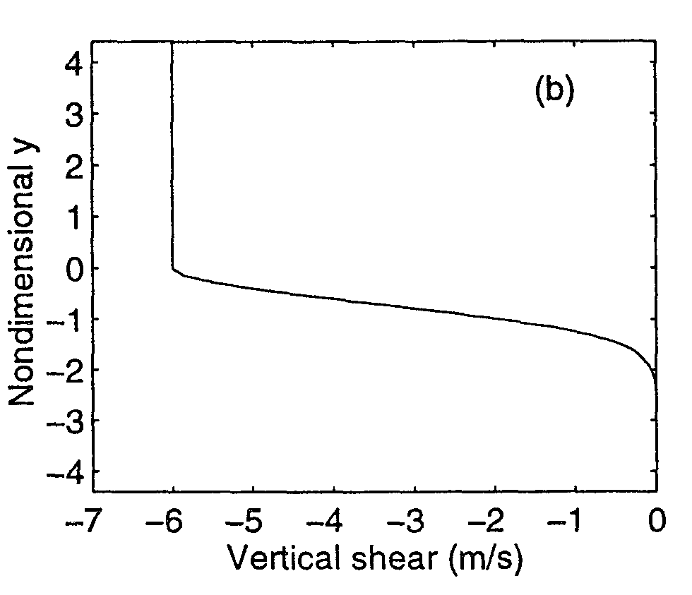
Monsoon Easterly Vertical Shear can dramatically change Horizotal and Vertical structure of the moist ERW
Vertical easterly shear sets in NH only
Upper
Lower
Rossby waves will be enhanced in the vicinity of the latitudes where the vertical shear is strengthened.
Equatorial symmetric Rossby waves can become highly asymmetric under the vertical shear and convective interaction.
Xie and Wang 1996 JAS

Slide 26
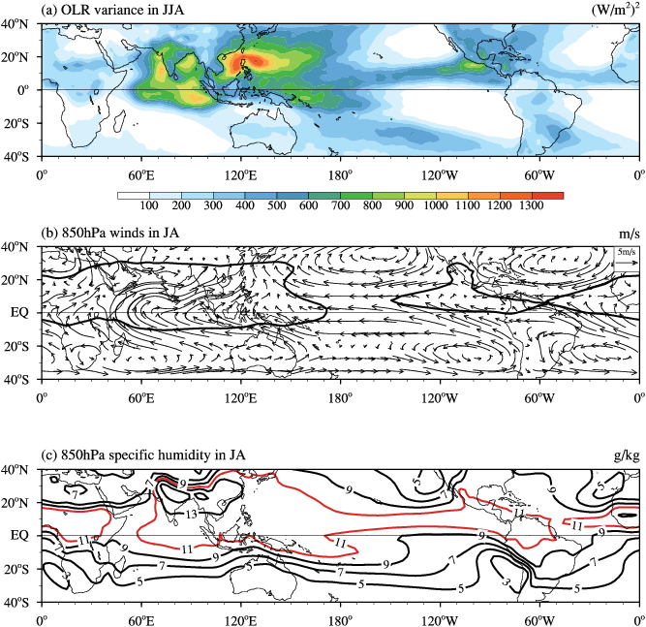
The ISV activity is trapped by boreal summer MSE (or SST) distribution and monsoonal vertical wind shears.

Slide 27
Theoretical Framework for ISO
Two and half layer model for ISV (nondimensional)
Long wave
approximation
Mean flow
effects
Scale
interaction
Boundary layer Ekman Pumping: (Wang and Rui 1990)
Wang and Xie: A model for boreal summer ISO, JAS 1997

Slide 28
Mean Flow Terms

Slide 29
BSISO model Rainfall Anomaly
Formation of NW-SE slanted precipitation band
The RW is trapped in NH and has a northward propagation component
Wang and Xie 1997,
Drbohlav and Wang 2005

Slide 30
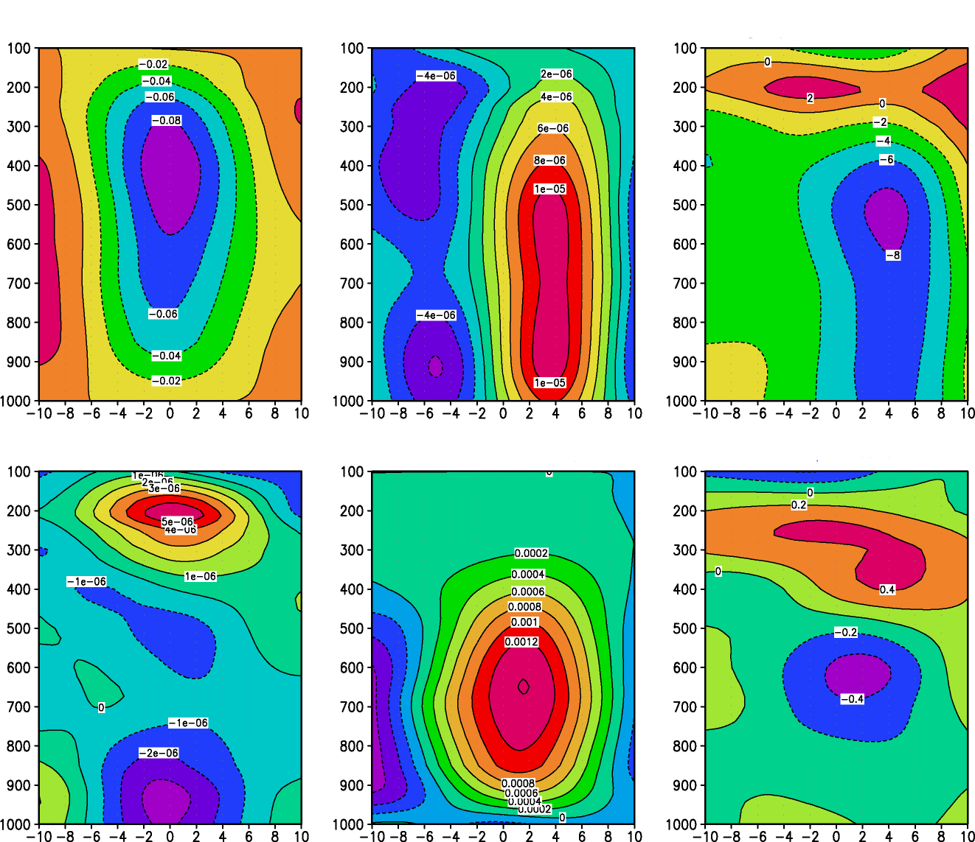
Cyclonic Vorticity is seen north of the BSISO convection
Vertical velocity
Vorticity
S
C
N
S
C
N
Barotropic cyclonic vorticity induces boundary layer moisture convergence that leads to northward propagation of BSISO convection.
Jiang et al. 2003

Slide 31
Monsoonal vertical wind shear induces N-propagation
z
CONV
CONV
PBL
y (North)
x (East)
Generation of Barotropic Vorticity
Wang : Theory in Lau and Waliser 2005
Wang and Xie 1996

Slide 32
BSISO Dynamics
.
BSISO is a modified MJO mode (the frictionally coupled moist Kelvin-Rossby wave) by boreal summer mean flows.
The BSISO variability pattern is controlled by trapping effects of combined Easterly Vertical Shear and Moist Static Stability.
The convective band forms due to emanation of the moist Rosbby waves as equatorial K-R Couplet weakens.
Easterly Vertical wind shear plays a key role in formation of the BSISO rain band and northward propagation of the BSISO.

Slide 33
4. Multi-scale interaction in MJO dynamics
To what extent and under what conditions do the upscale eddy momentum, heat, and moisture transports contribute to MJO dynamics?

Slide 34
Two and half layer model of MJO
Scale
interaction
Long wave
approximation
Mean flow
effects
Steady boundary layer: (Wang and Rui 1990)
Basic MJO model: neglects scale interaction, mean flow, air-sea interaction

Slide 35
Meso-Synoptic Eddy transfer terms
(1)
(2)
(3)
(4)
Majda and Klein 2003)

Slide 36
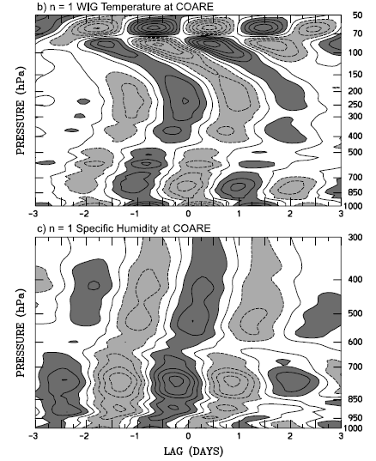
Observed vertical structure of synoptic-scale waves
MKW
WIG
q
Vertical tilt against movement
Kiladis et al. 2009

Slide 37
Nondimensional Meso-Synoptic scale models
MKW
WIG
Liu and Wang 2012

Slide 38
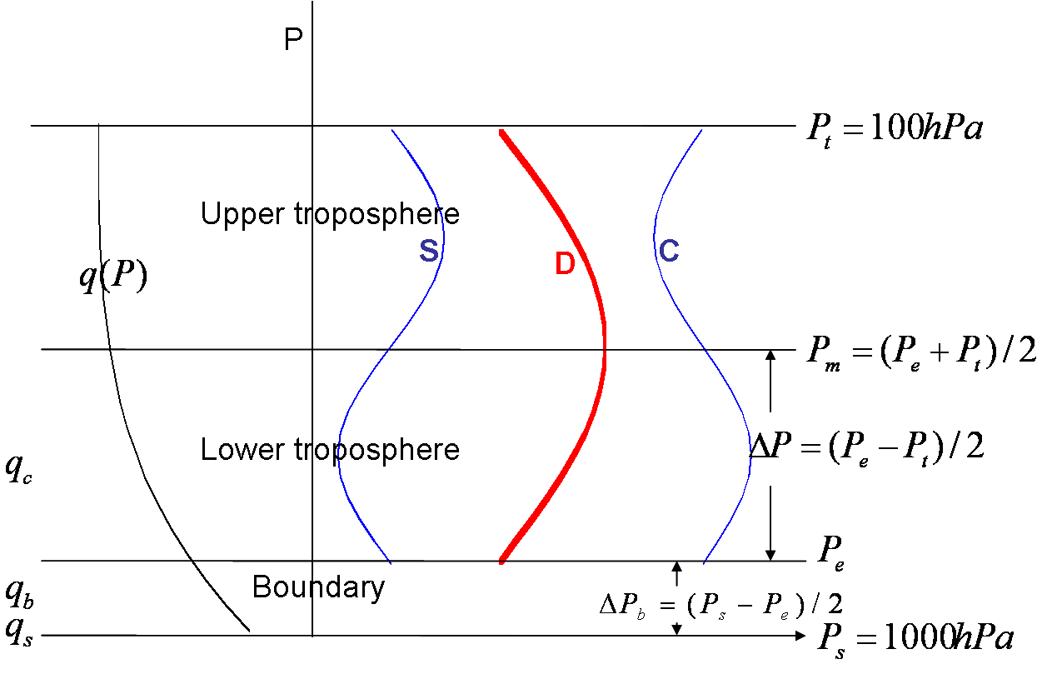
Cloud heating profile and model vertical structure
Schematic diagram describing the model vertical structure, the vertical profile of the basic state specific humidity (q) and heating profiles associated with the stratiform (S), deep convection (D) and congestus (C) clouds, respectively.
Khouider and Majda, 2007

Slide 39
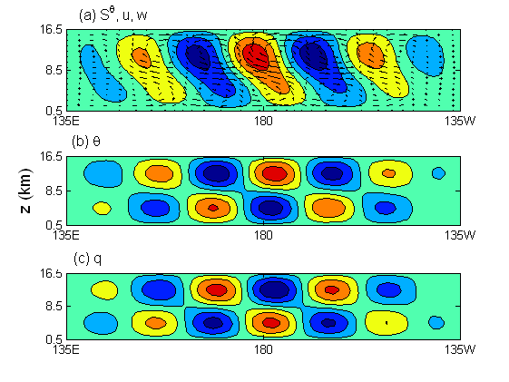
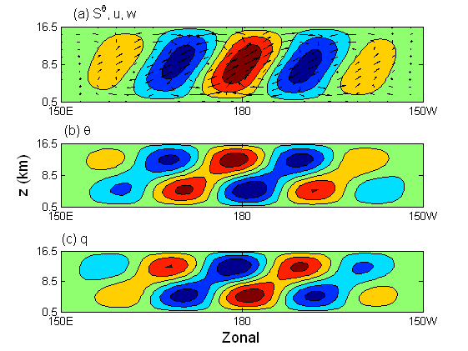
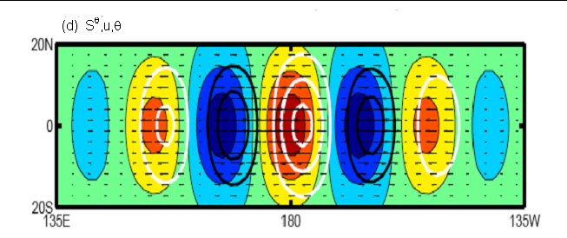
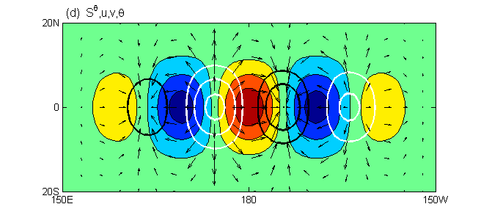
Simulated structures of synoptic-scale waves
MKW- Westward tilt
WIG- Eastward tilt
Equatorial
Vertical
Horizontal
At mid-level

Slide 40
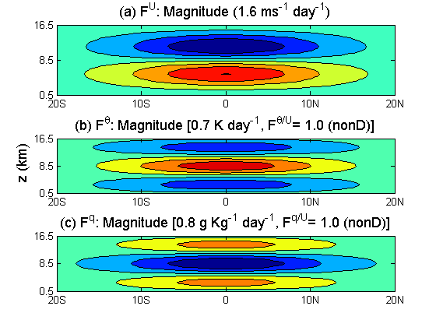
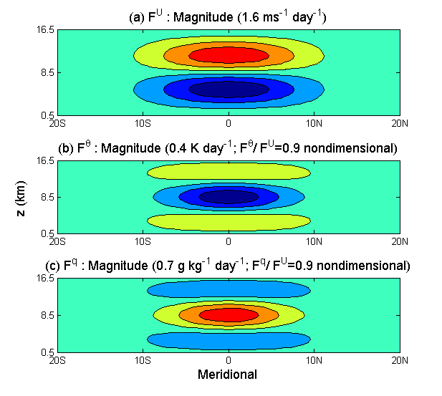
Upscale Eddy Transfer of momentum, heat, moisture
MKW
12.5 K Day⁻¹
WIG
8.0 K Day⁻¹
Zonal phase independent
Westward tilted MKWs produce lower-tropospheric westerly EMT, positive mid-tropospheric EHT and negative mid-tropospheric EQT.
The eastward tilted WIGs produce opposite Eddy forcing compared with those of EKW!
Liu and Wang (2012)

Slide 41
Impact of Eddy Momentum Transfer (EMT) induced by super cloud clusters (MKW) and two-day waves (WIG) on MJO
The contributions of eddy forcing to development and maintenance of MJO critically depend on their relative phases of occurrence in MJO convective envelope.
Wang and Liu 2011 JAS

Slide 42
Two and half layer MJO MSI model
(1)
(2)
(3)
(4)
(5)
Parameterization of the EMT of MKW and WIG
Deep convective
Congestus/Stratiform
ALPHA: Ratio of deep convective versus total condensation heating

Slide 43
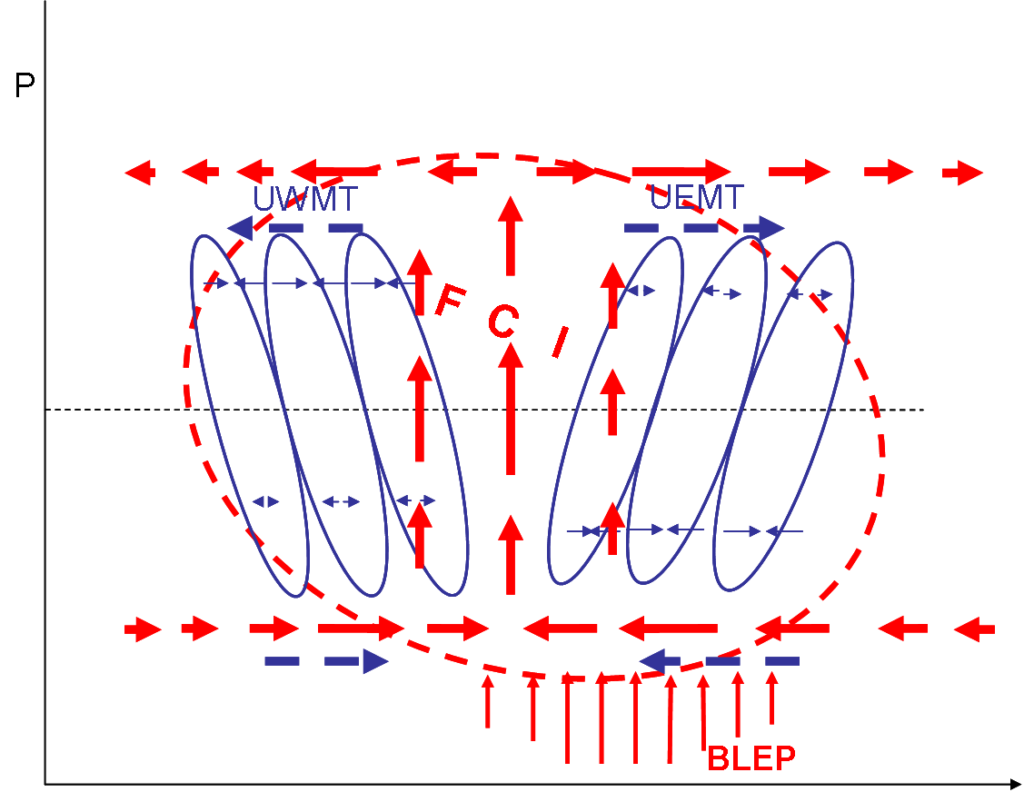
EMT induced instability
Eddy forcing of MKW and WIG waves
MJO convective complex
SCC
2-Day waves
Boundary layer
East

Slide 44
Growth rate and phase speed
Growth rate (day⁻¹)
Three types of instability
Phase speed (m s⁻¹)
The Instability properties of the FCI, CMT and MSI modes for wave-1 as functions of (the ratio of deep convective versus total condensation heating).

Slide 45
Summary
Role of the upscale eddy momentum transfer
EMT mechanism: a stationary quadrupole mode (enhanced Rossby wave comp.); The FCI mechanism favors a fast eastward-moving mode with a Gill-pattern-like structure (enhanced Kelvin wave comp.).
MSI instability (a combination of FCI or EMT) depends on the ratio of deep convective versus stratiform/congestus heating. With increasing stratiform/congestus heating, the FCI weakens while the CMT becomes more effective.
Instability occurs only when EMTs of MKW and WIG are located on the rear and front of the MJO, respectively.
A growing MSI mode has a mixed horizontal quadrupole structure and prefers slow eastward propagation of wavenumber 1. FCI sets the eastward propagation, CMT slows down the propagation.

Slide 46
MJO Skeleton model
(Majda and Stechmann 2009; Liu and Wang 2012)
Assumption:
Frictional skeleton model
Liu and Wang 2012
Skeleton model
Majda and Stechmann 2009

Slide 47
Thank you!

Slide 48
Supporting figures

Slide 49
Essential Large Scale
MJO dynamics
Low-Frequency
Equatorial Waves
SST controls
Of basic state MSE
Convective
Latent
Heating
Boundary
Layer
Dynamics
Moisture
Distribution
Wang 1988
Land-sea Distribution | Climatological SST | Surface Heat Flux
Lower boundary forcing

Slide 50
BSISO: Essential Physical Processes
Boreal Summer
ISO
Essential Large scale
MJO dynamics
Low-Frequency
Equatorial Waves
Background Circulation
(Annual & Interannual )
Convective
Latent
Heating
Boundary
Layer
Dynamics
Moisture
Distribution
Land-sea Distribution | Climatological SST | Surface Heat Flux
Lower boundary forcing

Slide 51

PBL moistening creates moisture-convection phase lead
①
②
① Free tropospheric moisture convergence reduce effective static stability
② PBL Moisture convergence generates moisture leading convection
W
Free Atmosphere
H
L
W_{b}
W_{b}
EQ.
PBL
Frictional
Convergence

Slide 52
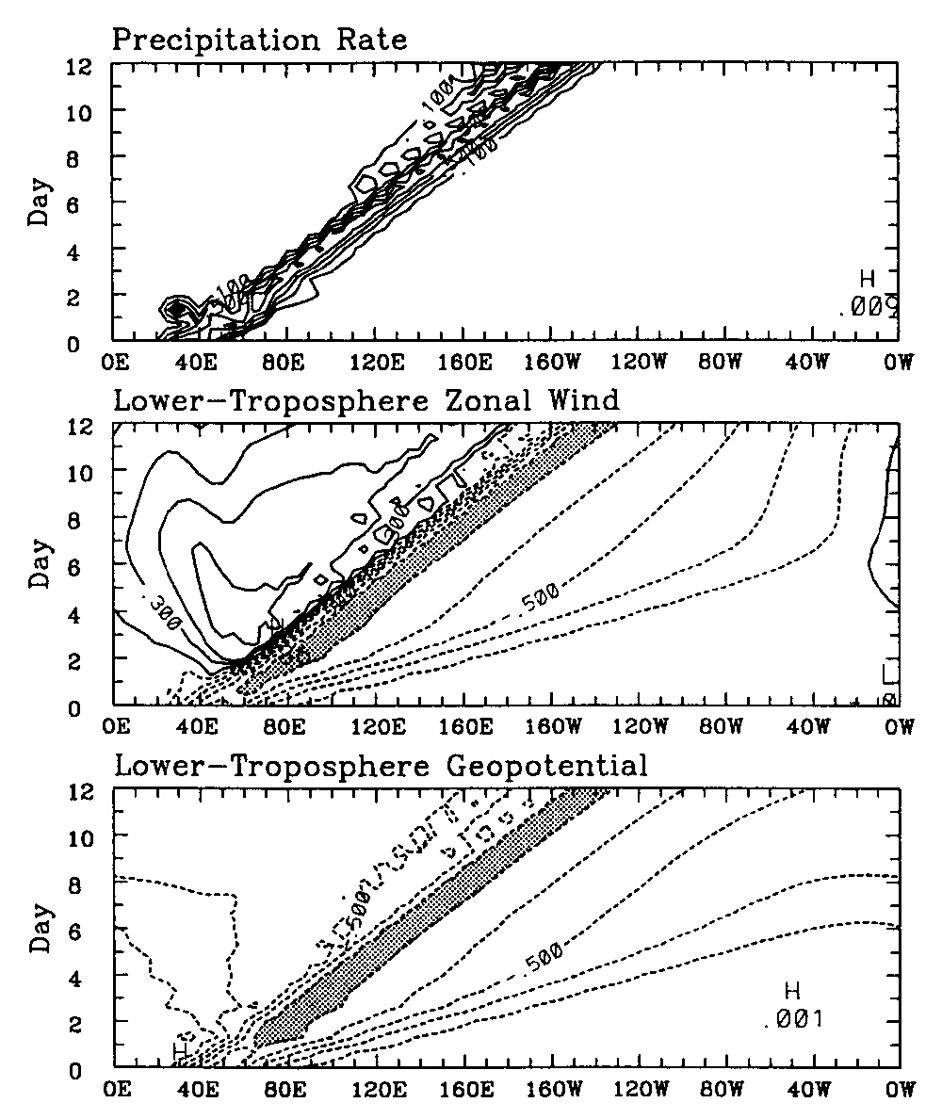
Why MJO has a planetary zonal scale
Role of nonlinear heating
A portion of the eddy available potential energy is carried away from the core convective regions by fast moving, dry Kelvin and Rossby waves, which spread perturbed circulation around the globe. This energy dispersion accounts for the planetary circulation scale of the MJO.
Wang and Li 1994

Slide 53
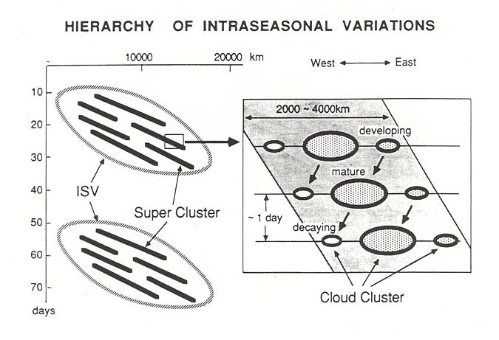
Multi-scale structure of the convective complex
Nakazawa 1988

Slide 54
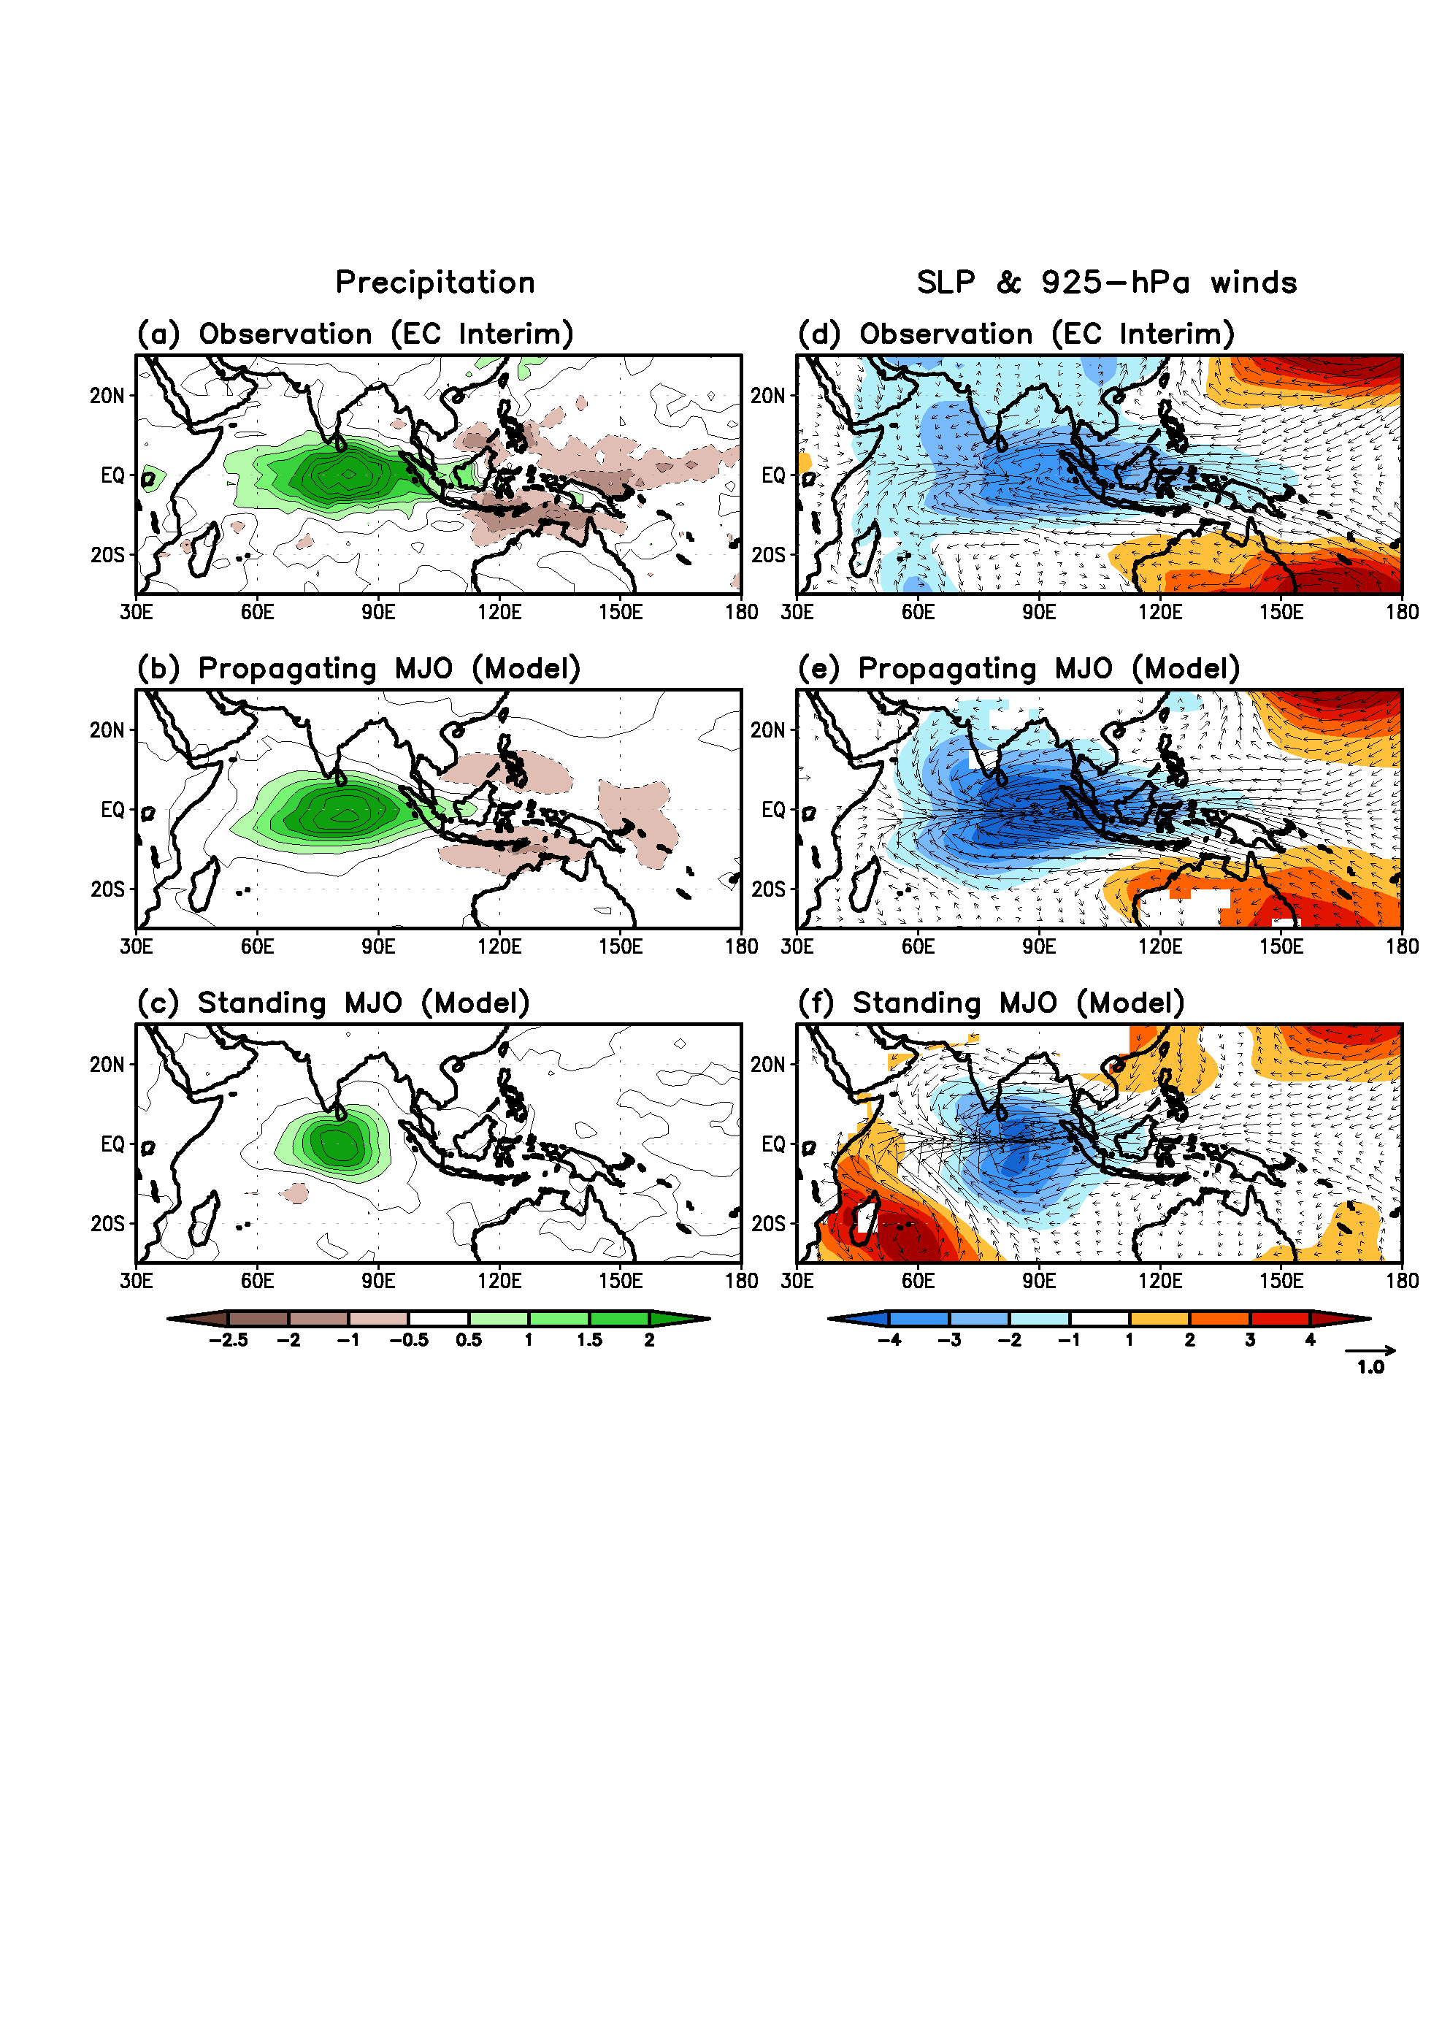
Fig. 1 Composite precipitation (mm/day) (left panels) and SLP (shading) and 925 hPa winds (m/s, vector) (right panels) fields with reference to the MJO wet phase in the equatorial Indian Ocean(EIO) for (a)(d) Observation (EC Interim), (b)(e) Propagating MJO (model), and (c)(f) Standing MJO (model). The EIO wet phase is defined by the precipitation averaged in the region (5S-5N, 70-90E) reaches maximum.
In left panels, 925-hPa geopotential height has been plotted instead of SLP. I will change to SLP when Dr. Jiang send SLP data.

Slide 55
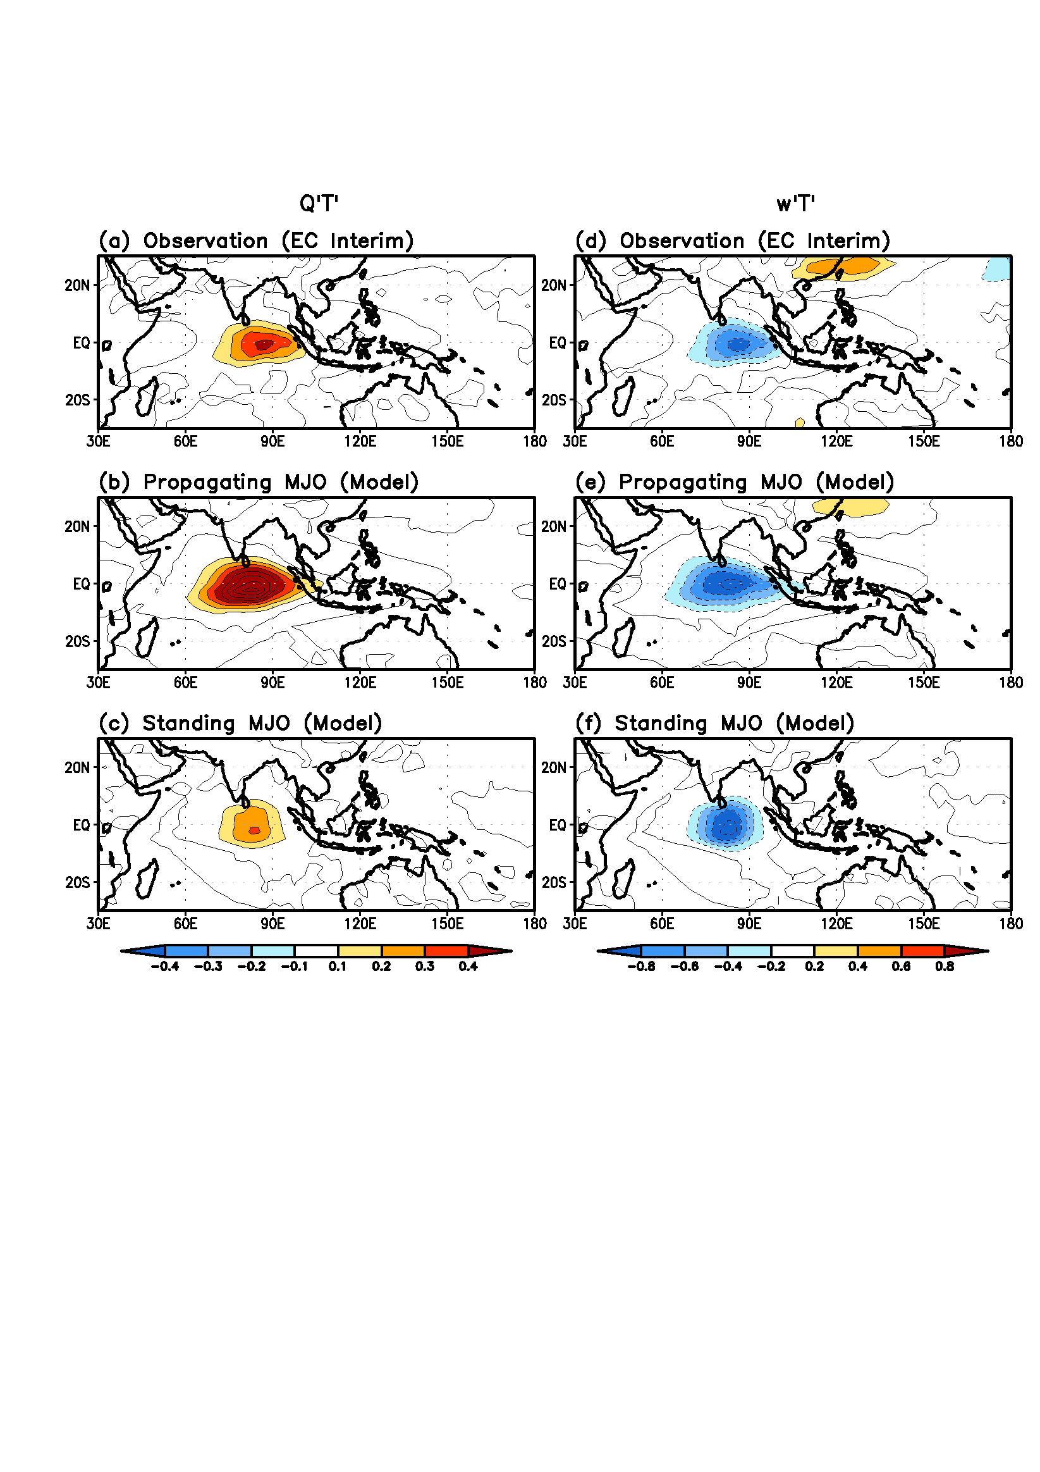
Fig. 4 Comparison of the composite Q’T’ (A) and W’T’ (B) fields at 500 hPa between observation and theoretical model

Slide 56
DJF mean state
Convection center is located at
(5S-5N, 70E-90E)
OBS
Shading: 900 hPa
Contours: 500 hPa
Model
Comparison of vertical pressure velocity at 850 hPa (900 hPa) and 500 hPa for observation and theoretical model

Slide 57
OBS
Model
Comparison of Observation and theoretical model results

Slide 58
Interaction between moist Rossby wave and the vertical shear of the mean monsoon provides a mechanism for the formation of the slanted ISO rain band.
Mean flows removed
Uniform SST
Only Monsoon vertical
Shear included
Drbohlav and Wang 2005

Slide 59
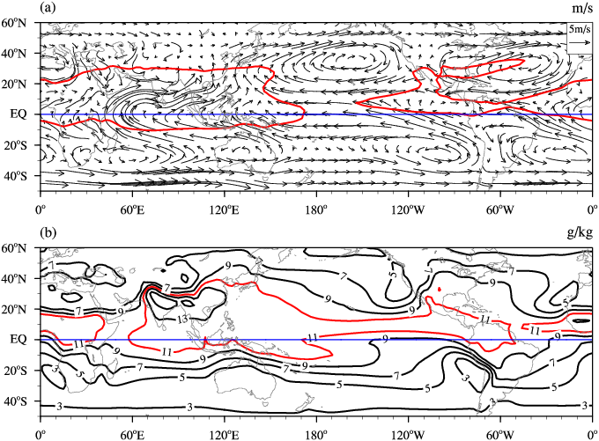
July-August mean states

Slide 60
Three types of instability
Planetary scale motion: FCI: Frictional convergence instability (Coupled Kelvin-Rossby waves by BL convergence
EMT instability induced by Synoptic eddy forcing
MSI: Instability resulting from Multi-scale Interaction

Slide 61





Vertical Structure and Diabatic Processes of
the MJO: Global Model Evaluation Project
MJO Task Force/YOTC and GASS
www.ucar.edu/yotc/mjodiab.html
Model Experiment
Science Focus
Exp. POC
20 Yr Climatological Simulations
(1991-2010 if AGCM)
6-hr, Global Output
Vertical Structure, Physical Tendencies
Model MJO Fidelity
Vertical structure
Multi-scale Interactions:
(e.g., TCs, Monsoon, ENSO)
UCLA/JPL
X. Jiang
D. Waliser
I.
II.
2-Day MJO Hindcasts
YOTC MJO Cases E & F (winter 2009)*
Time Step, Indo-Pacific Domain Output
Very Detailed Physical/Model Processes
Heat and moisture budgets
Model Physics Evaluation
(e.g. Convection/Cloud/BL)
Short range Degradation
Met Office
P. Xavier
J. Petch
20-Day MJO Hindcasts
YOTC MJO Cases E & F (winter 2009)*
3-hr, Global Output
Elements of I & II
MJO Forecast Skill
State Evolution/Degradation
Elements of I & II
NCAS/Walker in.
N. Klingaman
S. Woolnough
III.
*DYNAMO Case TBD
Commitments: About 30 Modeling Groups with AGCM and/or CGCM
Notes:
61

Slide 62
Participating GCMs for Climate Simulation (Experiment Component I)
 | Model | Horizontal Resolution | Vertical Resolution | Cumulus Scheme | Notes
1 | 01_NASAGMAO_GEOS5 | 0.625º lon x 0.5º lat | 72 | RAS (RAS; Moorthi & Suarez 1992)
2 | 03a_SPCCSM (CAM3 + POP) | T42 (~2.8º) | 30 | Super-parameterization (Khairoutdinov & Randall 2003)
3 | 03b_SPCAMP_AMIP | T42 | 30 | (Khairoutdinov & Randall 2001) | 1986-2003
4 | 04_GISS_ModelE2 | 2.75º lon x 2.2º lat | 40 | Kim et al. (2012), Del Geino et al. (2012)
5 | 05_EC_GEM | ~1.4º | 64
6 | 07_MIROC | T85 (~1.5º) | 40 | Chikira scheme (Chikira and Sugiyama 2010) | AMIP SST 1986-2005
7 | 10_MRI-GCM | T159 | 48 | (Pan and Randall 1998)
8 | 11_CWB_GFS | T119 (~1º) | 40 | (RAS; Moorthi & Suarez 1992)
9 | 14_PNU_CFSv1 | T62 (~2º) | 64 | (RAS; Moorthi & Suarez 1992)
10 | 16_MPI_ECHAM6 (ECHAM6 + MPIOM) | T63 ( ~2º) | 47 | (Tiedtke 1989; Nordeng 1994)
11 | 17_MetUM_GA3
12 | 21_NCAR_CAM5
13 | 22_NRL_NAVGEMv.01 | T359 (37km) | 42 | (Hong and Pan 1996; Han and Pan 2011)
14 | 24_UCSD_CAM | T42 (~ 2.8º) | 30 | (Zhang & McFarlane 1995)
15 | 27_NCEPCPC_CFSv2 | T126 (~ 1º) | 64 | (Hong & Pan 1998)
16 | 31a_CNRM_AM | T127 (~1.4º) | 31 | Bougeault (1985)
17 | 31b_CNRM_CM (CNRM_AM+ NEMO)
18 | 31c_CNRM_ACM
19 | 34_CCCma_CanCM4 | T63(?) | 35(?) | (Zhang & McFarlane 1995)
20 | 35_BCCAGCM2.1 | T42 (~2.8 deg) | 26 | (Wu et al 2011)
21 | 36_FGOALS2.0-s | R42 (2.8ºlonx1.6ºlat) | 26 | (Tiedtke 1989; Nordeng 1994)
22 | 37_NCHU_ECHAM5-SIT | T63 | 31 | (Tiedtke 1989; Nordeng 1994)
23 | 37b_NCHU_AGCM
24 | 39_TAMU_Modi-CAM4 (CCSM4) | 2.5 º lon x 1.9 º lat | 26 | (Zhang & McFarlane 1995) | Idealized tilted heating
25 | 40_ACCESS (modified METUM) | 1.875º lon x 1.25º lat | 85 | (Gregory and Rowntree 1990)
26 | 43_ISUGCM | T42 (~ 2.8º) | 18 | (Zhang & McFarlane 1995)
27 | 44_LLNL_CAM5ZMMicro
28 | 45_SMHI_ecearth3 | T255(80km) | 91 | IFS cy36r4

