Slide 1



MJO Moistening Processes Deduced from DYNAMO Sounding (and Radar) Data
Richard H. Johnson
Paul E. Ciesielski
James H. Ruppert, Jr.
Colorado State University
Masaki Katsumata
JAMSTEC, Japan
Zhe Feng
PNNL
Tropical Dynamics Workshop, East-West Center, University of Hawaii, 14-16 January 2014

Slide 2
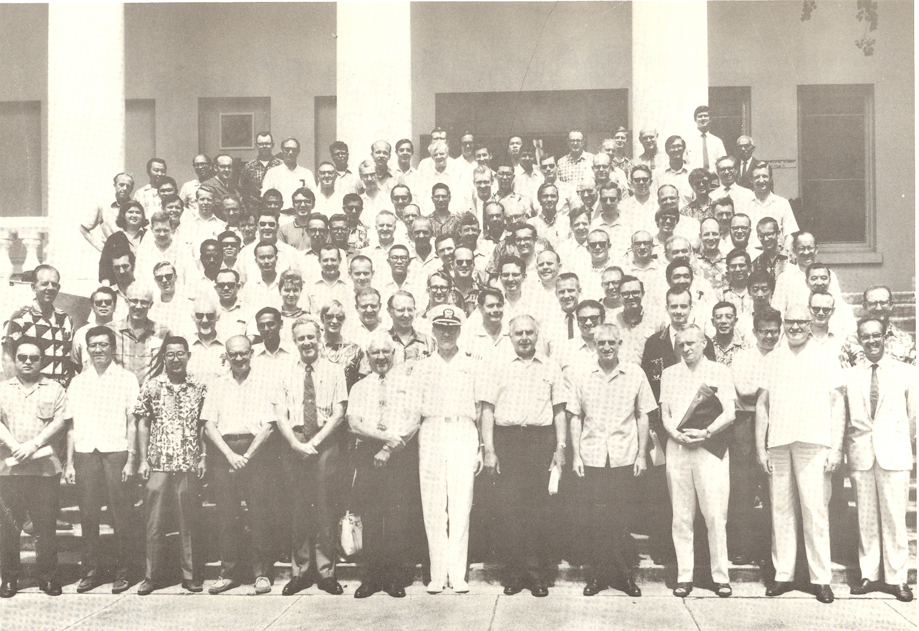
AMS/WMO Symposium on Tropical Meteorology, 1-6 June 1970, Honolulu
van Loon
Spengler
Dunn
Julian
Reed
Gray
Madden
La Seur
Zipser
Jim Sadler
Ruprecht
Holton
Hastenrath
J. Simpson
N. Frank
R. Simpson
Takio Murakami
Jenne
Krish
W. Sam Houston
V. Oliver
Colin Ramage
E. Bollay
P. Kutschenreuter

Slide 3
“Hot Topics” at 1970 Tropical Conference
Planning for “GATE” in Pacific (switched to Atlantic in 1970; Japan pulled out)
“Easterly wave” studies (Reed, Holton)
Results from Line Islands Experiment (1967), including analysis by Madden of 4-5 day tropical variations using Line Islands rawinsonde data
**
**A question raised by Gary Atkinson led to the analysis of a much longer record by Madden using Canton Is. data, and the eventual discovery of the MJO.
Notes:
At meeting in Brussels in 1970 it was decided that due to the availability of resources (ships, satellite), the preferred location for “GATE” – the western Pacific – had to be given up, with the third choice (the eastern Pacific was 2nd), the eastern Atlantic being selected.

Slide 4
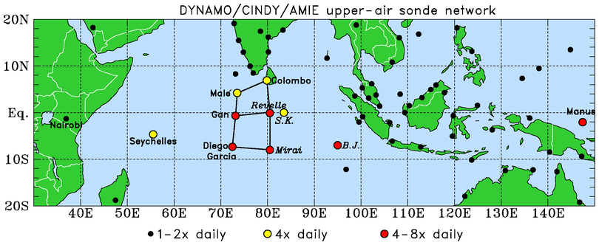
DYNAMO/CINDY/AMIE; October 2011 – March 2012
.
N Array
S Array
Moistening processes during the initiation stage of the MJO
Role of convective cloud populations in MJO initiation
Role of air-sea interaction in the Indian Ocean in MJO initiation
Northern Array: October-early December, 4 & 8/day soundings
Southern Array: October-November, 8/day soundings
Gridded analysis 1 deg, 4/day, using high-res & QC’d sounding data, no model data

Slide 5
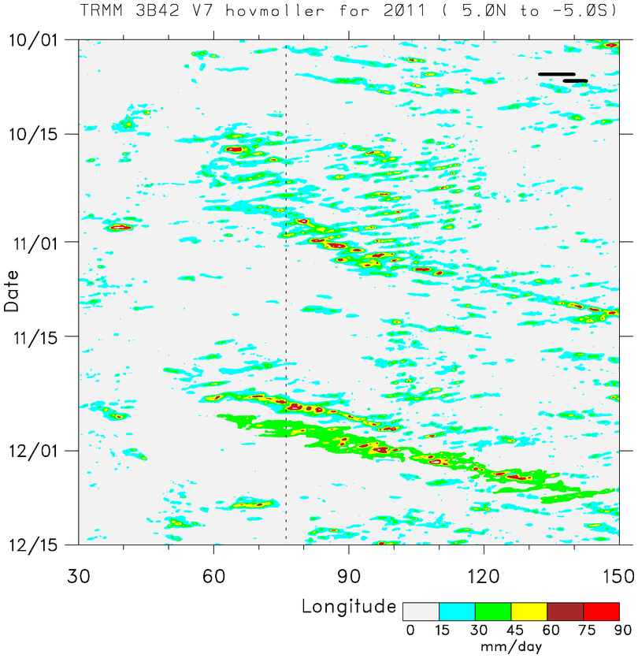
■ Two prominent MJO events: October and November
MJO 1
■ MJO envelopes consists of westward- and eastward-moving disturbances
Time
EAST AFRICA
MJO 2
DYNAMO ARRAY
SUMATRA
■ MJO2: two strong Kelvin waves, shorter precipitation duration
BORNEO

Slide 6
Northern Sounding Array
(NSA)
u
MJO1 preceded by low-level westerlies descent of easterlies; MJO2 by low-level easterlies; WWBs follow each MJO
Low-level moisture build-up several weeks prior to active phases
Prominent UT/LS gravity wave signal
Two-day disturbances with MJO1, 4-5 day period with MJO2
RH
T’
PRECIPITATION
MJO2
MJO1
(Johnson and Ciesielski 2013)

Slide 7
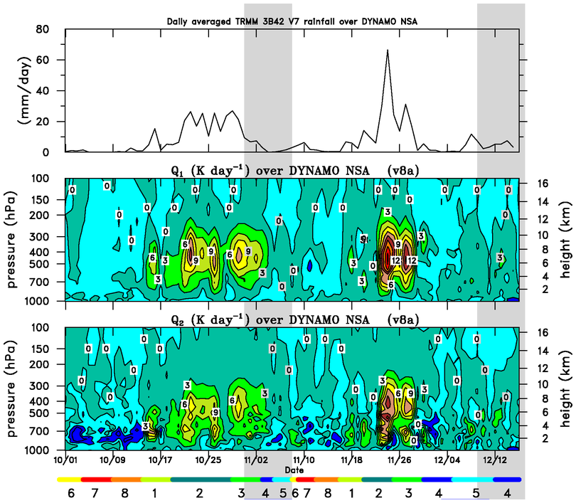
TRMM RAINFALL NORTHERN ARRAY
Agreement lends confidence to budget results
Q₁
Q₂
MJO Phase

Slide 8
“Stepwise” Evolution of Clouds/Moisture During MJO Build-up Phase
W
E
1992-93 TOGA COARE: Kikuchi and Takayabu (2004)
2006 MISMO: Yoneyama et al. 2008; Katsumata et al. (2009)
CALIPSO/CloudSat data: Virts and Wallace (2010); Del Genio et al. (2012)

Slide 9
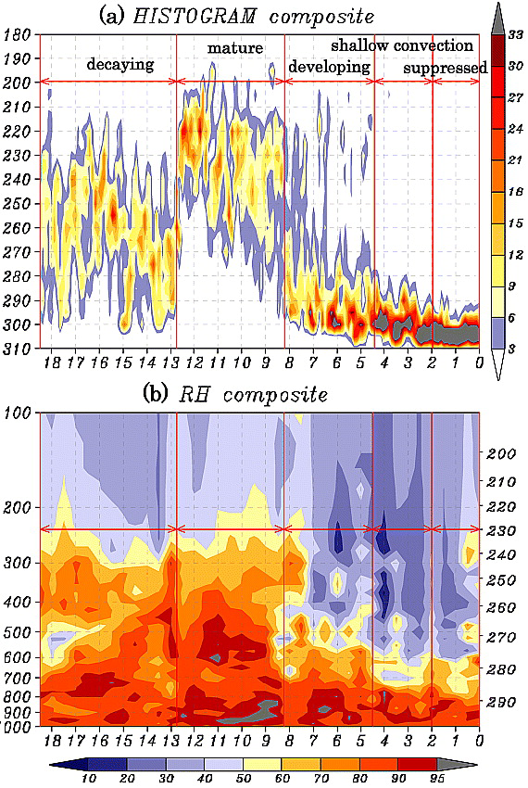
1992-93 TOGA COARE
deep
Kikuchi and Takayabu (2004)
Three stages of convective development and associated moistening
T_{BB}
mid
shallow
RH
deep
mid
shallow
TOGA COARE – 6 Jan-5 Feb (Indonesia)

Slide 10
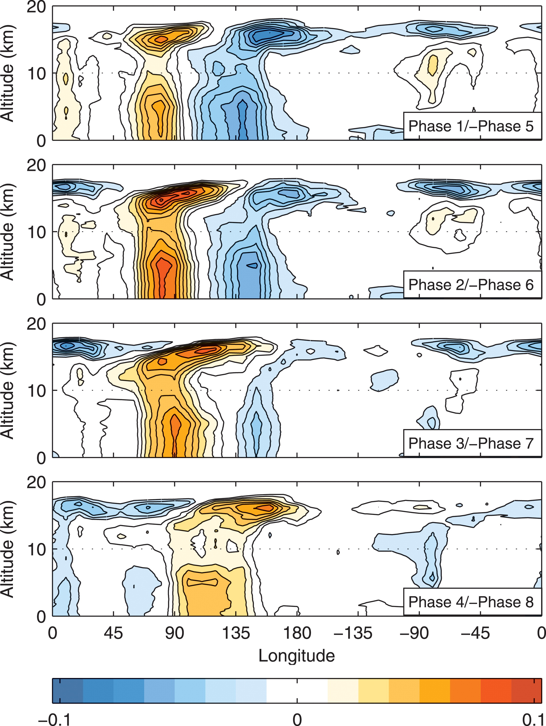
Virts and Wallace(2010)
⬥ CALIPSO (3 years) height-dependent cloud index regressed onto phases of MJO
⬥ Cirrus 30° in advance of deep convection due to gravity/Kelvin wave excited by MJO convective envelope
⬥ Congestus in Phase 3?
Congestus?
CLOUD INDEX

Slide 11
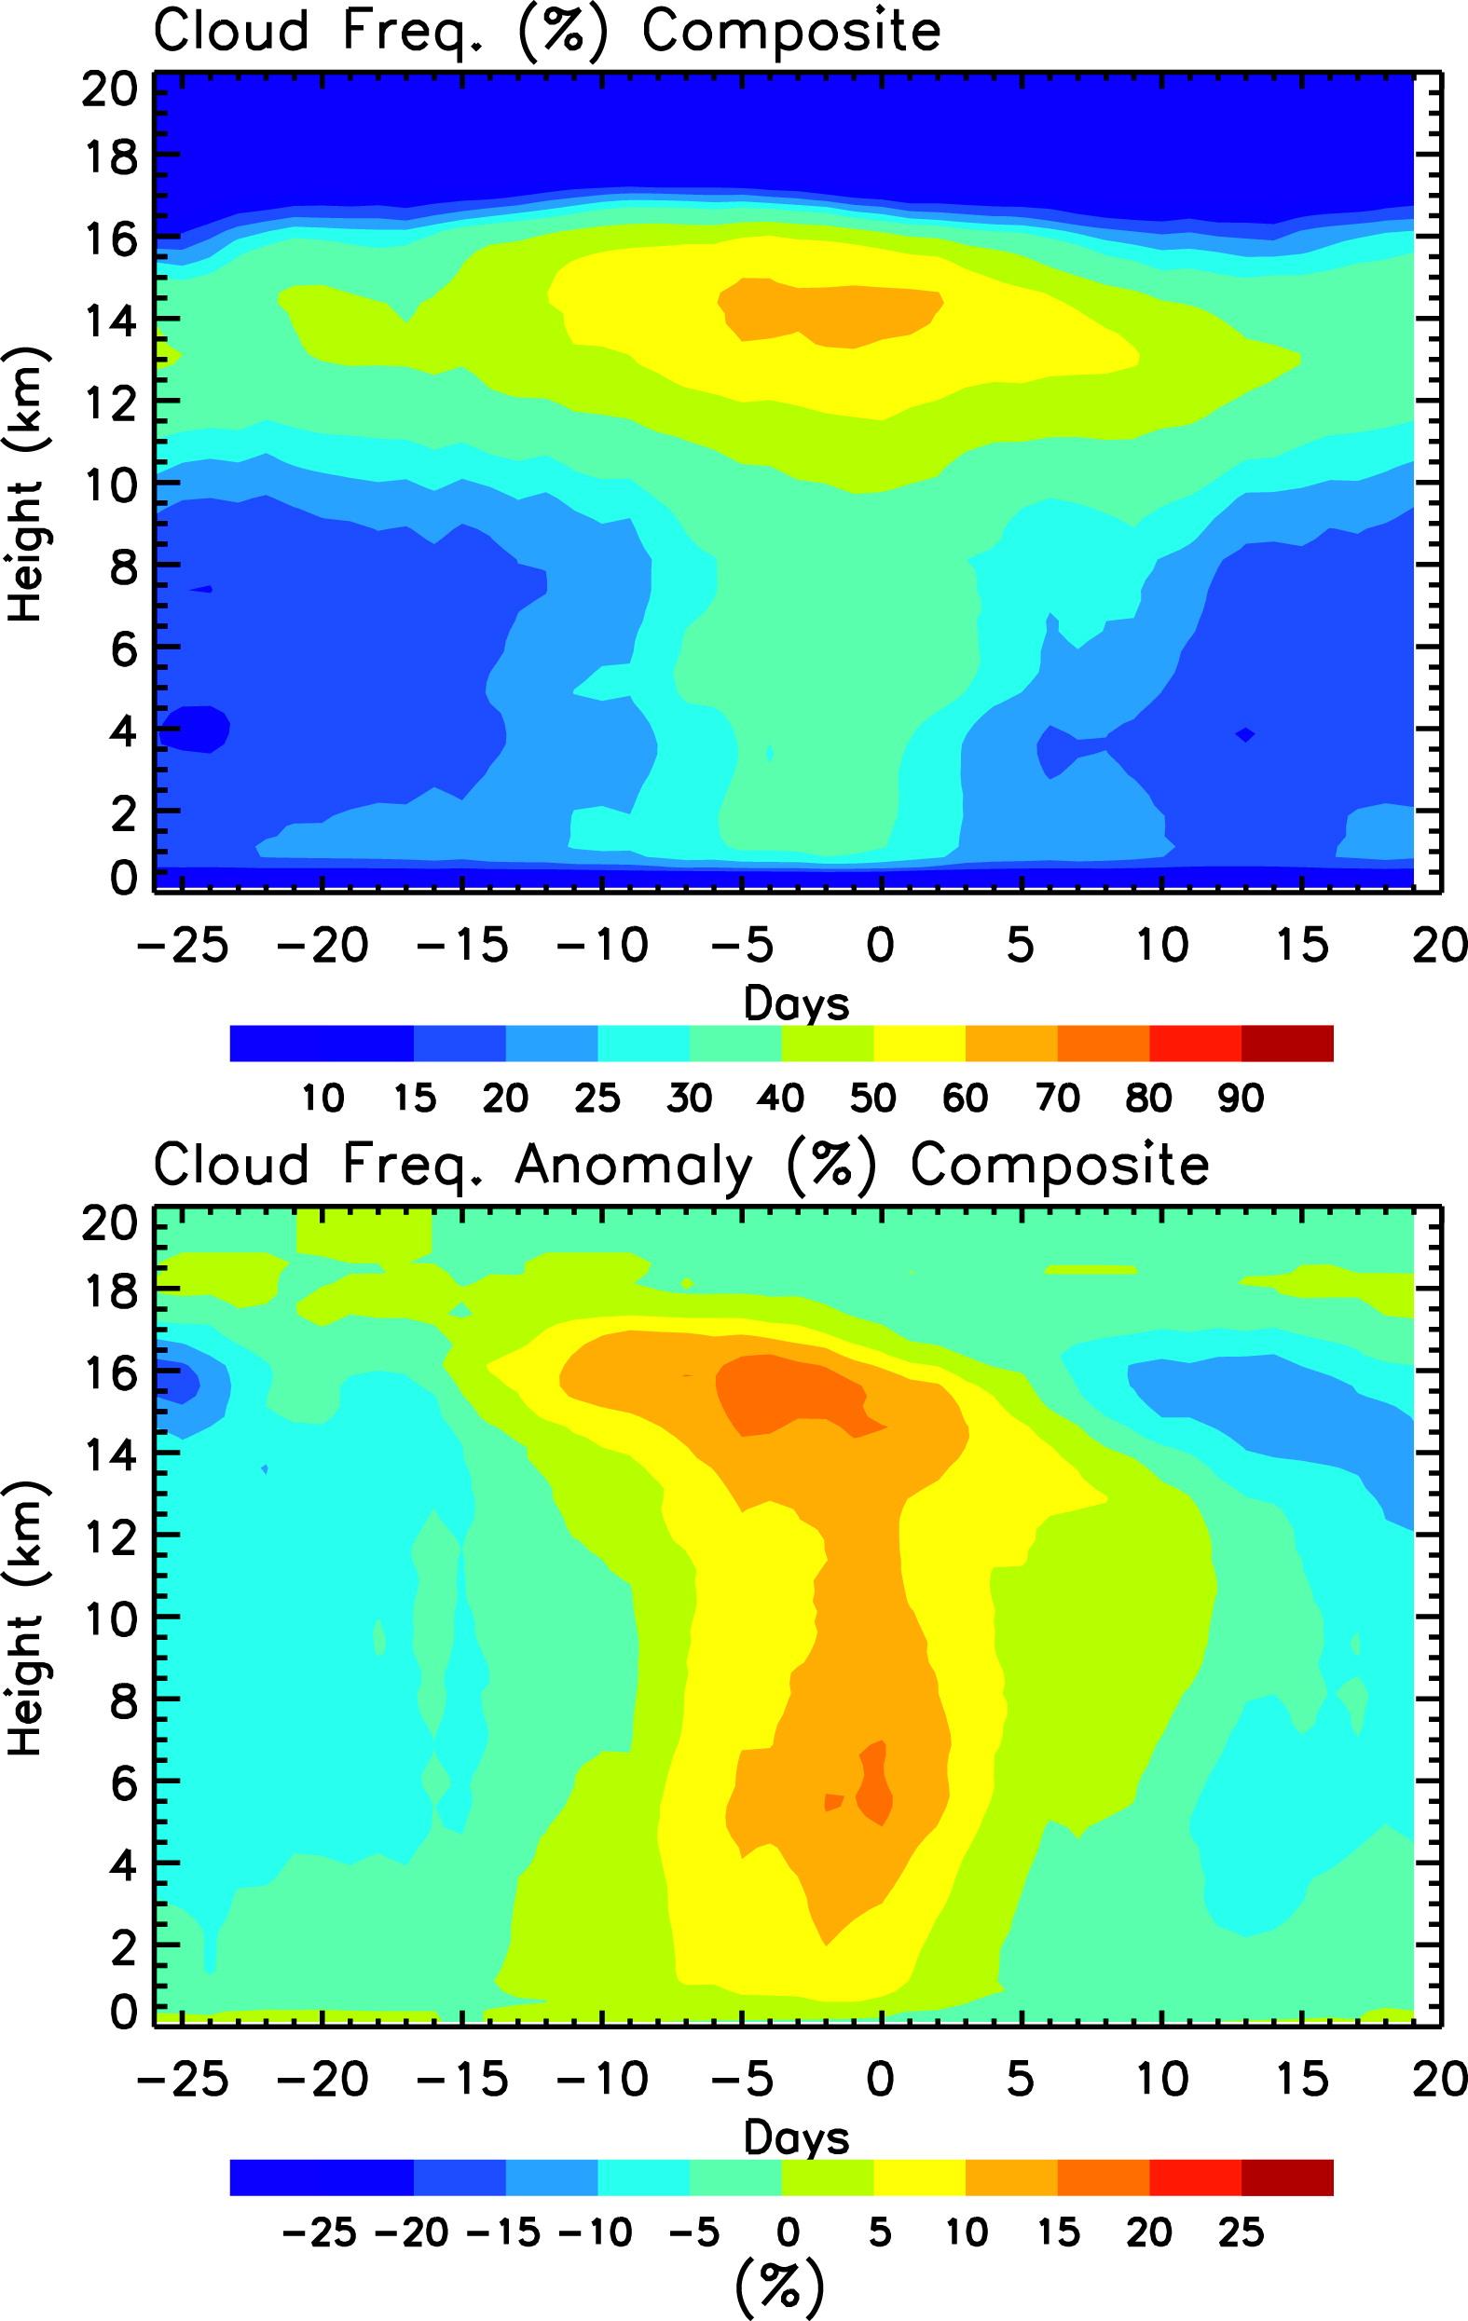
Del Genio et al.(2012)
CloudSat/CALIPSO ten MJO composite: found shallow-to-congestus-deep transition
Congestus

Slide 12
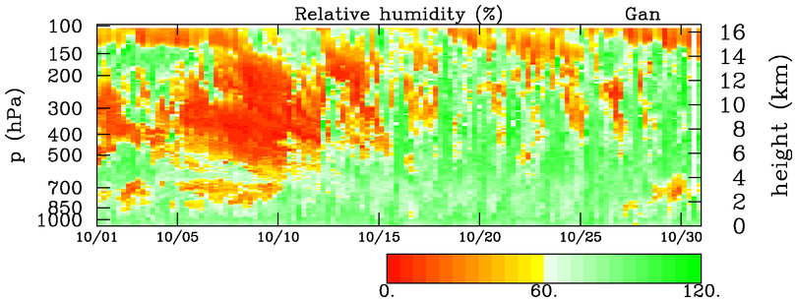
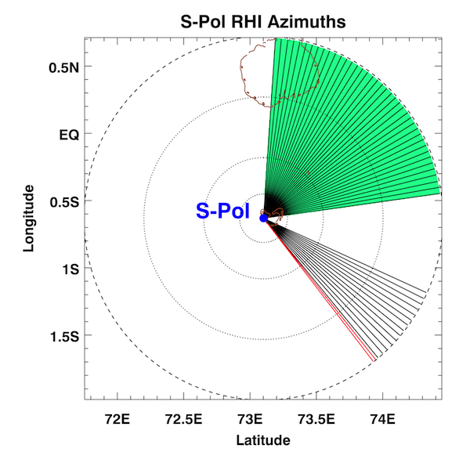
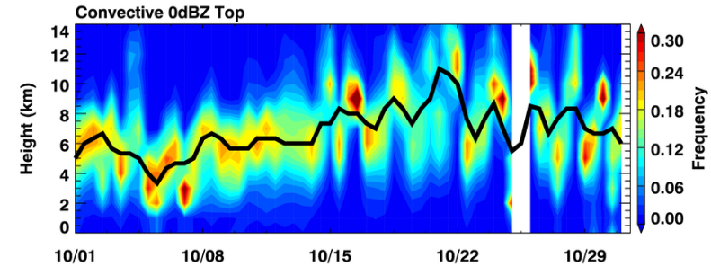
Cloud population analysis (Zhe Feng)
RHI scans in northeast sector at 15-min intervals
C/S separation using Steiner et al. (1995)
0 dBZ top of convective echoes obtained working from bottom up
Acknowlegment: Bob Houze
~One-week congestus period coincident with mid-tropospheric moistening
Stepwise pattern to moistening
Diurnal cycle important (Ruppert)
DRY
DEEP
MID
MOIST
SHALLOW
October
Deep
Cg
0°C
Cu

Slide 13
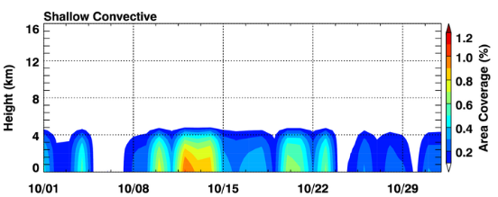
(< 5 km tops)
Area Coverage
Increasing area coverage of shallow convection during congestus period
October
Deep
Cg
0°C
Cu

Slide 14
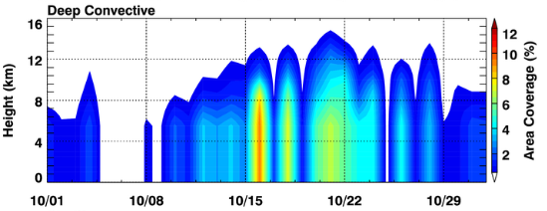
(> 5 km tops)
Area Coverage
Increasing area coverage of deep convection during congestus period
October
Deep
Cg
0°C
Cu

Slide 15
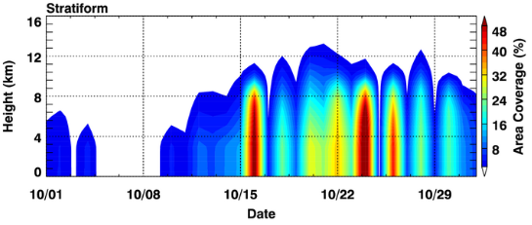
Increasing area coverage of stratiform precipitation during congestus period
Area Coverage
October
Deep
Cg
0°C
Cu

Slide 16
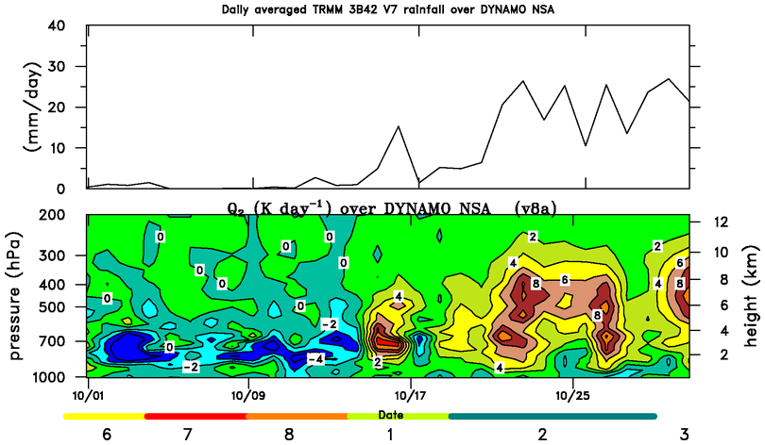
October
TRMM Rainfall
Congestus period: very little rain
Negative Q₂: Low-to-midlevel moistening during congestus period
Sudden onset of drying follows
Q₂
Cg

Slide 17
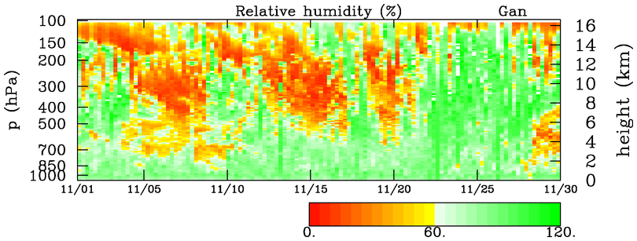
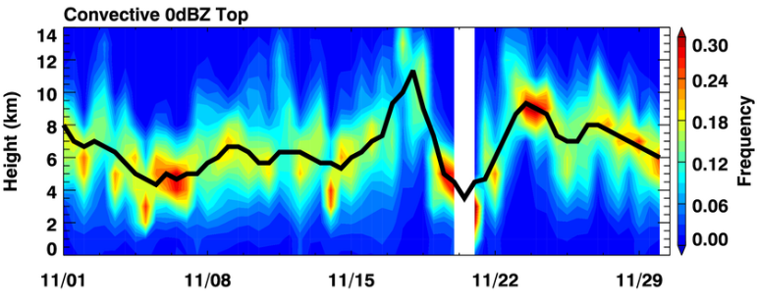
~One-week congestus period coincident with mid-tropospheric moistening
Again, stepwise pattern to moistening
November
DEEP
MID
SHALLOW
November
Deep
Cg
0°C
Cu

Slide 18
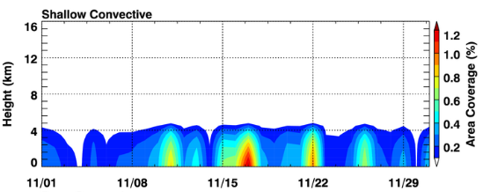
(< 5 km tops)
Area Coverage
Increased area coverage of shallow convection during congestus period
November
Deep
Cg
0°C
Cu

Slide 19
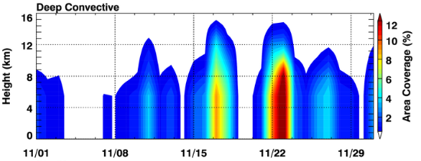
(> 5 km tops)
Area Coverage
Increasing area coverage of deep convection during congestus period
November
Deep
Cg
0°C
Cu

Slide 20
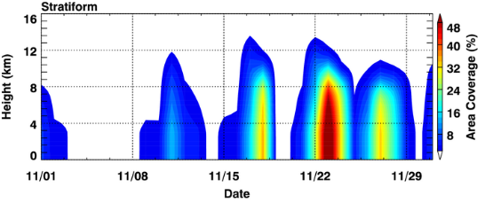
Area Coverage
Increasing area coverage of stratiform precipitation during congestus period
November
Deep
Cg
0°C
Cu

Slide 21
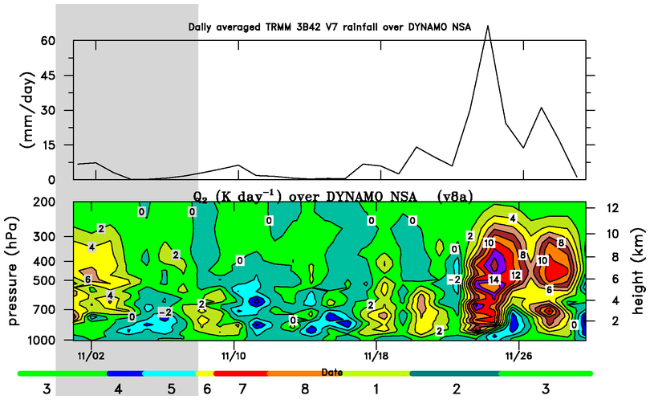
TRMM Rainfall
Congestus period: very little rain
Negative Q₂: Low-to-midlevel moistening during congestus period, followed by onset of drying
Revelle port call
November
Cg

Slide 22
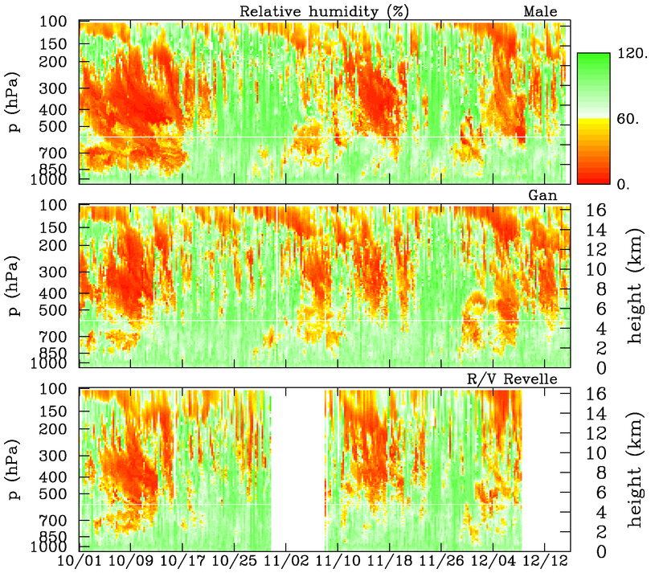
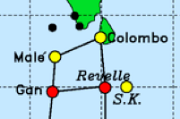
‘
Malé
10N
deep
deep
DRY
0°C
mid
mid
mid
Eq.
shallow
shallow
shallow
Gan
DRY
deep
deep
mid
mid
mid
shallow
shallow
shallow
Revelle
DRY
deep
deep
mid
mid
shallow
shallow

Slide 23
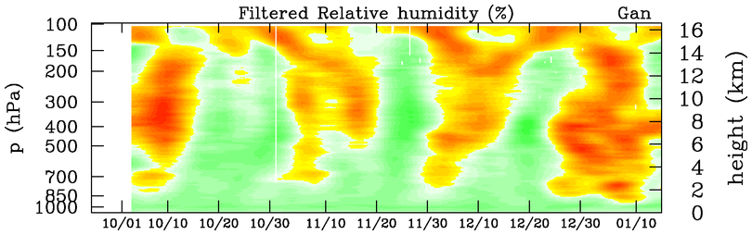
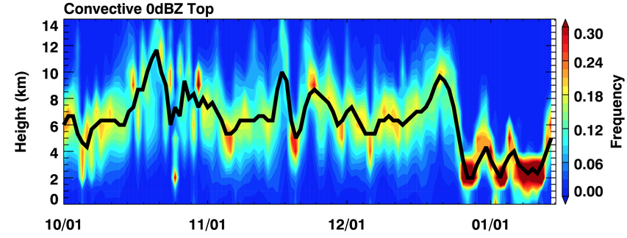
10-day low-pass
Oct/Nov/Dec: similar moistening during Cg periods
DRY
DRY
MOIST
S-PolKa RHI
Deep
Deep
Deep
Cg
Cg
Cg
Cu
Cu
0°C
Cu
1 October 2011 – 15 January 2012

Slide 24
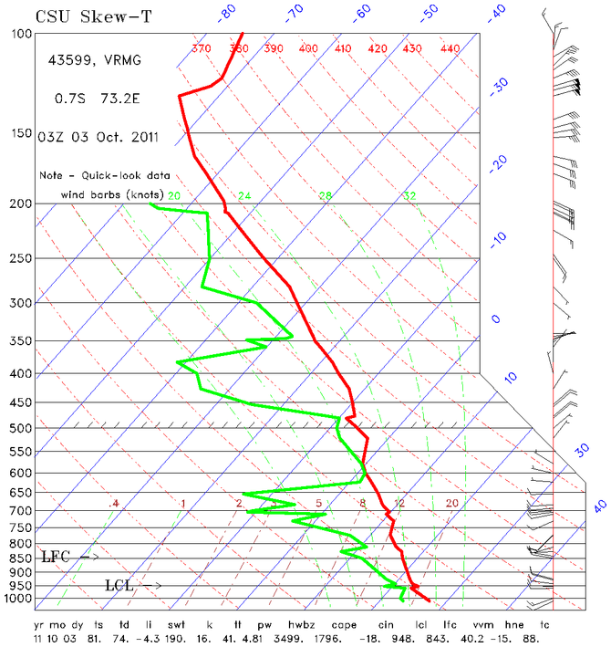
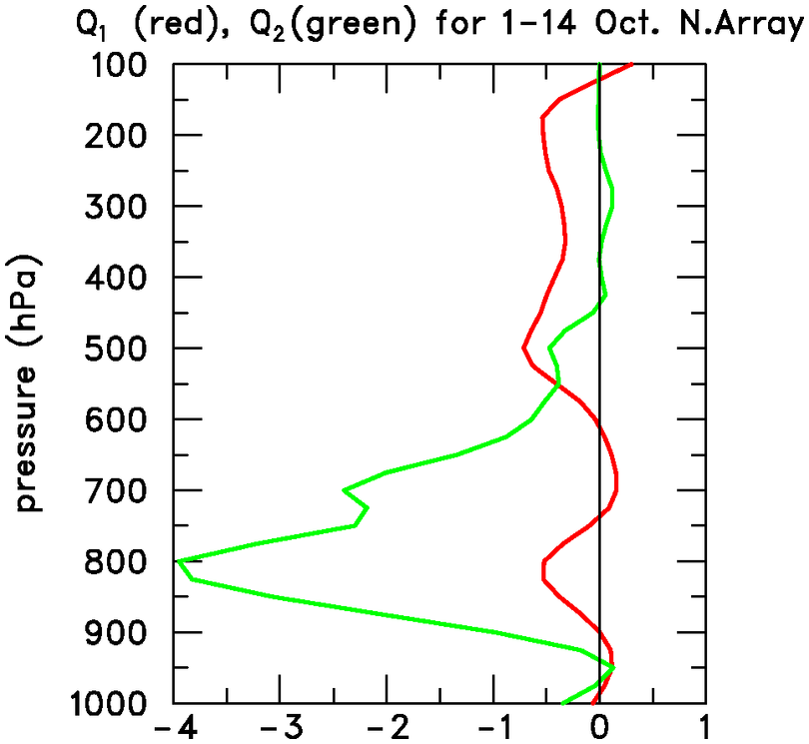
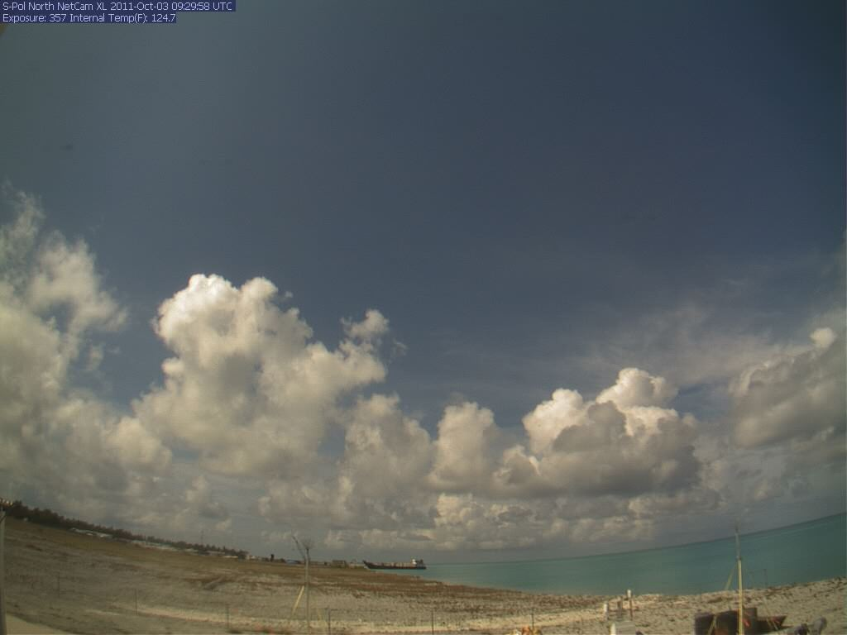
Why might a stepwise evolution occur?
Trade-like, shallow cumulus during suppressed MJO phases during TOGA COARE and DYNAMO related to intrusions of dry air
October 3, S-Polka
Q₂
Q₁

Slide 25
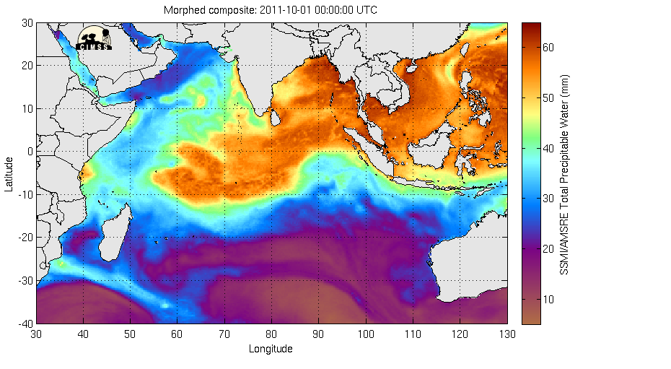
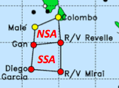
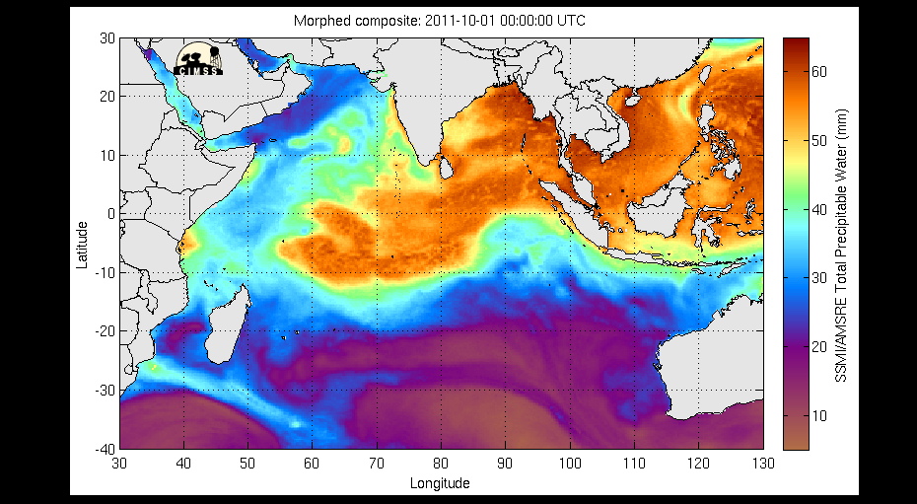
SSMI/AMSR-E Total Precipitable Water (mm) – October 1-15

Slide 26
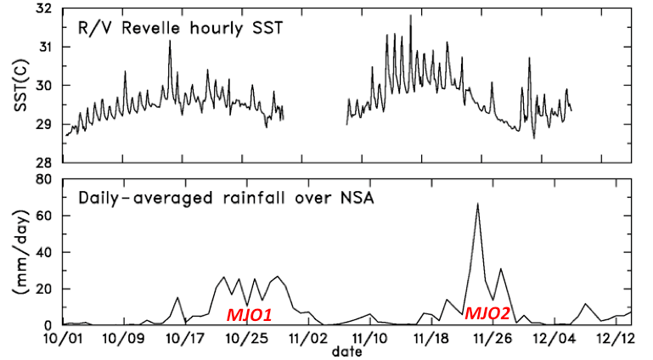
Why might a stepwise evolution occur?
Gradual increase in SST, diurnal cycle and mesoscale organization (Ruppert – next talk), and abatement of drying lead to deepening clouds (congestus)
Cg
Cg

Slide 27
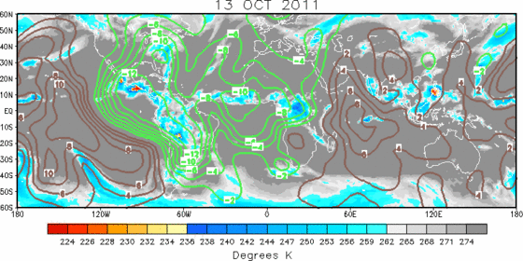
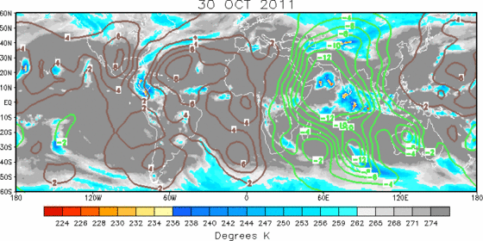
Why might a stepwise evolution occur?
Rather sudden onset of deep convection: continued moistening, glaciation, equatorial disturbances, large-scale processes?
200 hPa velocity potential, IR brightness T
13 October
Africa
S.A.
30 October
Africa
S.A.

Slide 28
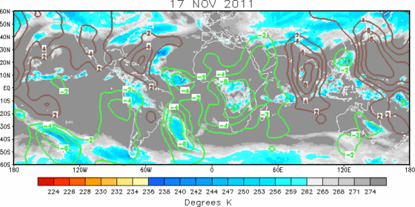
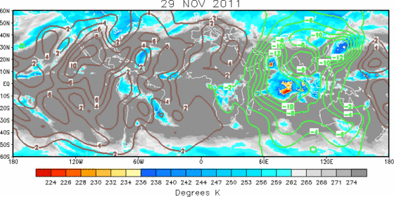
Why might a stepwise evolution occur?
Rather sudden onset of deep convection: continued moistening, glaciation, equatorial disturbances, large-scale processes?
200 hPa velocity potential, IR brightness T
17 November
Africa
S.A.
29 November
Africa
S.A.

Slide 29
Summary
S-PolKa radar data combined with moisture budget (Q₂) results to investigate cloud-related moistening processes during DYNAMO
Q₂ budget indicates moistening during ~1-week long congestus periods; areal coverage of precipitation increases during these periods
Stepwise evolution of moistening and cloud population: shallow cu to congestus to deep convection
Latter finding consistent with Kikuchi and Takayabu (2004), Yoneyama et al. (2008), Katsumata et al. (2009), Virts and Wallace (2010), Del Genio et al.( 2012)

Slide 30
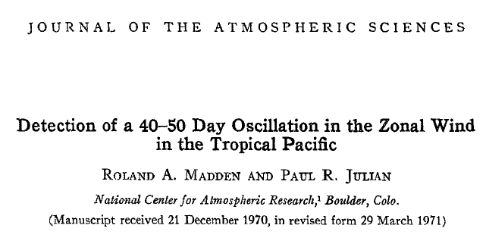
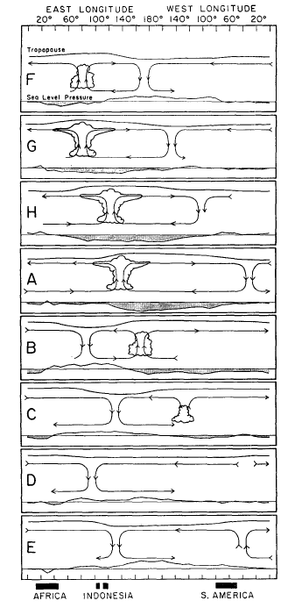
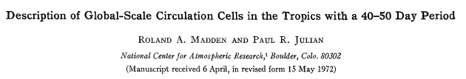
(Madden and Julian 1972)
“Madden-Julian Oscillation: MJO”
Published September 1972
Webster, P.J., 1987: The variable and interactive monsoon. Monsoons, J.S. Fein and P.L. Stephens, Eds. (“Madden-Julian 40-50 day wave”)
R. Swinbank, T.N. Palmer and M.K. Davey. 1988: Numerical Simulations of the Madden and Julian Oscillation. Journal of the Atmospheric Sciences: Vol. 45, No. 5, pp. 774–788.
(“MJ Oscillation”)
Ngar-Cheung Lau, Isaac M. Held and J. David Neelin. 1988: The Madden-Julian Oscillation in an Idealized General Circulation Model. Journal of the Atmospheric Sciences: Vol. 45, No. 24, pp. 3810–3832.
(“Madden-Julian Oscillation”)

Slide 31

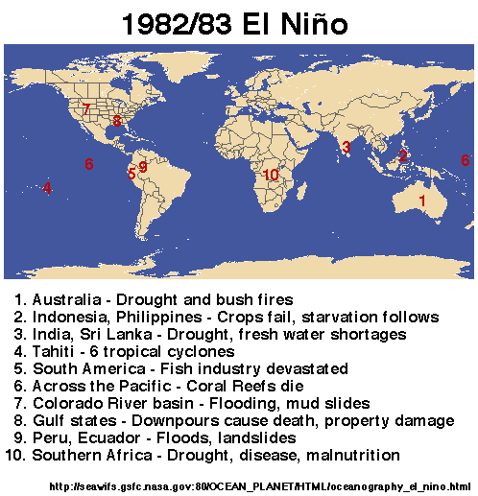
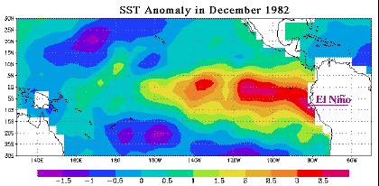
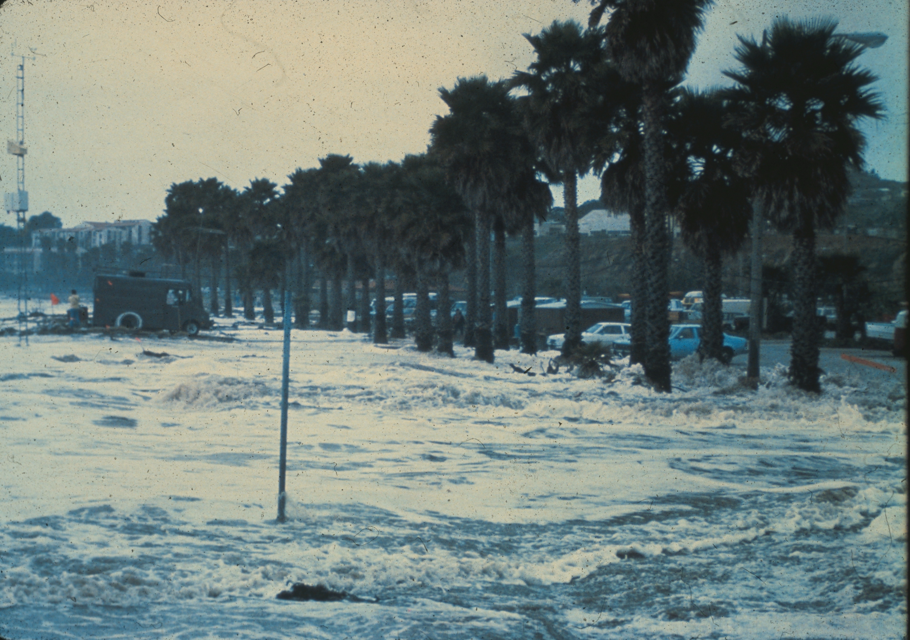
1982-83 El Niño
Cost: 2000 lives lost, ~$13B worldwide
Santa Barbara, CA

Slide 32
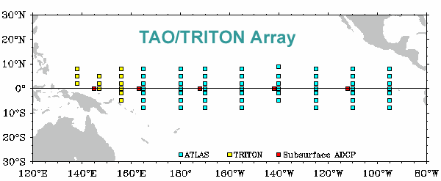
1982-83 El Niño motivated the establishment of TOGA TAO Array, starting in 1984
Shortly thereafter, the TOGA (1985-1994) pro-gram began → observations, predictability, and prediction of tropical ocean-atmosphere coupled system → prominent intraseasonal variability (westerly wind bursts, MJO events) observed

Slide 33
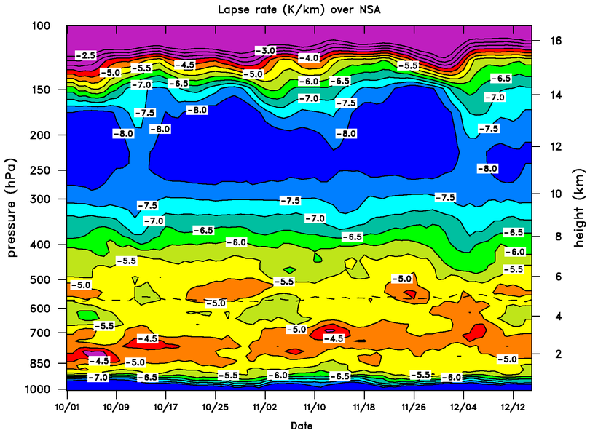
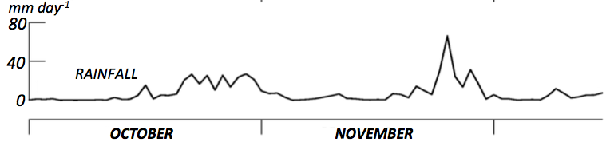
Trade-like stable layer during first half of October
Layer ascends slightly, then weakens as rain sets in
Melting stable layers
0° C
Similar evolution in November

Slide 34
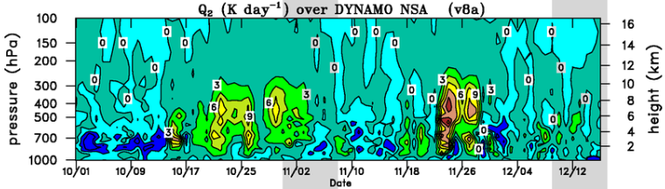
Low-level stable layer ascends during periods of moistening (negative Q₂) when there is minimal rainfall
P (hPa)
km
0° C

Slide 35
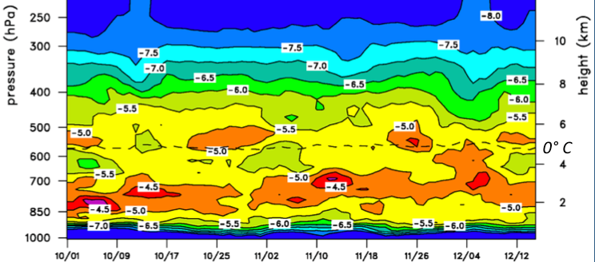
“Trade” stable layer shifts upward during cg periods in Oct and Nov
S-PolKa RHI
Deep
Deep
Deep
Cg
Cg
Cg
Cu
Cu
0°C
Cu
1 October 2011 – 15 January 2012

